Slide 1
South Selmon Capacity Project
Pre-proposal Meeting
March 11, 2025
Notes:
Welcome to the Pre-proposal Meeting for the South Selmon Capacity Project. Thank you for your interest in delivering this very important project and congratulations on being short-listed.

Slide 2
Project Roles
Tampa Hillsborough Expressway Authority (THEA) – Owner
HNTB – General Engineering Consultant (GEC)
Consor – Pavement, Drainage & Permitting Consultant
Tierra – Geotechnical Consultant
Element – Survey & Utilities Consultant
HDR – Construction Engineering & Inspection Consultant
Notes:
The project roles including the supporting engineering firms for the project are shown here.

Slide 3
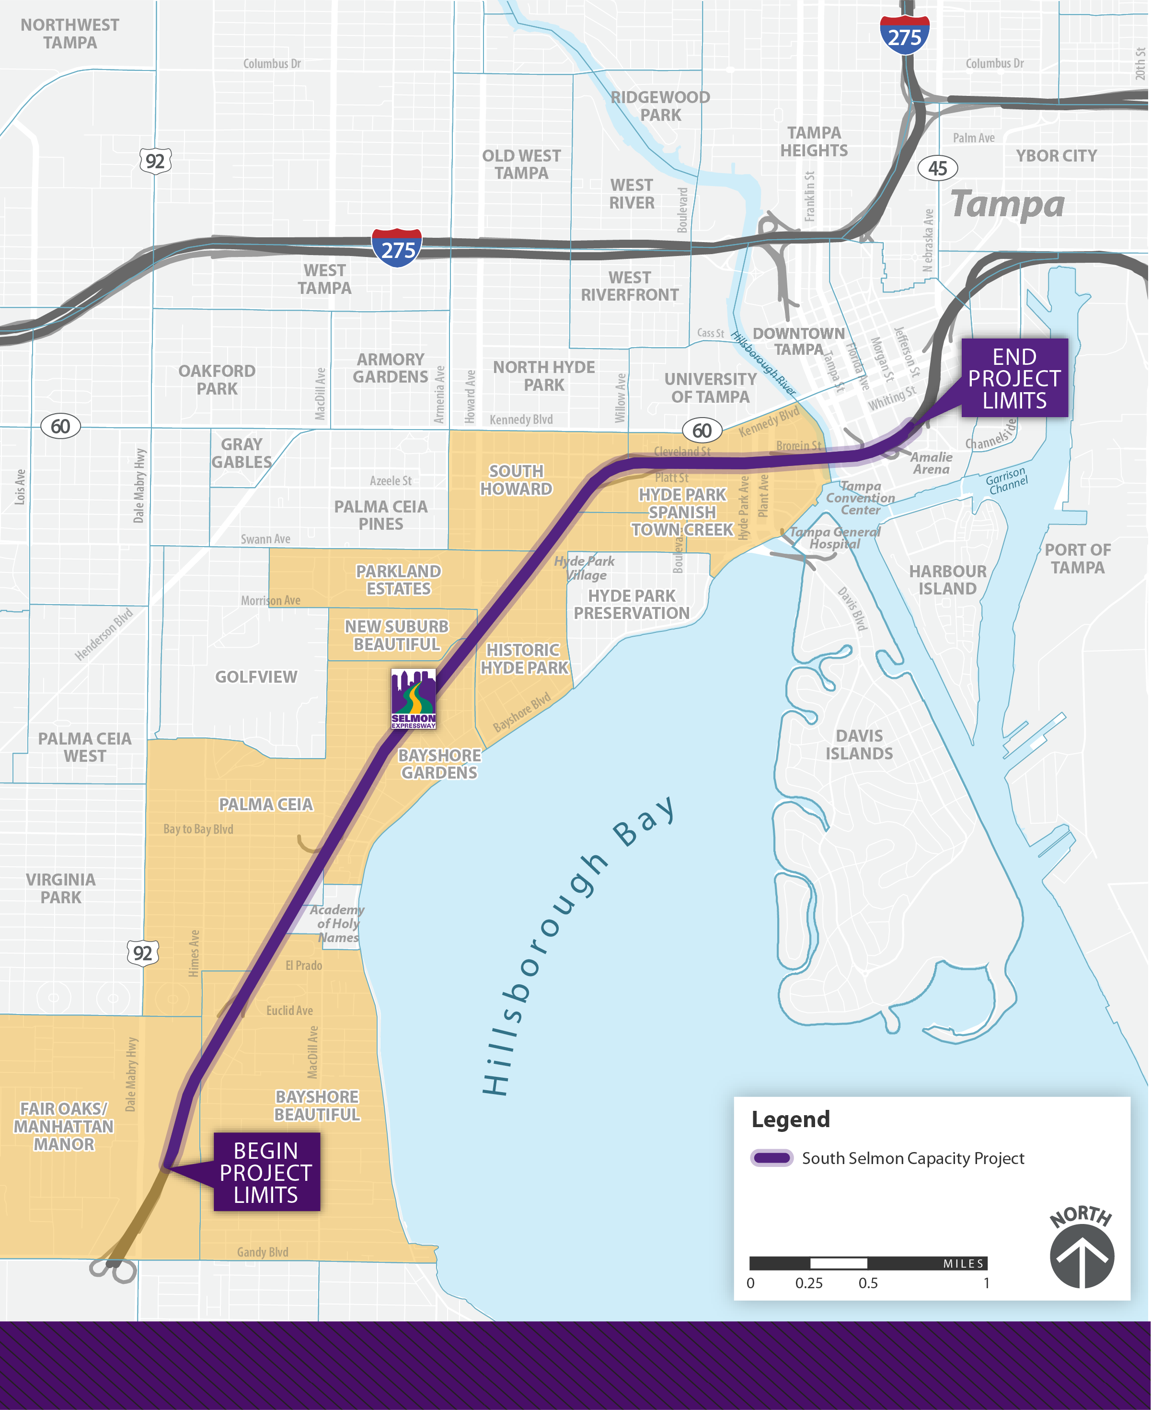
Project Overview
Notes:
The project extends 4.5 miles along the Selmon Expressway from west of Himes Avenue to east of Florida Avenue. The primary project scope is to add a third travel lane in each direction within the median. The project will be delivered by the selected design-build team.

Slide 4
Project Goals
Reduce congestion and improve operations and safety for motorists and pedestrians
Minimize impacts to the community, adjacent properties and roadway users during construction, and expedite the east-end construction
Improve signing, ITS and lighting along the corridor
Minimize the number of traffic control phases to limit disruption to customers
Maintain all tolling points
Provide enhanced aesthetics along the corridor, at local road underpasses, and at the Hillsborough River bridge
Notes:
THEA’s project goals are to (read bullets)

Slide 5
Project Commitments
Cultural Resources – a focus on archeology near the Fort Brooke Site
Natural Resources – focus on marine wildlife protection at the Hillsborough River
Provide noise walls along the roadway for traffic noise abatement
For identified medium & high contamination sites, consider field screening
Install temporary 8’ fence with fabric cover along limits of construction of EB roadway prior to construction start
Notes:
The project has a completed PD&E which details these project commitments. These have been incorporated into the RFP. A forthcoming RFP Addendum will include recently received Florida State Historic Preservation Officer opinion that the project will have no effect on historic properties, and as such, an archeologist will not be required to be on site during construction unless artifacts or human remains are encountered.

Slide 6
THEA’s Risk Mitigation Measures
Significant preliminary engineering studies and concept plan development
Structural analysis of existing retaining walls to support barrier-mounted 8' noise walls
Extensive geotechnical exploration and data collection
Comprehensive survey and 3D terrain model
Utility SUE data collection (Level A and B) and initiation of compensable advanced relocations
Advancing agency permitting
Notes:
To balance the risk for this project, THEA has performed the listed risk mitigation measures. These are detailed in the RFP and addressed within this presentation.

Slide 7
Project Scope
Notes:
(no narrative)

Slide 8
Scope of Work
Roadway
Bridges
Retaining Walls
Noise Walls
Drainage
Tolling
ITS
Lighting
Signals
Signing
Pavement Marking
Traffic Control
Fencing
Aesthetics
Notes:
The scope of work on this project encompasses all the major work elements you would expect on a modern urban expressway capacity expansion project. However, it does not include landscaping, as this will be performed through a subsequent project.

Slide 9
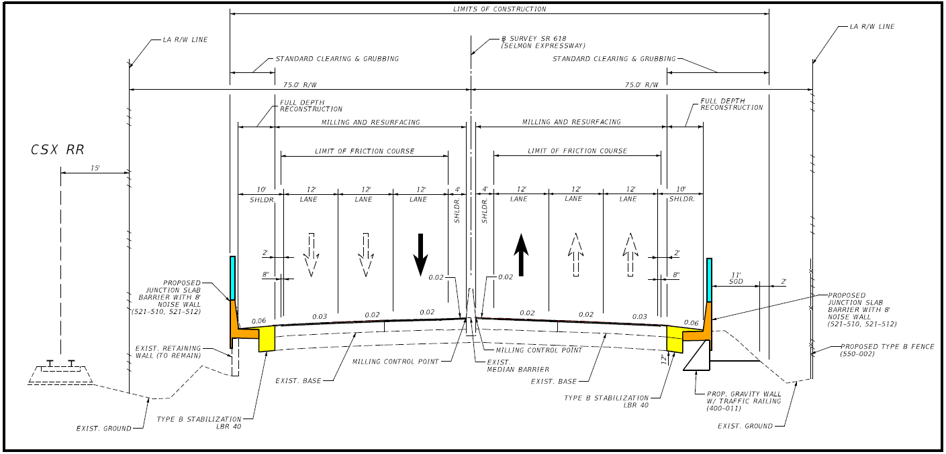
Typical Sections - Mainline
Notes:
A third travel lane will be added in each direction within the median. For most of the corridor, the typical section includes a 4-foot inside shoulder and 10-foot outside shoulder. The median roadway was widened under a previous project along most of the corridor, however the bridges were not widened. As depicted in color, it is anticipated the outside shoulders will need to be reconstructed to accommodate the proposed noise walls. For much of the project, the CSX Railroad abuts the right of way along the westbound roadway.

Slide 10
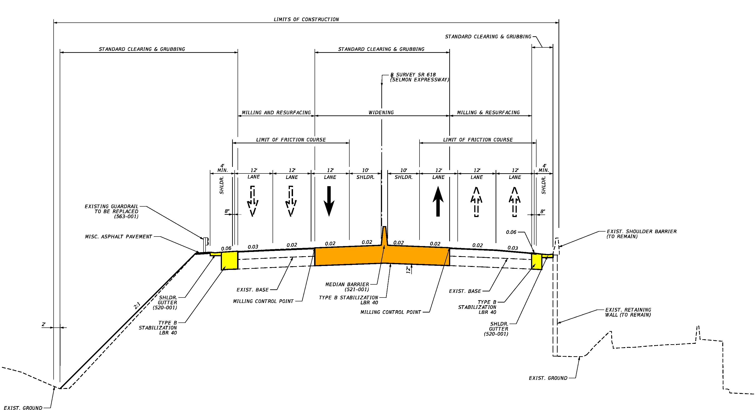
Typical Sections – Mainline (Cont.)
Notes:
East of Platt Street, the typical section includes a 4-foot outside shoulder and 10 foot inside shoulder due to limited sight distance and to reduce impacts to ramps in the Downtown viaduct section. As depicted in color, median pavement reconstruction and median barrier are required at all bridge approaches and a few other roadway segments.
Additionally, all guard rail within the project limits is to be replaced with new guard rail.

Slide 11
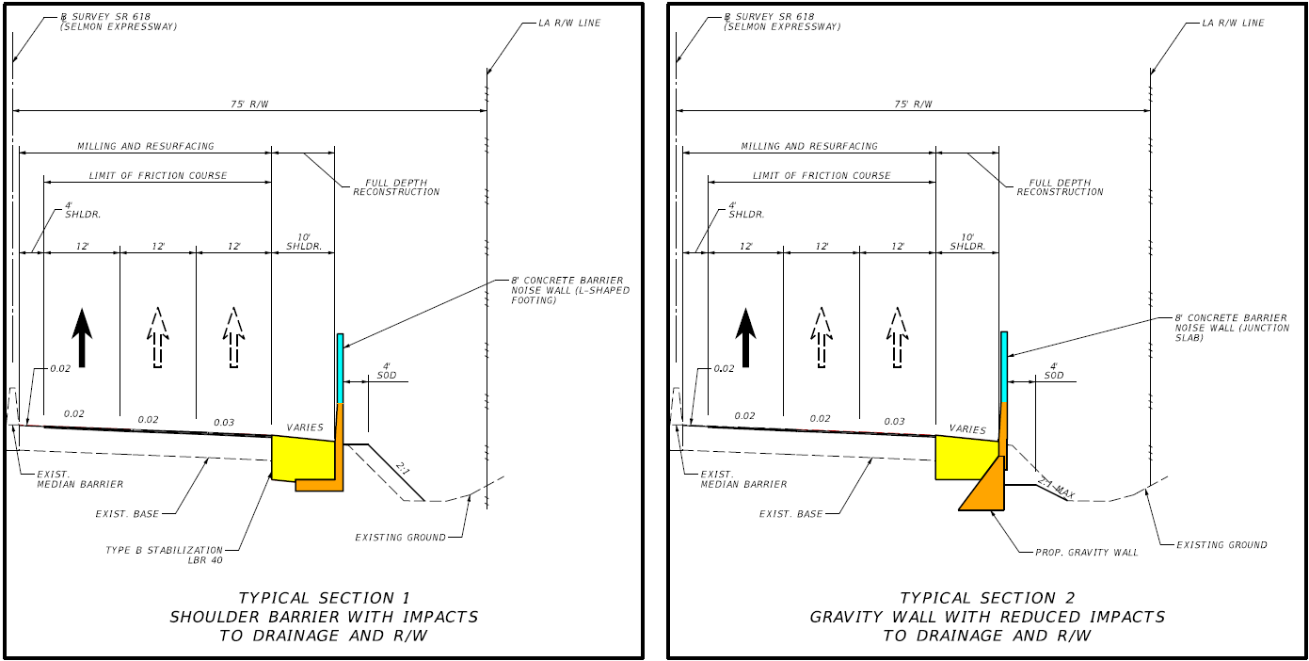
Typical Sections – Gravity Wall Detail
Notes:
As depicted in typical section 1 on the left, the proposed noise walls may result in slopes within the existing ditch. Where right of way is limited and ditch capacity must be maintained, it is anticipated that gravity walls will be required as shown in typical section two, on the right.

Slide 12
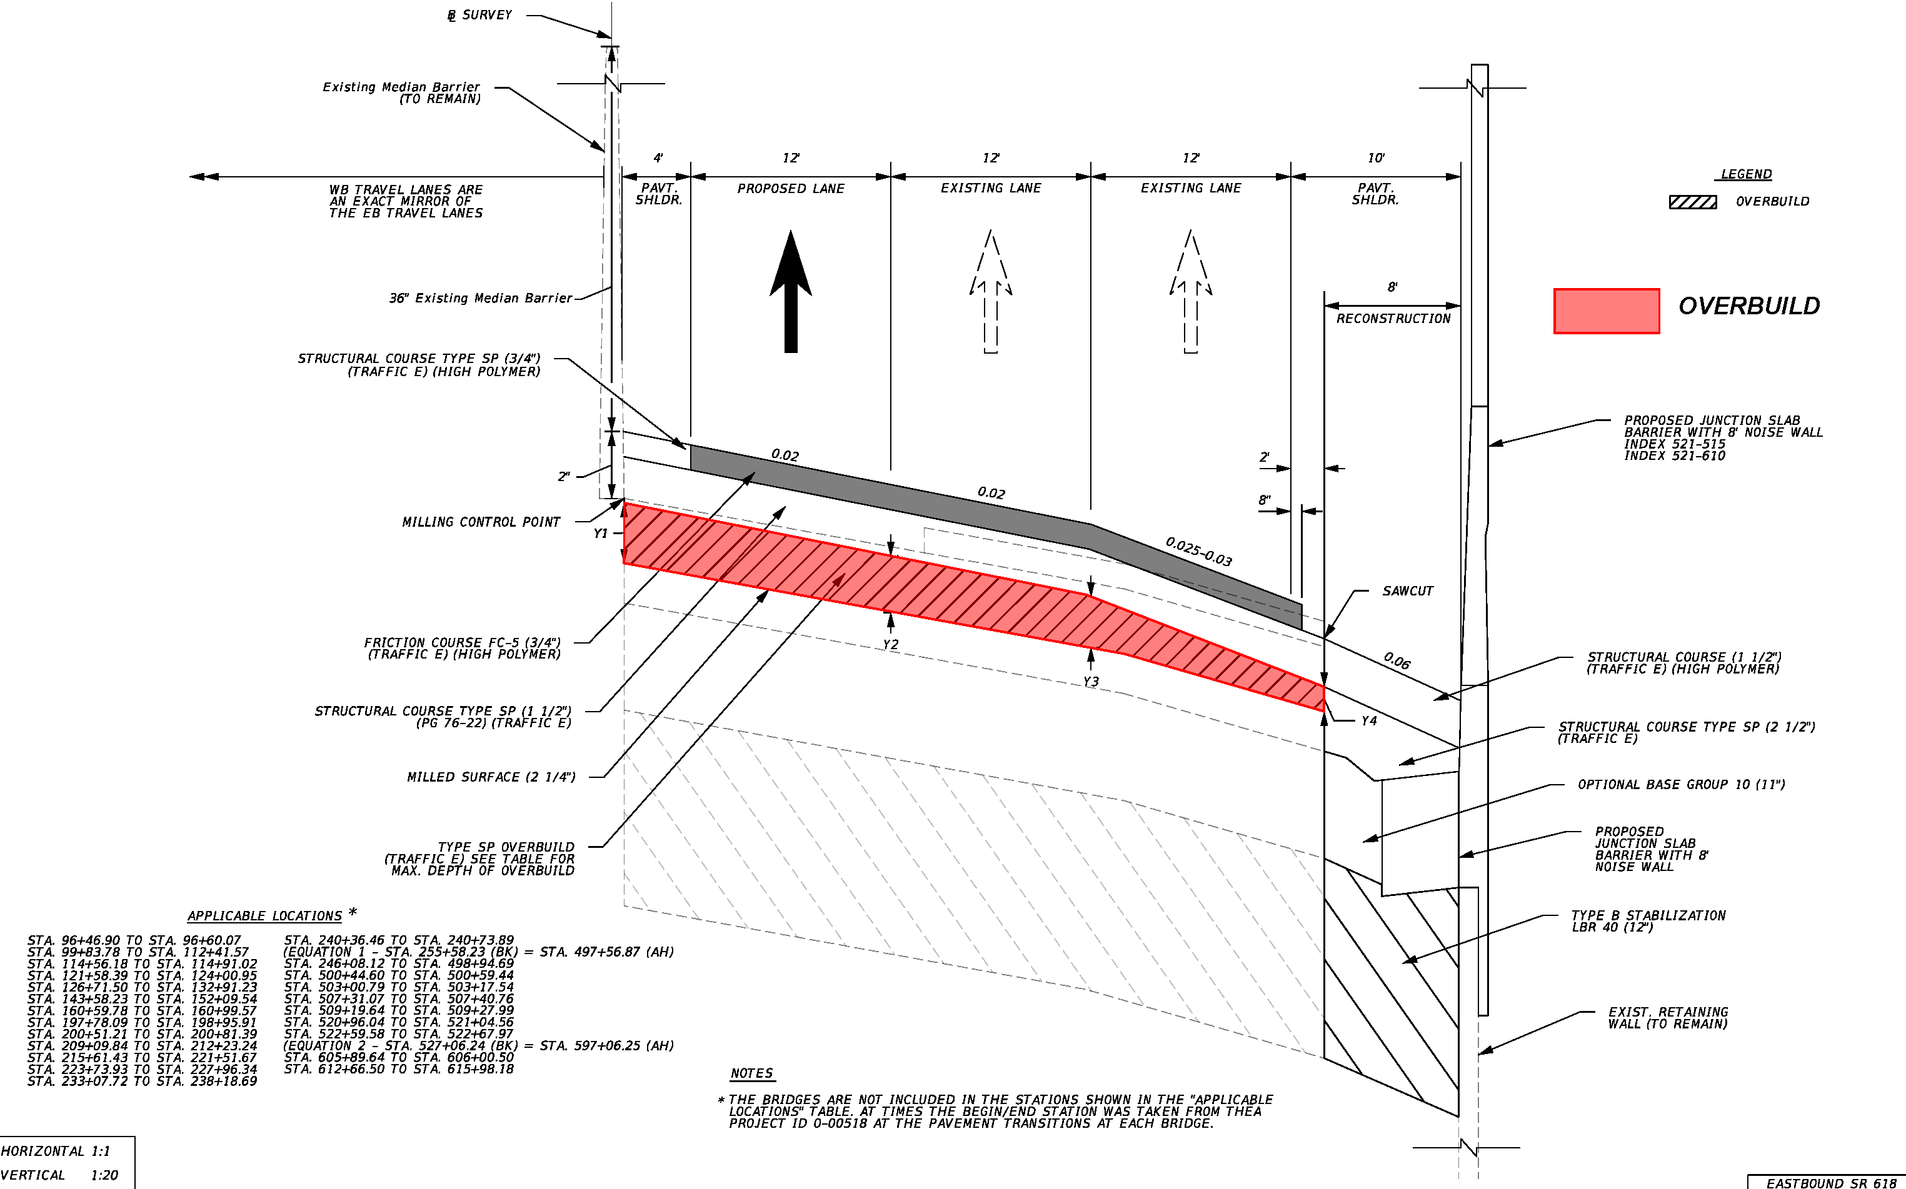
Typical Sections – Cross Slope Correction/Overbuild
Notes:
THEA performed field survey of the project corridor following the completion of the Median Safety project. The survey concluded that the existing mainline cross slopes are often flatter than standard as detailed in Reference Document No. 8 entitled “Cross Slope Correction Analysis and Pavement Design”. The mainline cross slopes are to be corrected utilizing pavement overbuild as shown in red to meet FDM criteria where possible. Special attention shall be given to provide for a minimum 36-inch-high median barrier. A cross-slope design variation has been prepared for areas where it is infeasible or impractical to meet FDM criteria.

Slide 13
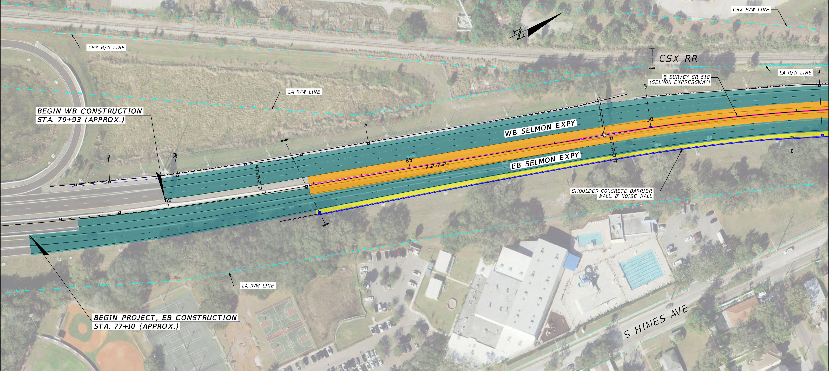
West Project Limits
Notes:
The west project limit is west of Himes Avenue and ties into the recently completed West Selmon Extension Project.

Slide 14
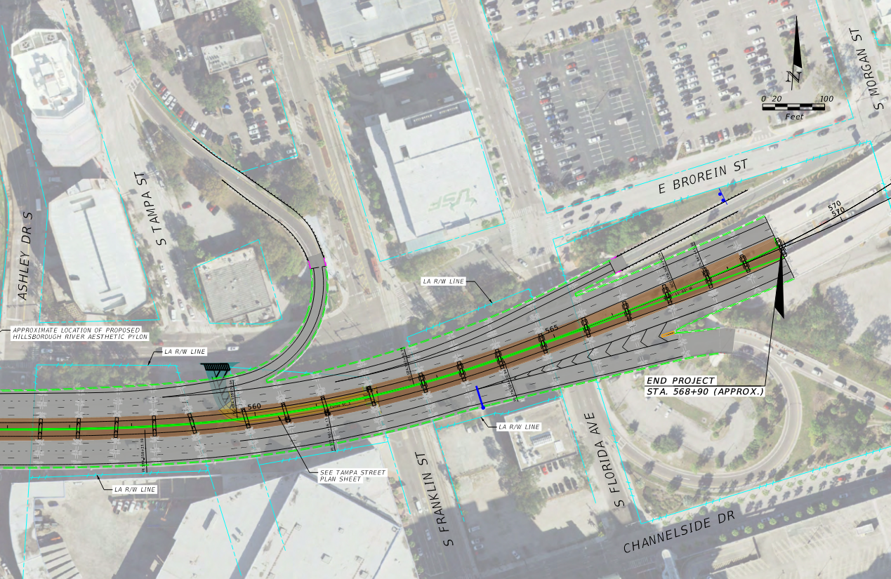
East Project Limits
Notes:
The east project limit is 5 bridge spans east of Florida Avenue. This portion of the project is on viaduct and includes median bridge widening to accommodate the westbound Morgan Street on ramp revision from a merge condition to an auxiliary lane addition. This is a major safety improvement.

Slide 15
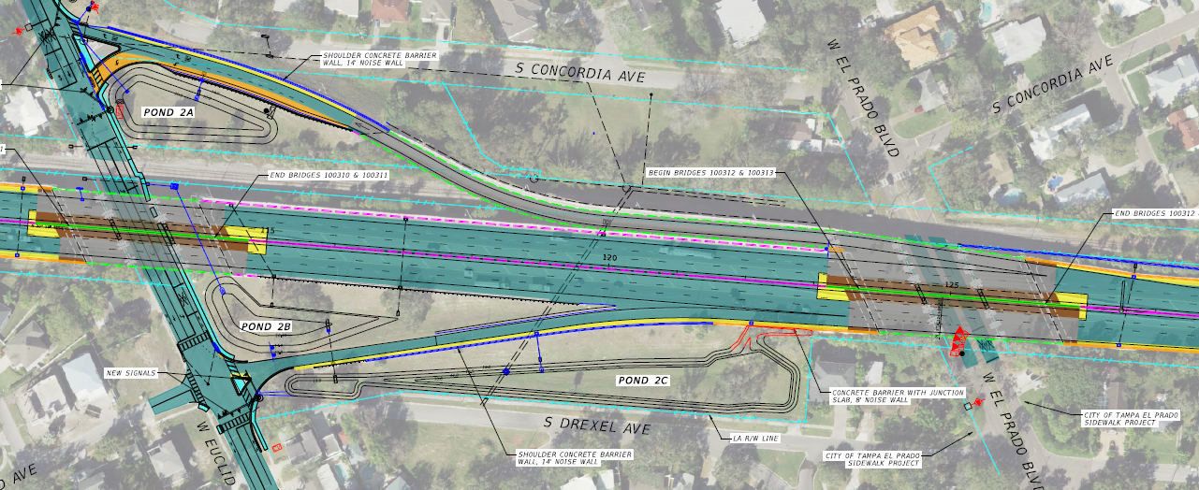

W. Euclid Avenue Interchange
Notes:
There are 5 interchanges within the project limits. At the Euclid Avenue interchange, the most significant improvements are the lengthening of the left turn lane along the westbound off ramp as depicted in orange and a new sidewalk on the north side of Euclid Avenue.

Slide 16
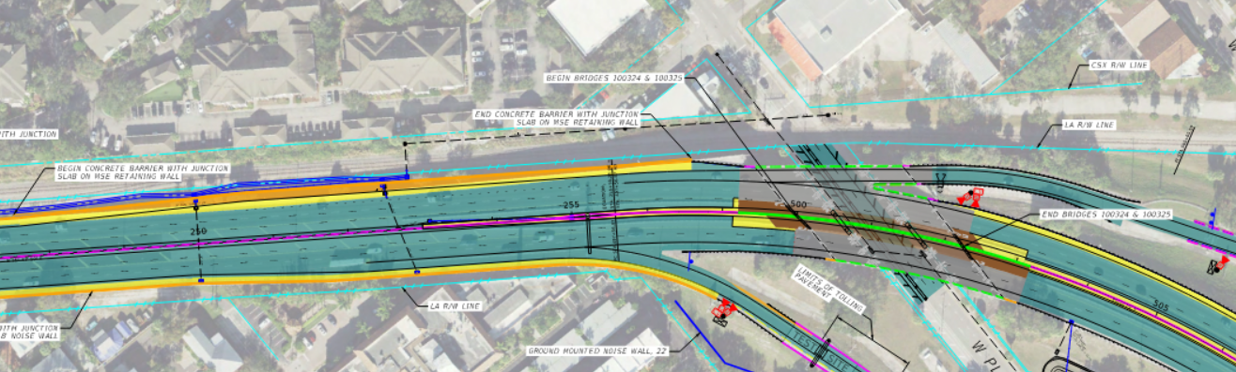
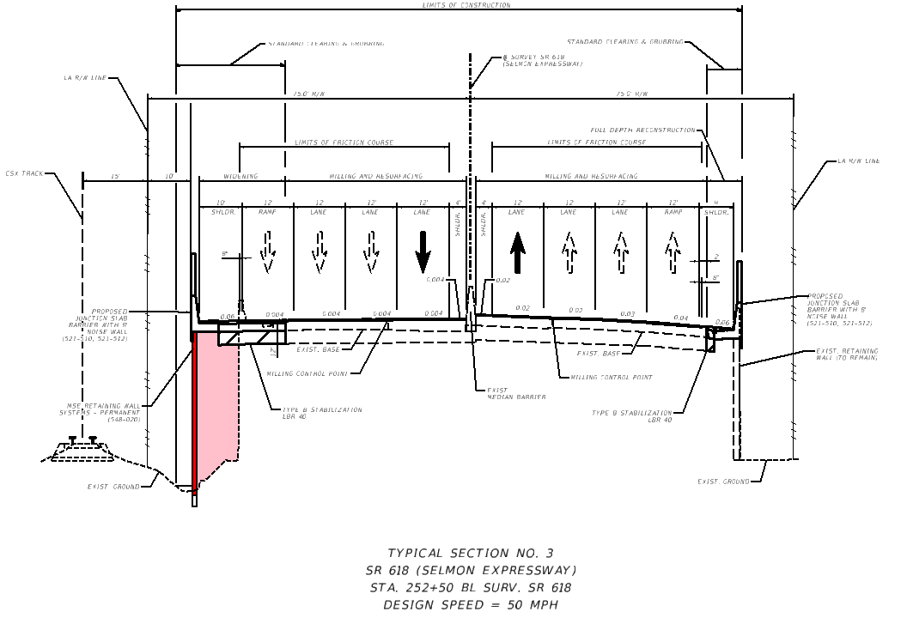
Willow Avenue WB On Ramp
Proposed Retaining Wall
CSX RR
Notes:
The westbound entrance ramp from Willow Avenue will maintain its alignment but be widened downstream to increase the ramp acceleration length to improve safety. It is anticipated this will result in a new MSE wall depicted in red being attached to the existing retaining wall with the strap area between the two walls being flowable fill as shaded in pink. The proximity to the CSX railroad right of way constrains the work area. The RFP details the Design-Build Firms responsibilities related to CSX RR, including coordination and payment for railroad flagging operations. THEA is coordinating a meeting with CSX to seek their input.

Slide 17
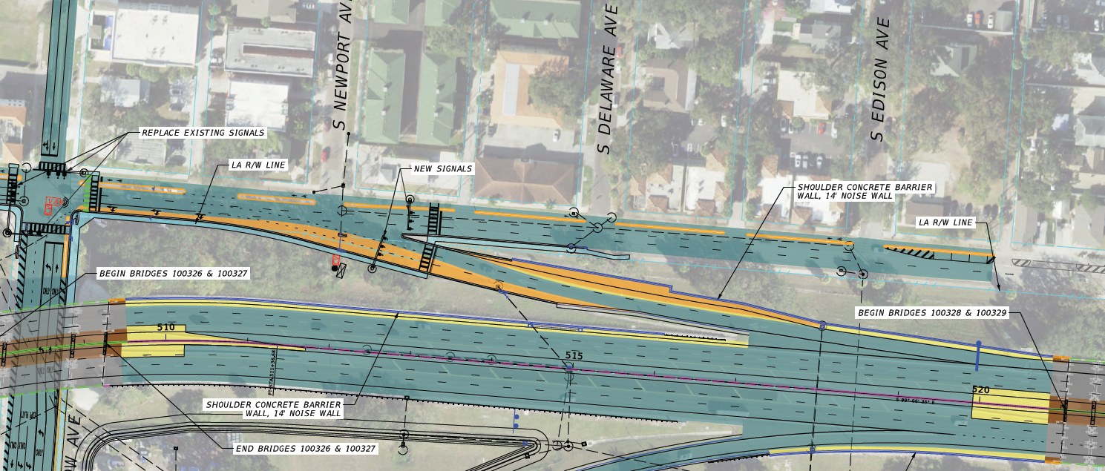
Willow Avenue WB Off Ramp
WILLOW AVE
CLEVELAND ST
Notes:
The westbound off ramp to Willow Avenue will be widened on both sides to accommodate 3 lanes at the intersection with Cleveland Street, which will be newly signalized.

Slide 18
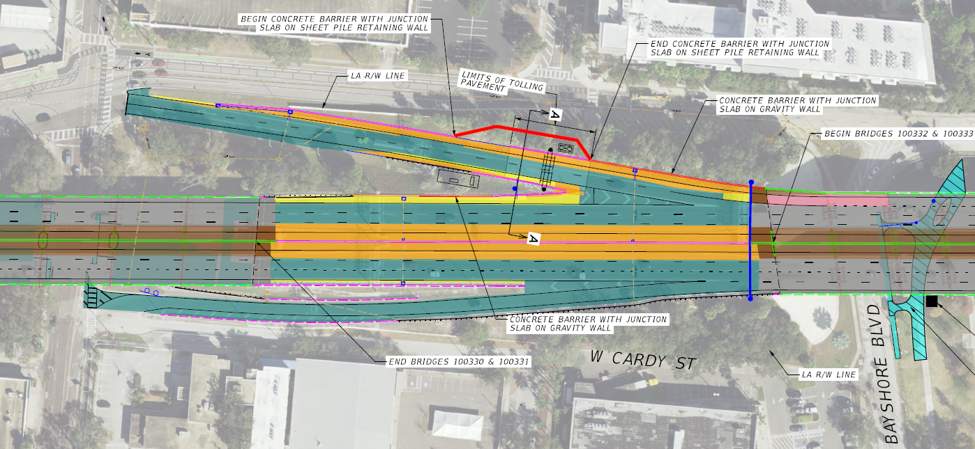
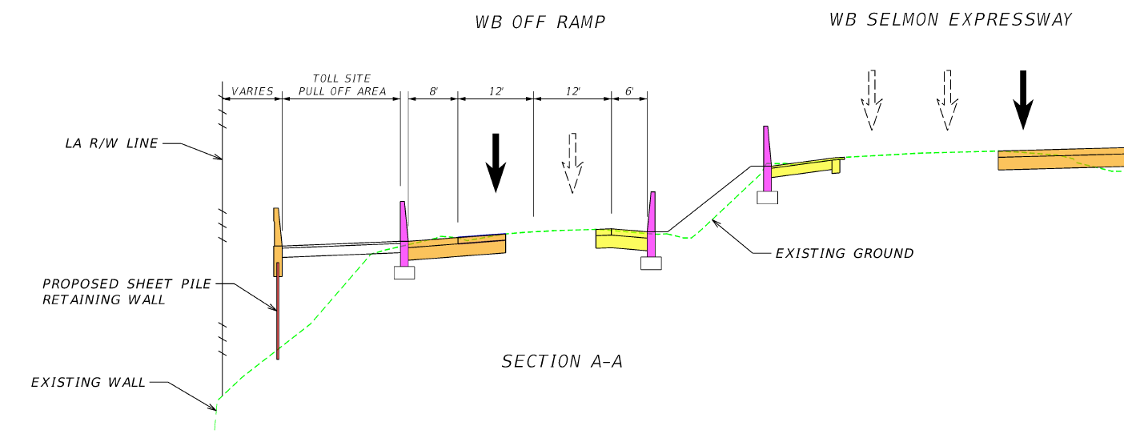
Plant Avenue WB Off Ramp
Proposed Sheet Pile Retaining Wall
PLANT AVE
Notes:
The westbound off ramp to Plant Avenue will be widened to the outside to accommodate a two-lane exit. It is anticipated that this will require re-decking and minor widening of a portion of the westbound mainline bridge, as depicted in pink. Additional ramp work will include superelevation correction, a new retaining wall and relocating the existing toll facility to the north side of the ramp. This exit serves Tampa General Hospital and must remain open at all times.

Slide 19
Design Variations and Exceptions
Design Variations
Design Speed
Stopping Sight Distance
Horizontal Curve Radius
Vertical Clearance
Design Loading Structural Capacity
Horizontal Curve Length
Cross Slope
Horizontal Deflection without a Curve
Design Exceptions
Lane Width
Shoulder Width
Stopping Sight Distance
Vertical Clearance over Railroad
Notes:
THEA is in the process of approving the noted design variations and exceptions for the concept plans. A forthcoming addendum will be provided with the approved design variations and exceptions attachment.

Slide 20
Temporary Traffic Control Plan (TTCP) Goals
Maintain the existing capacity of the mainline, ramps, and cross streets to the maximum extent possible
Minimize the number of traffic shifts, detours and disruption of traffic throughout the contract duration
Prioritize the East End work (east of Plant Avenue)
Minimize the closure duration of the Tampa Street connection to Franklin Street
Minimize the duration of work along the westbound Plant Avenue off-ramp, which serves Tampa General Hospital
Avoid disruption of tolling operations
Effective implementation of an Incident Management Plan
Notes:
The Temporary Traffic Control Plan goals are listed and will be emphasized in the following material.

Slide 21
Project Schedule Considerations
Contract Days = 1640 days, includes weather days and holidays
Toll-Equipment Contractor shall be commissioned to the project no earlier than February 1, 2027
City of Tampa West Riverwalk project to be under construction until Spring 2027
Lane closure restrictions
East End Incentive-Disincentive
Notes:
THEA has established 1640 contract days which has been factored upward to include weather days and holidays. The design build firm schedule should take into account availability of the toll equipment contractor, the City of Tampa’s West Riverwalk project, and lane closure restrictions.

Slide 22
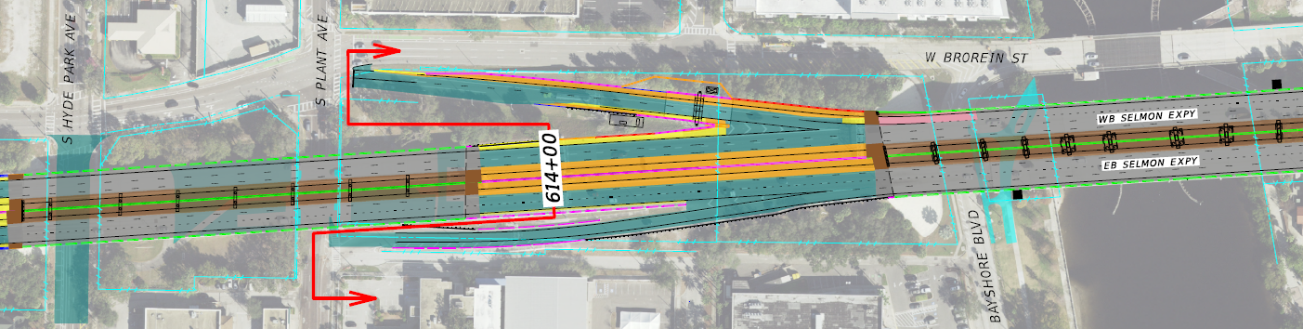
East End Incentive-Disincentive
THEA desires to expedite completion of the East End (east of Sta 614+00)
Goal is to reach partial acceptance of the East End no later than 1280 days of Contract time
Incentive/Disincentive daily amount = $15,000/day
Maximum Incentive/Disincentive total = $5.4 million
(equates to 360 days less or more than 1280 days)
Notes:
Furthermore, THEA desires to expedite completion of the East End to minimize disruption to the downtown area and advance improvements to traffic operations and safety. The RFP outlines the specifics for East End partial acceptance, including opening all mainline lanes east of Station 614 plus zero zero, both Plant Avenue ramps, and the Tampa Street reconnection, in their final condition.
An incentive/disincentive daily amount of $15,000 per day is applied for each day - up to 360 days - before or after 1280 days, for a maximum incentive/disincentive amount of $5.4 million dollars.

Slide 23
TTCP Work Hours
No Lanes Closures allowed:
  Monday thru Friday from 6:00 AM to 8:00 PM
  During non-work periods
  On holidays
  During large special events
Notes:
The RFP specifies the noted lane closure restrictions.

Slide 24
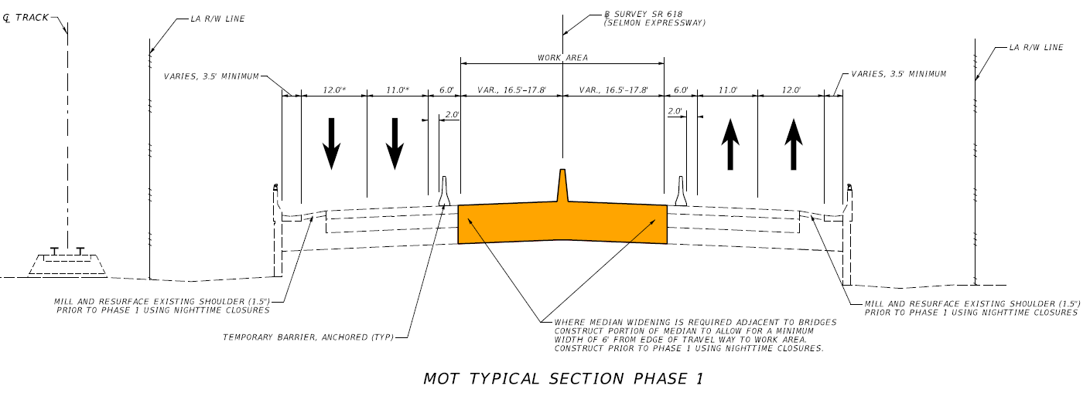
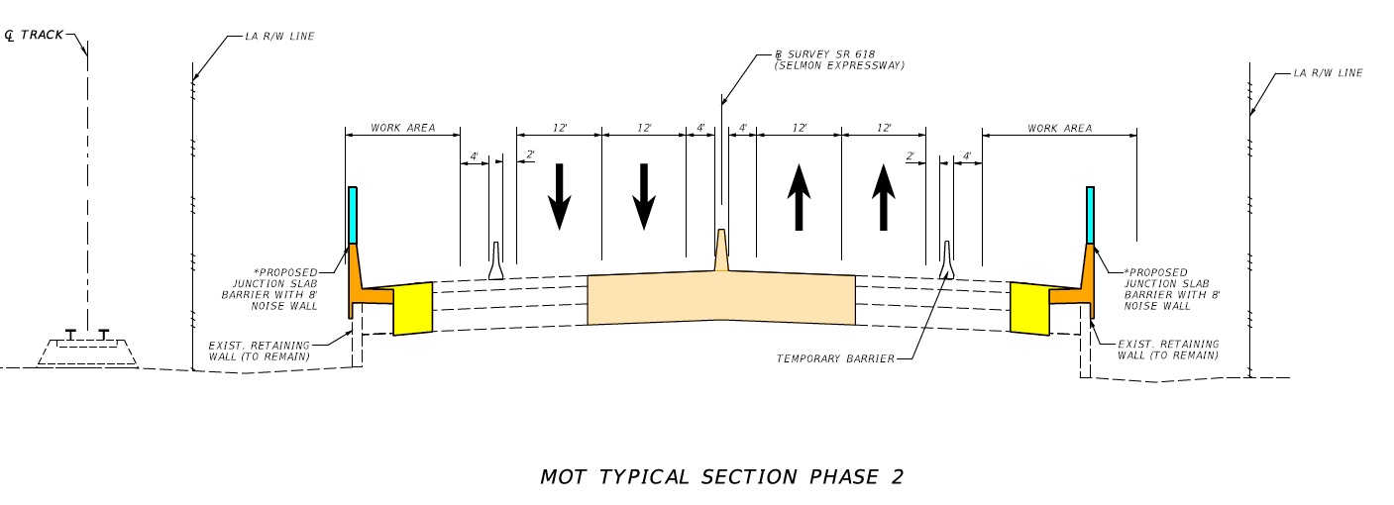
Mainline TTCP
Notes:
For most of the corridor, it is anticipated construction will occur over two primary phases. Median roadway and bridge work will take place in Phase 1 followed by outside improvements in Phase 2. Pre-phase work may be necessary to maintain minimum lane and shoulder widths.
Furthermore, additional phases are anticipated to fully redeck the bridges at Himes and Mississippi Avenues.

Slide 25
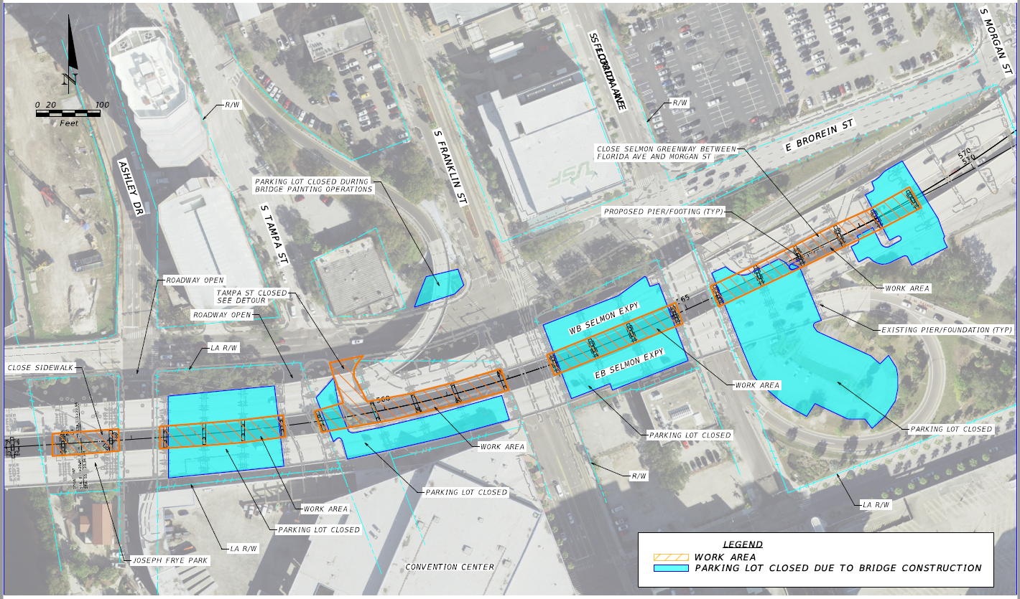
Tampa Street and Parking Lot Closures
Notes:
All THEA owned right of way throughout the corridor is available to the contractor. This includes parking lots under the Selmon Expressway in the downtown area which will be closed for an extended period. Additionally, the Tampa Street connection under the Selmon Expressway will be closed and detoured.

Slide 26
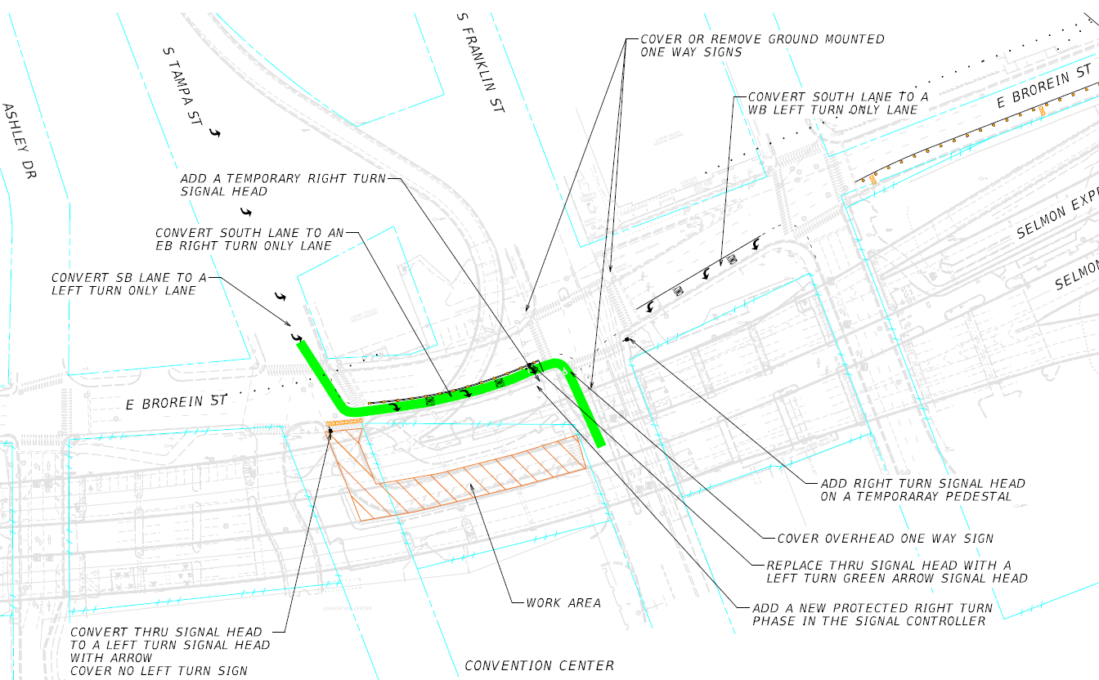
Tampa Street Detour (2-way Brorein St)
Notes:
The long-term Tampa Street detour will include converting a portion of Brorein Street to 2-way operations between Tampa Street and Franklin Street, as depicted in green. This requires changes in signals, signage and pavement marking. Brorein Street will be milled, resurfaced and restored to one-way operation once Tampa Street is reconstructed and re-opened under the Selmon Expressway viaduct.

Slide 27
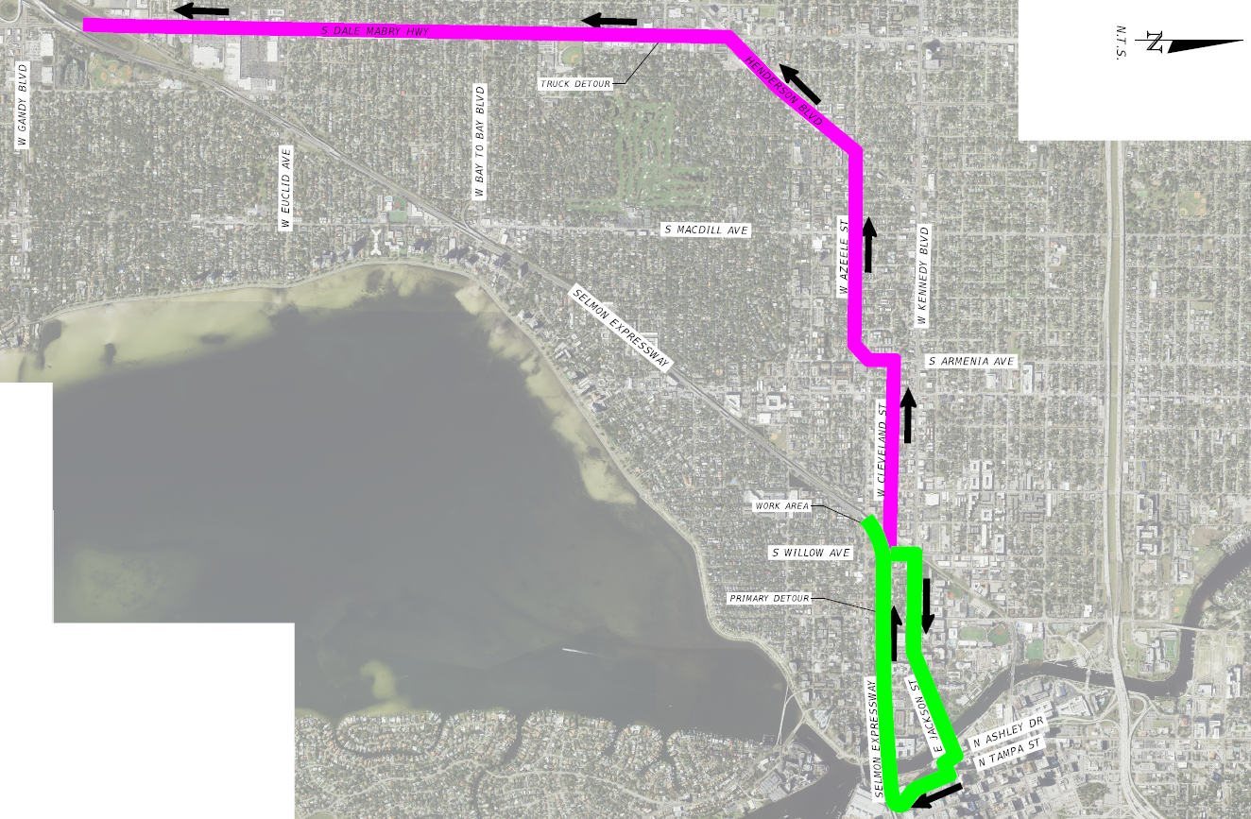
Night-time Detours (WB Willow On-Ramp Shown)
Notes:
Detour routes for night-time ramp and local underpass closures are included in the Concept Plans and have been discussed with the City of Tampa. In some cases, a truck detour route, as shown in magenta, will differ from the primary detour route, as shown in green.

Slide 28
Structures
26 Bridge Inside Widenings
1 Bridge Outside Widening
4 Bridge Redeckings
6 Steel Bridge Recoatings
7 Bridge Designs requiring Independent Peer Reviews
Retaining Walls: gravity, MSE & sheet pile
5.2 Miles of Noise Walls: barrier-mounted & post and panel
Notes:
The project includes extensive modifications to the existing bridges and miscellaneous structures. These include 26 existing bridges to be widened, of which, 4 bridges require a full deck replacement and 6 steel bridges that need to be cleaned and recoated. Seven (7) of the proposed bridge designs require an Independent Peer Review in accordance with the FDOT Design Manual. Additional structural components included in the project scope include various types of retaining walls and approximately 5.2 miles of noise walls. THEA completed a structural analysis of the existing cast-in-place retaining walls and verified their ability to support barrier-mounted 8' noise walls.

Slide 29
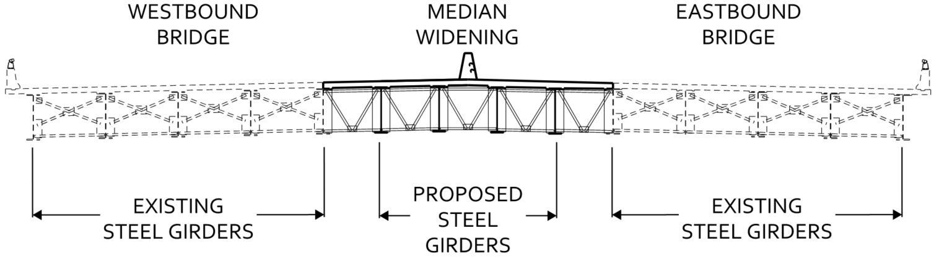
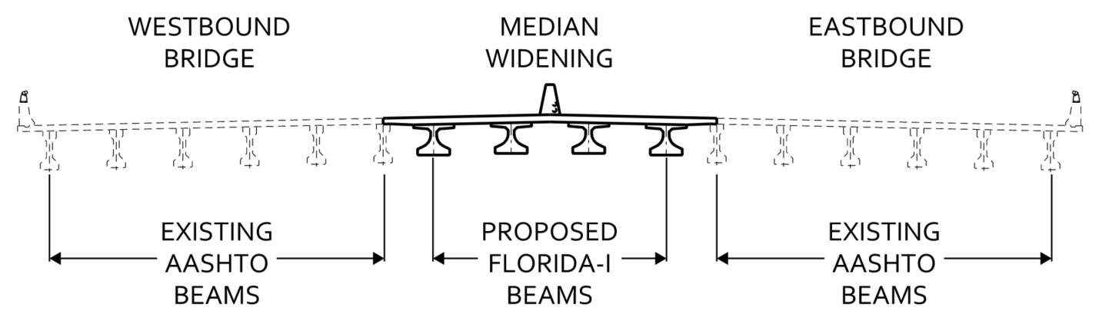
Structures
Bridge Widening Locations
  2 Steel Bridges:
    Himes
  20 P/S Concrete Bridges:
    Euclid
    El Prado
    Mississippi
    Morrison
    Swann
    Platt
    Willow
    S. Boulevard
    Hyde Park & Plant
    Viaduct (Inside & Outside)
  4 Combination Bridges:
    MacDill & Bay to Bay
    Watrous & Howard
Steel Bridge Widening Example
Concrete Bridge Widening Example
Notes:
The 26 existing bridges to be widened have superstructures comprised of steel girders, prestressed concrete beams, and in some cases, both. The majority of the existing bridges are comprised of AASHTO beams and will be widened with Florida-I Beams.

Slide 30
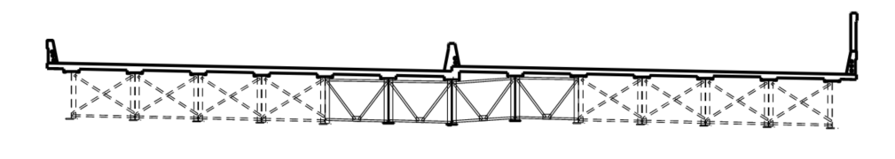
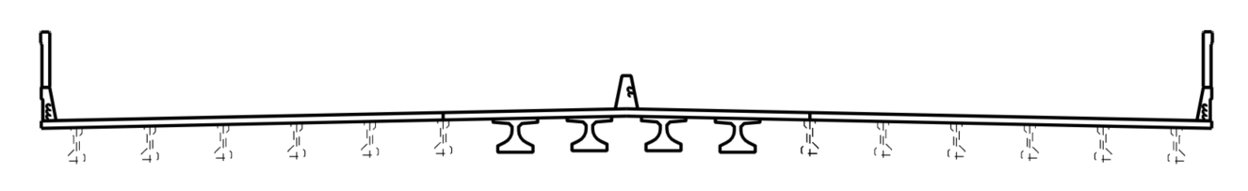
Structures
Full Deck Replacements
Bridge Nos. 100308 & 100309 over Himes Avenue
Bridge Nos. 100316 & 100317 over Mississippi Avenue
Notes:
In addition to the proposed widenings, the bridges over Himes and Mississippi Avenues require full deck replacements due to existing substandard decks. The full deck replacements are to accommodate standard single-slope traffic railings and proposed 8-foot noise walls.

Slide 31
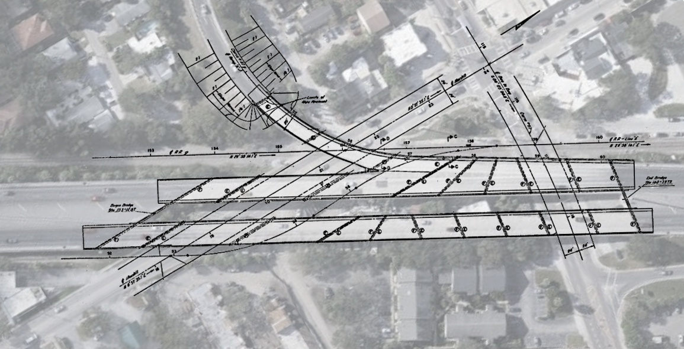
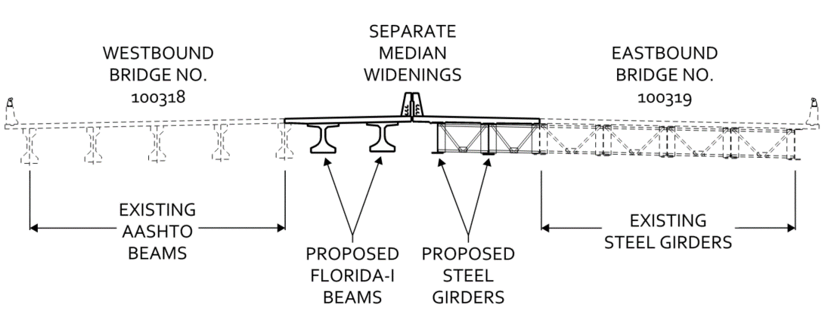
Structures
Combination Steel-P/S Concrete Bridge Widenings
S MACDILL AVE
WB SELMON EXPY
EB SELMON EXPY
W BAY TO BAY BLVD
Watrous & Howard
(Bridge Nos. 100318 & 100319)
MacDill & Bay to Bay
(Bridge Nos. 100314 & 100315)
Steel Span
Concrete Span
Notes:
As depicted on the left section view, the bridges over Watrous and Howard Avenues, consist of both steel and prestressed concrete. The entire westbound bridge contains AASHTO beams, while the eastbound bridge is comprised entirely of steel girders. Due to the dissimilar superstructure types, the bridges at this location will require separate median widenings and will remain as two independent bridges.
As shown on the right plan view, the bridges over MacDill Avenue and Bay to Bay Boulevard also contain a combination of steel and concrete girders.

Slide 32
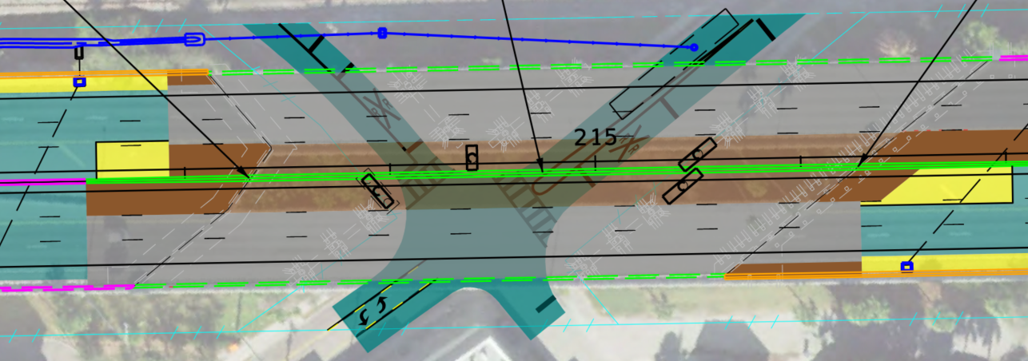
Structures
Challenging Pier Location: Howard & Watrous
BEGIN BRIDGES 100318 & 100319
£ SURVEY SR 618
(SELMON EXPRESSWAY)
END BRIDGES 100318 & 100319
PROPOSED SINGLE-COLUMN PIER SKEWED TO BOTH CL EXISTING WB PIERS 2 & 3
CL EXISTING WB PIER 3
CL EXISTING WB PIER 2
CL WB PIER 4
WB SELMON EXPY
EB SELMON EXPY
PROPOSED SINGLE-COLUMN PIER NORMAL TO CL EXISTING EB PIER 2
CL EB PIER 3
CL EXISTING EB PIER 2
S HOWARD AVE
W WATROUS AVE
PROPOSED SINGLE-COLUMN PIERS PARALLEL TO CL EXISTING PIERS
Notes:
There are several locations with challenging pier configurations. At Howard and Watrous, the orientation of the Expressway to the underlying roadways results in pier locations with skewed bridge spans.

Slide 33
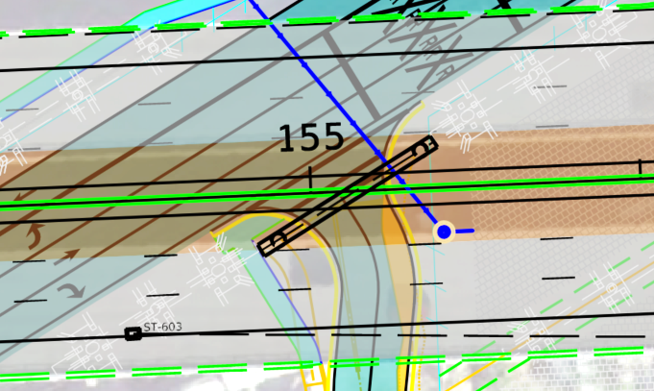
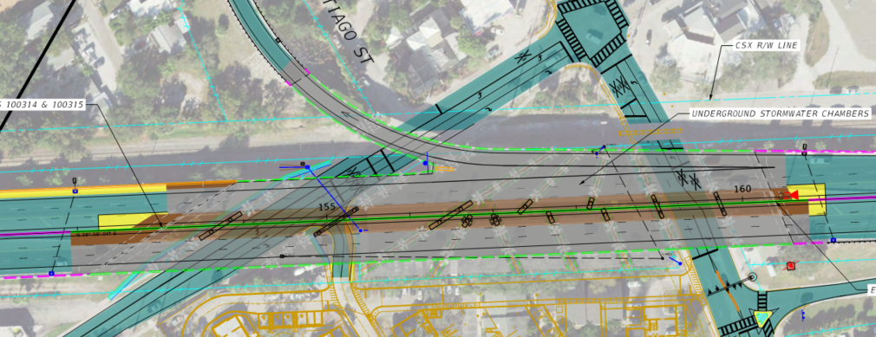
Structures
S MACDILL AVE
Challenging Pier Location: MacDill Ave & Santiago St
W SANTIAGO ST
PROPOSED INTEGRAL STEEL STRADDLE PIER
BEGIN BRIDGES 100314 & 100315
WB SELMON EXPY
EB SELMON EXPY
END BRIDGES 100314 & 100315
S MACDILL AVE
W BAY TO BAY BLVD
W SANTIAGO ST
Notes:
At MacDill Avenue, it is anticipated that an integral steel straddle pier span will be required at a realigned Santiago Street.

Slide 34
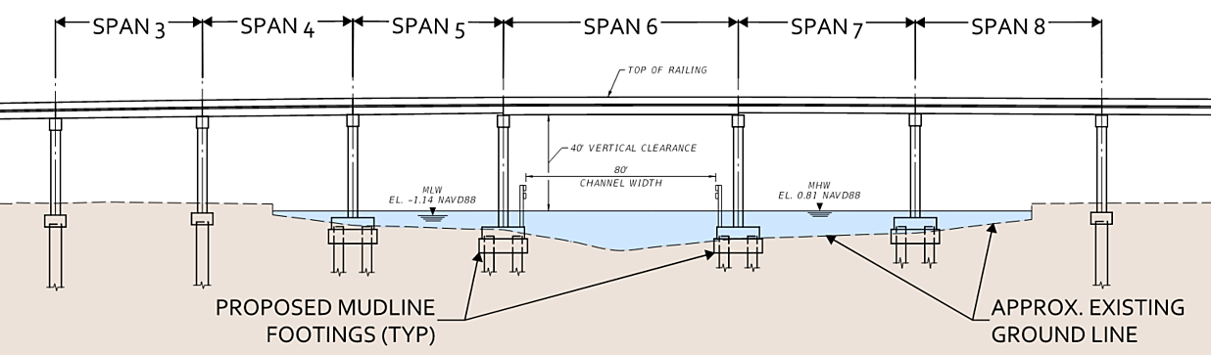
Structures
Challenging Pier Location: Viaduct over the Hillsborough River
Notes:
At the Hillsborough River, it is anticipated mudline footings for the piers will be constructed in the riverbed.
It is also anticipated that the proposed footings will necessitate the removal and replacement of a portion of the existing fender system, approximately 30 feet on each side, and the navigation light system. The main navigation channel is to remain open during construction.

Slide 35
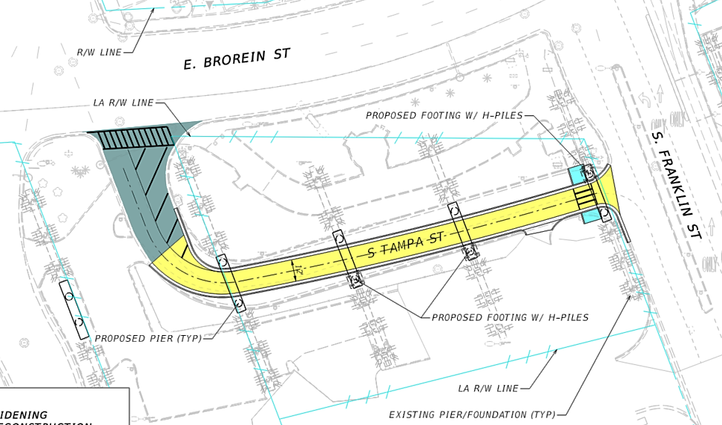
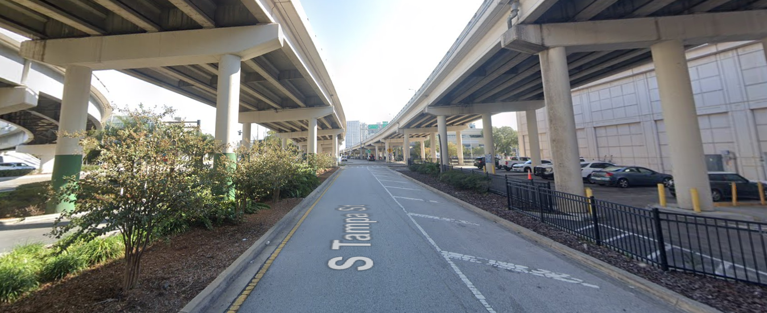
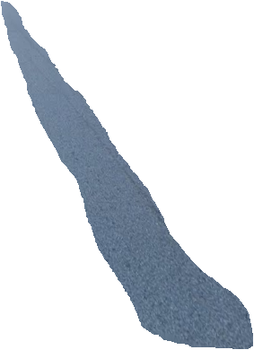



Structures
Challenging Pier Location:
Viaduct Piers over Tampa St.
PROPOSED
Reduce clear width between curb & gutter to maintain traffic underneath straddle piers.
Notes:
East of the Hillsborough River, the Tampa Street connection to Franklin Street will be realigned to pass under four proposed straddle piers, similar to the one depicted here.

Slide 36
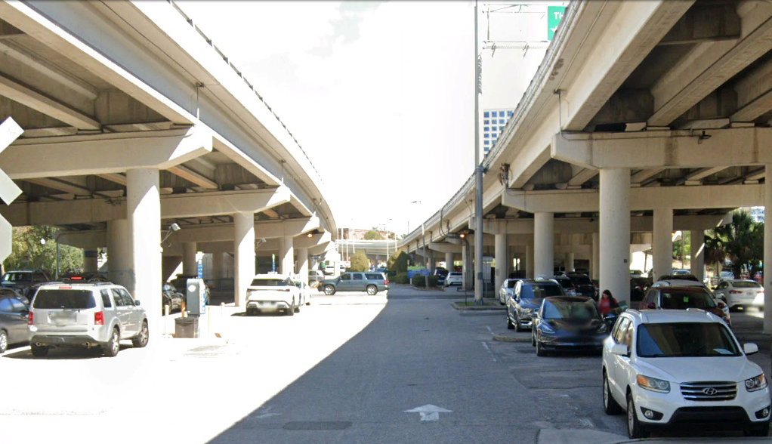
















Structures
Challenging Pier Location: Viaduct Piers over Parking Lots
PROPOSED
Maintain 2-way traffic through parking lots by eliminating select parking spaces.
Notes:
East of Franklin Street, it is anticipated the proposed hammerhead piers will be placed in the center of the travelway within the parking lots. Two-way traffic will be provided, which is expected to result in some loss of parking spaces.

Slide 37
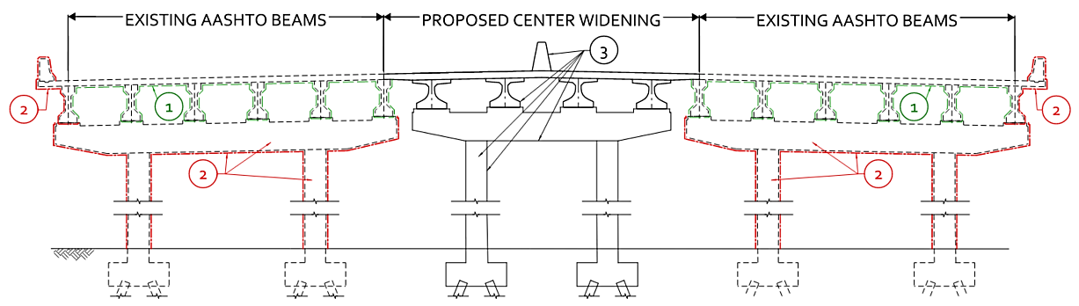
Structures
Clean & Coat: P/S Concrete Girder Spans
1
Pressure wash existing surface
Clean and stain existing surface
Coating included in the cost of new construction
2
3
Notes:
All existing concrete bridge spans will undergo cleaning and coating as depicted. Similarly, the 6 existing steel superstructure bridges will undergo cleaning and coating. Existing roadway median barriers, slope pavement at bridge abutments, retaining walls, and sidewalks will also require cleaning and coating.

Slide 38
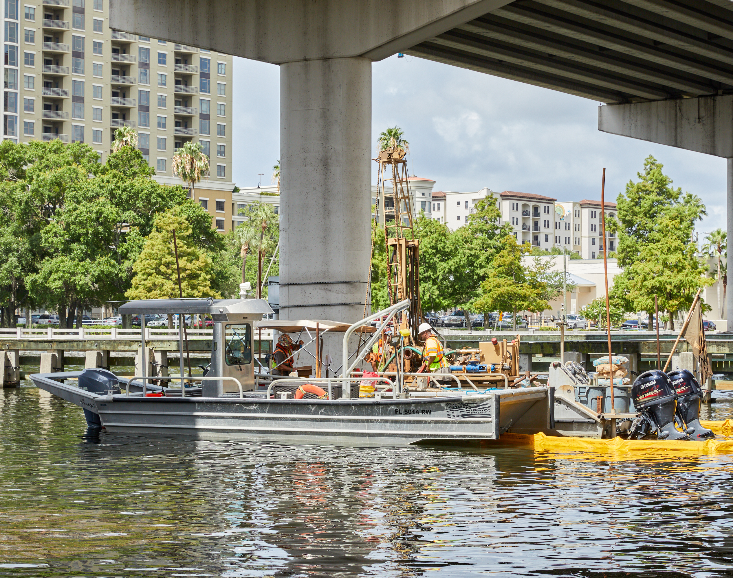
Geotechnical Exploration and Data Collection
Bridges
  145 Bridge SPT Borings (Tierra)
  26 SPT Borings (By Others)
  121 Rock Cores of 5 feet in length
  33 Environmental Classification Tests
  10 Bridge Deck Concrete Cores
  47 Bridge Deck Thickness Measurements
  RETA Testing for Rock Cores obtained in Hillsborough River (Performed by the SMO)
Retaining Walls & Noise Walls
  63 Retaining Wall SPT borings
  15 Noise Wall SPT borings
  3 Concrete Cores within the existing Retaining Walls for Compressive Strength testing
Roadway
  24 Auger Borings
  12 Pavement Cores (within the paved shoulder)
Ponds
  7 Pond SPT Borings
  14 Auger Borings
  8 Field Permeability Tests
  6 Double Ring Infiltration Tests
Notes:
Here is a list of the extensive geotechnical exploration performed in support of the project and this data will be provided with the RFP.

Slide 39
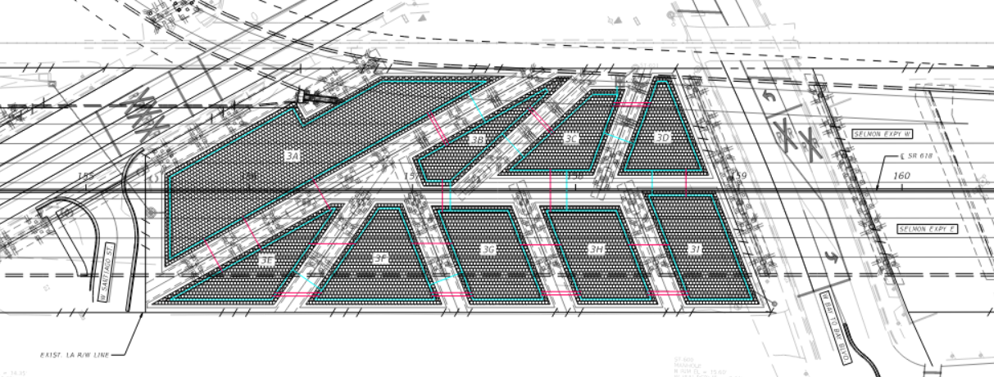

Drainage
8 new/modified stormwater ponds
1 new underground storage chamber system
Limited new piping including some new roadway side street crossings
Substantial number of inlet replacements along proposed noise walls
Extensive new or regraded roadside ditches
Notes:
It is anticipated that the drainage design will include 8 new or modified stormwater ponds and a new underground storage chamber system located under the Selmon mainline and west of Bay to Bay Boulevard as depicted. It is important to note that the design of this chamber system must accommodate the future public recreational area planned by THEA under a separate project.
It is expected that a limited amount of new piping be required, however there will be a substantial number of inlet replacements along the proposed noise walls. Extensive new or regraded roadside ditches will be required to provide proper conveyance.

Slide 40
Drainage
Assume pipe-lining of all existing pipes to be utilized
Video inspect all pipes to be utilized in the design and recommend alternatives to pipe-lining if necessary
If pipe replacements are determined to be necessary by THEA, this will be considered additional work
Notes:
In the procurement phase, design-build firms are to assume pipelining of all existing pipes to be utilized in their design. It should be noted that the majority of pipes were constructed with the original roadway and are over 50 years old.
Following award and prior to 90% plans, the design-build firm shall video inspect all pipes to be utilized in their design and recommend alternatives to pipe-lining if necessary. If pipe replacements are determined to be necessary by THEA, this will be considered additional work.

Slide 41
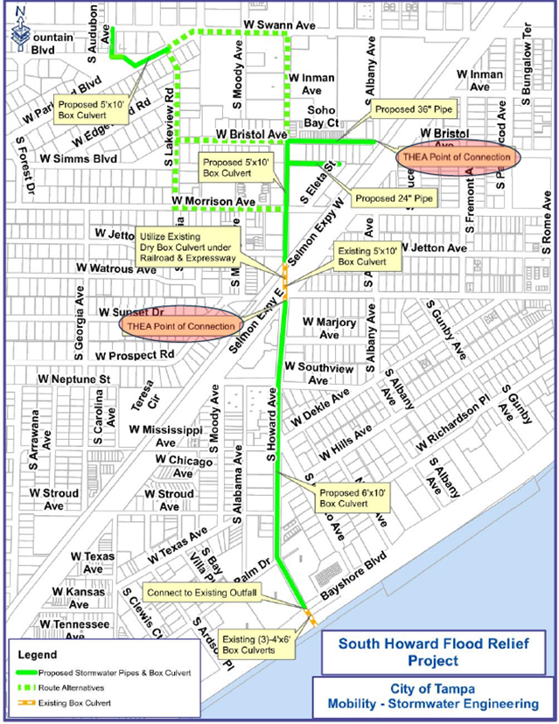
Drainage
THEA’s SSCP basins from Mississippi Ave to Swann Ave will directly connect to the City of Tampa’s proposed South Howard Outfall project.
THEA will not provide attenuation within these basins but will compensate the City of Tampa.
The SWFWMD permit application will be conditioned for this.
Notes:
As part of an agreement between THEA and the City of Tampa, the THEA basins from Mississippi to Swann will directly connect to the City of Tampa’s proposed South Howard Outfall project.
THEA will not provide attenuation within these basins but will compensate the City of Tampa.
The Southwest Florida Water Management District permit application will be conditioned for this.

Slide 42
Permitting
Two attenuation criteria were evaluated:
1. SWFWMD attenuation criteria
  •25-year/24-hour Post Discharge Rate = or < than 25-year/24-hour Pre-Discharge Rate
2. City of Tampa attenuation criteria
  •25-year/24-hour Post Discharge Rate = or < than 5-year/24-hour Pre-Discharge Rate
  •Applicable within the THEA ROW where the land-use changed (pervious to impervious + locations of proposed ponds) during the Median Safety Improvements and SSCP.
Notes:
Two attenuation criteria were evaluated:
-The Southwest Florida Water Management District attenuation criteria requires the 25-year, 24-hour Post Discharge Rate to be equal to or less than the 25-year, 24-hour Pre Discharge Rate.
-The City of Tampa attenuation criteria requires the 25-year 24-hour Post Discharge Rate to be equal to or less than the 5-year 24-hour Pre Discharge Rate.
-The City of Tampa attenuation criteria is applicable in all areas within the THEA right of way where the land use changed from pervious to impervious and in the location of proposed ponds for both the previous Median Safety Improvements and the South Selmon Capacity Project improvements.

Slide 43
Permitting
THEA is currently proceeding with obtaining the following permits based on Concept Plans:
  SWFWMD: Individual Environmental Resource Permit and Authorization to Use State-Owned Submerged Lands
    Anticipated Submittal in March 2025
  USACE: No Permit Required Letter
    Submitted on 11/19/24; addressing comments
  Port of Tampa Bay: Minor Work Permit – Application to perform work in waters of the Hillsborough county port district
    Submitted on 1/16/25; addressing comments
  US Coast Guard: Bridge Permit
    Submitted on 2/12/25
Notes:
THEA is currently proceeding with obtaining the following permits based on Concept Plans from the listed agencies.
Initial permit applications are shown for each of the permit applications.

Slide 44
Signing
Replace 2 cantilever and 3 span structures
New sign panels on 5 existing sign structures
2 sign panels to be overlaid
Design for sign support structures and foundations shall account for size of future sign panels (EB at East End)
Notes:
This information lists the primary scope of work for signing.

Slide 45
ITS
Two new 72-pair fiber trunk lines on each side of the mainline
Provide communication with TMC
Wrong Way detection at all off-ramps
  - Includes advance warning signage & in-pavement lighting
Preliminary ITS Devices | Quantity
CCTV Camera | 5
Microwave Vehicle Detection System (MVDS) | 17
Verification Camera | 3
Dynamic Message Signs (DMS) | 4
Roadside Unit (RSU) | 13
Video Analytics | 5
Wrong Way Vehicle Detections System (WWVDS) | 5
Portable Work-zone Camera System | TBD
Notes:
The project scope includes the addition of two new 72-pair fiber trunk lines on each side of the mainline in order to provide communication with the traffic management center and support tolling. Additionally, wrong way detection is to be provided at the five off-ramps. Multiple portable camera locations are to be determined by Design-Build Firm to support full coverage of project limits throughout construction.

Slide 46
Roadway Lighting
Replace and provide new LED lighting on mainline west and east of the South Selmon Median Safety Improvement Project limits (West of S. Himes Avenue and East of S. Plant Avenue)
Retrofit median LED lighting implemented on South Selmon Median Safety Improvement Project (replace luminaires)
Replace and provide new LED lighting on all ramps and all underdeck areas
Provide new lighting at the 4 proposed signalized intersections
Provide daytime lighting, if necessary, for any bridges creating a “tunnel affect” at the underpasses
Notes:
This information lists the primary scope of work for roadway lighting. Special attention will be given to mitigate any roadway lighting intrusion into the neighborhoods.

Slide 47
Tolling
New mainline gantry with aesthetic concrete columns
New gantry at WB Plant Avenue off-ramp
New test gantry at EB Willow Avenue off-ramp
Coordination with THEA’s Toll Equipment Contractor, who will install and test tolling equipment
All tolling operations to be maintained during construction
As needed, Design-Build Firm may schedule use of THEA’s temporary portable toll gantry
Notes:
The tolling scope includes a new mainline gantry with aesthetic concrete columns, a new gantry at the westbound Plant Avenue off ramp, and a new test gantry at the eastbound Willow Avenue off ramp. The RFP outlines requirements for the design-build firm’s coordination with THEA’s toll equipment contract who will install and test the tolling equipment. To facilitate the maintenance of tolling operations, the design-build firm may schedule use of THEA’s temporary portable toll gantry.

Slide 48
Signals
Install new mast arm traffic signals at
  WB off-ramp at W Euclid Avenue
  EB on-ramp at W Euclid Avenue
  EB on-ramp at W Bay to Bay Boulevard
  WB off-ramp to Willow Avenue, intersection at W Cleveland Street
Replace existing traffic signal with new mast arms at
  S Willow Avenue at W Cleveland Street
Notes:
The project includes signalizing the four listed intersections which are currently unsignalized and replacing the existing span wire traffic signal with new mast arms at the intersection of Willow Avenue and Cleveland Street.

Slide 49
Utilities
THEA has collected SUE Data (Level A & B) and obtained RGBs from the UAOs
Utility Works Schedules have been obtained and are being reviewed by THEA
Utility relocations for bridge pier conflicts are compensable and will advance
Frontier advancing utilities hanger system under WB HRB
City of Tampa water relocation work to be completed by Design-Build Firm
Design-Build Firm will finalize coordination efforts based on their design approach
Notes:
Coordination with the UAOs is on-going to finalize utility work schedules. For utility conflicts with proposed bridge piers, THEA will compensate utility owners for advanced relocation, with the intent that this work be completed prior to major roadway construction. THEA has already developed an agreement with Frontier to relocate utilities to be attached to the underside of the westbound Hillsborough River Bridge, which is expected to be completed by March 1, 2026.
City of Tampa Water facilities within the project limits will be completed by the Design-Build Firm through a Utility Work by Highway Contractor Agreement. An addendum will be issued with the final UWHCA documents and plans.
THEA will issue an RFP Addendum with the draft utility work schedules and utility relocation plans once they have been completed.

Slide 50
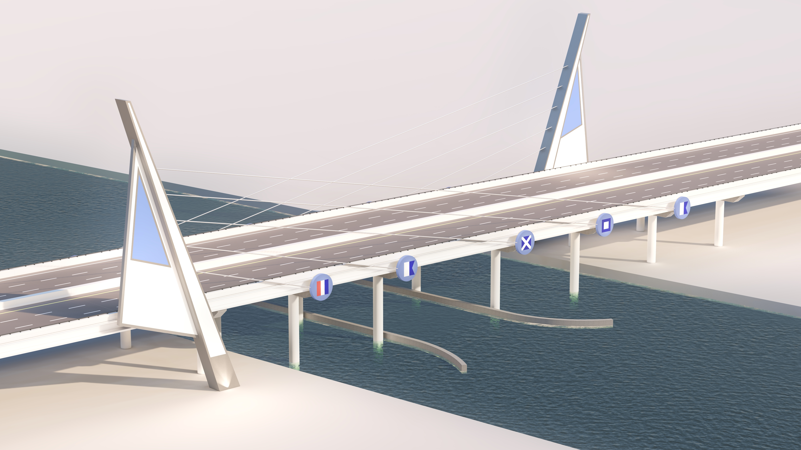
Aesthetics
Notes:
The most significant aesthetic element on the project is associated with the addition of signature structural features adjacent to and adjoining the Selmon Expressway over the Hillsborough River Bridge. The inspiration comes from Tampa’s historical and current relationship with maritime activities. The theme is composed of diametrically opposite configurations of large, free-standing “masts” and “sails” with cable stays terminating at decorative “buttons”. The buttons spell out TAMPA using The International Code of Maritime Signals. These elements will be both internally and externally illuminated.

Slide 51

Aesthetics
Notes:
The illumination of the bridge features will be on an independent, fully programmable circuit. The white portion of the sails will be externally illuminated. They will also include a steel mesh panel with internal illumination projecting a uniform ‘glow’. The buttons will also include this internal illumination ‘glow’ however, the signal flags will be externally illuminated.
These signature river bridge aesthetic features represent THEA’s base concept, which is to be the basis of the design-build firm’s price proposal. Alternative concepts may be explored during procurement and after award through a process to be discussed later in this presentation.

Slide 52
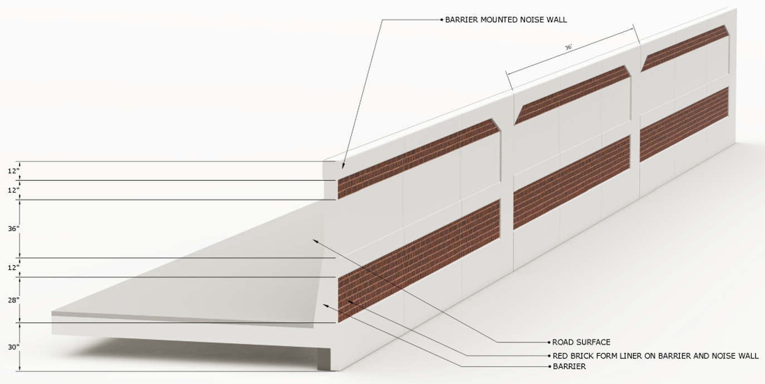
Aesthetics – Noise Walls Community Facing
Notes:
The aesthetics also include decorative form liner applications for the barrier-mounted noise walls. The community-facing design will include architectural inset panels and red brick patterning to reflect the historic nature of the adjacent neighborhoods.

Slide 53
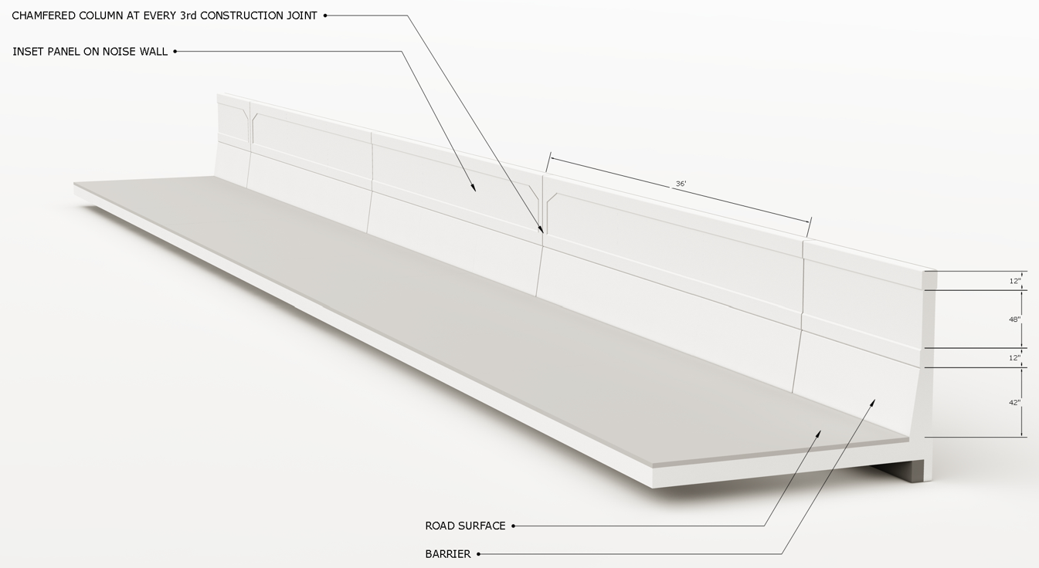
Aesthetics – Noise Walls Roadway Facing
Notes:
The roadway-facing noise walls will also include the architectural inset panels, however they will not include the brick patterning.

Slide 54
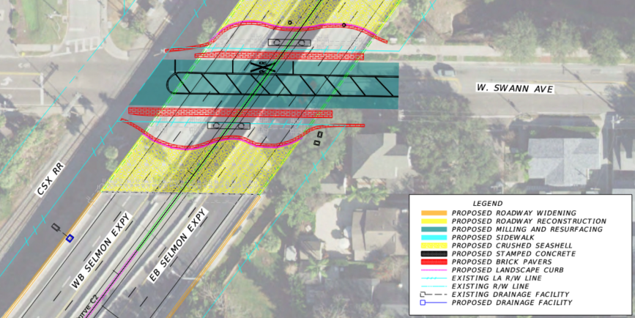
Aesthetics – Underpasses
Notes:
Local roadways beneath the Selmon Expressway west of Plant Avenue will include some or all of the following; milling and resurfacing, restriping, curb replacement, sidewalk replacement and new sidewalk. Aesthetic treatments will include stamped concrete, brick pavers, landscape curb and crushed seashell.
Where possible the pedestrian pavements should extend behind the pier columns. A combination of red brick and concrete is preferred as is a curvilinear geometry.

Slide 55
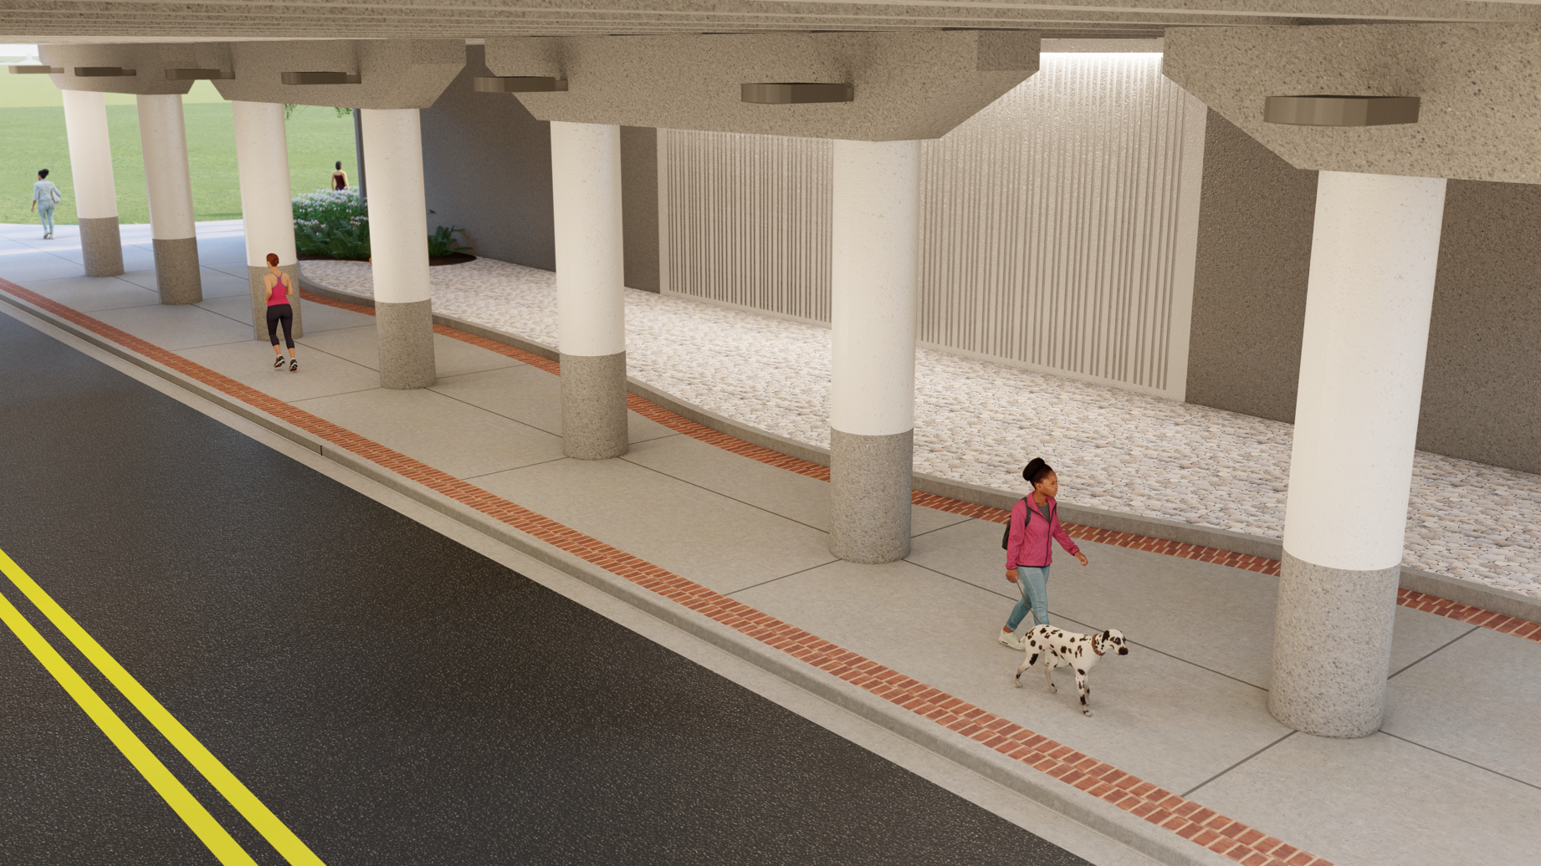
Aesthetics – Lighting
Underdeck down-lighting of underpass abutments (wall wash)
Notes:
The underpasses will also be provided with under deck down lighting to provide a wall washed illumination of the existing stratified abutment.
Other aesthetic lighting scope is under the Hillsborough River Bridge and for the proposed signature structural sail features.

Slide 56
Procurement

Slide 57
Project Delivery Approach
Adjusted-Score Design-Build
Lump sum, fixed-price, date-certain delivery
Established Contract Time of 1640 calendar days
Design-Build Firm responsible for development, design, and construction
Accelerated Scope Augmentation Phase (ASAP)
90-day period post-award (unless mutually agreed to extend)
Collaborative investigation and development of potential Project Augmentations
  Enhance safety (e.g. shoulder widths, accelerations lanes, etc.)
  Address drainage (e.g. South Howard outfall/Pump station in lieu of outfall)
  Improve aesthetics (e.g. Hillsborough River Bridge)
Notes:
THEA has selected an Adjusted Score Design Build approach for the procurement of this project
Proposers will provide a lump sum fixed price for development, design, and construction of the scope of work, delivered according to their technical approach and on a committed schedule
Price, qualifications and technical approach will be considered as part of the evaluation
However, THEA has determined to establish maximum contract time rather than to evaluate schedule as part of proposal selection
THEA is also implementing an innovative delivery approach that it is calling the Accelerated Scope Augmentation Phase, or ASAP
The ASAP, which will last for a period of 90 days after execution of the contract, will provide the selected Design Build Firm and the Authority the opportunity to collaboratively investigate and develop potential Project Augmentations
Project Augmentations are improvements to the base scope of work that may
Enhance safety, for example by improving shoulder widths, or lengthening accelerations lanes
Improve drainage, such as at the South Howard outfall, or
Improve aesthetics, in particular at the Hillsborough River Bridge

Slide 58
Project Delivery Approach
Accelerated Scope Augmentation Phase (ASAP), continued
Potential inclusion in the Project based on feasibility, affordability, and public benefit
  Implemented via Design-Build Amendment, to address scope, schedule, price
  THEA retains right to proceed without implementation of Project Augmentations
Preconstruction work to be compensated based on actual costs at a fixed multiplier
Notes:
THEA will determine the specific Project Augmentations to be developed during the ASAP, and the scope of preconstruction work, including tasks and deliverables required of the Design-Build Firm, prior to contract execution
Based on the deliverables submitted by the Design Build Firm, and THEA’s assessment of their feasibility, affordability, and public benefit, the Authority may choose to implement one or more Project Augmentations via a Design-Build Amendment
However, THEA also has the right to proceed without implementation of any of the Project Augmentations according to the Design Build Firm’s original proposal
All ASAP related preconstruction work will be completed on a time and materials basis at a fixed multiplier for actual approved costs

Slide 59
Procurement Approach
Procurement Overview
The Project will be procured through a two-phase solicitation, taking into account such factors as qualifications, approach and innovations, and price
Phase 1 - Qualifications and Shortlisting
  Expanded LOI detailing team structure, key personnel, technical qualifications
Phase 2 - Technical and Price Proposal
  Technical proposals detailing project approach narrative both for DB delivery of Base Scope of Work and Augmentation Phase
  Project design concept – Plans and drawings that meet technical requirements and design criteria for Base Scope of Work and approved ATCs
  ATC process for technical innovations
  Price proposals: Fixed-price, lump sum to schedule
Notes:
The procurement will proceed according to two phases, with Phase 1....Expanded Letters of Interest and Shortlisting now completed.
The second phase will involve submission of technical and price proposals
The technical proposal will address an approach to both delivery of the base scope of work and the ASAP phase work- though not that Project Augmentations themselves- and will include submission of a project design concept
THEA will include an Alternative Technical Concepts Process to consider potential innovative aspects from proposers
Price proposals will represent a fixed price lump sum for delivery of the Project on the established schedule

Slide 60
Phase 1 – Expanded Letters of Interest
Expanded Letters of Interest Format and Contents
  Expanded Letters of Interest (ELOI) Content
    Past Performance History and Similar Project Experience
    Proposed Design-Build Firm Staffing and Organization Plan
    Design-Build Project Requirements, Design and Construction Criteria, and Critical Issues, including Aesthetics and Community Involvement
  Additional items
    Pass/Fail Criteria
  Organizational Chart and Resumes
  Performance History
Required prequalification in all work types required for the Project
Notes:
The Phase 1 submittal will involve Expanded Letters of Interest detailing past performance history, similar project experience, a proposed staffing and organization plan, and a narrative discussing project requirements, design and construction criteria, and critical issues, including aesthetics and community involvement
Additional pass/fail criteria, and organizational chart and resumes, and a performance history will also be required, as well as prequalification in all required work type

Slide 61
Phase 1 - Expanded Letters of Interest
Evaluation and Shortlisting
ELOI Evaluation Criteria (Maximum of 50 points)
  Past Performance History & Similar Design Build Project Experience (15 points)
  Proposed Design-Build Staffing & Organization Plan (15 points)
  Design-Build Project Requirements, Design & Construction Criteria, and Critical Issues including Aesthetics & Community Involvement (20 points)
Recommended selection of between three and five Proposers (if reasonably possible)
    LOI Scoring does not carry forward to final selection calculation
Notes:
50 points are available for ELOI, allocated across the criteria mentioned
THEA will recommend between three and five proposers for shortlisting if reasonably practical
It should be noted that ELOI scoring will NOT carry forward into final selection

Slide 62
Contractor Pre-Qualifications
Major work types:
7 – Drainage
11 – Grading
17 – Intermediate Bridges
Other minor work types can be accommodated by subcontractors
8 – Electrical Work
10 – Flexible Paving
12 – Grassing, Seeding and Sodding
13 – Guardrail
38 – Roadway Signing
39 – Traffic Signal
Notes:
The following major and minor work types require contractor prequalification, or subcontractor prequalification in the case of minor work

Slide 63
Consultant Pre-Qualifications
3.1 Minor Highway Design
3.2 Major Highway Design
3.3 Controlled Access Highway Design
4.1.1 Miscellaneous Structures
4.1.2 Minor Bridge Design
4.2.1 Major Bridge Design- Concrete
4.2.2 Major Bridge Design- Steel
5.4 Bridge Load Rating
6.1 Signal Timing
6.3 Intelligent Transportation Systems
Analysis, Design, and Implementation
6.3.1 Intelligent Transportation Systems
Analysis and Design
6.3.2 Intelligent Transportation Systems Implementation
6.3.3 Intelligent Transportation Traffic Engineering Communications
7.1 Signing, Pavement Marking & Channelization
7.2 Lighting
7.3 Signalization
8.1 Control Surveying
8.2 Design, Right of Way, & Construction Surveying
9.1 Soil Exploration
9.2 Geotechnical Classification Lab Testing
9.4.1 Standard Foundation Studies
9.4.2 Non-Redundant Drilled Shaft Bridge Foundation Studies
15 Landscape Architect
Notes:
Consultant pre-qualifications are required as listed

Slide 64
Phase 2 – Technical Proposals
Technical Proposal Format and Contents
  Project Approach
    Design and Aesthetics
    Project Augmentation
    Construction
    Temporary Traffic Control Plan
    Coordination
  Plans and Drawings
  Renderings, including two alternative signature bridge concepts and noise wall form liner aesthetics
    Utilization of Sustainable, Recycled, and Environmentally Friendly Materials
    Value-Added Features
    SBE Participation
Notes:
Shortlisted firms will be invited to submit Technical and Price proposals
Technical proposals will describe the proposed technical approach to all elements of the work, as well as project plans and renderings
In particular, THEA is requesting submission of renderings for two alternative aesthetic designs for a signature bridge concept and noise wall form liner aesthetics
Such alternatives shall be similar in cost to the Authority’s concept
The quality of the alternative proposed aesthetic concepts will be evaluated; however, pricing of such alternatives will not be included or evaluated. Alternative aesthetic concepts my be addressed in the previously described 90-day ASAP phase.

Slide 65
Phase 2 – Technical Proposals
Technical Proposal Evaluation
Technical Proposal Evaluation Criteria (Maximum of 100 points):
  Design and Aesthetics (25 points)
  Project Augmentation (5 points)
  Construction (30 points)
  Temporary Traffic Control Plan (15 points)
  Coordination (10 points)
  Utilization of Sustainable, Recycled, and Environmentally Friendly Materials (5 points)
  Value-Added Features (5 points)
  SBE Participation (5 points)
Proposal Score based on average of Evaluator Scores
Notes:
The technical proposals will be evaluated by a review committee based on the following point allocations
The final technical proposal score will be determined as the average of each evaluator’s score

Slide 66
SBE
THEA’s Small Business Enterprise (SBE) Policy requires nondiscrimination on the basis of race, color, national origin, and gender in its employment and contracting practices and encourages the solicitation and utilization of SBE’s. This means that the Authority’s goal is to spend a portion of the highway dollars with Certified SBE’s as prime Design-Build Firms or as subcontractors. Race-neutral means that the Authority believes that the overall goal can be achieved through the normal competitive procurement process. THEA has exceeded 15% SBE participation on its program for the last several years.
Notes:
The design-build firm shall adhere to THEA’s SBE policy. Note, SBE utilization is part of the technical evaluation score.

Slide 67
Phase 2 – Technical Proposals
Innovative Aspects Format and Contents
  Innovative Aspects considered via Alternative Technical Concepts (ATC): technical solutions that meet or exceed the Project goals and requirements
  ATCs are limited to means and methods, roadway alignments, approach to Project, etc.
    May propose design exceptions, changes in scope, or modifications to the horizontal and/or vertical geometry
  ATCs shall not
    include revisions to specifications, standards or established Authority policies
    reduce the construction coverage, diminish the design criteria or quality, or increase impacts
    address Hillsborough River Bridge signature aesthetic features/structures
    Address Project Augmentations
Notes:
THEA has included an ATC process to evaluate proposed innovative aspects that could be included in the project
ATCs are limited to means and methods, alignments, approach to project delivery and other similar innovations, and propose design exceptions, changes in scope, or modifications to the horizontal and/or vertical geometry as limited by the RFP
ATCs shall not include revisions to specifications, standards or established Authority policies, reduce the construction coverage, diminish the design criteria or quality, or increase impacts, or address Hillsborough River Bridge signature aesthetic features/structures
ATCs also shall not address the Project Augmentations

Slide 68
Phase 2 – Technical Proposals
ATC’s deferred to ASAP Phase
ATC’s, including those submitted by others, that are not incorporated into the selected Design-Build Firms Technical Proposal may be considered in the ASAP Phase at the Authority’s discretion.
Notes:
THEA has included an Alternative Technical Concept or ATC process to evaluate proposed innovative aspects that could be included in the project. It is anticipated that some ATC’s, especially those that may significantly increase project costs, will be deferred to the Accelerated Scope Augmentation Phase...known as “ASAP” (say ASAP, not A...S...A...P)
ATC’s, including those submitted by others, that are not incorporated into the selected Design-Build Firms Technical Proposal may be considered in the ASAP Phase at the Authority’s discretion.

Slide 69
Phase 2 – Price Proposal
Price Proposal
  Proposed Total Lump Sum Contract Amount
    Amount representing full, complete, and final compensation for the Work required to complete the Project within the time required
  Total Lump Sum Contract Amount shall not include costs for Augmentation Process, nor potential Project Augmentations
  Price Proposal Guaranty of not less than five percent (5%) of the Total Lump Sum Contract Amount
Notes:
The Price Proposal shall consist of a Total Lump Sum Contract Amount representing full, complete, and final compensation for the Work required to complete the Project within the time required
Total Lump Sum Contract Amount shall not include costs for Augmentation Process, nor potential Project Augmentations
A Price Proposal Guaranty of not less than five percent (5%) of the Total Lump Sum Contract Amount is required at time of submission

Slide 70
Q & A Sessions
Q&A Session Format and Contents
120 minutes Q&A with Shortlisted Proposers regarding Technical Proposals
Questions will be provided five (5) calendar days in advance of the Q&A Session
No other handouts, electronic presentations, etc. other than copies of the submitted written Technical Proposal
No questions allowed by the Proposers
Notes:
The Authority will host Q&A with Shortlisted Proposers to allow the Authority to seek clarification on Technical Proposals. The RFP will detail the expectations and restrictions for these Q&A sessions.

Slide 71
Basis of Award
Formula for Final Selection
Calculation of Adjusted Score using the following formula:
  BPP = the Bid Price Proposal
  TS = the Technical Score
  (Calculated as the Average Score from Technical Proposal)
  Adjusted Score =
The intended selected Proposer will be the responsive and responsible Proposer whose adjusted score is lowest
BPP
TP
Notes:
The intended selected Proposer will be the responsive and responsible Proposer whose adjusted score is lowest, with the Adjusted Score equaling the Bid Price divided by the Technical Score.

Slide 72
Procurement Schedule-
Upcoming Major Milestones
April 8, 2025 One-on-One ATC No. 1 Meetings
May 28, 2025 One-on-One ATC No. 2 Meetings
July 16, 2025 Technical Proposals Due
July 22, 2025 Technical Proposal Page Turn Meetings
August 5, 2025 Questions and Answers Sessions
August 29, 2025 Price Proposals Due
September 2, 2025 Public Announcement of Scores and Prices
Notes:
The latest RFP “Schedule of Events” outline these upcoming major milestones in the procurement process.

Slide 73
Project Documents
http://www.tampa-xway.com/procurement/#
The cone of silence remains in place for all THEA staff, board members and supporting consultants.
All questions should be emailed to THEA Procurement Office: Procurement@tampa-xway.com
Answers will be posted on the THEA website and Demandstar
Notes:
Following advertisement, the documents will be located at the website listed. All questions should be emailed to the THEA procurement office at the email listed.
Note, the cone of silence remains in place for all THEA staff, board members and supporting consultants.

Slide 74

This presentation or verbal representations made at this meeting are not binding on THEA. The RFP, Addendums and Written Correspondence from THEA are the official project documents and communications.
THE CONE OF SILENCE HAS BEEN IN PLACE DURING THE ENTIRETY OF THIS RE-SOLICITATION
All questions should be emailed to THEA Procurement Office: Procurement@tampa-xway.com
Notes:
This presentation or verbal representations made at this meeting are not binding on THEA. The RFP, Addendums and Written Correspondence from THEA, such as answers to your questions or ATC proposals, are the official project documents and communications. It is critical that all parties understand and respect the on-going cone of silence. All questions should be emailed to THEA Procurement Office at the email address shown.
Thank you for your interest in the South Selmon Capacity Project.

