Slide 1
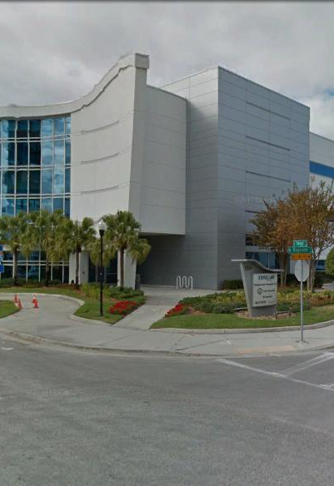
Tampa Hillsborough
Expressway
Authority
ITS Fiber Data Collection & Characterization Low Bid
Design-Build
Pre-Proposal Meeting
1/4/2022
THEA Project No. O-02121

Slide 2
Introductions
Man Le – THEA Contracts & Procurement Manager
Judith Villegas, EI – THEA Project Manager
Brian Pickard, PE – THEA Director of Operations and Engineering
Shari Callahan, PMP – THEA IT Manager
Jim Drapp, PE – THEA GEC
Ken Jacobs – THEA GEC
Terry Opdyke – THEA GEC
Jorge Uy – THEA GEC

Slide 3
Project Roles
Tampa Hillsborough Expressway Authority (THEA)- Owner
  Judith Villegas, EI- THEA Project Manager
HNTB- General Engineering Consultant (GEC) to THEA

Slide 4

Agenda
Project Overview & Objectives
Letter of Interest (LOI)
Technical Proposal
Bid Price Proposal
Qualification Criteria
Evaluation Process
Procurement Schedule
SBE
TRC Members & Technical Advisors
Project Documents
Questions

Slide 5
Project Overview & Objectives
Low Bid Design-Build Procurement to Fiber Data Collection and Characterization
  Review existing inventory files
  Set up a data collection application
  Set up an information housing database in ArcGIS Online
  Geolocate ITS inventory, document all connected technologies, build turnkey database and supply training for staff
  Inventory data format will be compatible with FDOT ITSFM. Where approved the ITSFM forms will be used as a template for attributes in the data collection app
Project Limits
  Selmon Expressway
  Selmon West Extension
  Brandon Parkway
  Meridian Avenue
  Selmon Greenway
Intent of the Authority to award the contract based on the lowest responsible, responsive, and qualified bid.

Slide 6

Location Based Inventory
Closed-Circuit Television (CCTV) cameras
Dynamic Message Signs (DMS)
Barrier gates
Warning gates
Microwave Vehicle Detection Systems (MVDS) and other vehicle detectors
Overhead directional signs (e.g., green/yellow arrow, red X, etc.)
Connected and Automated Vehicle (CAV) Roadside Units (RSUs)

Slide 7
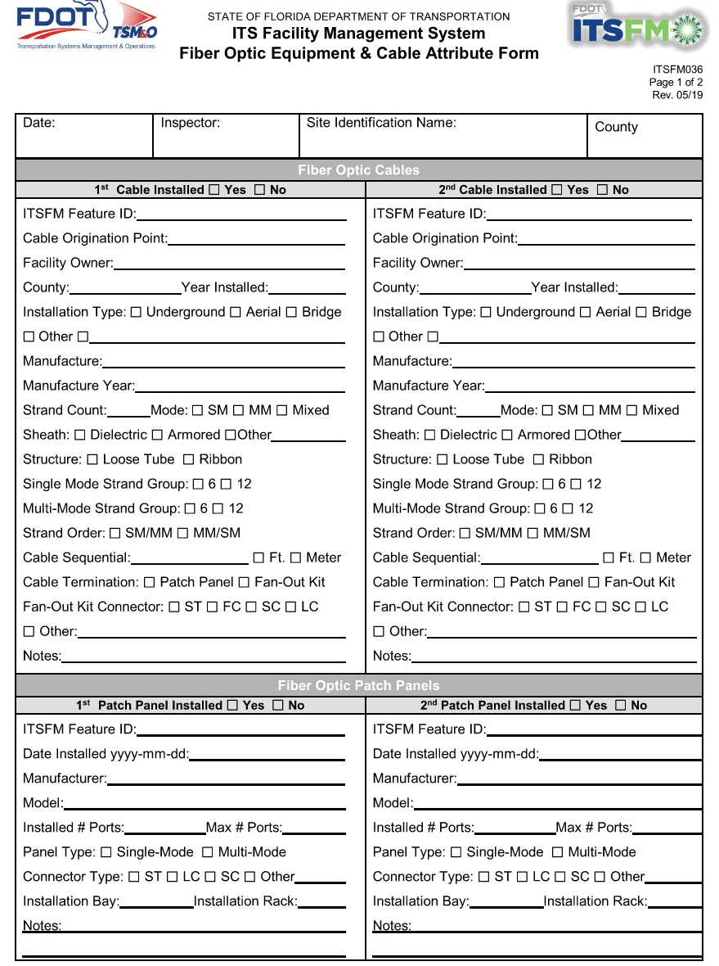
Fiber Optic Characteristics
Fiber optic cables
Conduits
Pull boxes
Fiber optic concrete splice vault details and attributes
Communications Facility Equipment Site Attributes including managed field ethernet switches, routers and device configuration (e.g., IP address), etc.
Electrical power service point
Document the utilization of fiber-optic strands by sub-systems (i.e. ITS, Tolls, CoT, spares, etc.).
Notes:
Managed Field Ethernet Switches (MFES, OSI Layer 2), Routers (OSI Layer 3), and configuration (e.g., IP address)
Fiber optic cables
Multimode or single-mode characteristic
The number of fibers (e.g., 12-count, 24-count, etc.)
Conduits
Size
Location
Number of cables
Communications Facility Equipment Site Attributes
Electrical power service point
Fiberoptic concrete vault detail and attributes
Fiberoptic end-to-end connectivity, terminal points, such as, but not limited to:
Equipment connectivity to THEA Traffic Management Center (TMC) servers and control room connectivity.
The connectivity coverage will be provided and confirmed by the AUTHORITY’s network consultant to include THEA equipment connections in its internal network.
Connectivity coverage to include identifying fibers that connect to or are shared with external networks, such as the Statewide ITS Communications Network (SICN)
Connectivity coverage will not include fibers or equipment used within external networks.
Connectivity coverage to terminate at the network switch in the TMC server.
Document the utilization of fiber-optic strands by sub-systems (i.e. ITS, Tolls, CoT, spares, etc.). The demarcation point for tolling equipment is at the fiber optics patch panels in the in-lane toll cabinets and HQ-tolling racks.
Fiberoptic pull boxes
Length of slack fiber looped
Fiberoptic cable and equipment attributes
Fiberoptic patch panel connection attributes
Fiber splice inventory and terminations
Miscellaneous communication equipment attributes
Non-Fiber Optic data transport media (e.g., twisted pair, coax, etc.)

Slide 8
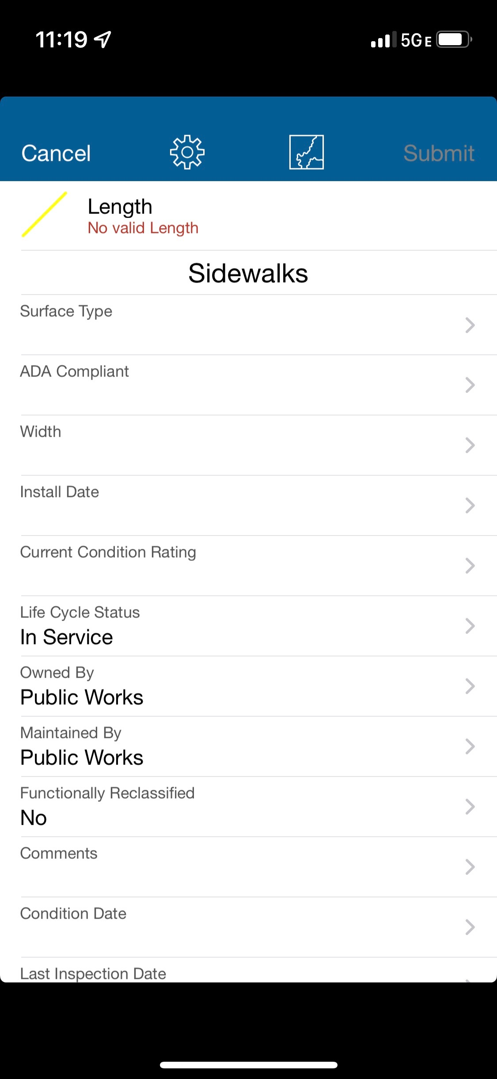
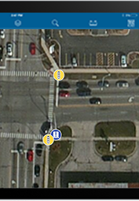
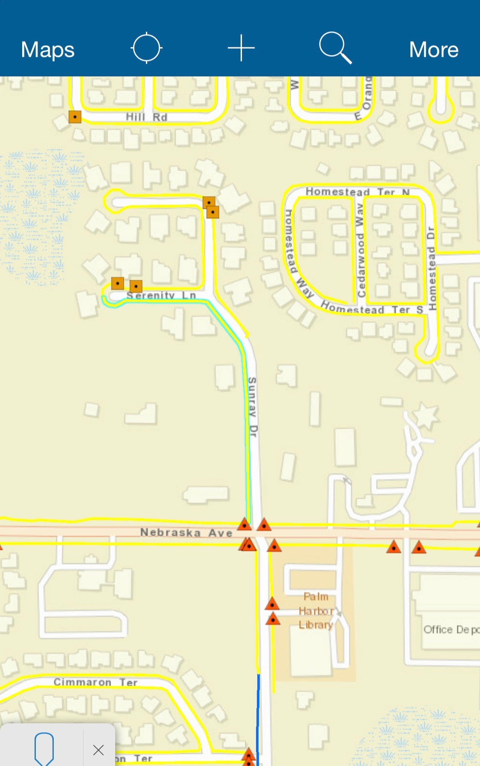
Example of GIS input –
Collector Application
https://www.fdot.gov/traffic/itsfm/new-construction/contractor/data-collection-forms.shtml

Slide 9
Deliverables
Draft Data Collection Application
Final Data Collection Application
ITS Fiber Data Collection and Characterization
  Selmon Expressway
    Selmon Expressway East
    Selmon Expressway West
    Selmon West Extension
    Reversible Express Lanes
  Brandon Parkway
  Meridian Avenue
  Selmon Greenway
Monthly progress report
Damage Report (If necessary)
Training of Identified Authority Staff on Maintaining and Updating of the Database

Slide 10
Letters of Interest (Phase I)
Maximum of three (3) pages
  8 ½” x 11” sheets
  Minimum font size ten (10)
Additional items – Not counted in the 3-page limit
  11” x 17” Organizational Chart
  Resumes – one page for 8 key positions
  Three (3) pages of Performance History
LOI Evaluation Criteria (Maximum of 30 points):
    Past Performance, D-B Project Experience, Organization & Staffing (10 points)
    Design-Build Project Requirements and Critical Issues (10 points)
LOI Evaluation is for the purpose of Shortlisting Only.
From LOI Scores, THEA will shortlist 3 Firms, each of which will declare intent to move forward to Phase II

Slide 11
Technical Proposal (Phase II)
Submit electronically in Adobe.pdf format (unzipped) and attached to a single email
FDOT Form 700-010-21 Low Bid Design-Build Technical Proposal
  Approach and Understanding of the Project, Staffing, Responsible Office
  Two (2) pages maximum, 8.5” x 11”, single-sided, typed pages including text, graphics, tables, charts, and photographs

Slide 12
Bid Price Proposal
One (1) hard copy Bid Price Proposal shall be hand delivered in separate, sealed package to THEA
  Bid Price and Calendar
  Initial Schedules of Values/Anticipated Payment Schedules

Slide 13
Qualification Requirements
Team Pre-Qualifications
Major work types:
16 – Intelligent Transportation Systems
Subcontractors can be used to meet prequalification requirements.
Consultant Pre-Qualifications
6.3.4 – Intelligent Transportation Systems Analyses, Design & Implementation
In lieu of FDOT Prequalification, the Design-Build Team may provide documented evidence of completion of 3 similar projects within the last five (5) years.

Slide 14
Evaluation Process
Authority opens Bid Price Proposals from shortlisted firms
THEA TRC reviews the Technical Proposal of Lowest Bidder for Responsiveness based on RFP criteria
If Responsive, D-B Firm will be awarded project
If Non-Responsive, TRC will review Technical Proposal of next Lowest Bidder for Responsiveness or Non-Responsiveness based on the RFP, and so on.

Slide 15
Procurement Schedule
Notes:
n

Slide 16
SBE
THEA’s Small Business Enterprise (SBE) Policy requires nondiscrimination on the basis of race, color, national origin, and gender in its employment and contracting practices and encourages the solicitation and utilization of SBE’s. This means that the Authority’s goal is to spend a portion of the highway dollars with Certified SBE’s as prime Design-Build Firms or as subcontractors. Race-neutral means that the Authority believes that the overall goal can be achieved through the normal competitive procurement process. THEA has exceeded 15% SBE participation on its program for the last several years.

Slide 17

TRC Members and Technical Advisors
  TRC Members:
    Judith Villegas, EI – THEA
    Brian Pickard, PE– THEA
    Shari Callahan – THEA
  Technical Advisors:
    Gary Holland – THEA
    Jim Drapp, PE – THEA GEC
    Ken Jacob – THEA GEC
    Terry Opdyke – THEA GEC

Slide 18
Project Documents
http://www.tampa-xway.com/procurement/#
The cone of silence remains in place for all THEA and HNTB staff. The cone of silence begins on date of advertisement and ends upon Board Approval.
All questions should be emailed to Man Le, THEA Contracts & Procurement Manager: man.le@tampa-xway.com
Answers will be posted on the THEA website and Demandstar

Slide 19

All questions should be emailed to Man Le, THEA Contracts & Procurement Manager: man.le@tampa-xway.com

