Slide 1
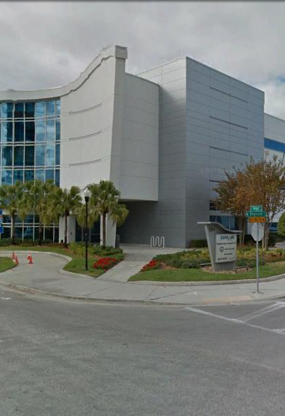
Tampa Hillsborough
Expressway
Authority
Pre-Bid Conference
9/1/2021
FY22 SELMON BRIDGE PAVEMENT STRIPING
O-01421

Slide 2
Introductions
Man Le – THEA Contracts & Procurement Manager
Judith Villegas, EI – THEA Project Manager
Brian Pickard, PE – THEA Director of Operations and Engineering
Jim Drapp, PE – THEA GEC Program Manager
David Hubbard, PE – THEA GEC Project Manager
Terry Opdyke – THEA GEC
Brian McKishnie, PE – THEA Consultant CEI

Slide 3

SELMON BRIDGE PAVEMENT STRIPING
AGENDA
Project Overview
CEI/Public Involvement
Schedule
Project Documents
Questions

Slide 4
SELMON BRIDGE PAVEMENT STRIPING
OVERVIEW
Located at Select Bridges/Concrete Approaches along the Selmon Expressway:
  Mainline (Downtown)
    100330 (WB over Plant Ave)
    100331 (EB over Plant Ave)
    100332 (WB Viaduct)
    100333 (EB Viaduct)
    100443 (WB over 21st)
    100444 (EB over 21st)
  REL (all bridges)
    100800
    100802
    100450
    100806
    100461
    100810
    100466
    100490
    100812

Slide 5
SELMON BRIDGE PAVEMENT STRIPING
OVERVIEW
Restriping details
  Remove existing thermoplastic markings via hydro-blasting
  Replace all striping to meet current standards
  Remove and replace RPM Type B to current standards
  Provide MOT
Use FDOT Specifications/Approved Products List
Include black contrast skip striping per standard
Lump Sum
120 Calendar Days

Slide 6
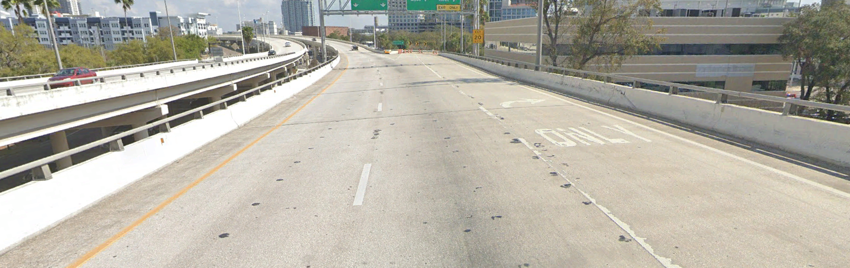

SELMON BRIDGE PAVEMENT STRIPING
OVERVIEW
Replace interchange markings (permanent tape)
Replace pavt. messages (preformed thermo.)
New edge striping (permanent tape)
New
RPMs
EB Selmon Expressway
Approaching Florida Ave
New white-black skip striping (permanent tape)

Slide 7
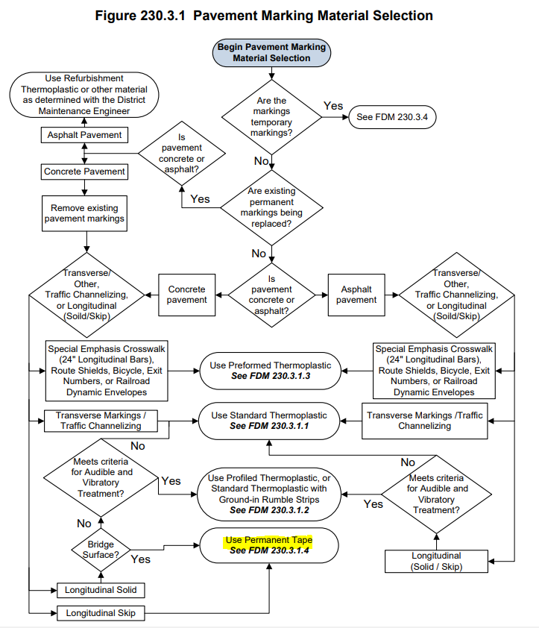
SELMON BRIDGE PAVEMENT STRIPING
OVERVIEW
Pavement Marking Material Selection:
  Longitudinal striping is to be permanent tape
  All other pavement markings use thermoplastic
Follow the FDM Section 230 flowchart:

Slide 8
SELMON BRIDGE PAVEMENT STRIPING
OVERVIEW
MOT requirements
  Coordination with adjacent projects, including FY22 Resurfacing and East Selmon Slip Ramps
  Lane Closure Restrictions
    Mainline/Local Lanes – 5 AM to 7 PM (night work only)
    REL – 5 AM to 9 AM and 3 PM to 7 PM (off-peak only)
  Provide at least one lane EB/WB/REL at all times
  Ramps to remain open (Spec 102-4 applies)
  THEA-specific special event days apply

Slide 9
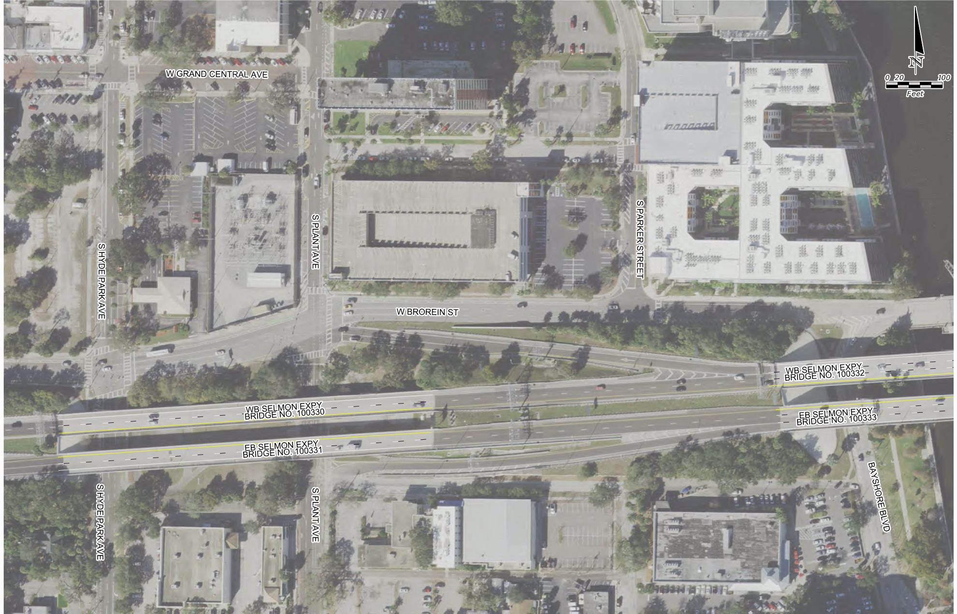
SELMON BRIDGE PAVEMENT STRIPING
Selmon Expressway Local Lanes
Bridge 100330/100331
Bridge 100332/100333

Slide 10
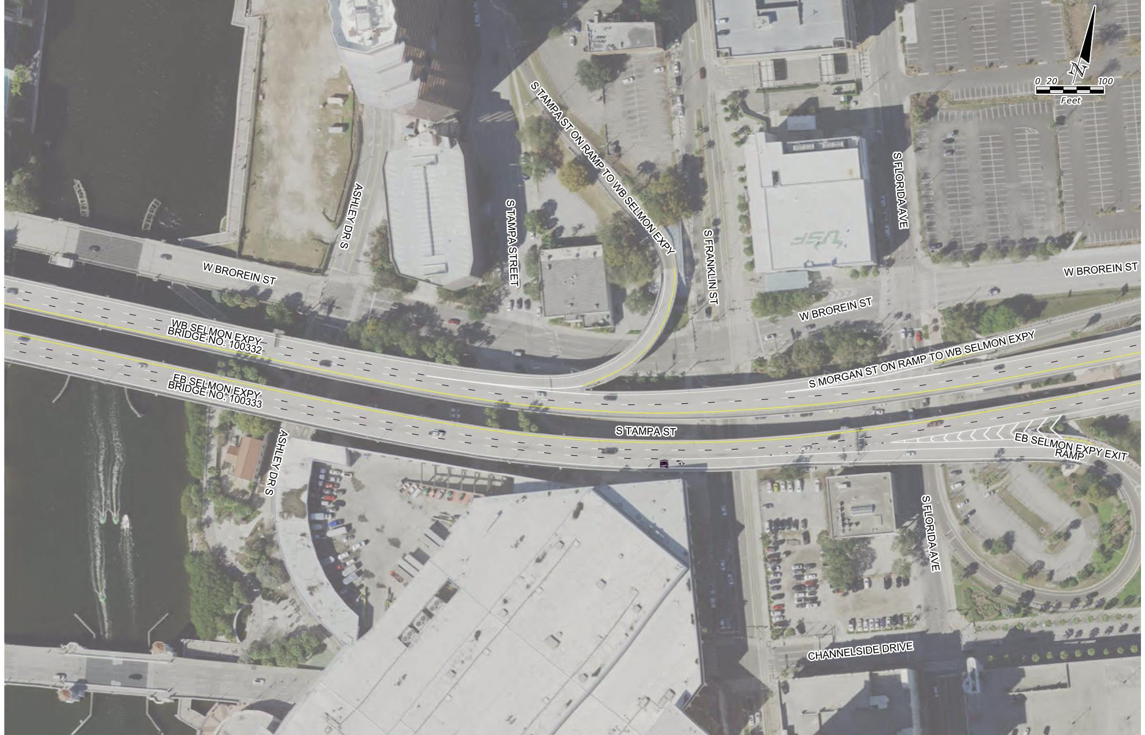
SELMON BRIDGE PAVEMENT STRIPING
Selmon Expressway Local Lanes
Tampa St. On Ramp
Morgan St. On Ramp
Bridge 100332/100333
Florida Ave. Off Ramp (2-lane)

Slide 11
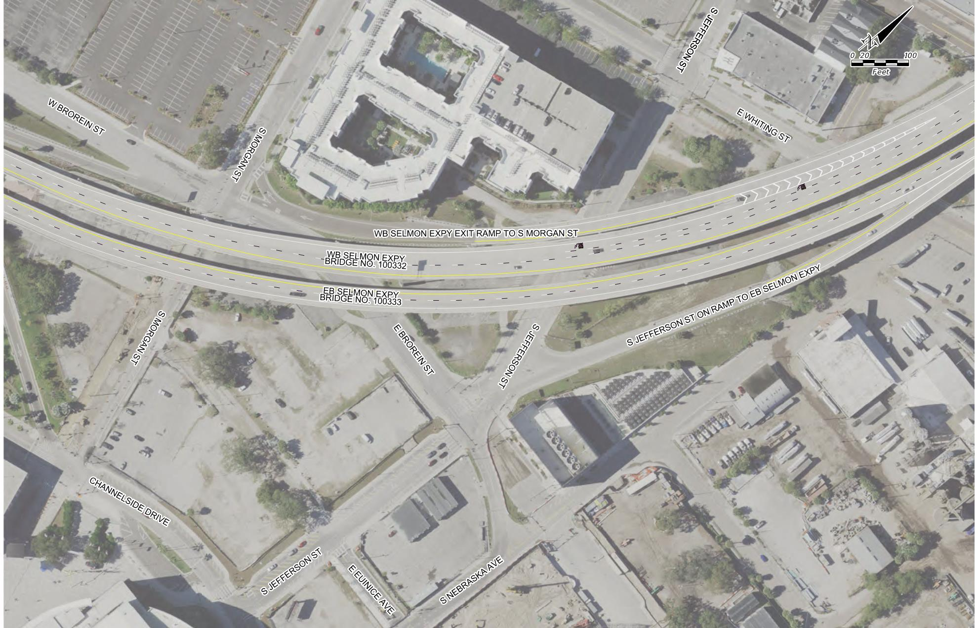
SELMON BRIDGE PAVEMENT STRIPING
Selmon Expressway Local Lanes
Morgan St. Off Ramp
Bridge 100332/100333
Jefferson St. On Ramp

Slide 12
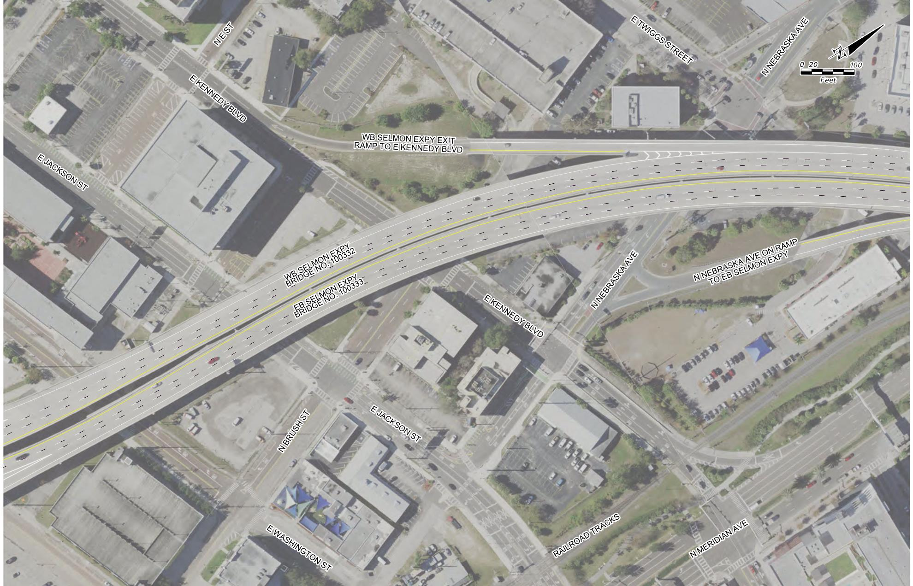
SELMON BRIDGE PAVEMENT STRIPING
Selmon Expressway Local Lanes
Kennedy Blvd. Off Ramp
Coordinate MOT with Kennedy Blvd. Ramp Resufacing Contractor
(TBD)
Nebraska Ave. On Ramp
Bridge 100332/100333

Slide 13
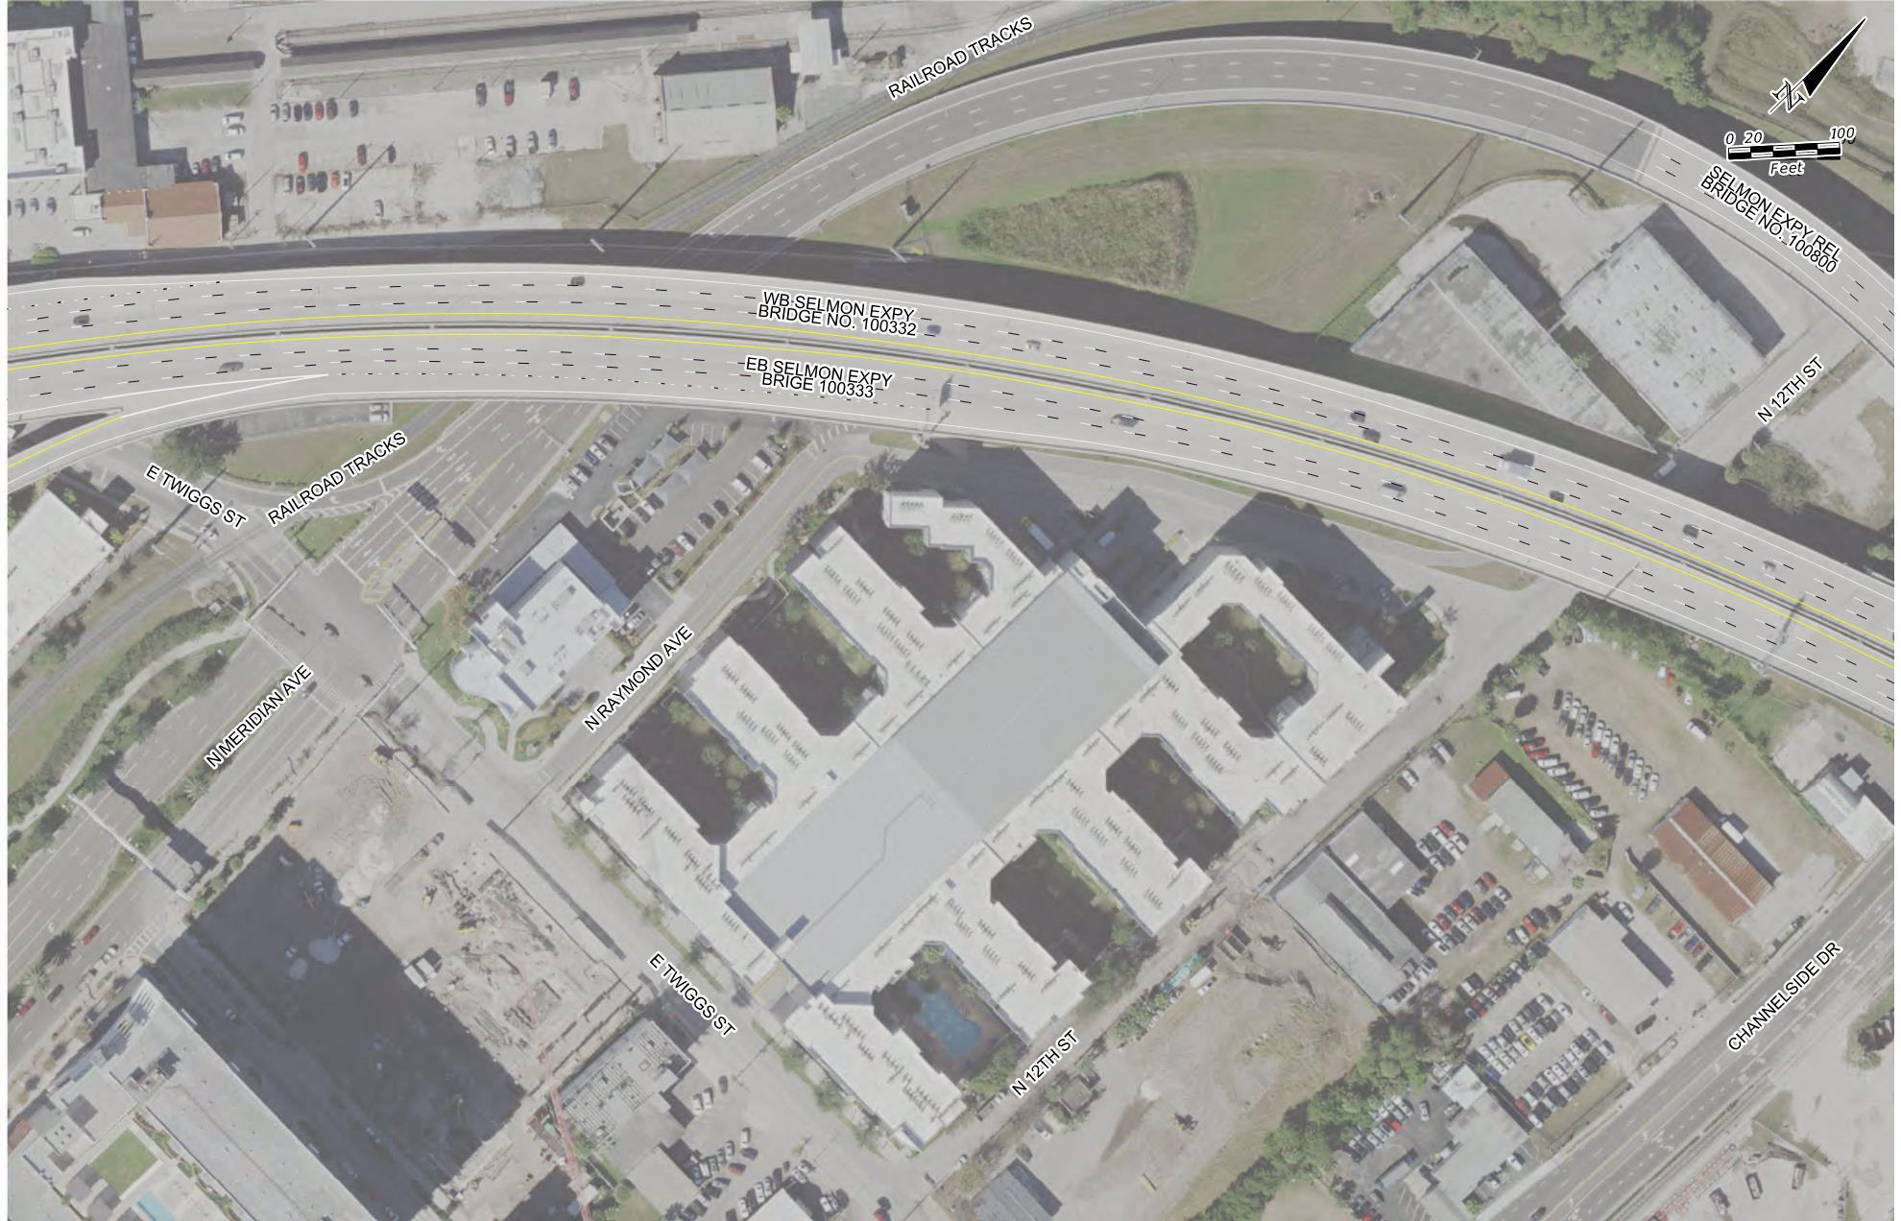
SELMON BRIDGE PAVEMENT STRIPING
Selmon Expressway Local Lanes/REL
REL Bridge 100800
Nebraska Ave. On Ramp
Bridge 100332/100333

Slide 14
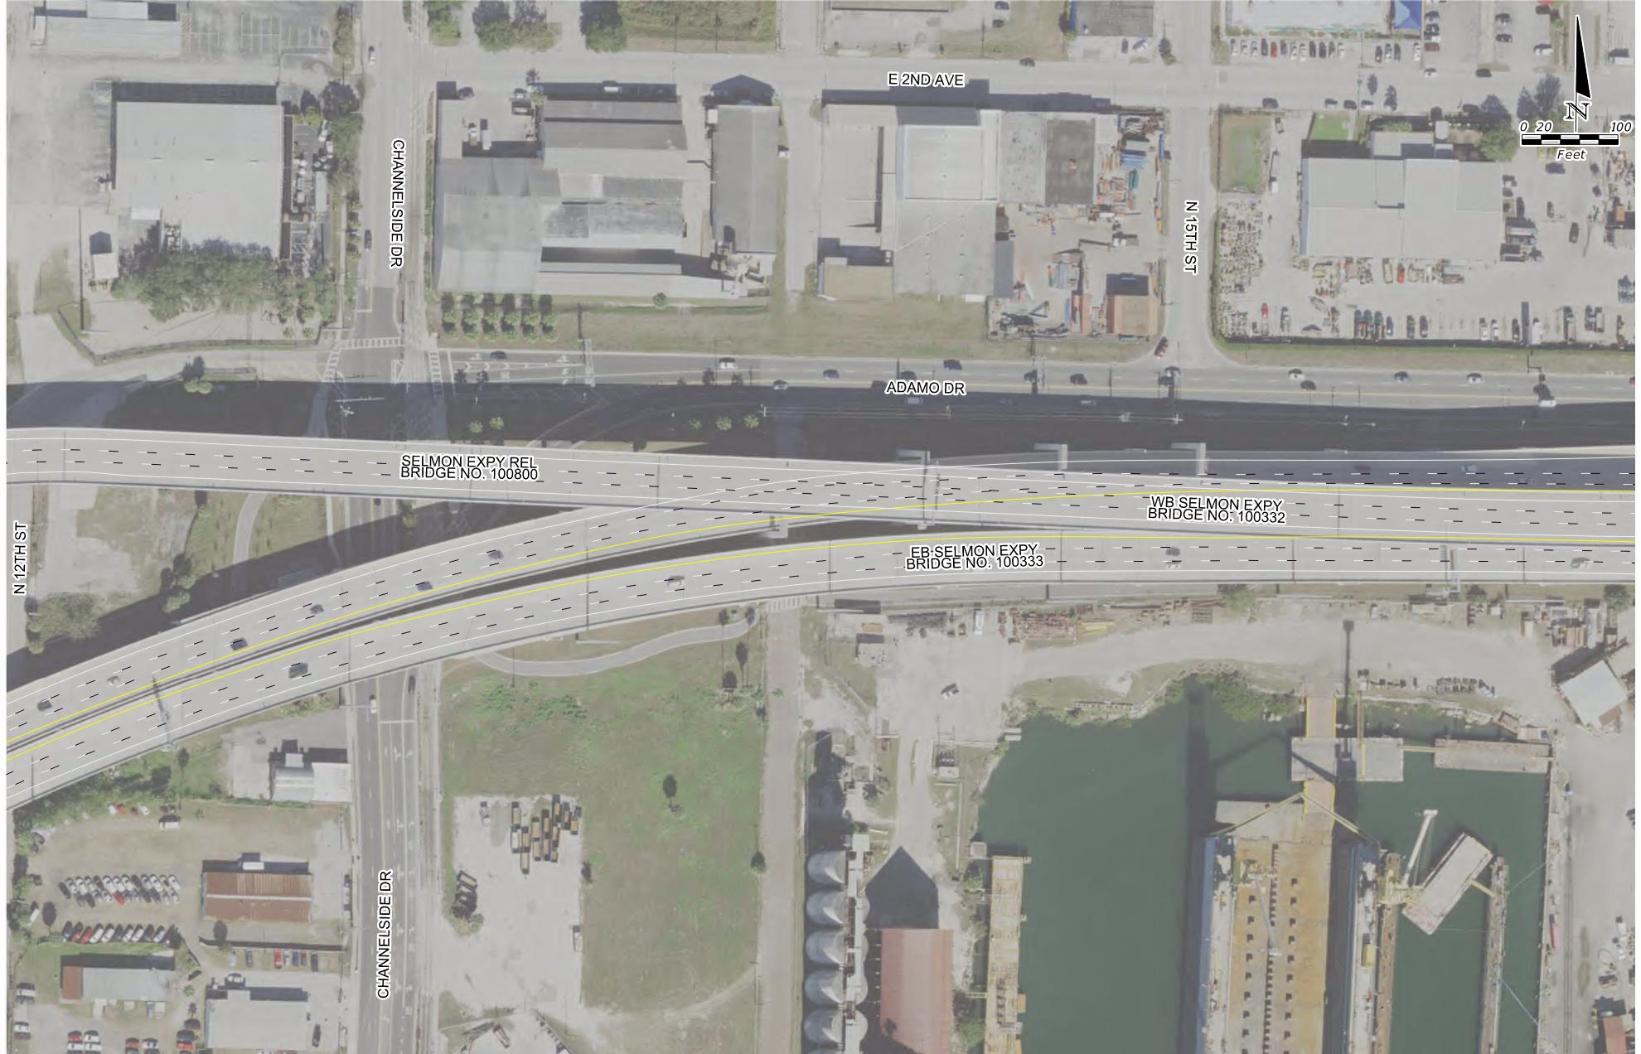
SELMON BRIDGE PAVEMENT STRIPING
Selmon Expressway Local Lanes/REL
REL Bridge 100800
Bridge 100332/100333
Below REL

Slide 15
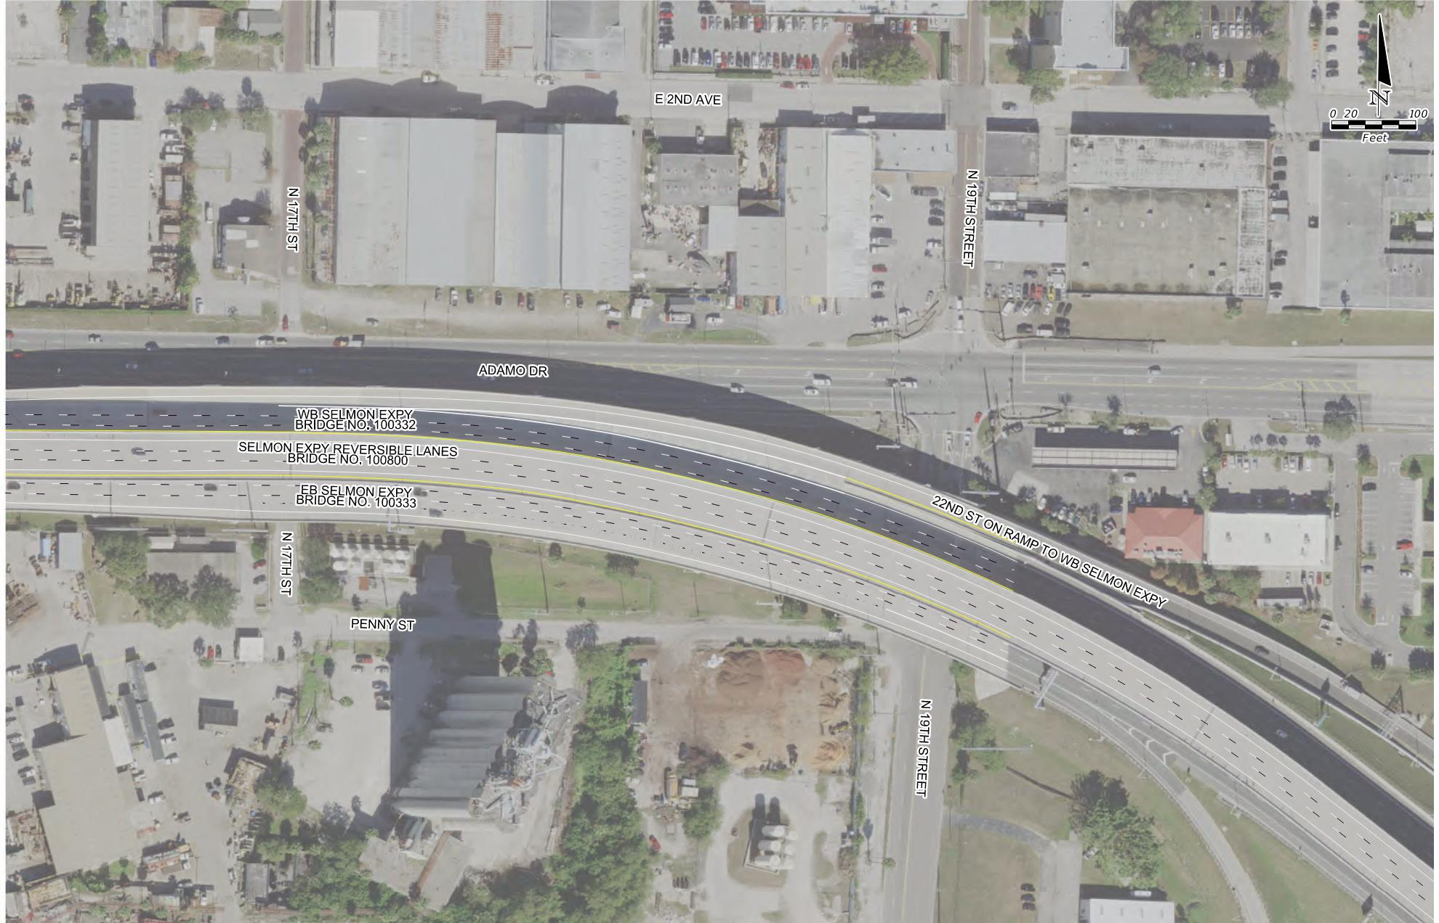
SELMON BRIDGE PAVEMENT STRIPING
Selmon Expressway Local Lanes/REL
REL Bridge 100800
22nd St. On Ramp
Bridge 100332/100333
Below REL
19th St. Off Ramp

Slide 16
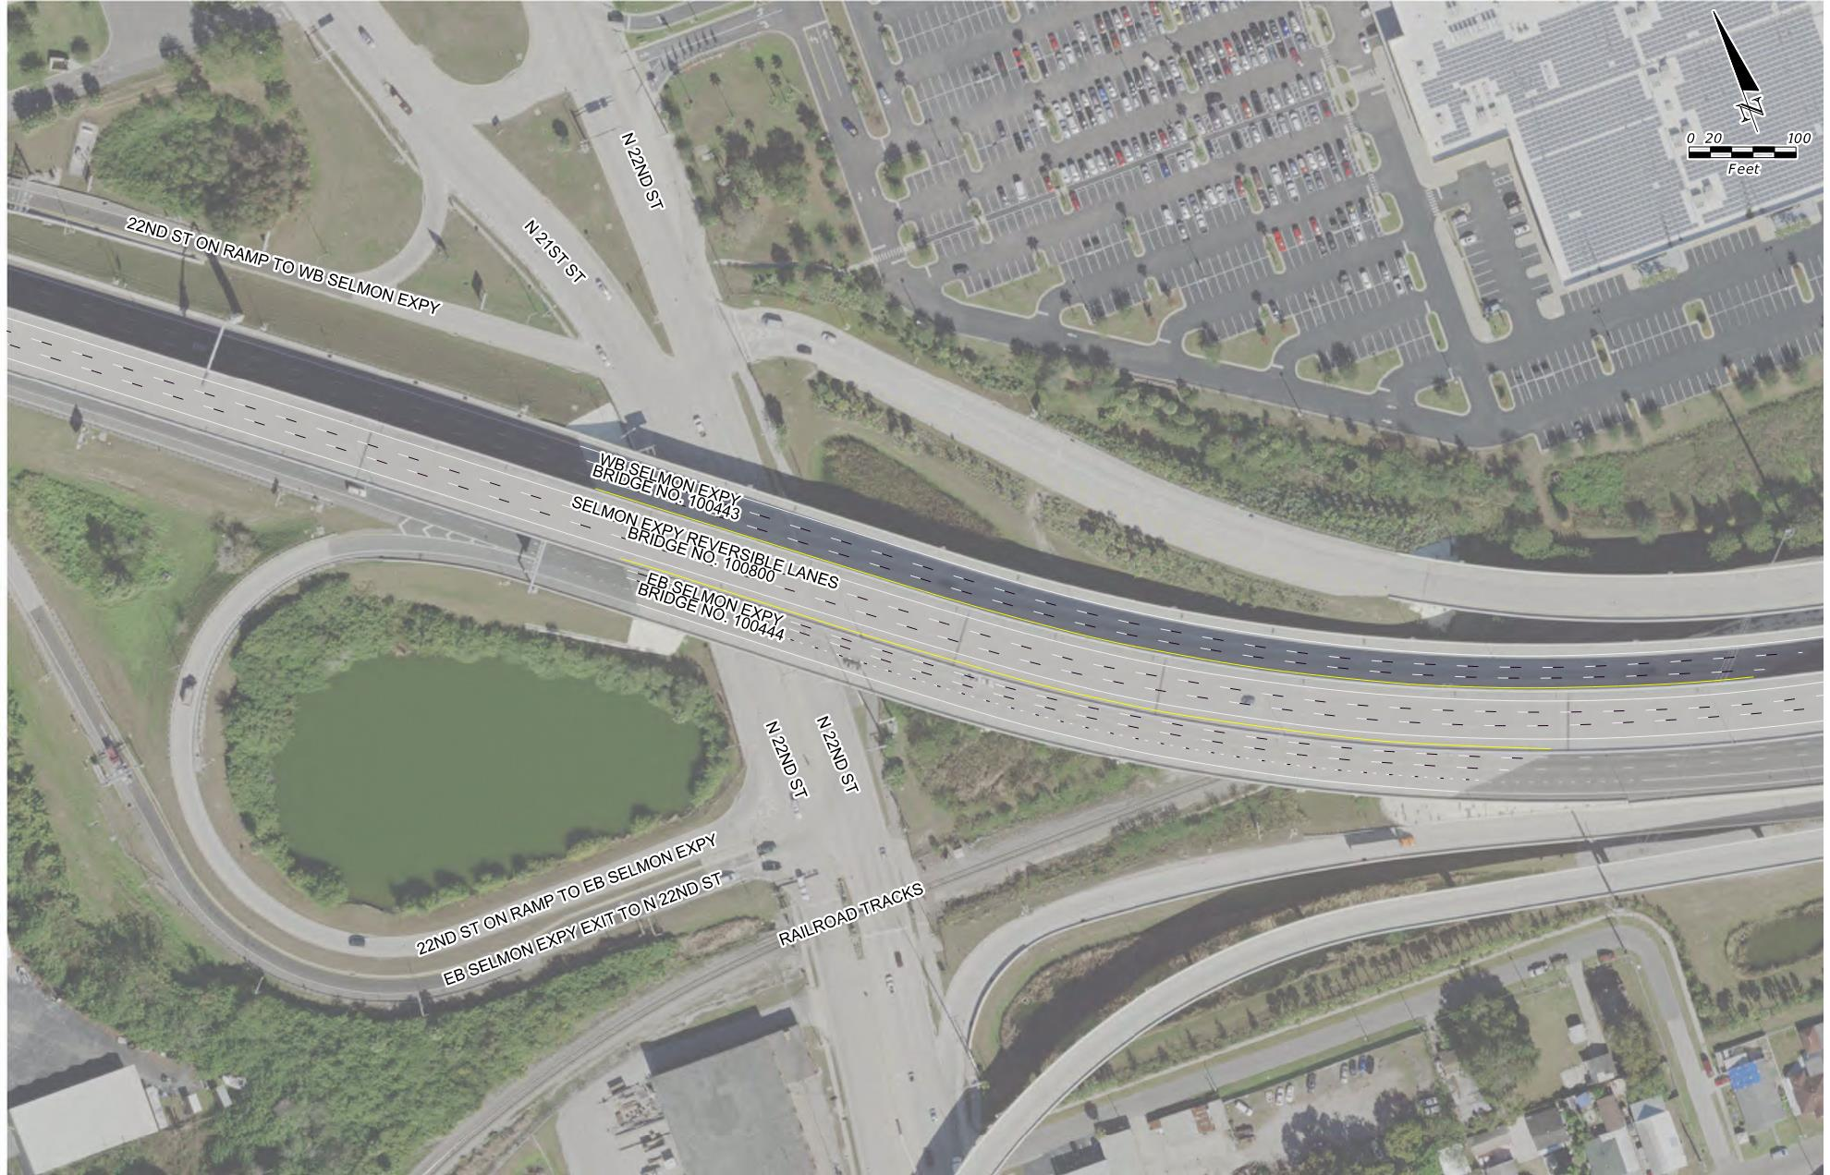
SELMON BRIDGE PAVEMENT STRIPING
Selmon Expressway Local Lanes/REL
REL Bridge 100800
22nd St. On Ramp
Bridge 100443/100444
Below REL

Slide 17
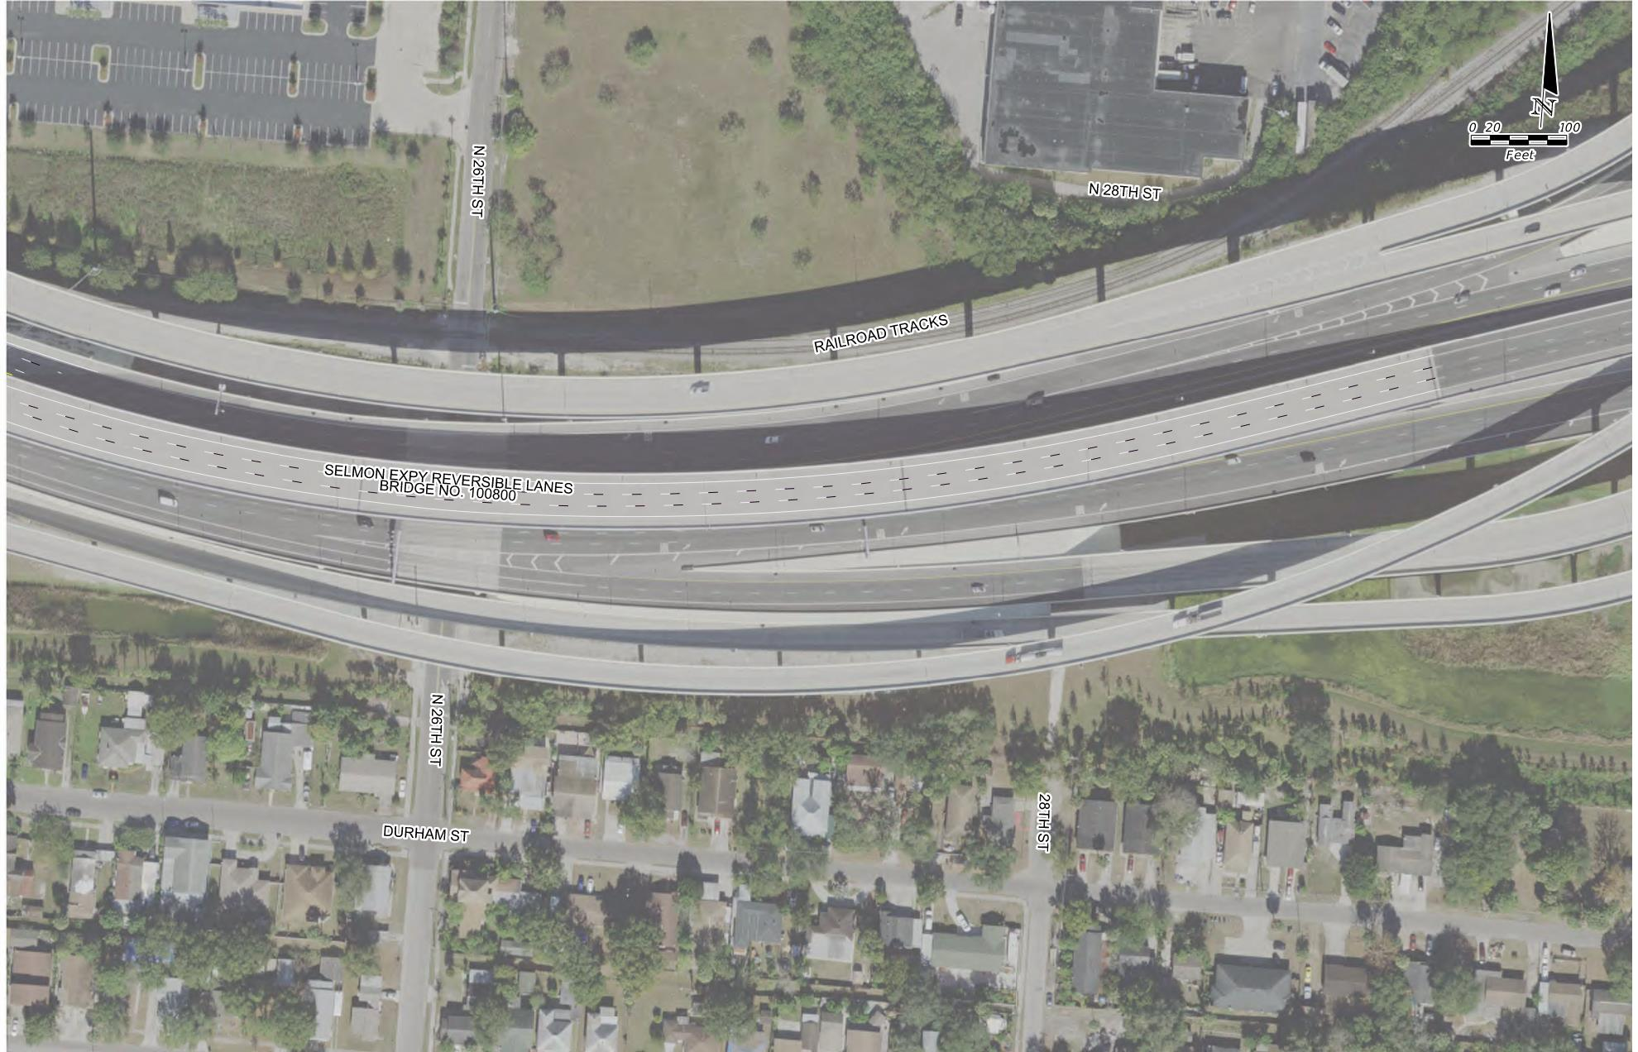
SELMON BRIDGE PAVEMENT STRIPING
Selmon Expressway REL
REL Bridge 100800

Slide 18
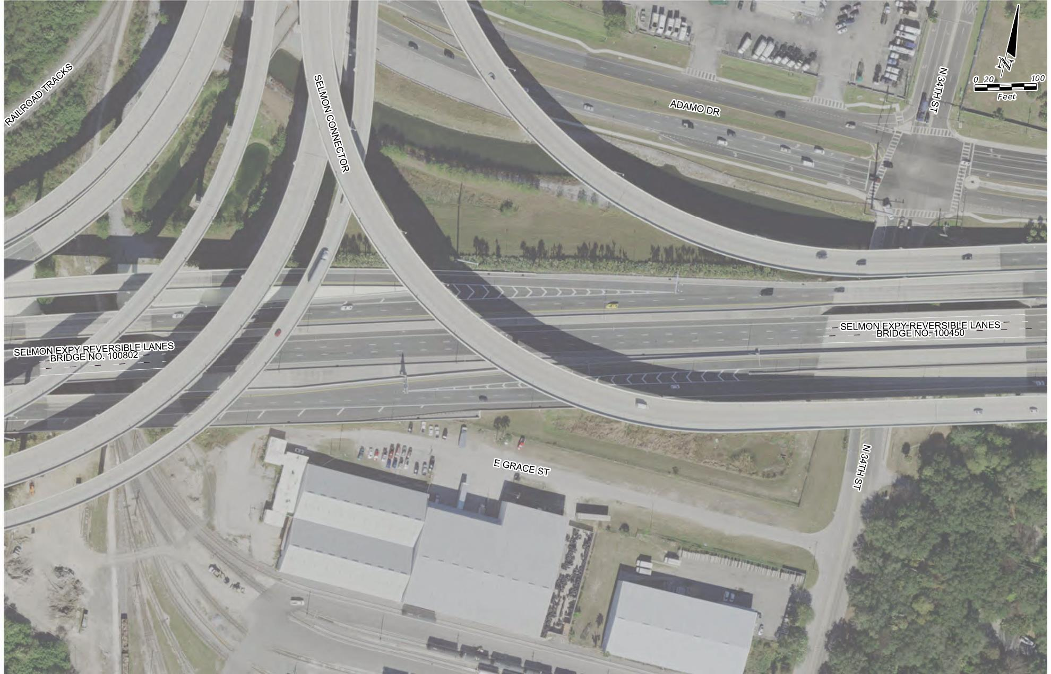
SELMON BRIDGE PAVEMENT STRIPING
Selmon Expressway REL
REL Bridge 100802
REL Bridge 100450
Coordinate MOT with E. Selmon Ramp DB Contractor (Middlesex)

Slide 19
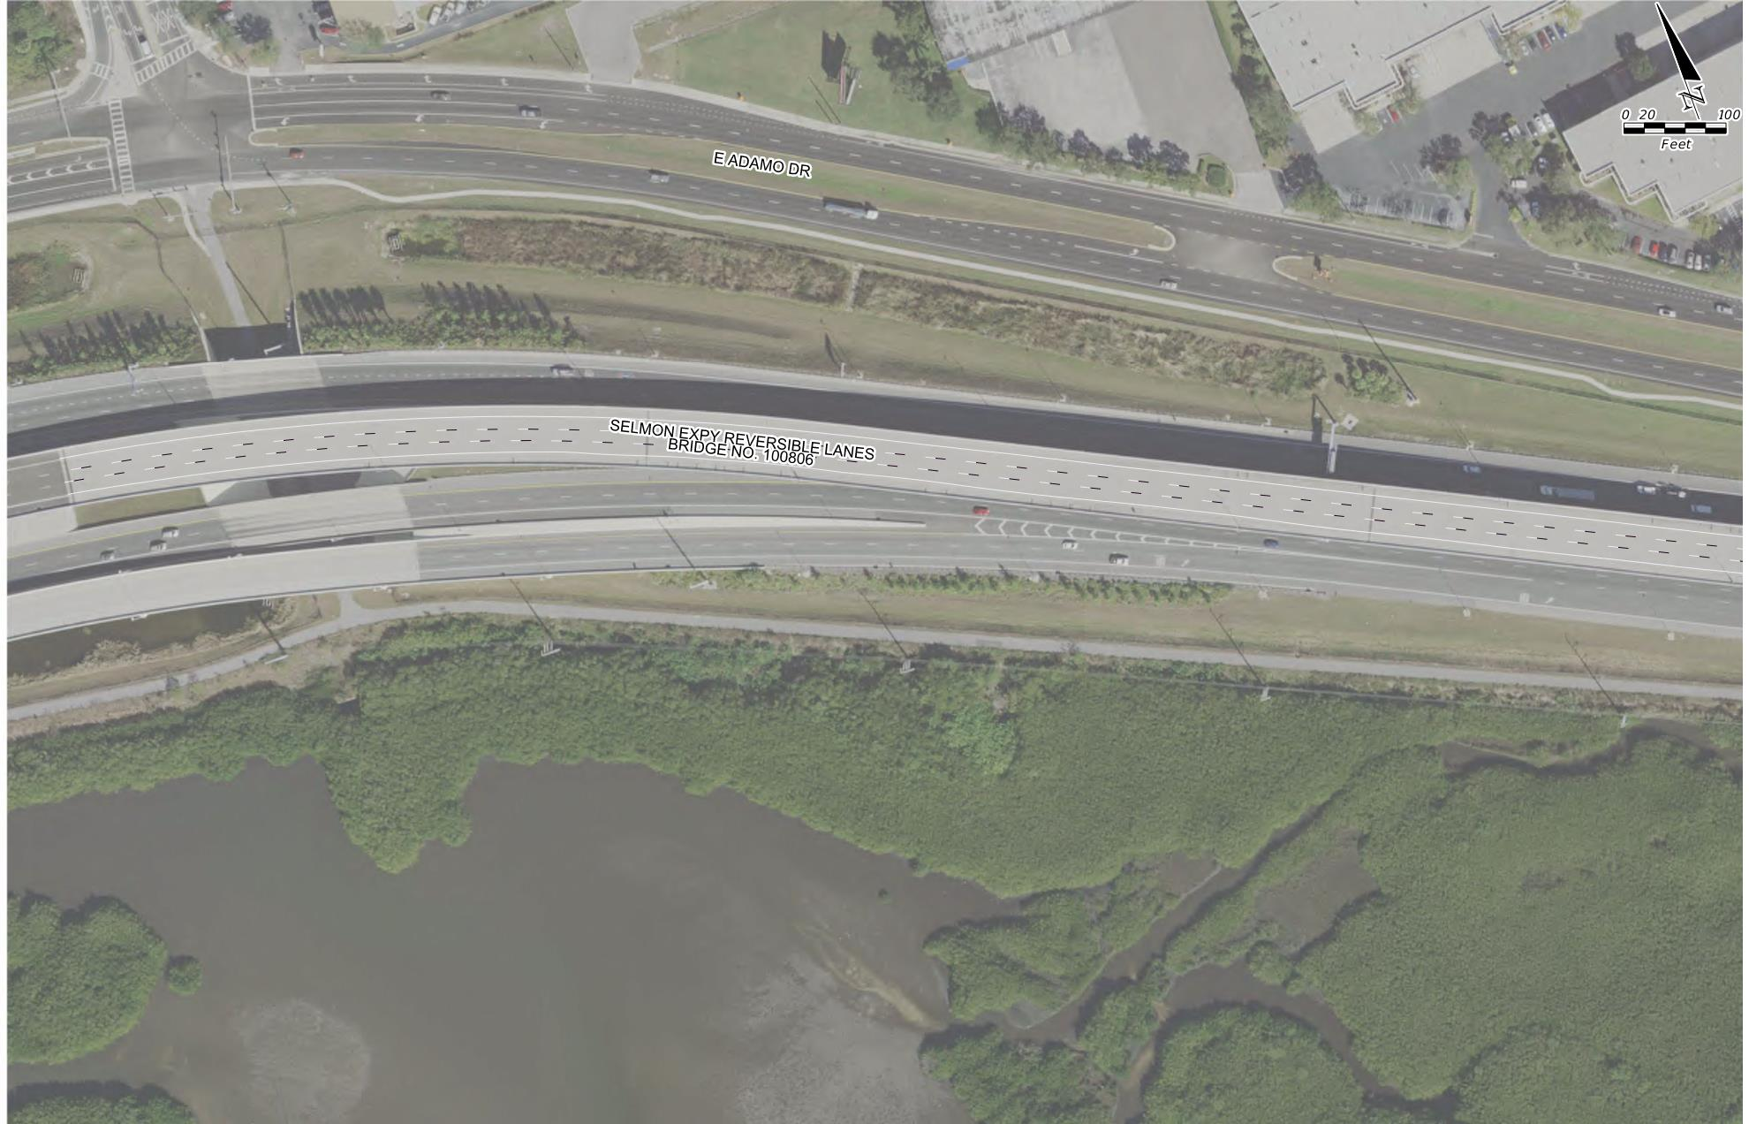
SELMON BRIDGE PAVEMENT STRIPING
Selmon Expressway REL
REL Bridge 100806

Slide 20
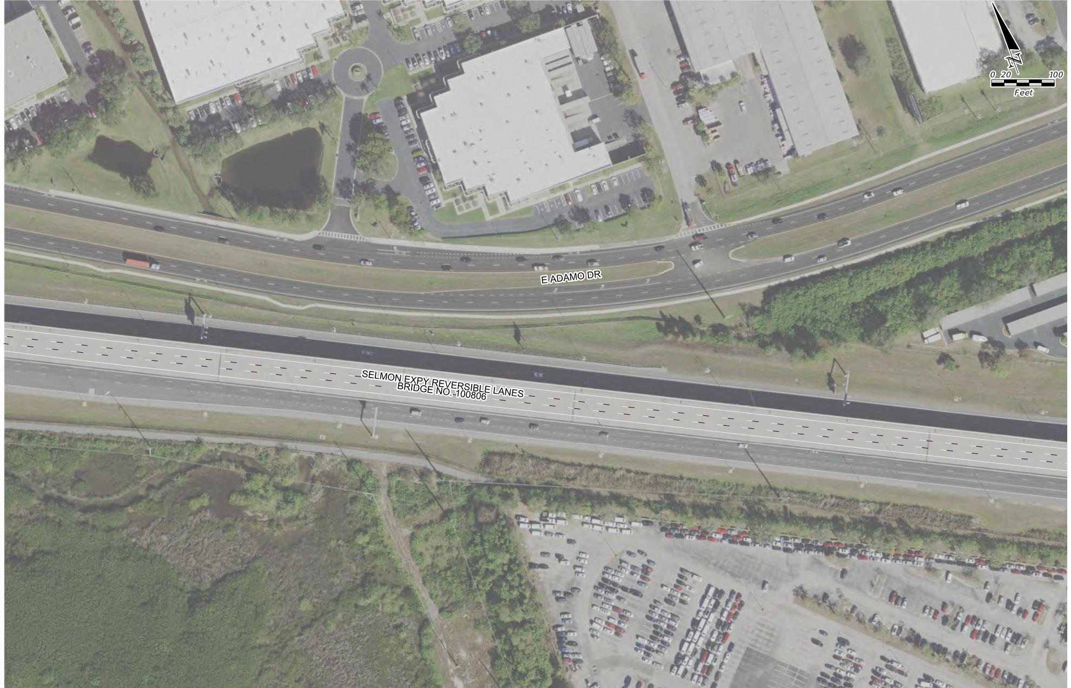
SELMON BRIDGE PAVEMENT STRIPING
Selmon Expressway REL
REL Bridge 100806

Slide 21
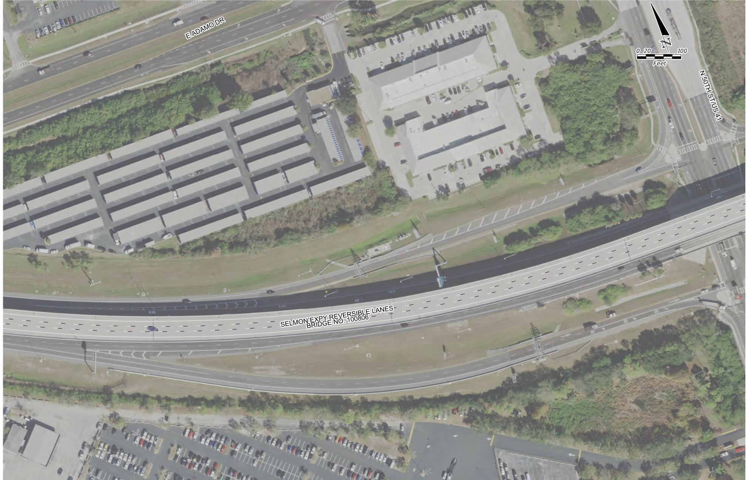
SELMON BRIDGE PAVEMENT STRIPING
Selmon Expressway REL
REL Bridge 100806

Slide 22
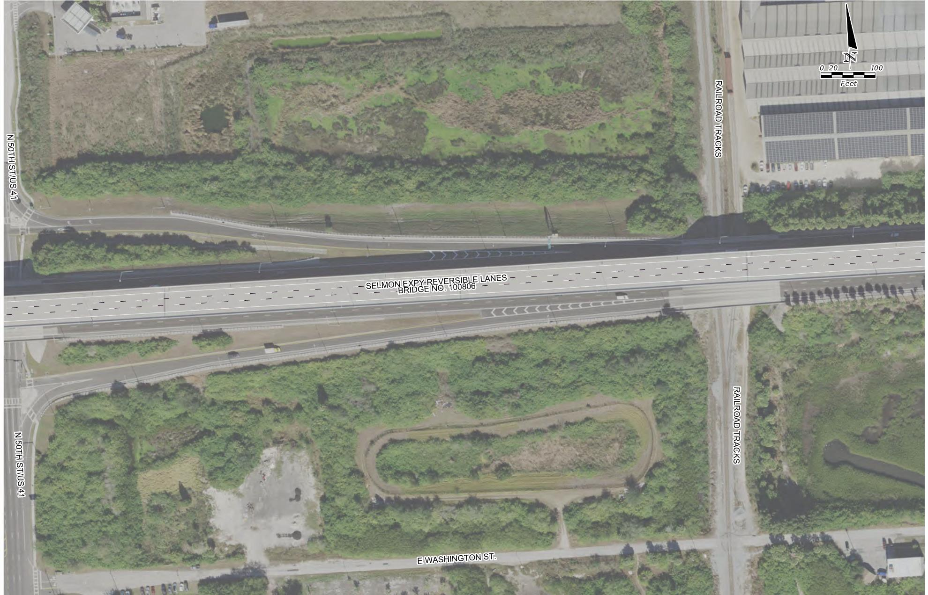
SELMON BRIDGE PAVEMENT STRIPING
Selmon Expressway REL
REL Bridge 100806

Slide 23
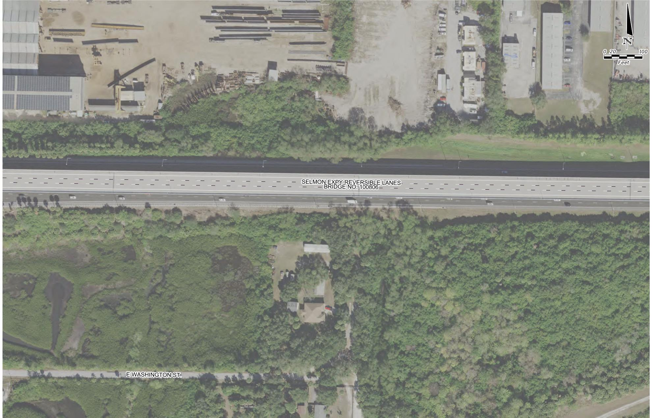
SELMON BRIDGE PAVEMENT STRIPING
Selmon Expressway REL
REL Bridge 100806

Slide 24
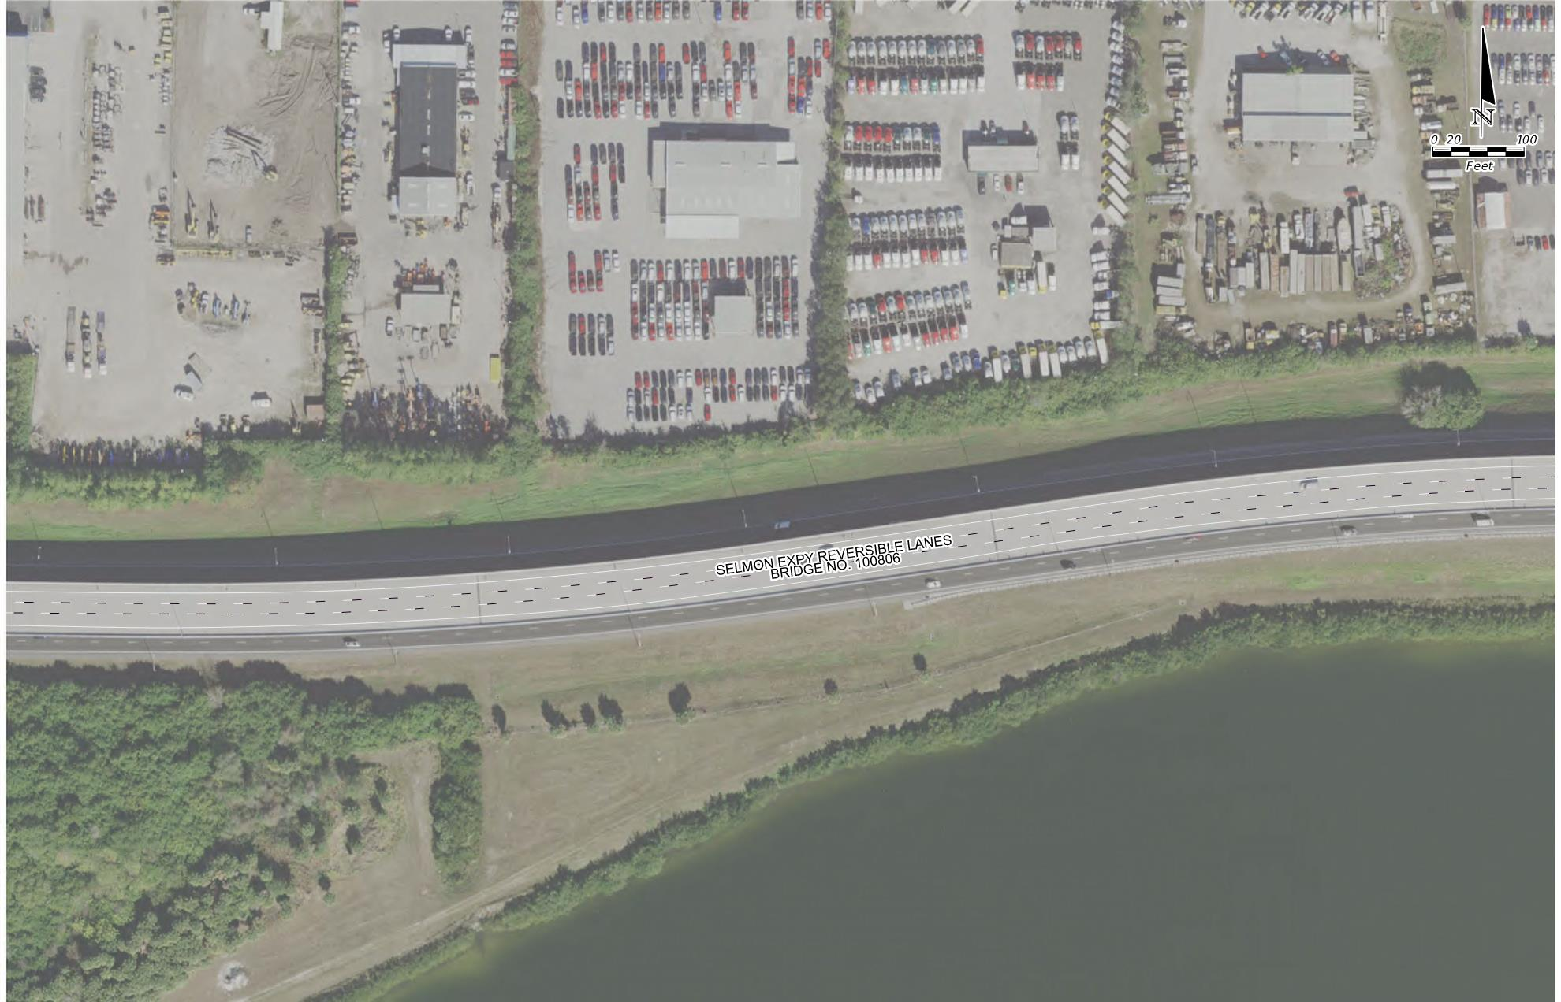
SELMON BRIDGE PAVEMENT STRIPING
Selmon Expressway REL
REL Bridge 100806

Slide 25
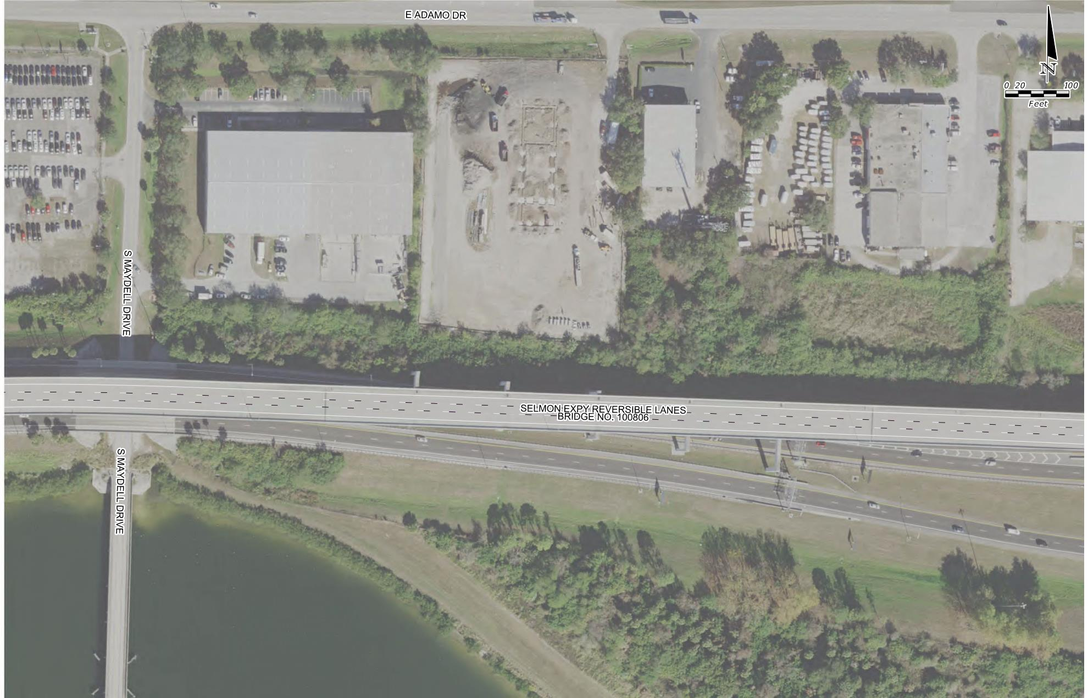
SELMON BRIDGE PAVEMENT STRIPING
Selmon Expressway REL
REL Bridge 100806

Slide 26
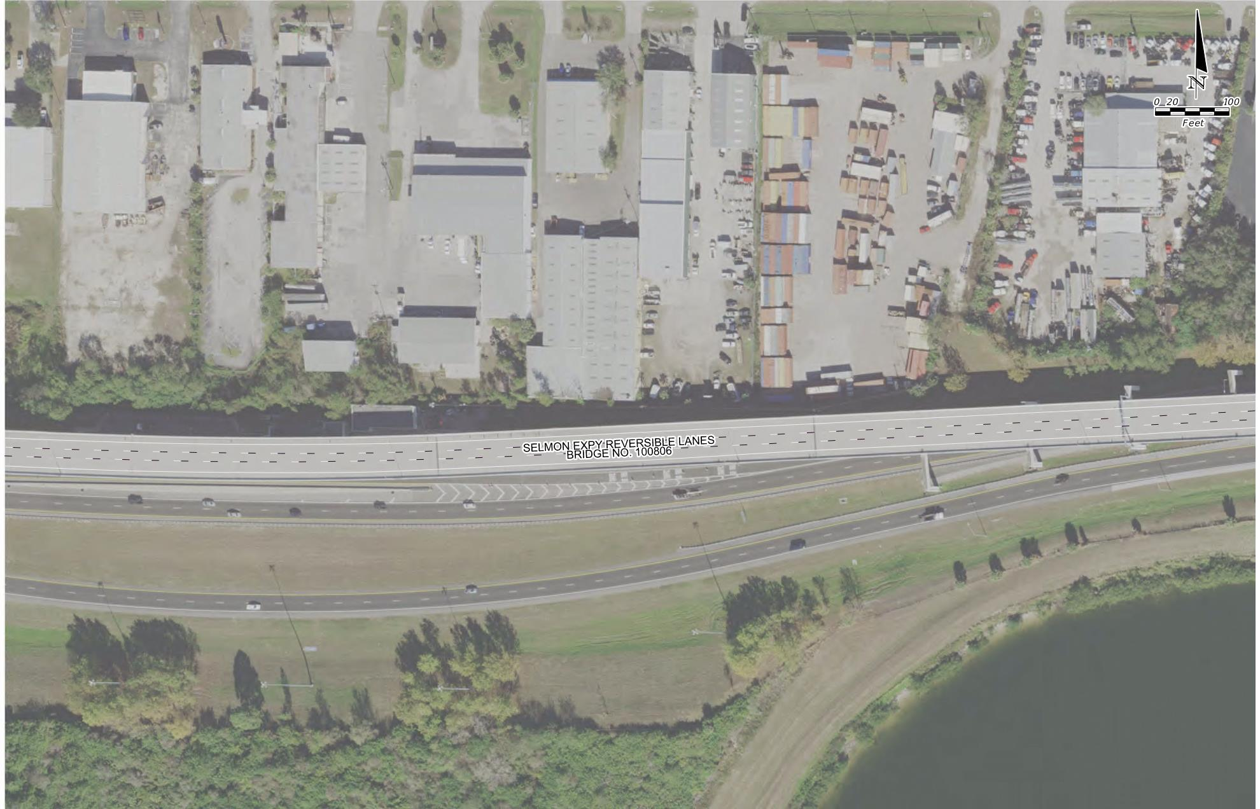
SELMON BRIDGE PAVEMENT STRIPING
Selmon Expressway REL
REL Bridge 100806

Slide 27
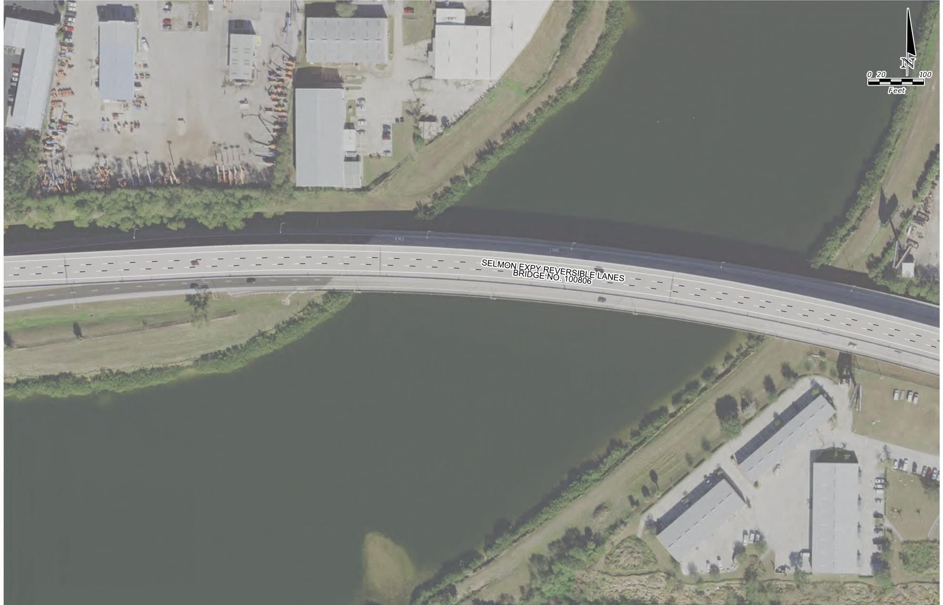
SELMON BRIDGE PAVEMENT STRIPING
Selmon Expressway REL
REL Bridge 100806

Slide 28
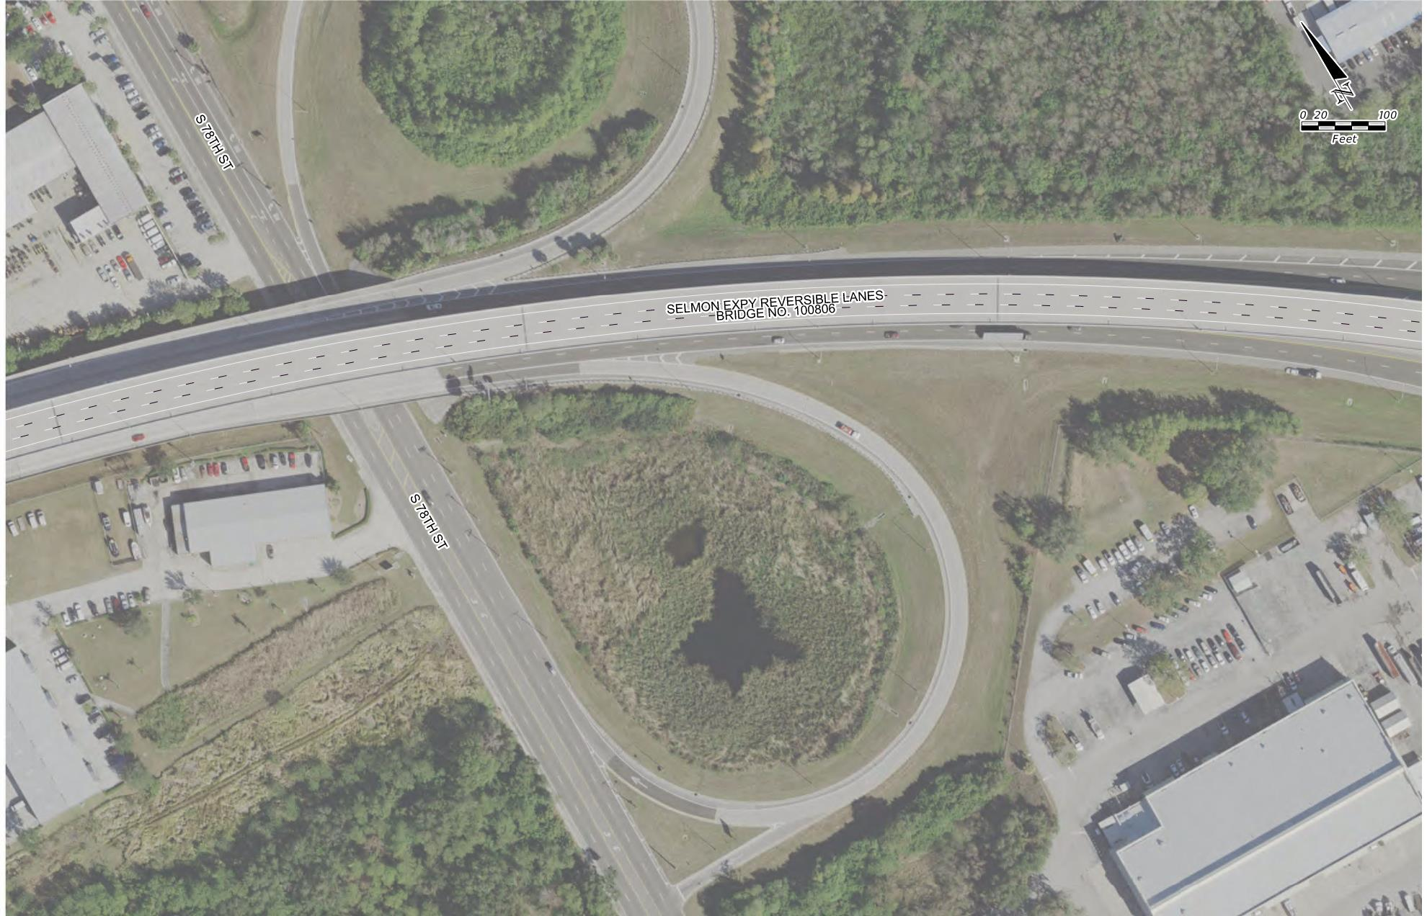
SELMON BRIDGE PAVEMENT STRIPING
Selmon Expressway REL
REL Bridge 100806

Slide 29
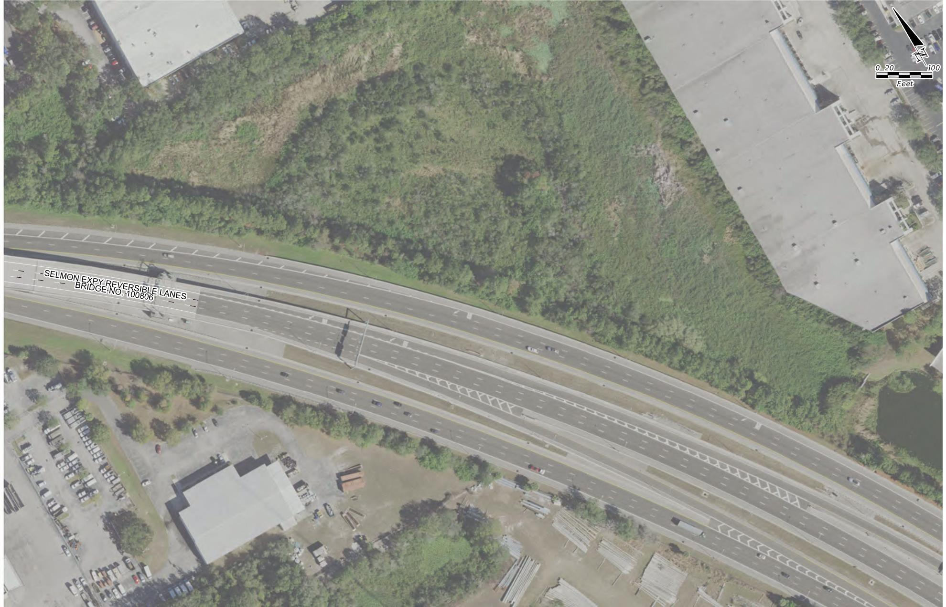
SELMON BRIDGE PAVEMENT STRIPING
Selmon Expressway REL
REL Bridge 100806

Slide 30
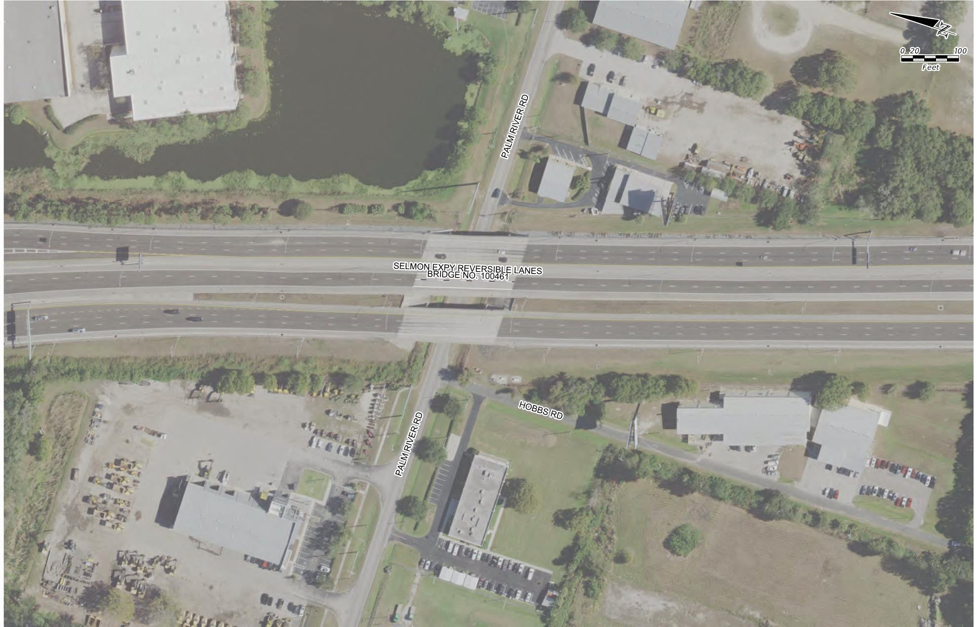
SELMON BRIDGE PAVEMENT STRIPING
Selmon Expressway REL
REL Bridge 100461

Slide 31
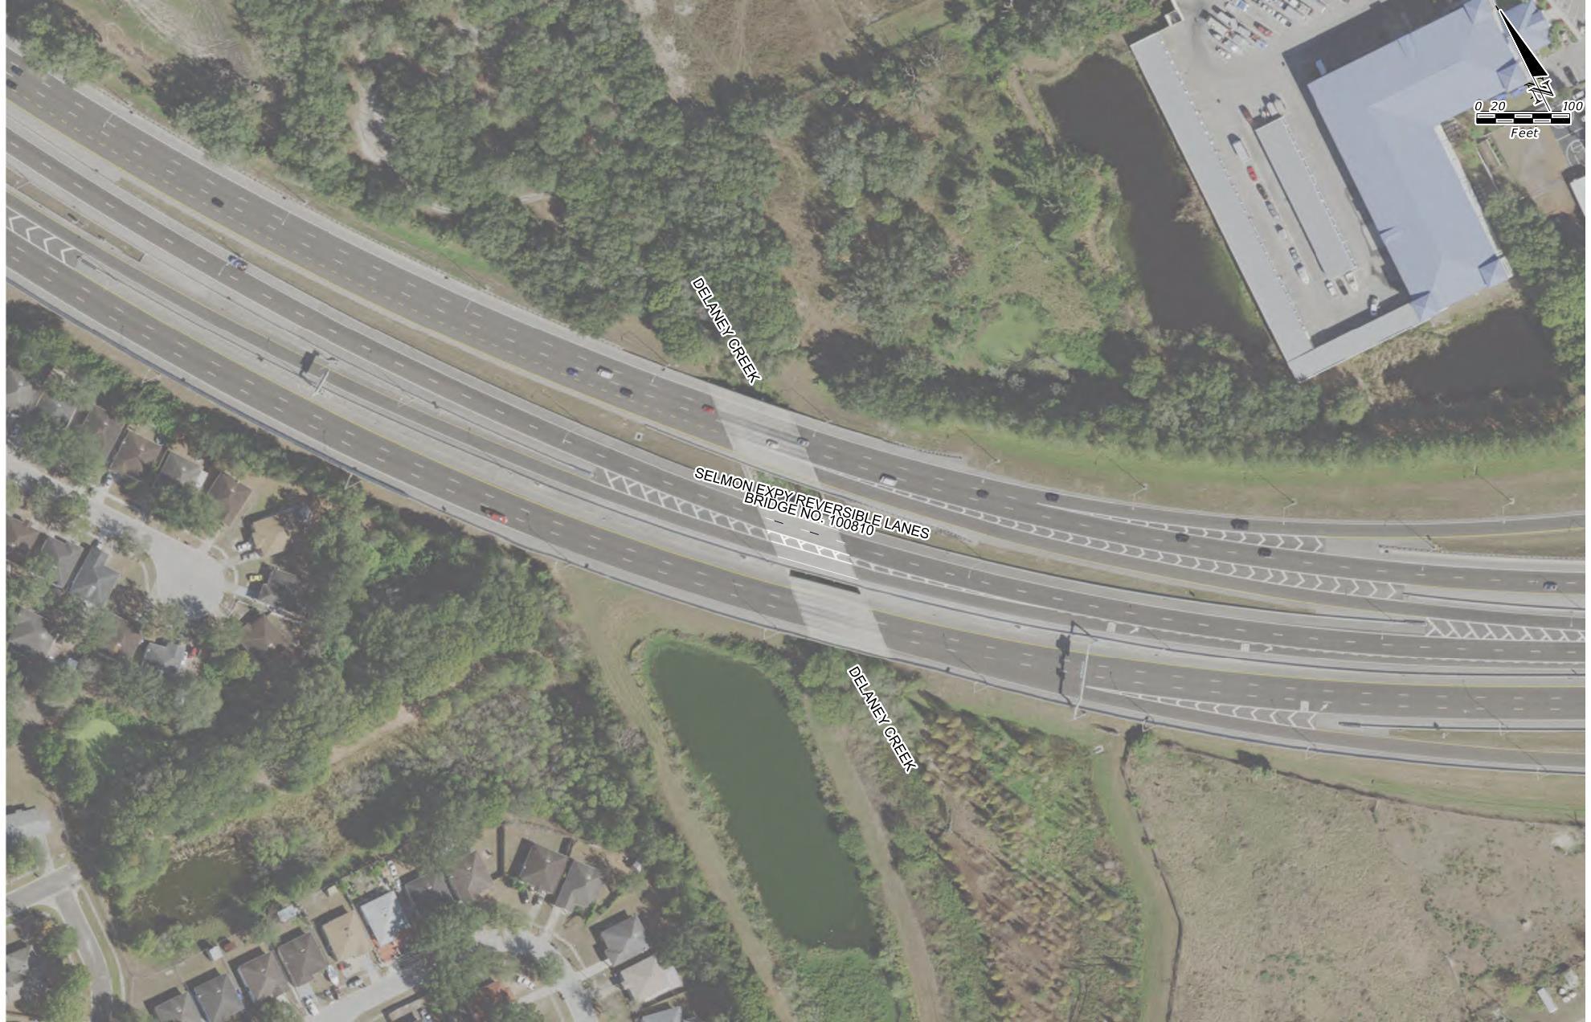
SELMON BRIDGE PAVEMENT STRIPING
Selmon Expressway REL
REL Bridge 100810
Match existing REL slip ramp pattern

Slide 32
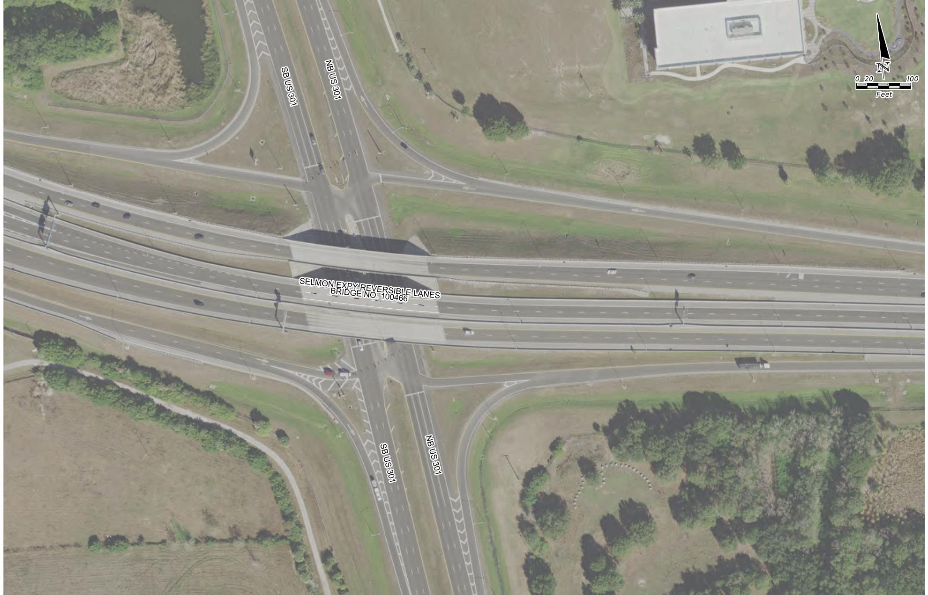
SELMON BRIDGE PAVEMENT STRIPING
Selmon Expressway REL
REL Bridge 100466

Slide 33
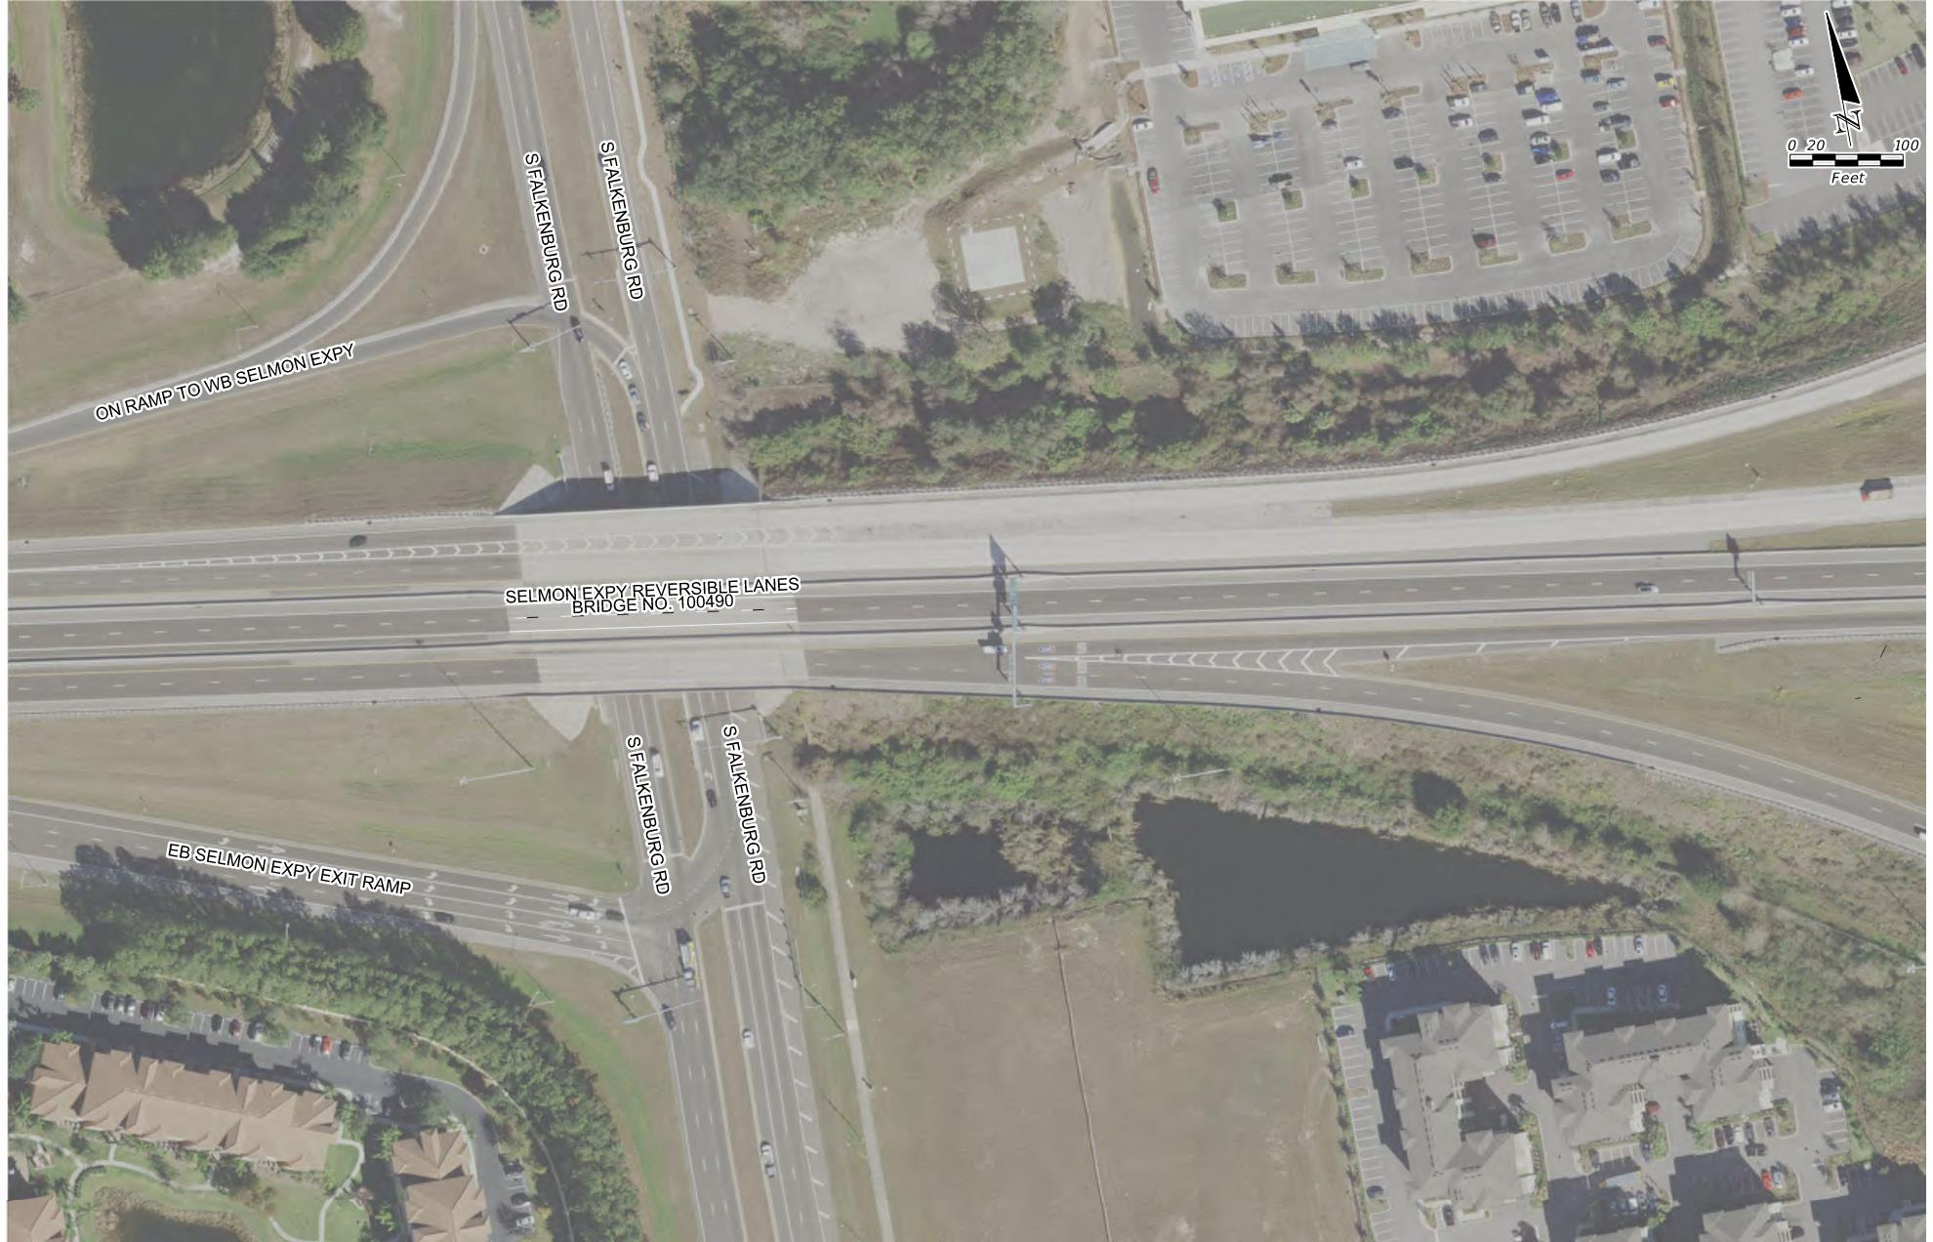
SELMON BRIDGE PAVEMENT STRIPING
Selmon Expressway REL
REL Bridge 100490
Coordinate MOT with E. Selmon Ramp DB Contractor (Middlesex)

Slide 34
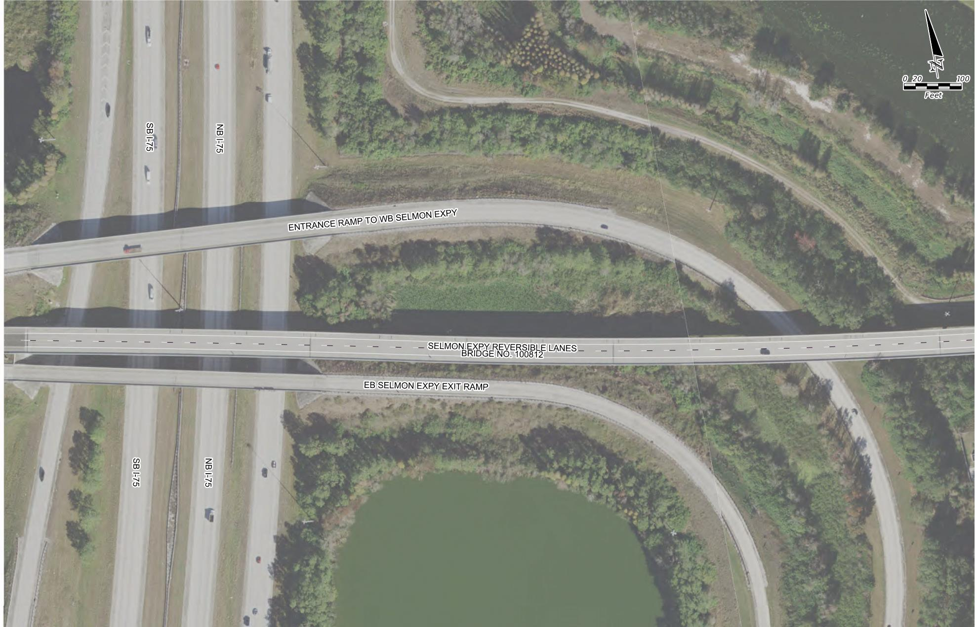
SELMON BRIDGE PAVEMENT STRIPING
Selmon Expressway REL
REL Bridge 100812

Slide 35
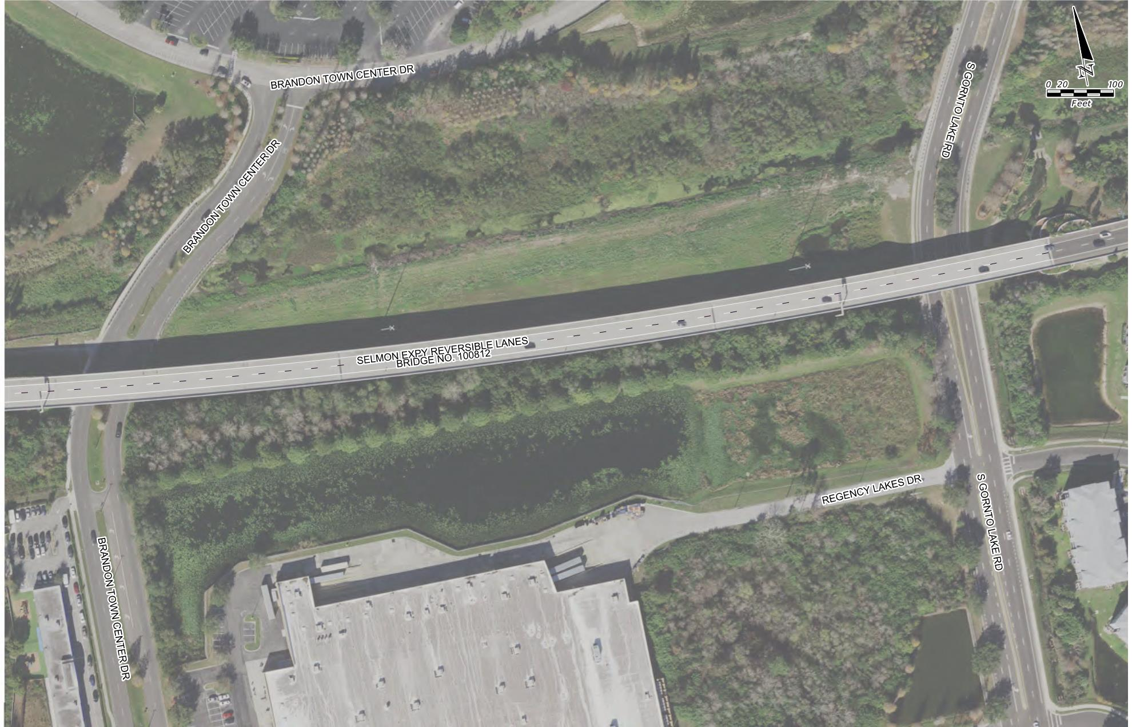
SELMON BRIDGE PAVEMENT STRIPING
Selmon Expressway REL
REL Bridge 100812

Slide 36
CEI/PUBLIC INVOLVEMENT
Consor - CEI Consultant
Sue Chrzan & THEA staff/consultants to perform Public Involvement efforts

Slide 37
Schedule
Deadline for Questions:
September 3, 2021
Deadline for Responses to Questions:
September 8, 2021

Slide 38
Schedule
Bid Package Due:
2:00pm September 16, 2021
September 27, 2021:
THEA Board Approval
NTP & Construction:
October 10, 2021 through February 2022

Slide 39
Project Documents
http://www.tampa-xway.com/procurement/#
Project is advertised, therefore, cone of silence is in effect for all THEA, HNTB, and Consor staff until the Board of Directors Selection.
All questions should be emailed to Man Le, THEA Contracts & Procurement Manager: man.le@tampa-xway.com
Answers will be posted on the THEA website

Slide 40

Questions?

