Slide 1
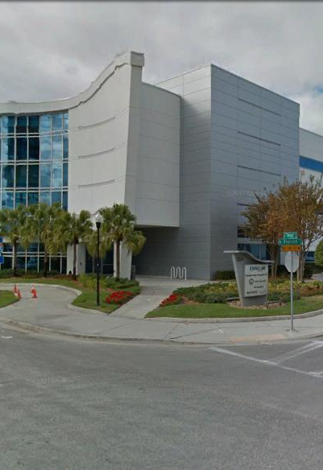
Tampa Hillsborough
Expressway
Authority
Pre-Bid Conference
8/25/2021
FY22 SELMON RAMPS & MISCELLANEOUS MAINLINE RESURFACINGS
O-01221
O-01321

Slide 2
Introductions
Man Le – THEA Contracts & Procurement Manager
Judith Villegas, EI – THEA Project Manager
Jim Drapp, PE – THEA GEC Program Manager
David Hubbard, PE – THEA GEC Project Manager
Terry Opdyke – THEA GEC
Brian McKishnie, PE – THEA Consultant CEI

Slide 3

SELMON EXPRESSWAY MISC. RESURFACINGS
AGENDA
Project Overview
CEI/Public Involvement
Schedule
Project Documents
Questions

Slide 4
SELMON EXPRESSWAY MISC. RESURFACINGS
OVERVIEW
Two construction projects
  O-01221 – Euclid Ave. EB On Ramp, Bay-to-Bay Blvd. EB On Ramp, 50th St. WB On Ramp & WB East Selmon Mainline at Two Locations
  O-01920 – Kennedy Blvd. WB Off Ramp, 78th St. Ramps, US 301 EB Off Ramp, Falkenburg Rd. WB On Ramp, EB East Selmon Mainline at Two Locations & EB & WB West Selmon Mainline Median Shoulders at Eight Locations

Slide 5
SELMON EXPRESSWAY MISC. RESURFACINGS
OVERVIEW
Select milling and resurfacings throughout the Selmon Expressway
  Replace all striping to meet current standards
  Provide MOT
  Utilize pavement designs specified in ITB (including High Polymer and FC-5 locations)
Lump Sum – Provide prices for 2 separate projects, awarded to Bidder with lowest combined total bid price for both projects
75 Calendar Days

Slide 6
SELMON EXPRESSWAY MISC. RESURFACINGS
OVERVIEW
MOT requirements
  MOT plans required for ramp closures
Maintenance of Traffic, (MOT), to be provided by the Contractor during all set-up and take-down activities and work activities. Maintenance of Traffic to be performed by “MOT certified” staff in accordance with the July 2021 edition of the Florida Department of Transportation (FDOT), Standard Specifications for Road and Bridge Construction, Section 102, Maintenance of Traffic and the July 2021 edition of the Florida Department of Transportation (FDOT) Standard Plans for Road and Bridge Construction.
Mainline and ramp lane closures are not permitted during the following hours:
5:00 AM to 9:00 AM
3:00 PM to 7:00 PM
Paving operations shall be performed at night.
Special event days as directed by THEA will apply.
No two consecutive ramps in the same direction shall be closed within the same work period.

Slide 7
SELMON EXPRESSWAY MISC. RESURFACINGS
OVERVIEW
Pavement
  May reduce mill depth to base to minimize rework
  On FC-5 sections, apply 8” overlap
  Feather milled surface to match sections
  Asphalt Pay Adjustments Apply (Special Provision 9-2)
  Rumble Strips
  Cores not available
9-2.2.2 Asphalt Pay Adjustments: Asphalt pay quantity adjustments apply to asphalt items listed in Sections 234, 334, 337 and 339.
For each item, the pay quantity will be based on the quantity placed on the project, limited to 105% of the adjusted quantity for the item. The adjusted quantity will be determined by dividing the sum of the quantities from the Invitation to Bid (including any Engineer approved quantity revisions) by the design Gmm stated in 334-1.4 (design Gsb stated in 337-8.2 for FC-5), and multiplying by the tonnage-weighted average Gmm (tonnage-weighted average Gsb for FC-5) of the mixes used.
For each item, additions in pay will be made if the actual quantity placed exceeds the adjusted quantity. Additions in pay will be calculated by subtracting the adjusted quantity placed from the actual quantity placed, multiplied by the Department’s 12-month statewide average unit price. The additional pay quantity shall not exceed 5% of the adjusted quantity. Additions in pay will be made only for additions exceeding $5,000.
For each item, reductions in pay will be made if the quantity placed is less than the adjusted quantity. Reduction in pay will be calculated by subtracting the adjusted quantity from the quantity placed, then multiplying by the Department’s 12-month statewide average unit price.

Slide 8
SELMON EXPRESSWAY MISC. RESURFACINGS
EUCLID AVE EB ON RAMP O-01221

Slide 9
SELMON EXPRESSWAY MISC. RESURFACINGS
BAY TO BAY BLVD EB ON RAMP O-01221

Slide 10
SELMON EXPRESSWAY MISC. RESURFACINGS
50TH ST WB ON RAMP O-01221

Slide 11
SELMON EXPRESSWAY MISC. RESURFACINGS
WB EAST SELMON MAINLINE E OF TOLL GANTRY O-01221

Slide 12
SELMON EXPRESSWAY MISC. RESURFACINGS
WB EAST SELMON MAINLINE NEAR PIER 97 O-01221

Slide 13
SELMON EXPRESSWAY MISC. RESURFACINGS
WB EAST SELMON MAINLINE NEAR PIER 97 O-01221

Slide 14
SELMON EXPRESSWAY MISC. RESURFACINGS
KENNEDY BLVD WB OFF RAMP O-01321
HIGH POLYMER

Slide 15
SELMON EXPRESSWAY MISC. RESURFACINGS
78TH ST RAMPS O-01321
HIGH POLYMER

Slide 16
SELMON EXPRESSWAY MISC. RESURFACINGS
78TH ST RAMPS O-01321

Slide 17
SELMON EXPRESSWAY MISC. RESURFACINGS
78TH ST RAMPS O-01321

Slide 18
SELMON EXPRESSWAY MISC. RESURFACINGS
US 301 EB OFF RAMP O-01321

Slide 19
SELMON EXPRESSWAY MISC. RESURFACINGS
FALKENBURG RD WB ON RAMP O-01321

Slide 20
SELMON EXPRESSWAY MISC. RESURFACINGS
FALKENBURG RD WB ON RAMP O-01321

Slide 21
SELMON EXPRESSWAY MISC. RESURFACINGS
EB EAST SELMON MAINLINE PIER 65 TO MAYDELL O-01321

Slide 22
SELMON EXPRESSWAY MISC. RESURFACINGS
EB EAST SELMON MAINLINE PIER 65 TO MAYDELL O-01321

Slide 23
SELMON EXPRESSWAY MISC. RESURFACINGS
EB EAST SELMON MAINLINE PIER 94 TO BYPASS CANAL O-01321

Slide 24
SELMON EXPRESSWAY MISC. RESURFACINGS
EB EAST SELMON MAINLINE PIER 94 TO BYPASS CANAL O-01321

Slide 25
SELMON EXPRESSWAY MISC. RESURFACINGS
EB EAST SELMON MAINLINE PIER 94 TO BYPASS CANAL O-01321

Slide 26
SELMON EXPRESSWAY MISC. RESURFACINGS
EB EAST SELMON MAINLINE PIER 94 TO BYPASS CANAL O-01321

Slide 27
SELMON EXPRESSWAY MISC. RESURFACINGS
WB & EB WEST SELMON MAINLINE MEDIAN SHOULDERS BETWEEN HIMES AVE & EUCLID AVE O-01321

Slide 28
SELMON EXPRESSWAY MISC. RESURFACINGS
WB & EB WEST SELMON MAINLINE MEDIAN SHOULDERS BETWEEN MISSISSIPPI AVE & S HOWARD AVE O-01321

Slide 29
SELMON EXPRESSWAY MISC. RESURFACINGS
WB & EB WEST SELMON MAINLINE MEDIAN SHOULDERS BETWEEN MORRISON AVE & SWANN AVE O-01321

Slide 30
SELMON EXPRESSWAY MISC. RESURFACINGS
WB & EB WEST SELMON MAINLINE MEDIAN SHOULDERS BETWEEN SWANN AVE & PLATT ST O-01321

Slide 31
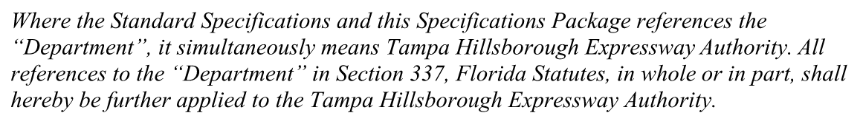
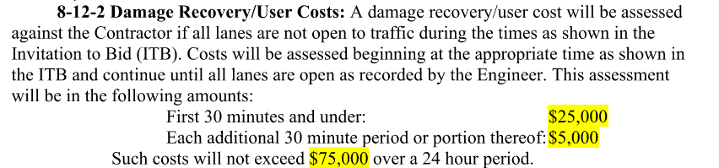
SELMON EXPRESSWAY MISC. RESURFACINGS
Use THEA-modified FDOT Specifications
Liquidated Damages/Damage Recovery
8-10.2 Amount of Liquidated Damages: Applicable liquidated damages are the sum
of the daily rate of $1,000 per Calendar Day assessed as projected lost toll revenues for failure to complete the Work within the Contract Time plus the amounts established in the following schedule:
Original Contract Amount Daily Charge Per Calendar Day
$50,000 and under ...................................................... $1,015 Over $50,000 but less than $250,000......................... $1,045
$250,000 but less than $500,000................................ $1,170
$500,000 but less than $2,500,000............................. $1,690
$2,500,000 but less than $5,000,000.......................... $2,579
$5,000,000 but less than $10,000,000........................ $3,756
$10,000,000 but less than $15,000,000...................... $4,344
$15,000,000 but less than $20,000,000...................... $5,574
$20,000,000 and over ............. $10,203 plus 0.00005 of any
amount over $20 million (Round to nearest whole dollar)

Slide 32
CEI/PUBLIC INVOLVEMENT
Consor- CEI Consultant
Sue Chrzan & THEA staff/consultants to perform Public Involvement efforts

Slide 33
Schedule
Deadline for Questions:
August 27, 2021
Deadline for Responses to Questions:
September 3, 2021

Slide 34
Schedule
Bid Package Due:
2:00pm September 13, 2021
September 27, 2021:
THEA Board Approval
NTP & Construction:
October 10, 2021 - December 24, 2021

Slide 35
Project Documents
http://www.tampa-xway.com/procurement/#
Project is advertised, therefore, cone of silence is in effect for all THEA, HNTB, and Consor staff until the Board of Directors Selection.
All questions should be emailed to Man Le, THEA Contracts & Procurement Manager: man.le@tampa-xway.com
Answers will be posted on the THEA website

Slide 36

Questions?

