Slide 1
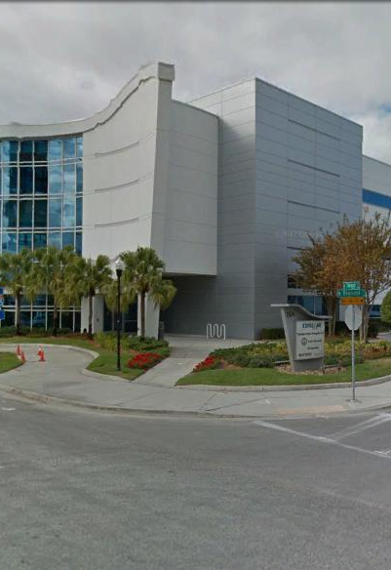
Tampa Hillsborough
Expressway
Authority
Pre-Proposal Conference
8/31/2021
ACCESS CONTROL SYSTEM (ACS) IN SUPPORT OF THE REVERSIBLE EXPRESS LANES (REL)
RFP O-01121

Slide 2
Introductions
Man Le – THEA Contracts & Procurement Manager
Brian Pickard, PE – THEA Director of Operations & Engineering
Shari Callahan – THEA IT Manager
Judith Villegas, EI – THEA Engineering Project Manager
Jim Drapp, PE – THEA GEC Program Manager
Terry Opdyke – THEA GEC

Slide 3

SELMON ACS IN SUPPORT OF THE REL
AGENDA
Today’s Meeting Schedule
Project Overview
Proposal Requirements
Evaluation Criteria
TRC Members
Schedule
Questions

Slide 4
SELMON ACS IN SUPPORT OF THE REL
AGENDA
9:00 a.m. 9:45 a.m. | Pre-Proposal meeting
10:00 a.m. 11:30 a.m. | There are two components to the project site visit: TMC Operations and Field Operations. There will be an escorted field site visit and tour of the REL roadway. Firms should document all questions during the project site visit and an opportunity for all Q&A will be available later in the schedule.
11:30 a.m. 12:30 p.m. | Lunch will be provided
12:30 p.m. 1:30 p.m. | There will be an observation of the change over from AM operations to PM operations at the TMC.
1:30 p.m. 2:00 p.m. | There will be an escorted tour of the server room.
2:00 p.m. 3:00 p.m. | Final Q&A in the conference room.

Slide 5
SELMON ACS IN SUPPORT OF THE REL
OVERVIEW
Project O-01121
  New Access Control System (ACS) in support of the Selmon Expressway Reversible Express Lanes (REL)
  Attachments in Scope detail Operational Overview

Slide 6
SELMON ACS IN SUPPORT OF THE REL
OVERVIEW
Project O-01121
  ACS involves:
    Coordination with City of Tampa staff
    Two (2) types of movable gate
    Electronic Dynamic Message Signs (DMS)
    Traffic Signals phasing and control
    Closed Circuit Television Camera (CCTV) manipulation
    Tolls Interface

Slide 7
SELMON ACS IN SUPPORT OF THE REL
OVERVIEW
Project O-01121
  ACS provides a very precise series of steps that must be used by the operators at THEA to open, close and reverse the Selmon Expressway Reversible Express Lanes (REL) system
  Software shall be written so that every operational step shall be completed in a precise order with a series of interlocks and conflict monitoring to ensure the safety of motorists is always maintained

Slide 8
SELMON ACS IN SUPPORT OF THE REL
OVERVIEW
Project O-01121
  The REL shall remain open and uninterrupted during development, final installation and every aspect of testing of the new ACS
  The Application Program Interface (API) shall be open architecture allowing economical, smooth and seamless addition of software features by the selected firm or third party and integration of new ITS Hardware should THEA decide to add at a later date

Slide 9
SELMON ACS IN SUPPORT OF THE REL
OVERVIEW
Project O-01121
  The ACS shall log system performance and errors
  The selected firm is required to construct and operate a hybrid system mock-up of the ACS at the THEA TMC
  CCTV system shall be interoperable with the City of Tampa and FDOT District 7 Sunguide systems for command control and viewing
  Project Schedule has been left to the proposing firms and will be part of the evaluation process

Slide 10
SELMON ACS IN SUPPORT OF THE REL
PROPOSAL REQUIREMENTS
Minimum 10 point font
Limited to 10 single sided 8 ½” x 11” pages exclusive of the following:
  Transmittal Letter
  Front and back cover and divider sections
  Key Staff Resumes
  References
Clearly indicate Legal Name, Federal Taxpayer Identification Number, Address and Telephone Number of the Proposer

Slide 11
SELMON ACS IN SUPPORT OF THE REL
PROPOSAL REQUIREMENTS
10 pages should include narrative of firm’s qualifications as listed in the Selection Criteria
  Qualifications & Experience of the firm
  Qualifications & Experience of the Key Personnel
  Project Management
  Approach to Providing Services
  Solutions to Providing Services Adheres to the Requirements
  SBE Utilizations
  Innovation

Slide 12
SELMON ACS IN SUPPORT OF THE REL
PROPOSAL REQUIREMENTS
Organizational Chart- Maximum of One (1) page folded neatly to 8 ½” x 11” if larger sized, does not count in ten (10) page limit
  Key Team Members specifically including
    Project Manager, Key Integrator, System Administrator/Engineer & Field Technician
  Key Sub-consultant Team Members
  Identify Firms that are SBE’s, including DBE/WMBE, etc.
  State Office Locations (City & State) of Key Team Members
  Only Team Members who will be actively participating should be included

Slide 13
SELMON ACS IN SUPPORT OF THE REL
PROPOSAL REQUIREMENTS
Resumes
  Maximum of one (1) page
  Key Active Participant Team Members
  Do not count in the ten (10) limit
Three (3) References
  Similar services for agencies other than THEA
    Short summary of ACS project such as timeframe, scope & budget
    Name and mailing address of the entity
    Name and telephone number of the contact person within the entity
  Do not count in the ten (10) limit

Slide 14
SELMON ACS IN SUPPORT OF THE REL
PROPOSAL REQUIREMENTS
Person signing the proposal on behalf of the proposer shall have the authority to bind the proposer to the submitted proposal
One (1) original, four (4) signed copies and one (1) electronic CD/USB copy of the submittal must be submitted to THEA’s Procurement Department in one package, clearly marked on the outside, “Request for Proposals No. O-01121 for Access Control System for the Tampa Hillsborough County Expressway Authority”, with opening time and date

Slide 15
SELMON ACS IN SUPPORT OF THE REL
EVALUATION CRITERIA
Innovation:
Evaluation of Consultant’s innovative ideas and approach for this project.

Slide 16
SELMON ACS IN SUPPORT OF THE REL
TECHNICAL REVIEW COMMITTEE (TRC) MEMBERS
Brian Pickard
Shari Callahan
Judith Villegas
Technical Advisors to support the TRC will be from other THEA staff, THEA GEC and other THEA consultants

Slide 17
Schedule
Deadline for Questions:
September 7, 2021
Deadline for Responses to Questions/Addendum:
September 9, 2021

Slide 18
Schedule
Proposal Package Due:
2:00pm September 29, 2021
October 4, 2021:
Presentations, Interview & Q&A Session at TMC
TRC Scoring Meeting: 2:00pm November 5, 2021 Board Approval:
November 15, 2021

Slide 19
Project Documents
http://www.tampa-xway.com/procurement/#
Project is advertised, therefore, cone of silence is in effect for all THEA Board of Directors, THEA staff, GEC HNTB and other THEA consultants until the Board of Directors Selection.
All questions should be emailed to Man Le, THEA Contracts & Procurement Manager: man.le@tampa-xway.com
Answers will be posted on the THEA website

Slide 20

Questions?

