Slide 1
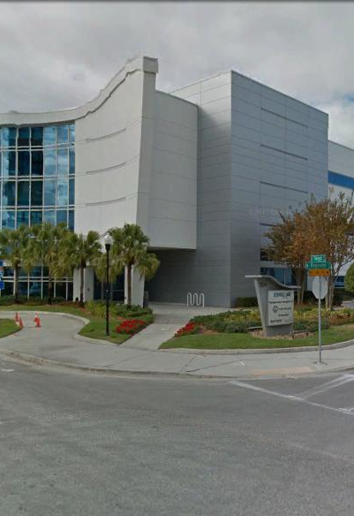
Tampa Hillsborough
Expressway
Authority
East Selmon Slip Ramps Design-Build
Pre-Proposal Meeting
1/29/2021 9:00 AM
Zoom Meeting

Slide 2
Introductions
Man Le – THEA Contracts & Procurement Manager
Judith Villegas, EI – THEA Project Manager
Sue Chrzan – THEA Director of Public Affairs and Communications
Brian Pickard, PE – THEA Director of Operations and Engineering
Jim Drapp, PE – THEA GEC Program Manager
David Hubbard, PE – THEA GEC
Terry Opdyke – THEA GEC
Brent Postma (Omni) – THEA GEC
Ed Ponce, PE – THEA GEC Project Manager
Al Stewart, PE - THEA GEC

Slide 3
Project Roles
Tampa Hillsborough Expressway Authority (THEA)- Owner
  Judith Villegas, EI- THEA Project Manager
HNTB- General Engineering Consultant (GEC) to THEA
Tierra- Geotechnical Consultant to GEC & THEA
Element- Survey Consultant to GEC & THEA
Omni- Utilities Coordinator to GEC & THEA

Slide 4

Agenda
Project Overview & Objectives
Upcoming Addendum Items
Innovative Aspects & ATC’s
Written Technical Proposal/Schedule
Q & A Session
Evaluation Criteria
Procurement Schedule
SBE
DB Stipend
TRC Members & Technical Advisors
Project Documents
Questions

Slide 5
Project Overview & Objectives
Project Limits
  Excerpt from Phase 1 Improvements proposed to the East Selmon Expressway and ongoing PD&E study (result of Feasibility Study)
    Ramp 2 – From I-4 Connector to east of 34th Street
    Ramp 3 – From east of US 301 to I-75
Project Goals
TTCP/Work Hours
Project Information

Slide 6
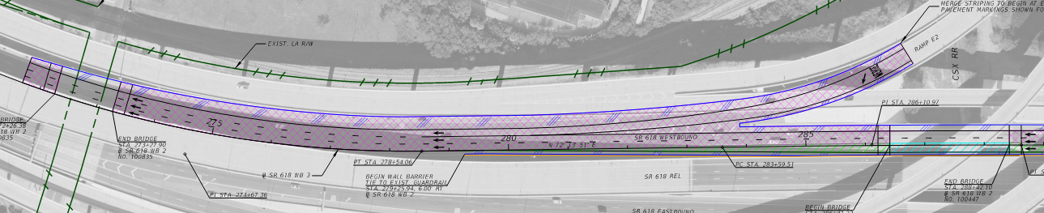
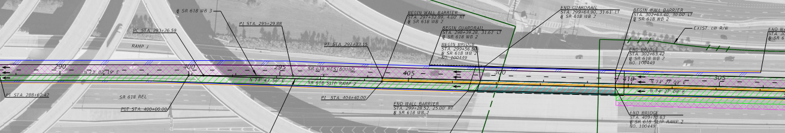
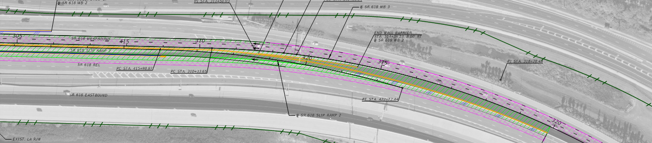
Project Limits – Ramp 2
Begin Merge at THEA Maintenance Limit
Bridge Widening over RR
Bridge Widening over 34th Street
New slip ramp entrance
Selmon realignment and retaining wall to support slip ramp
New slip ramp exit

Slide 7
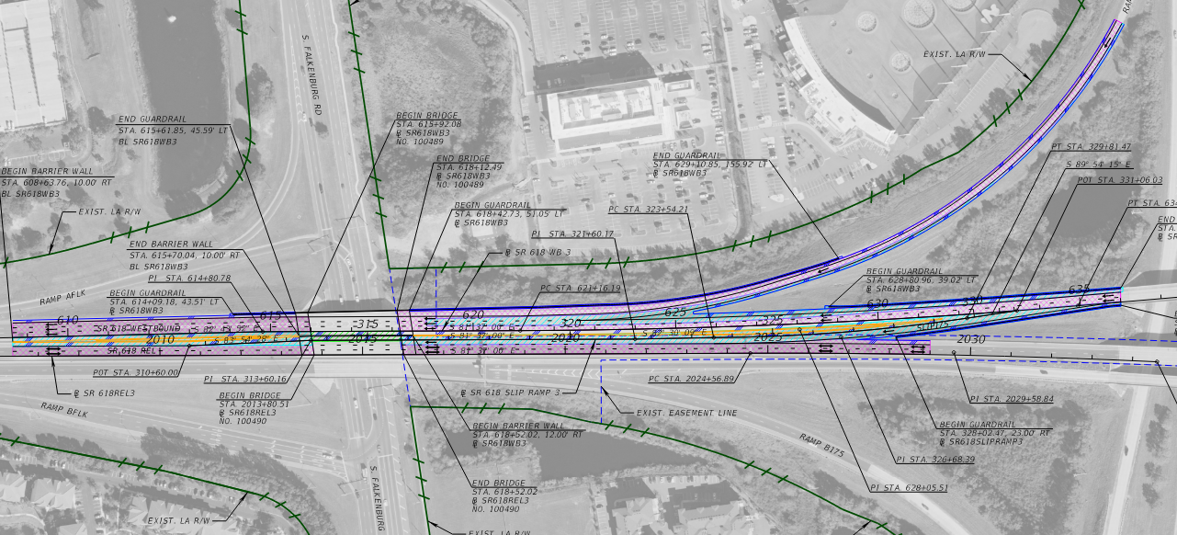
Project Limits – Ramp 3
Realignment/widening PCC pavement to facilitate slip ramp construction
Bridge widening over Falkenburg Rd
New gated slip ramp

Slide 8
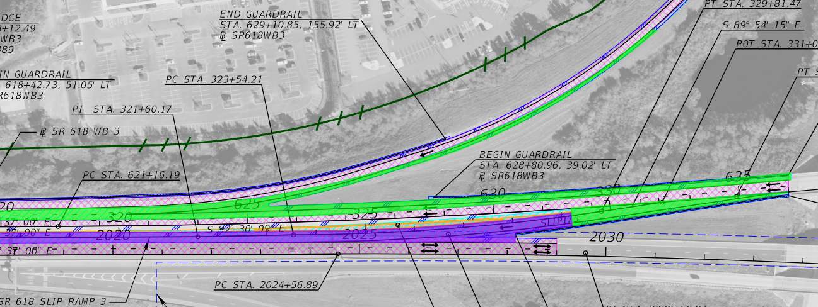
Pavement Limts – Ramp 3
PCC Pavement Widening
PCC Pavement Widening
Physical Gore
Standard Asphalt Widening
Standard Asphalt

Slide 9
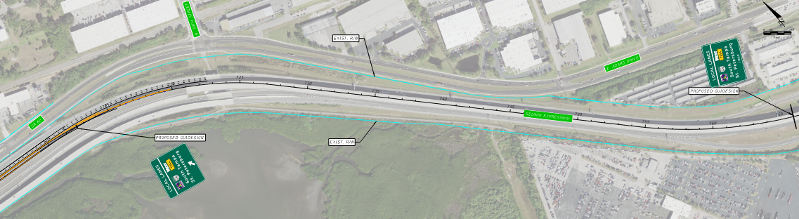
Master Signing – Ramp 2
New overhead sign at slip ramp exit gore
New overhead wayfinding sign located by DB Firm

Slide 10
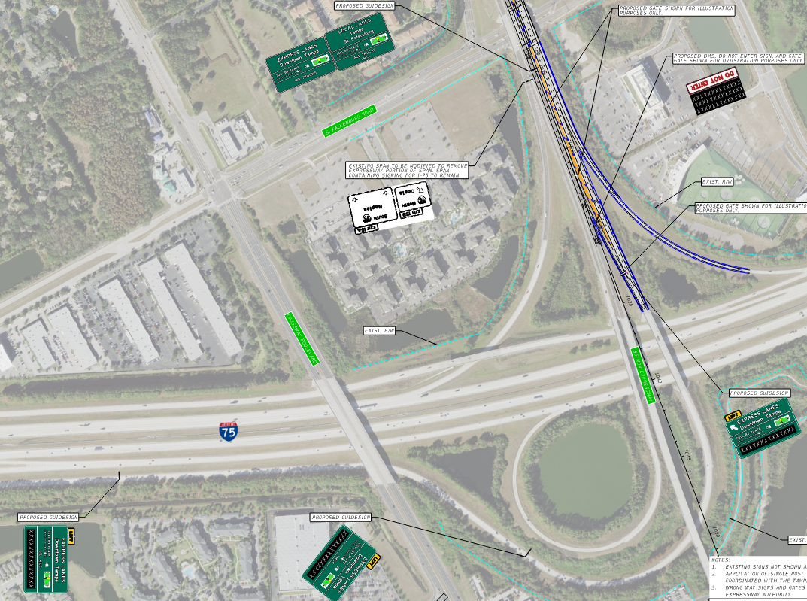
Master Signing – Ramp 3
Retrofit existing sign structure to accommodate new panels
New DMS/Do not enter signage to match existing REL slip ramps
New overhead sign at slip ramp exit gore
Two new overhead wayfinding signs located by DB Firm

Slide 11
Project Goals
Reduce congestion on the Local Lanes and increase usage of the REL during the AM Peak Hours by providing direct access to the REL from I-75 and egress onto the Westbound Local Lanes.
Provide slip ramp improvements that are compatible with the ultimate East Selmon Expressway widening.
Minimize the inconvenience to the travelling public.
Improve existing traffic operations, both in terms of flow rate and safety, throughout the duration of the Project.
Minimize the number of different Traffic Control Plan (TCP) phases, i.e., number of different diversions and detours for a given traffic movement.
Coordinate with adjacent construction projects, CSX Transportation, environmental resource/permitting agencies, and maintaining agencies.

Slide 12
Upcoming Addendum Items
Pavement Design
  PCC Pavement Widening will be required at Ramp 3.
Schedule of Values (SOV)
  Schedule of Values will require estimated quantities and unit prices similar to FDOT standard lump sum SOV.
PD&E Documents
  Will be provided once necessary documents are signed.

Slide 13
PD&E Updates
Ramp 2
  Project Environmental Impact Report (PEIR) final revisions currently being implemented.
  Final approval by THEA expected mid February.
Ramp 3
  Cultural Resources Assessment Survey (CRAS) submitted to the Florida State Highway Preservation Officer (SHPO) on 1/21/2021 (30 day response required).
  Draft Type 1 Categorical Exclusion to be completed once CRAS is approved.
  Final approval by FDOT expected mid February.

Slide 14
Roadway
Provide Typical Section Package, Pavement Design Package, and Design Variations/Exceptions.
Pavement Design
  If cross slope correction is required, the minimum milling depth shall replace at least 1.5” of structural course, and the cross slope correction is achieved through overbuild.
  If cross slope correction is NOT required, the min. milling shall completely remove the existing friction course and replace.
  Structural evaluation is still required in the pavement design package, and actual milling depth could be deeper than the minimum.
Mill and resurface when temporary or permanent realignment requires new permanent striping.
Match adjacent pavement type for PCC section, then switch to ramp pavement at the gore.

Slide 15
TTCP/Work Hours
Lanes Closures NOT allowed Monday thru Friday between the hours of:
  5:00 AM to 9:00 AM
  3:00 PM to 7:00 PM
  No Lane Closures allowed during non-work periods.
Current known special event days include the Florida State Fair and Tampa Bay Lightning home games.
Public Involvement support
DB Team is responsible for obtaining any required railroad permits and scheduling and paying for railroad flagging if required
Avoid activities on FTE maintained facilities and minimize activities on FDOT facilities.
Any lane closures, temporary construction, or permanent construction on FDOT ROW will require FDOT approval, including facilities maintained by FTE.

Slide 16
Structures
Intermediate bridge widening anticipated
Ramp 2 – Bridges potentially impacted:
  N. 34th Street
    Bridge No. 100450 Reversible Lee Roy Selmon Exwy. (LRSE)
    Bridge No. 100449 WB LRSE
  CSX Railroad
    Bridge No. 100802 Reversible LRSE
    Bridge No. 100447 WB LRSE
Ramp 3 – Bridges potentially impacted:
  Falkenburg Rd
    Bridge No. 100490 Reversible LRSE
    Bridge No. 100489 WB LRSE

Slide 17
Signing and Pavement Markings
Seven overhead miscellaneous structures identified including one retrofit.
No permanent changes to FTE maintained facilities at the Selmon Connector ramp merge.
Utilize black contrast markings for temporary/permanent applications.
  Permanent tape is required on bridge and concrete pavement surfaces.
Provide a minimum of one advanced guide sign for Ramp 2
Provide a minimum of two advanced guide signs for Ramp 3 (left exit) with embedded DMS boards.

Slide 18
ITS and Lighting
Must include Wrong-Way detection and gates
  Advance warning signage
  Prevent EB REL traffic from entering I-75 NB Loop Ramp
Provide Communication with TMC
Interoperability with existing system required
  Identical products to minimize impacts to THEA maintenance and operations
Evaluate existing lighting and provide lighting to meet required Lighting Initial Values for both ramps.

Slide 19
Drainage
Pipe video inspections are completed for existing structures at Ramp 3.
Cured in place pipe liners required at the locations identified in the RFP attachments.
Spread to be confined within shoulders.
34th Street Canal below bridge.
Utilize/modify THEA-maintained facilities.

Slide 20
Utilities
Utility coordination is underway (First Contact) by GEC.
Design-Build Firms will finalize coordination efforts based on their design approach.
Identify the Utility Coordination Manager in the Technical Proposal.
Details on utility coordination efforts to be provided during utility pre-proposal meeting.

Slide 21
Utilities
UAOs Identified Within the Project Limits
AT&T
Central Florida Pipeline/Kinder Morgan
CenturyLink Core Network (Lvl 3) aka Lumen
City of Tampa Transportation
City of Tampa Wastewater Dept
City of Tampa Water Dept
Crown Castle
FiberLight, LLC
Florida Gas Transmission
Frontier Communications
Hillsborough County Clerk of Court
Hillsborough County Public Utilities
Hillsborough County Sheriff
Hillsborough County Traffic
MCI/Verizon Business
Spectrum/Bright House Networks
Sprint/Nextel
Tampa Bay Water
Tampa Electric Company
TECO Peoples Gas
Zayo Group

Slide 22
Design Variations and/or Exceptions
Design-Build Firm shall prepare and submit applicable Design Variations and/or Exceptions
Known Variations/Exceptions to be prepared by the DB Firm (submit with Typical Section Package):
  Design Variations:
    Selmon WB Local Lanes:
      Shoulder Width
      Horizontal Curve Length
    REL / WB REL egress (Ramp 2)
      Shoulder Width
      Horizontal Curve Length

Slide 23
Design Variations and/or Exceptions
Known Variations/Exceptions
  Design Exceptions
    Selmon WB Local Lanes
      Shoulder Width
    REL / WB egress (Ramp 2)
      Shoulder Width
Clearly identify deviations from Concept Plans during ATCs and in signed/sealed reports.
Approvals required for identified variations/exceptions
  Brian Pickard (THEA Director of Operations and Engineering)
  Jim Drapp (GEC Program Manager)

Slide 24
Public Involvement
THEA Public Information Officer (PIO) will-
  Send Out Weekly Lane Closure Notifications
  Send Out Bi-weekly Project Status Emails
  Maintain and Update Project Website
  Post Updates on Social Media
Design Build Team will Coordinate with PIO
Design Build Team may Attend Meetings with the Public to Provide Quick Response to the PIO to Address Construction Issues
Design Build Team will Proactively Report any Interaction with the Public to the PIO
Design Build Team will Provide Support as needed by PIO

Slide 25
Innovative Aspects & ATC’s
ATC’s (One Round only) will follow standard FDOT process
The following will not be considered:
Reduction in the number of lanes and lane widths as depicted in the Conceptual Typical Sections and Concept Plans;
Reduction in permanent Design Speeds on all State or local roads;
Reduction in the Access Classification and Control, or changes to the access management or property access requirements;

Slide 26
Innovative Aspects & ATC’s
The following will not be considered (cont.):
Significant changes to any alignments that may jeopardize the cost feasibility of the proposed multi-laning of the East Selmon Expressway;
Elimination of tolling point locations;
Elimination of tolling site and equipment
Failure to reconstruct overhead sign span assemblies.
Failure to install wrong-way driving security features including gates and other features used on the REL.

Slide 27
Written Technical Proposal
Submit 1 Original, seven (7) Flash Drives containing the Letter of Interest in PDF format and seven (7) collated, complete sets of hard copies
Times New Roman type font, minimum font size ten (10)
Maximum of ten (10) pages
  8 ½” x 11” sheets
  Schedule Narrative for Design & Construction with Bar Charts showing Critical Path Duration w/no WAR (Work at Risk)
Plans
  11” x17” sheets
TSP’s

Slide 28
Q & A Session
Four (4) DB Teams are Shortlisted
60 minutes Q&A with Shortlisted DB Teams
No other handouts, electronic presentations, etc. other than copies of the submitted Written Technical Proposal
No questions other than clarifications allowed by the DB Team
Some questions, but not necessarily all, will be provided to each DB Team approximately 24 hours prior to their Q& A Session

Slide 29
Evaluation Criteria
Element: Points:
Design 25
Construction 25
Compatibility
with ultimate 20
Value Added 10
Proposal Score: 80
Letter of Interest: 20
Maximum
Technical Score: 100
Price Proposal scoring:
BPP/TS = Adjusted Score
Where:
BPP = Bid Price Proposal
TS = Technical Score (Combined Scores from LOI and TP)
Selected D-B firm will be team with the Lowest Adjusted Score

Slide 30
Procurement Schedule
January 29, 2021 Mandatory Pre-Proposal Meeting & Mandatory Utilities Pre-Proposal Meeting
Form 700-011-14 Due for Stipend Disbursement
February 10, 2021 Deadline to request participation in ATC Mtg. No.1
February 17, 2021 Deadline to submit Preliminary List of ATC’s prior to ATC Meeting
February 24, 2021 One-on-One ATC Meetings
March 3, 2021 Deadline to submit ATC Concept Proposals
March 10, 2021 Deadline to submit Design Exception or Variations & Questions prior to Technical Proposal
March 24, 2021 Deadline for Authority to post Responses to Questions
March 29, 2021 Technical Proposals Due by 2 PM
Notes:
n

Slide 31
Procurement Schedule
April 1, 2021 Tech. Proposal Page-Turn Meeting
April 6, 2021 Question & Answer Sessions
April 9, 2021 Deadline to submit Written Clarification Letter following Q & A Sessions
April 13, 2021 Deadline to submit Questions prior to submission of Price Proposal
April 20, 2021 Deadline for Authority to post Responses to Questions
April 27, 2021 Price Proposals Due, announcing of Technical Scores
April 28, 2021 Posting of Final Scores and Bid Prices
May 24, 2021 THEA Board Meeting
May 25, 2021 Posting of Award
Notes:
n

Slide 32
SBE
THEA’s Small Business Enterprise (SBE) Policy requires nondiscrimination on the basis of race, color, national origin, and gender in its employment and contracting practices and encourages the solicitation and utilization of SBE’s. This means that the Authority’s goal is to spend a portion of the highway dollars with Certified SBE’s as prime Design-Build Firms or as subcontractors. Race-neutral means that the Authority believes that the overall goal can be achieved through the normal competitive procurement process. THEA has exceeded 15% SBE participation on its program for the last several years.

Slide 33
DB Stipend
$40,000 per non-selected shortlisted Design-Build Firm that meets the stipend eligibility requirements including submittals of written technical proposal and price proposal
Design-Build Firm must fully execute with original signatures and have delivered to the Authority within one (1) week after the Short-List protest period, four (4) originals of the Design-Build Stipend Agreement.
  1/19/2021 - Intended Shortlist Decisions Posted
  1/22/2021 - End of 72-hour Protest Period
  1/29/2021 (today) – Form 700-011-14 Due

Slide 34

TRC Members and Technical Advisors
  TRC Members:
    Judith Villegas, EI – THEA
    Brian Pickard, PE – THEA
    Anna Quinones, AICP – THEA
  Technical Advisors:
    Sue Chrzan – THEA
    Jim Drapp, PE – THEA GEC
    Al Stewart, PE – THEA GEC
    Ed Ponce, PE – THEA GEC
    David Hubbard, PE – THEA GEC
    Julian Gutierrez, PE – THEA GEC
    CEI – To be determined

Slide 35
Project Documents
http://www.tampa-xway.com/procurement/#
The cone of silence remains in place for all THEA, HNTB, Tierra, Element, Kimley-Horn and Omni staff. The cone of silence begins on date of advertisement and ends upon Board Approval.
All questions should be emailed to Man Le, THEA Contracts & Procurement Manager: man.le@tampa-xway.com
Answers will be posted on the THEA website and Demandstar

Slide 36

All questions should be emailed to Man Le, THEA Contracts & Procurement Manager: man.le@tampa-xway.com

Slide 37
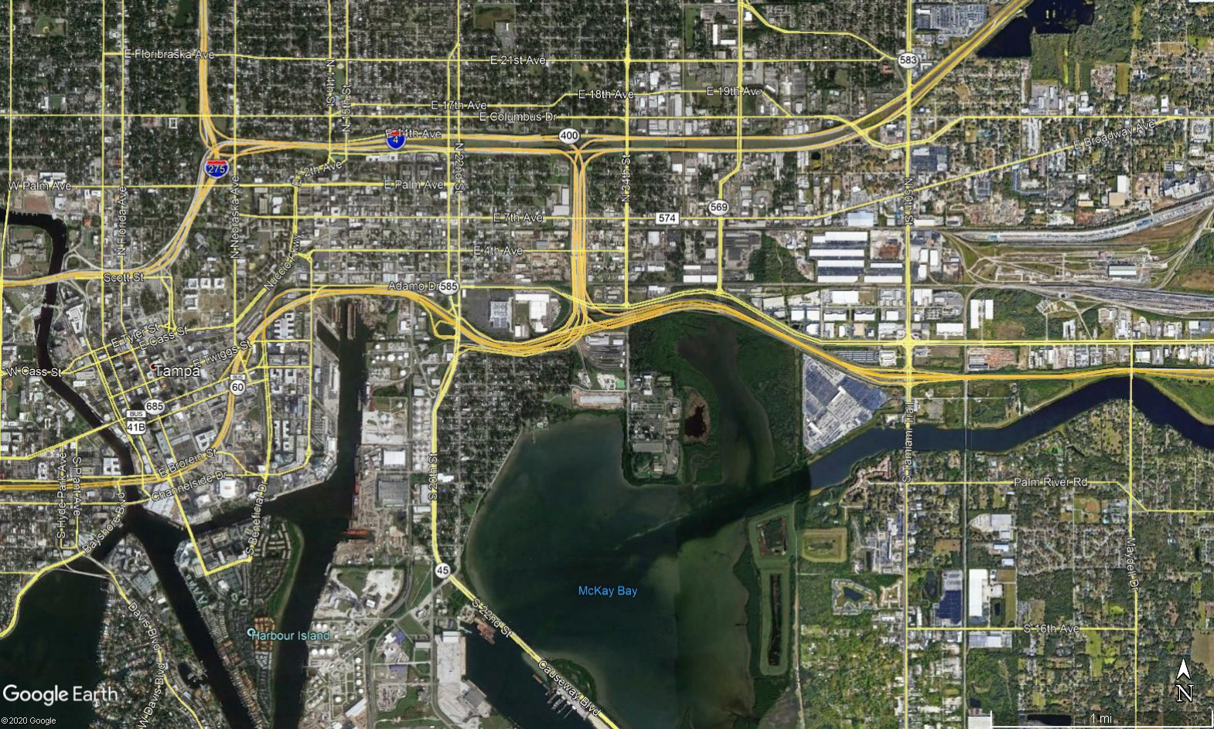
Ramp 2

Slide 38
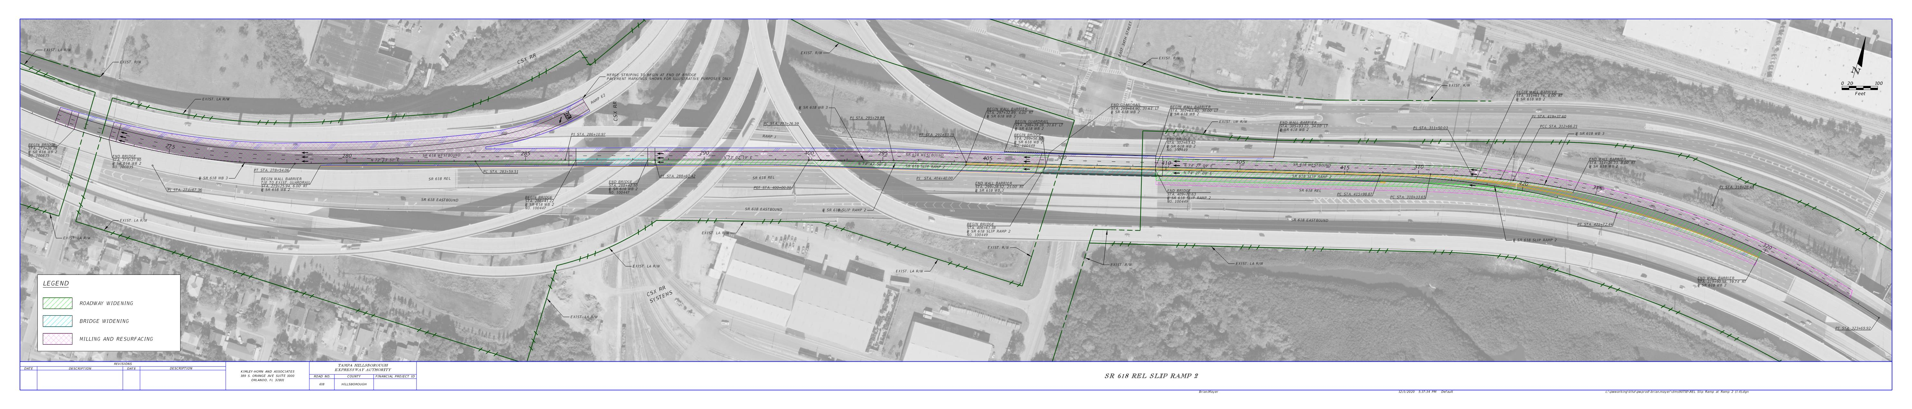

Slide 39
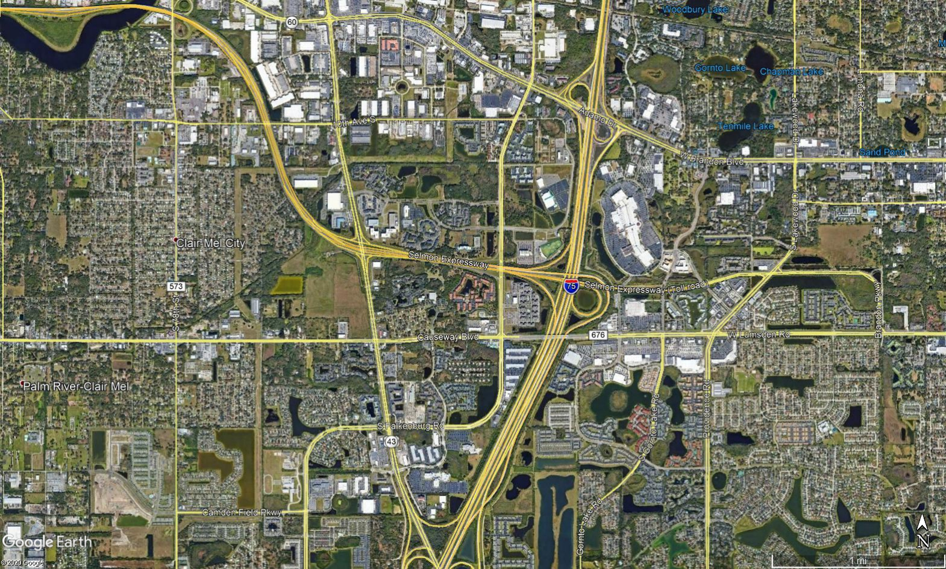
Ramp 3

Slide 40
