Slide 1
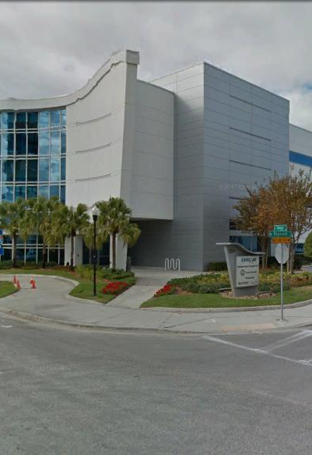
Tampa Hillsborough
Expressway
Authority
East Selmon Slip Ramps
DB Industry Forum
11/12/2020

Slide 2
Introductions
Man Le – THEA Contracts & Procurement Manager
Judith Villegas, EI – THEA Project Manager
Sue Chrzan – THEA Director of Public Affairs and Communications
Brian Pickard, PE – THEA Director of Operations and Engineering
Jim Drapp, PE – THEA GEC Program Manager
Al Stewart, PE – THEA GEC
Ed Ponce, PE – THEA GEC
David Hubbard, PE – THEA GEC

Slide 3
Project Roles
Tampa Hillsborough Expressway Authority (THEA)- Owner
  Judith Villegas, EI- THEA Project Manager
HNTB- General Engineering Consultant (GEC) to THEA
Tierra- Geotechnical Consultant to GEC & THEA
Element- Survey Consultant to GEC & THEA
Omni- Utilities Consultant to GEC & THEA

Slide 4

Agenda
Project Overview & Objectives
Innovative Aspects & ATC’s
LOI/Written Technical Proposal/Schedule
Contractor/Consultant Work Types
Q & A Session
Evaluation Criteria
Procurement Schedule
CEI Services
SBE
DB Stipend
TRC Members & Technical Advisors
Project Documents
Questions

Slide 5
Project Overview & Objectives
Project Limits
  Excerpt from Phase 1 Improvements proposed to the East Selmon Expressway and ongoing PD&E study (result of Feasibility Study)
    Ramp 2 – From I-4 Connector to east of 34th Street
    Ramp 3 – From east of US 301 to I-75
Project Goals
TTCP/Work Hours
Project Information

Slide 6
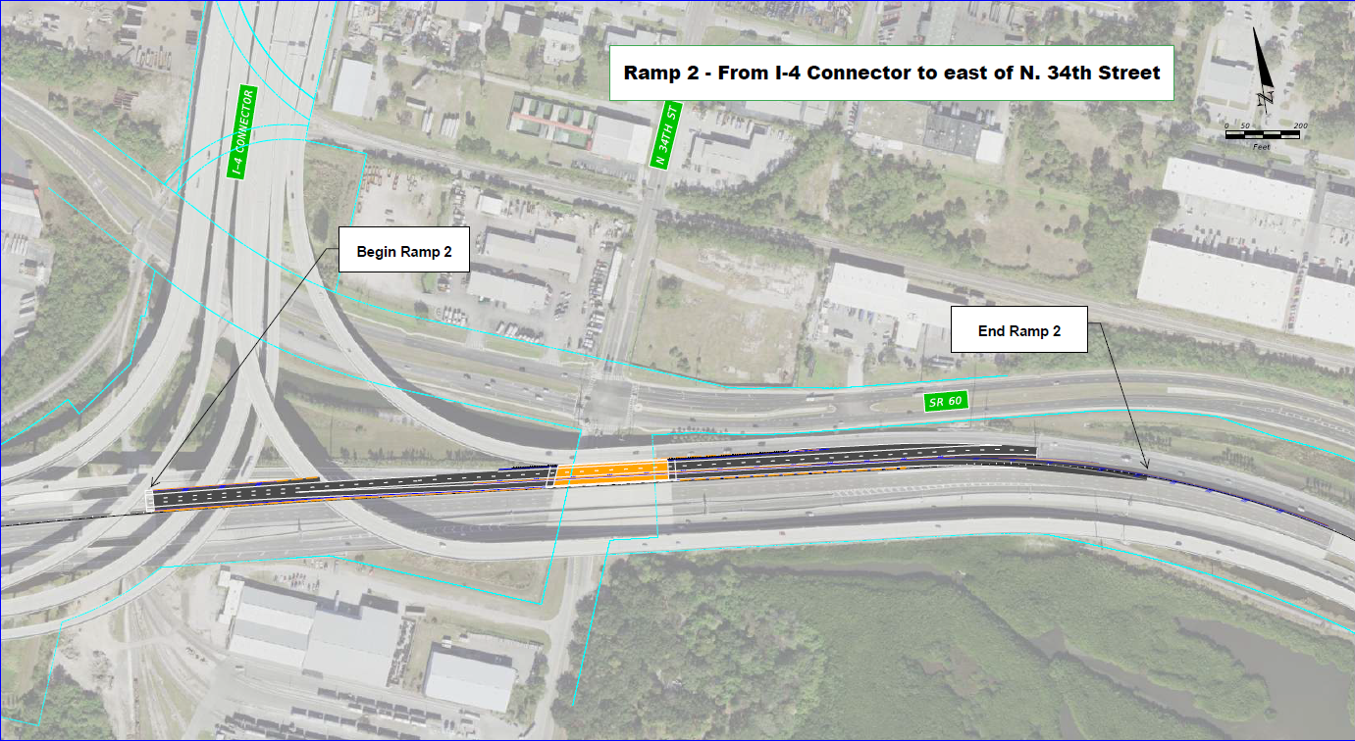
Project Limits – Ramp 2

Slide 7
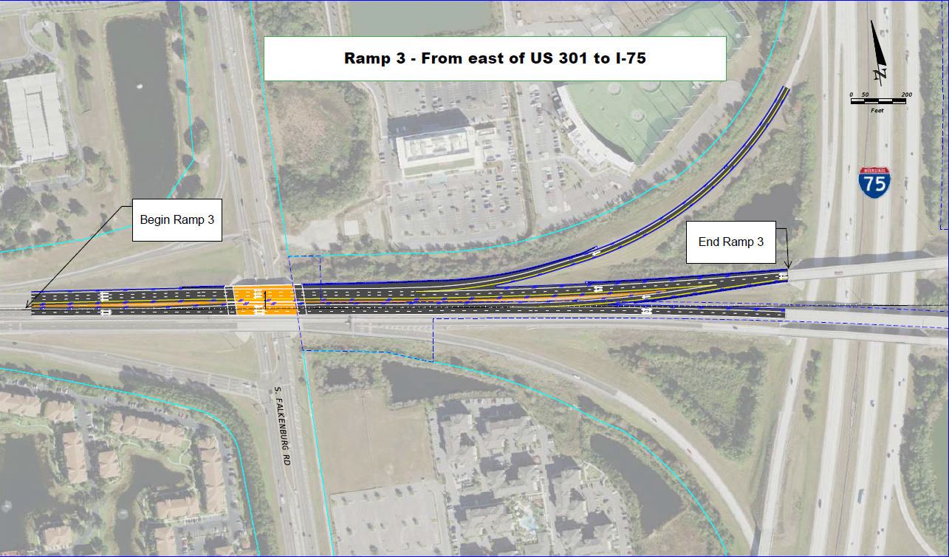
Project Limits – Ramp 3

Slide 8
Project Goals
Reduce congestion on the Local Lanes and increase usage of the REL during the AM Peak Hours by providing direct access to the REL from I-75 and egress onto the Westbound Local Lanes.
Provide slip ramp improvements that are compatible with the ultimate East Selmon Expressway widening.
Minimize the inconvenience to the travelling public.
Improve existing traffic operations, both in terms of flow rate and safety, throughout the duration of the Project.
Minimize the number of different Traffic Control Plan (TCP) phases, i.e., number of different diversions and detours for a given traffic movement.
Coordinate with adjacent construction projects, CSX Transportation, environmental resource/permitting agencies, and maintaining agencies.

Slide 9
TTCP/Work Hours
Lanes Closures NOT allowed Monday thru Friday between the hours of:
  5:00 AM to 9:00 AM
  3:00 PM to 7:00 PM
  No Lane Closures allowed during non-work periods.
Public Involvement support
DB Team is responsible for obtaining any required railroad permits and scheduling and paying for railroad flagging if required

Slide 10
Structures
Intermediate bridge widening anticipated
Ramp 2 – Bridges potentially impacted:
  N. 34th Street
  CSX Railroad
Ramp 3 – Bridges potentially impacted:
  Falkenburg Rd

Slide 11
ITS and Lighting
Must include Wrong-Way detection and gates
  Advance warning signage
  Prevent EB REL traffic from entering I-75 NB Loop Ramp
Provide Communication with TMC
Interoperability with existing system required
  Identical products to minimize impacts to THEA maintenance and operations
Evaluate existing lighting and provide lighting to meet required Lighting Initial Values for both ramps.

Slide 12
Drainage
Video inspection of oldest (constructed with the original Expressway) existing pipes and culverts will be provided to the Design-Build teams when complete.
Contract underway with Shenandoah
Anticipate completion by December 1 Design-Build advertisement date.
Spread to be confined within shoulders.

Slide 13
Utilities
Utility coordination is underway (First Contact).
Design-Build Firms will finalize coordination efforts based on their design approach.

Slide 14
Design Variations and/or Exceptions
Design-Build Firm shall obtain and/or modify applicable Design Variations and/or Exceptions
Known Variations/Exceptions
  Design Variations:
    Selmon WB Local Lanes:
      Shoulder Width
      Horizontal Curve Length
    REL / WB REL egress (Ramp 2)
      Shoulder Width
      Horizontal Curve Length

Slide 15
Design Variations and/or Exceptions
Known Variations/Exceptions
  Design Exceptions
    Selmon WB Local Lanes
      Shoulder Width
    REL / WB egress (Ramp 2)
      Shoulder Width

Slide 16
Public Involvement
THEA Public Information Officer (PIO) will-
  Send Out Weekly Lane Closure Notifications
  Send Out Bi-weekly Project Status Emails
  Maintain and Update Project Website
  Post Updates on Social Media
Design Build Team will Coordinate with PIO
Design Build Team may Attend Meetings with the Public to Provide Quick Response to the PIO to Address Construction Issues
Design Build Team will Proactively Report any Interaction with the Public to the PIO
Design Build Team will Provide Support as needed by PIO

Slide 17
Innovative Aspects & ATC’s
ATC’s (One Round only) will follow standard FDOT process
The following will not be considered:
Reduction in the begin and end Project limits;
Reduction in the number of lanes and lane widths as depicted in the Typical Section Package and Concept Plans;
Reduction in permanent Design Speeds on all State or local roads;
Reduction in the Access Classification and Control, or changes to the access management or property access requirements;

Slide 18
Innovative Aspects & ATC’s
The following will not be considered (cont.):
Reduction in the minimum storage lengths at intersections, as depicted in the Concept Plans;
Significant changes to any alignments that may jeopardize the cost feasibility of the proposed widening of the East Selmon Expressway;
Elimination of tolling point locations;
Elimination of tolling site and equipment
Failure to reconstruct overhead sign span assemblies.
Failure to install wrong-way driving security features including gates and other features used on the REL.

Slide 19
Letters of Interest (Phase 1)
Maximum of ten (10) pages
  8 ½” x 11” sheets
  Minimum font size ten (10)
Additional items – Not counted in the 10-page limit
  11” x 17” Organizational Chart
  Resumes
  Three (3) pages of Performance History
LOI Evaluation Criteria (Maximum of 20 points):
    Past Performance (10 points)
    Design-Build Project Requirements and Critical Issues (10 points)

Slide 20
Written Technical Proposal (Phase 2)
Submit 1 Original, seven (7) Flash Drives containing the Letter of Interest in PDF format and seven (7) collated, complete sets of hard copies
Times New Roman type font, minimum font size ten (10)
Maximum of ten (10) pages
  8 ½” x 11” sheets
  Schedule Narrative for Design & Construction with Bar Charts showing Critical Path Duration w/no WAR (Work at Risk)
Plans
  11” x17” sheets
TSP’s

Slide 21
Contractor Pre-Qualifications
Major work types:
7 – Drainage
10 – Flexible Paving
17 – Intermediate Bridges
Other minor work types can be accommodated by subcontractors

Slide 22
Consultant Pre-Qualifications
3.3 - Controlled Access Highway Design
4.1.1 - Miscellaneous Structures
4.1.2 - Minor Bridge Design
6.3 - Intelligent Transportation Systems Analysis, Design, and Implementation
7.1 - Signing, Pavement Marking & Channelization
7.2 - Lighting
8.1 - Control Surveying
8.2 - Design, Right of Way, & Const. Surveying
9.1 - Soil Exploration
9.2 - Geotechnical Classification Lab Testing
9.4.1 - Standard Foundation Studies

Slide 23
Q & A Session
Four (4) DB Teams to be Shortlisted
60 minutes Q&A with Shortlisted DB Teams
No other handouts, electronic presentations, etc. other than copies of the submitted Written Technical Proposal
No questions allowed by the DB Team
Some questions, but not necessarily all, will be provided to each DB Team approximately 24 hours prior to their Q& A Session

Slide 24
Evaluation Criteria
Element: Points:
Design 25
Construction 25
Compatibility
with ultimate 20
Value Added 10
Proposal Score: 80
Letter of Interest: 20
Maximum Score: 100
Price Proposal scoring:
BPP/TS = Adjusted Score
Where:
BPP = the Bid Price Proposal
TS = the Technical Score (Combined Scores from LOI and Technical Proposal)
Selected D-B firm will be team with the Lowest Adjusted Score

Slide 25
Procurement Schedule
November 12, 2020 Industry Forum
December 1, 2020 Advertisement
December 15, 2020 Deadline to submit Questions/Request for Clarification
December 29, 2020 Addendum Release (if required)
January 8, 2021 Expanded Letters of Interest Due
January 25, 2021 THEA Board Meeting to approve Shortlist January 25, 2021 Posting of Shortlist
January 27, 2021 Deadline for Shortlisted Firms to Declare Intent to Continue
January 28, 2021 THEA Contracting Unit Updates List of Shortlisted Firms to move to Phase II
Notes:
n

Slide 26
Procurement Schedule
January 29, 2021 Mandatory Pre-Proposal Meeting & Mandatory Utilities Pre-Proposal Meeting
February 10, 2021 Deadline to request participation in ATC Mtg. No.1
February 17, 2021 Deadline to submit Preliminary List of ATC’s prior to ATC Meeting
February 24, 2021 One-on-One ATC Meetings
March 3, 2021 Deadline to submit ATC Concept Proposals
March 10, 2021 Deadline to submit Design Exception or Variations & Questions prior to Technical Proposal
March 24, 2021 Deadline for Authority to post Responses to Questions
March 29, 2021 Technical Proposals Due
April 2, 2021 Page-Turn Meeting
April 6, 2021 Question & Answer Sessions
Notes:
n

Slide 27
Procurement Schedule
April 21, 2021 Deadline to submit Written Clarification Letter following Q & A Sessions
April 28, 2021 Deadline to submit Questions prior to submission of Price Proposal
May 5, 2021 Deadline for Authority to post Responses to Questions
May 12, 2021 Price Proposals Due, announcing of Technical Scores
May 13, 2021 Posting of Final Scores and Bid Prices
May 24, 2021 THEA Board Meeting & posting of Award
Notes:
n

Slide 28
CEI Services
Oversight CEI will be procured via two stages:
Initial LOI and shortlisting
Oral Interviews with three shortlisted firms
  5 minutes opening
  30 minutes Q & A
Selected CEI firm will participate in Design-Build evaluation of technical proposals and ATC’s.

Slide 29
CEI - Procurement Schedule
November 12, 2020 Industry Forum
December 1, 2020 Advertisement
December 15, 2020 Deadline to submit Questions/Requests for Clarification
December 18, 2020 THEA response to questions
January 8, 2021 Expanded Letters of Interest Due
January 11, 2021 Evaluation Committee Meeting
January 11, 2021 Posting of Shortlist
January 25, 2021 Oral Interviews with Shortlisted Firms
February 1, 2021 Evaluation Committee submits final scores
February 8, 2021 Posting of Notice Intended Final Ranking
February 22, 2021 THEA Board Meeting to approve Award

Slide 30
SBE
THEA’s Small Business Enterprise (SBE) Policy requires nondiscrimination on the basis of race, color, national origin, and gender in its employment and contracting practices and encourages the solicitation and utilization of SBE’s. This means that the Authority’s goal is to spend a portion of the highway dollars with Certified SBE’s as prime Design-Build Firms or as subcontractors. Race-neutral means that the Authority believes that the overall goal can be achieved through the normal competitive procurement process. THEA has exceeded 15% SBE participation on its program for the last several years.

Slide 31
DB Stipend
$40,000 per non-selected shortlisted Design-Build Firm that meets the stipend eligibility requirements including submittals of written technical proposal and price proposal
Design-Build Firm must fully execute with original signatures and have delivered to the Authority within one (1) week after the Short-List protest period, four (4) originals of the Design-Build Stipend Agreement.

Slide 32

TRC Members and Technical Advisors
  TRC Members:
    Judith Villegas, EI – THEA
    Brian Pickard, PE – THEA
    Anna Quinones, EI – THEA
  Technical Advisors:
    Sue Chrzan – THEA
    Jim Drapp, PE – THEA GEC
    Al Stewart, PE – THEA GEC
    Ed Ponce, PE – THEA GEC
    David Hubbard, PE – THEA GEC
    Julian Gutierrez, PE – THEA GEC
    CEI – To be determined

Slide 33
Project Documents
http://www.tampa-xway.com/procurement/#
The cone of silence remains in place for all THEA, HNTB, Tierra, Element, Kimley-Horn and Omni staff. The cone of silence begins on date of advertisement and ends upon Board Approval.
All questions should be emailed to Man Le, THEA Contracts & Procurement Manager: man.le@tampa-xway.com
Answers will be posted on the THEA website and Demandstar

Slide 34

All questions should be emailed to Man Le, THEA Contracts & Procurement Manager: man.le@tampa-xway.com

