Slide 1
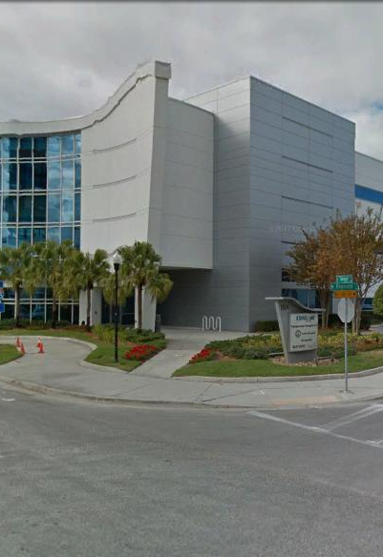
Tampa Hillsborough
Expressway
Authority
Pre-Bid Conference
10/20/2020
SELMON EXPRESSWAY MISC. RESURFACINGS
O-01820
O-01920
O-02020

Slide 2
Introductions
Man Le – THEA Contracts & Procurement Manager
Brian Pickard, PE – THEA Director of Operations and Engineering
Judith Villegas, EI – THEA Project Manager
Jim Drapp, PE – THEA GEC
Terry Opdyke – THEA GEC
David Hubbard, PE – THEA GEC
Consor/KCI– THEA Consultant CEI

Slide 3

SELMON EXPRESSWAY MISC. RESURFACINGS
AGENDA
Project Overview
CEI/Public Involvement
Schedule
Project Documents
Questions

Slide 4
SELMON EXPRESSWAY MISC. RESURFACINGS
OVERVIEW
Three construction projects
O-01820 – West Gantry Paving and Loops
  Includes S. Selmon Mainline and Gantry Area
  Includes All Toll Gantry M&Rs
O-01920 – S. Selmon Ramps
  Includes ramps from Euclid Ave. to Plant Ave.
O-02020 – Miscellaneous Paving
  Includes East Selmon and Downtown Ramps
  Tampa St. to Falkenburg Rd.

Slide 5
SELMON EXPRESSWAY MISC. RESURFACINGS
OVERVIEW
Select milling and resurfacings throughout the Selmon Expressway
  Replace all striping and traffic signal loops in-kind
  Provide MOT for Transcore to install new gantry loops
  Utilize pavement designs specified in ITB (including High Polymer and FC-5 locations)
Lump Sum – Provide prices for 3 separate projects, awarded to Bidder with lowest total.
120 Calendar Days

Slide 6
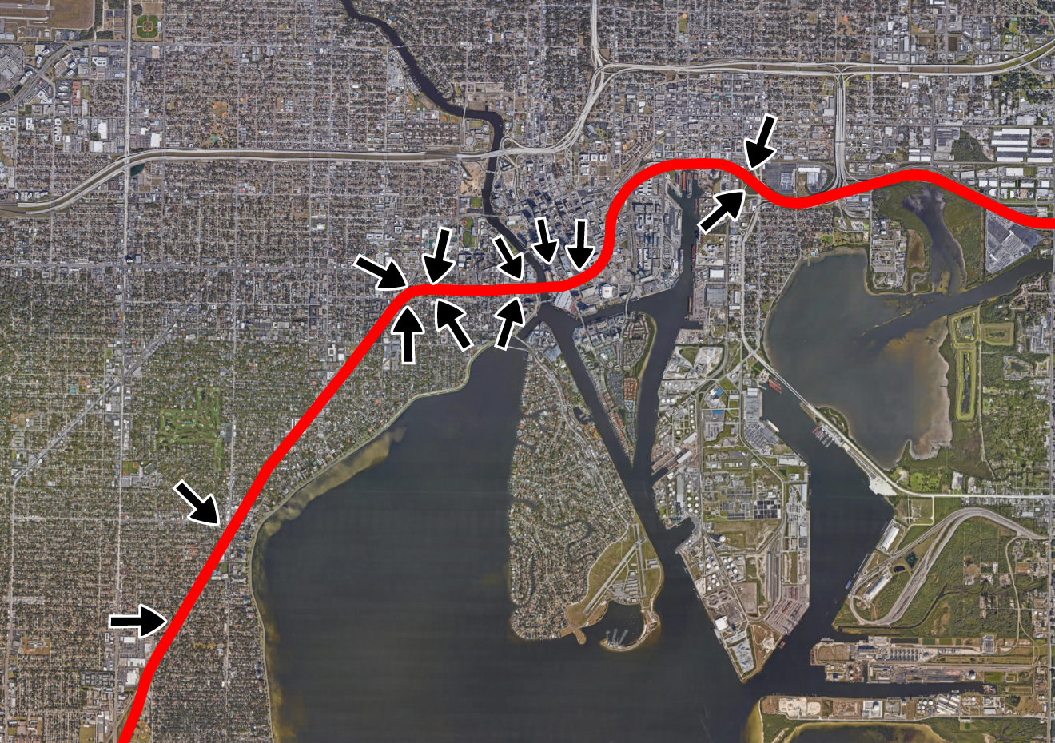
SELMON EXPRESSWAY MISC. RESURFACINGS
OVERVIEW
22nd St
Tampa St
Willow Ave
Morgan St
Plant Ave
Bay to Bay Blvd
Euclid Ave

Slide 7
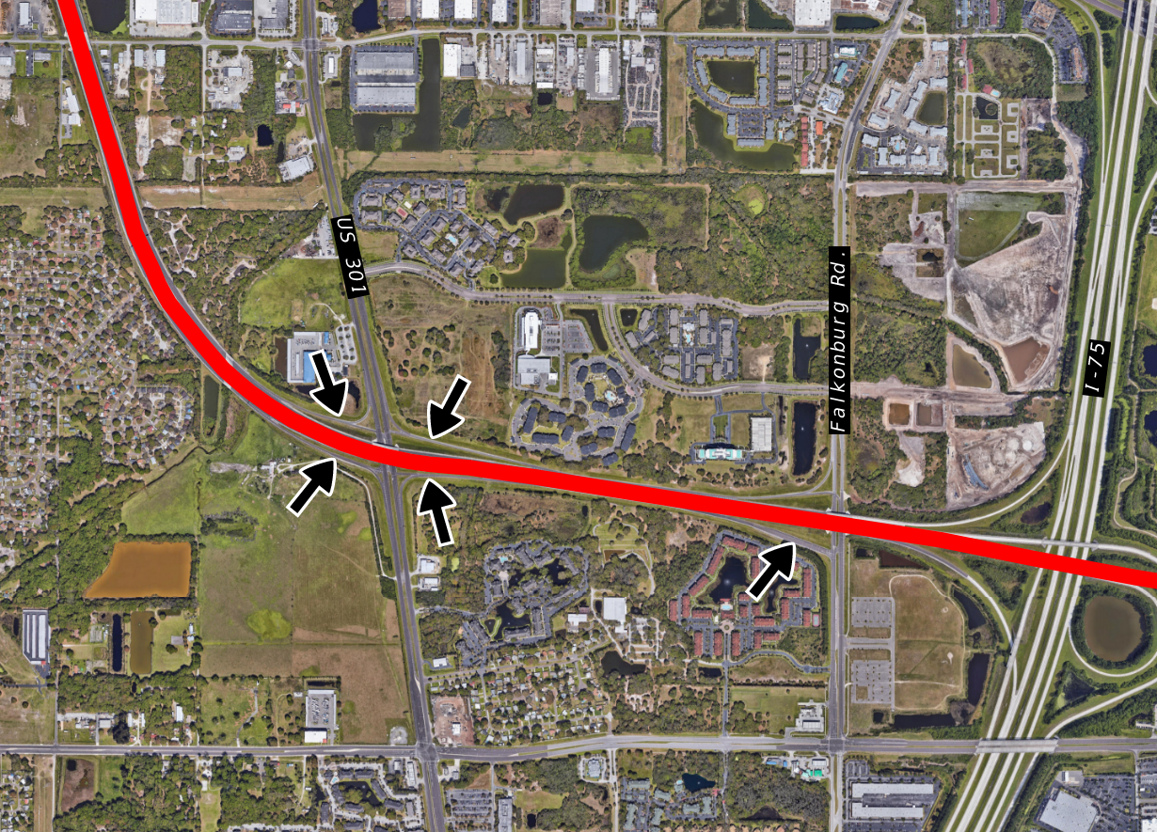
SELMON EXPRESSWAY MISC. RESURFACINGS
OVERVIEW
US Highway 301
Falkenburg Rd

Slide 8
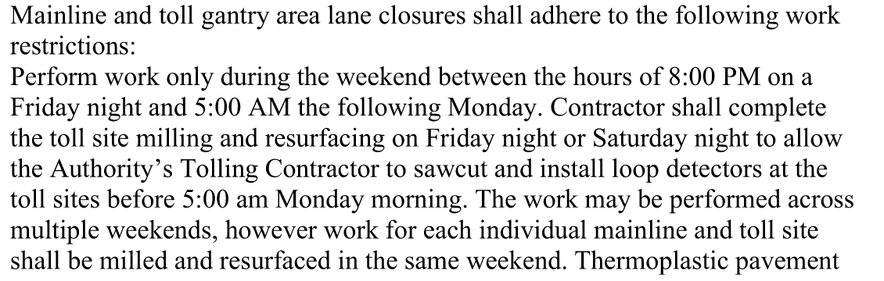
SELMON EXPRESSWAY MISC. RESURFACINGS
OVERVIEW
MOT requirements
  MOT plans required for ramp closures
  Mainline and Gantry closures require advanced coordination with CEI and Transcore
  One weekend per Toll Gantry Location
  Historic Plans provided for detour route examples.

Slide 9
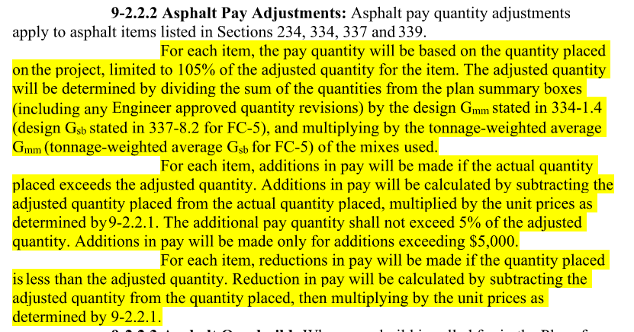
SELMON EXPRESSWAY MISC. RESURFACINGS
OVERVIEW
Pavement
  May reduce mill depth to base to minimize rework
  On FC-5 sections, apply 8” overlap
  Feather milled surface to match sections
  Asphalt Pay Adjustments Apply (Special Provision 9-2)
  Rumble Strips
  Cores not avail.

Slide 10
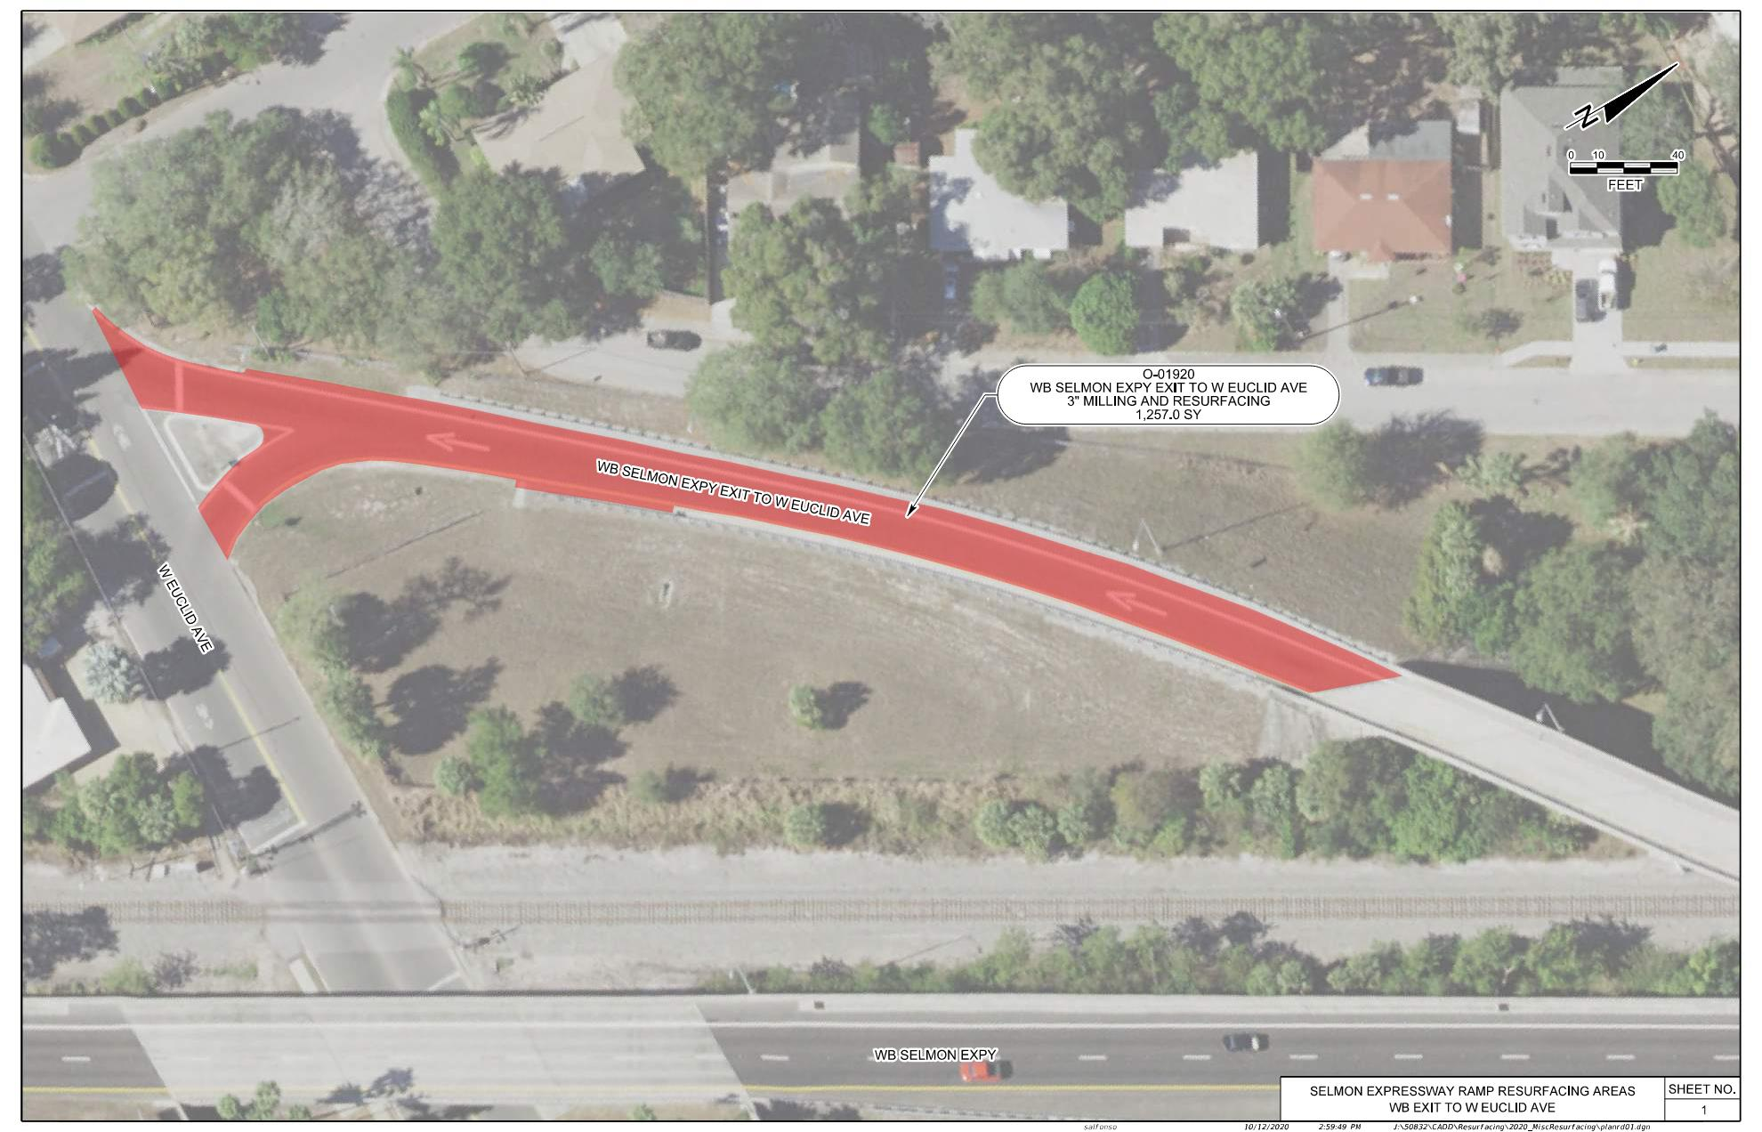
SELMON EXPRESSWAY MISC. RESURFACINGS
EUCLID AVENUE EXIT RAMP O-01920

Slide 11
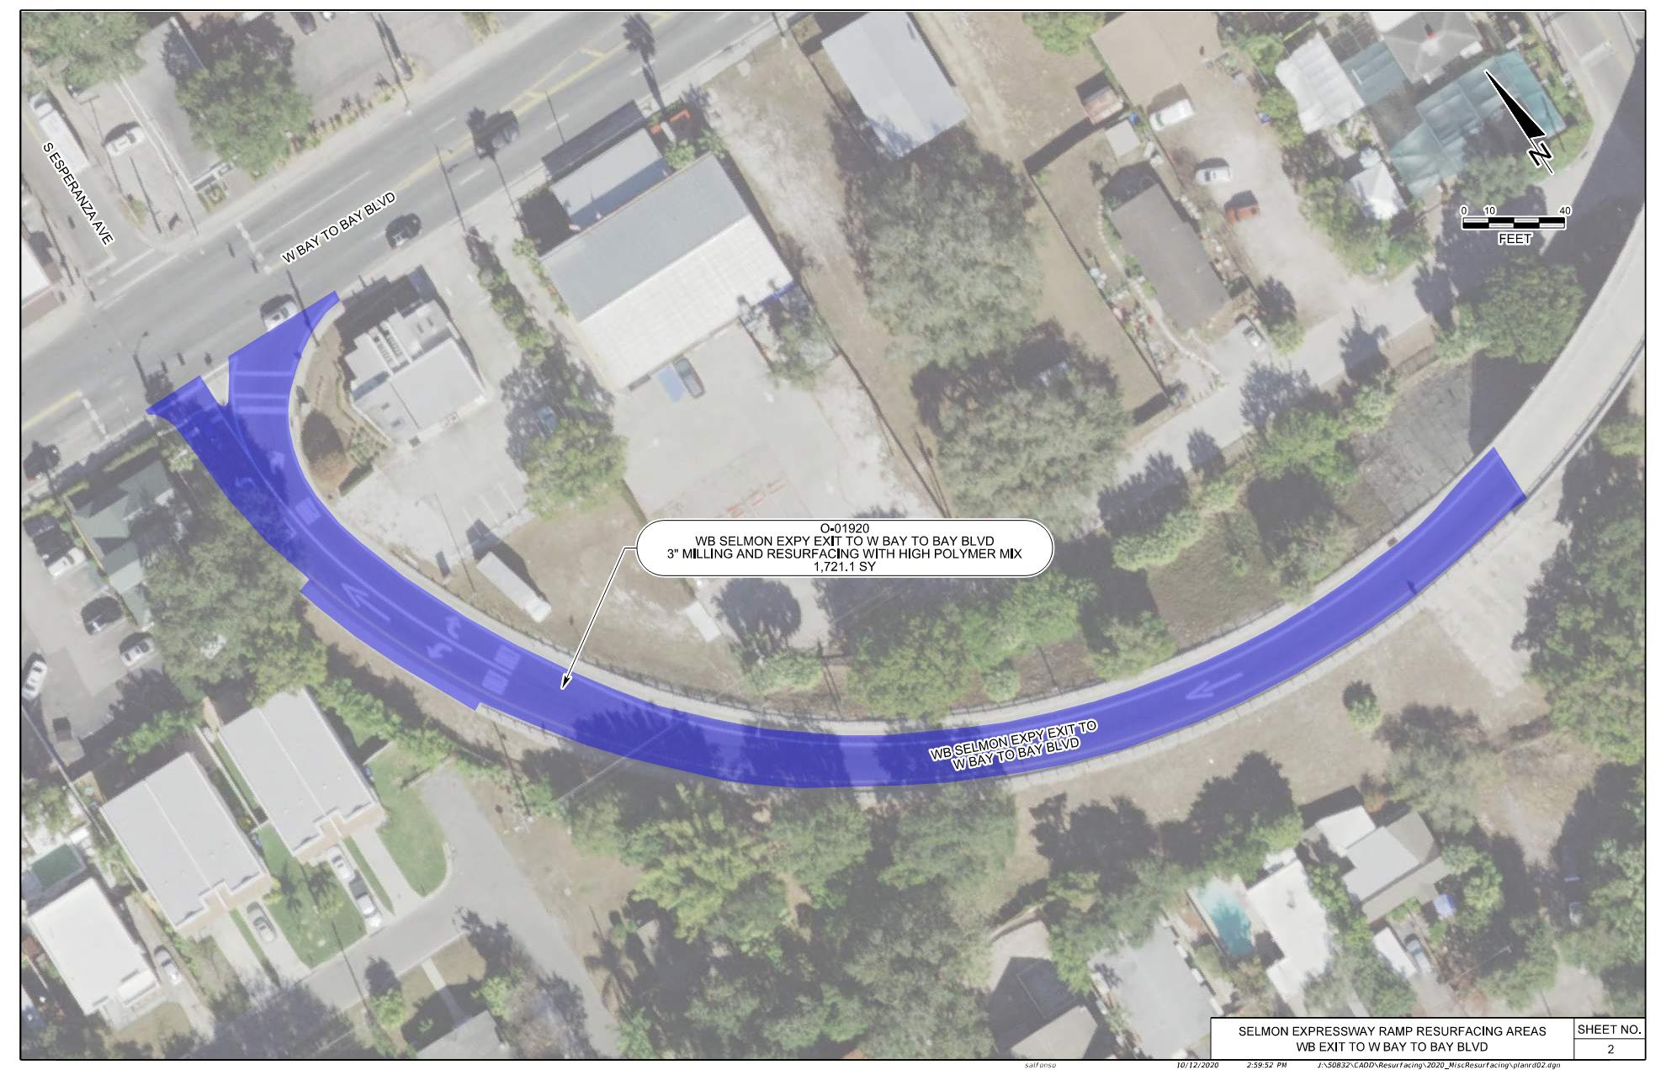
SELMON EXPRESSWAY MISC. RESURFACINGS
BAY TO BAY AVENUE EXIT RAMP O-01920
HIGH POLYMER ASPHALT REQUIRED

Slide 12
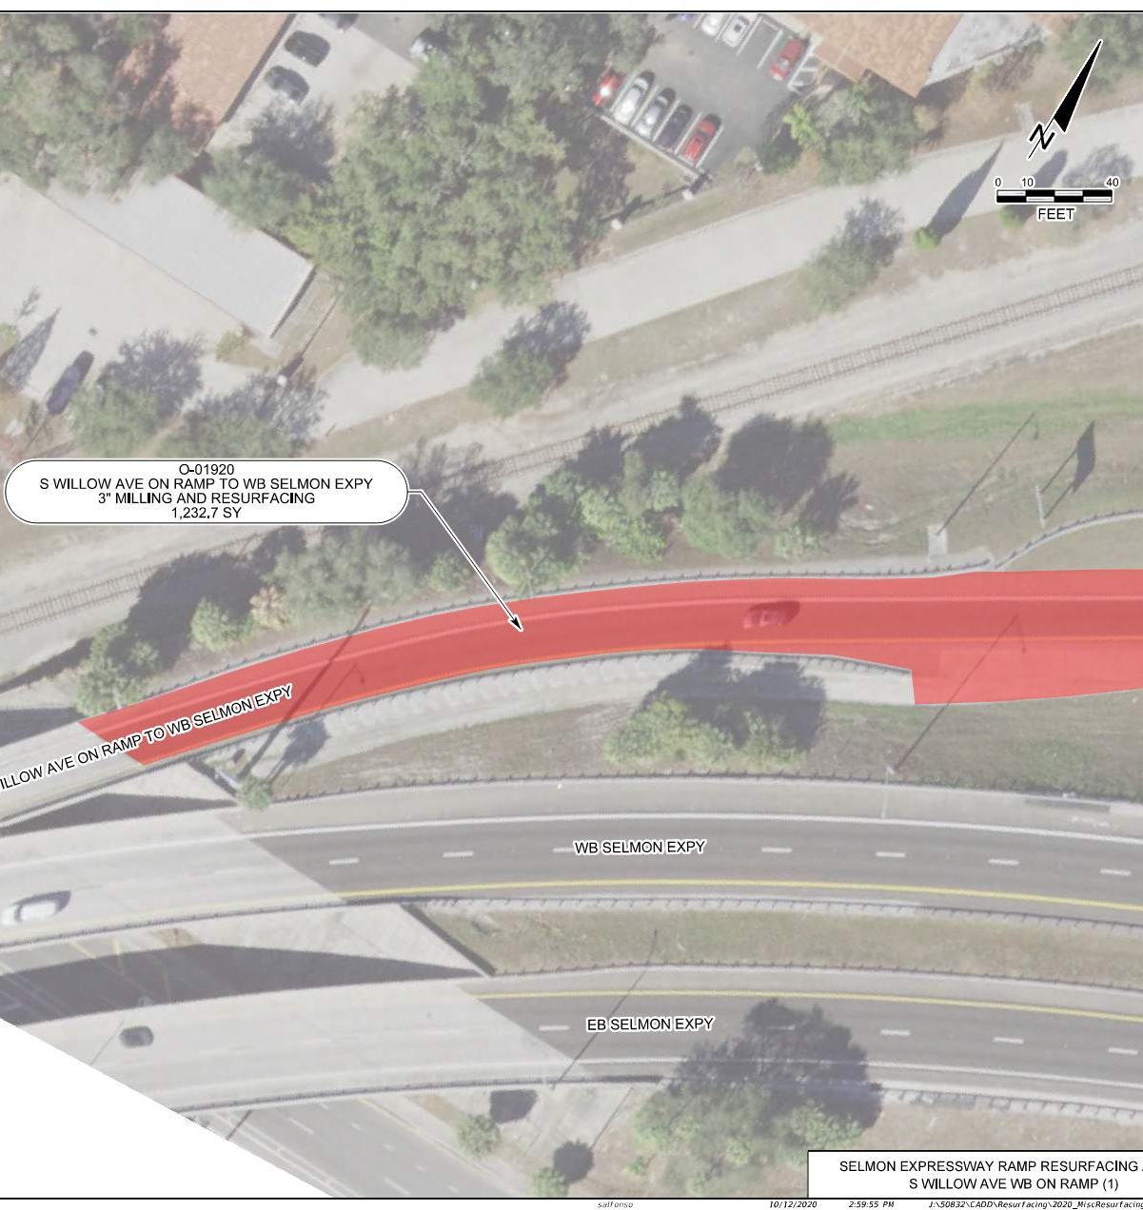
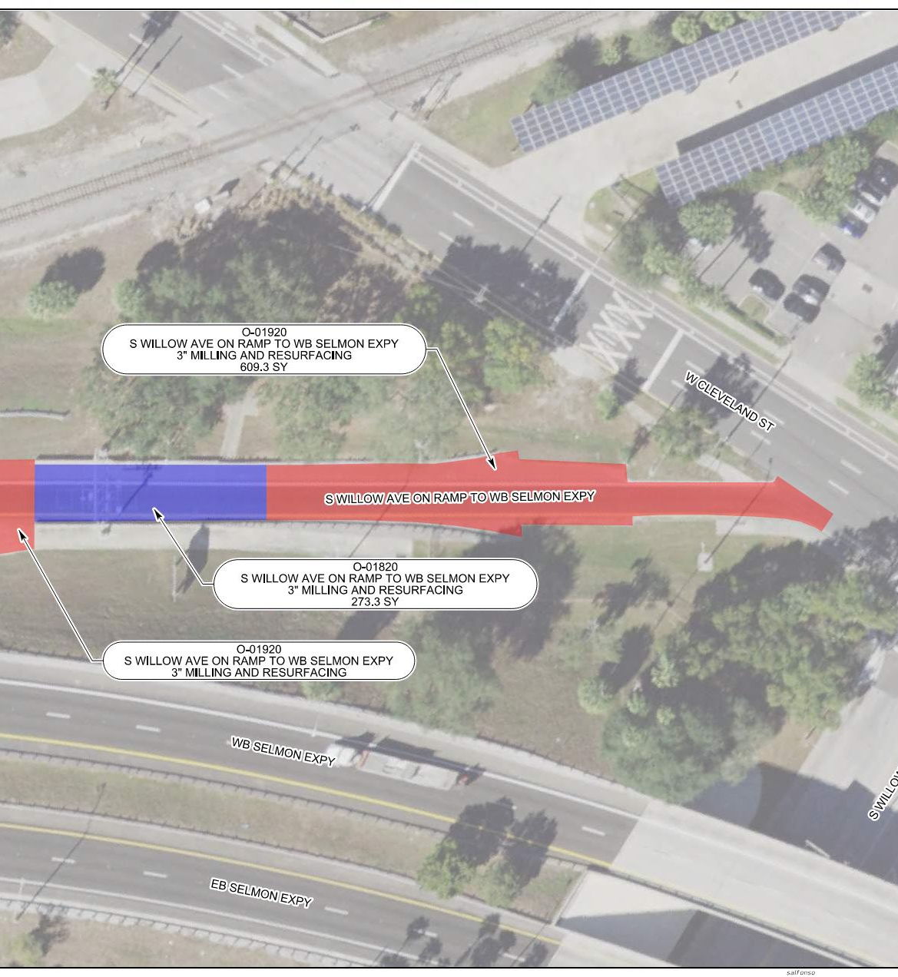
SELMON EXPRESSWAY MISC. RESURFACINGS
WILLOW AVENUE WB ENTRANCE RAMP O-01820/O-01920

Slide 13
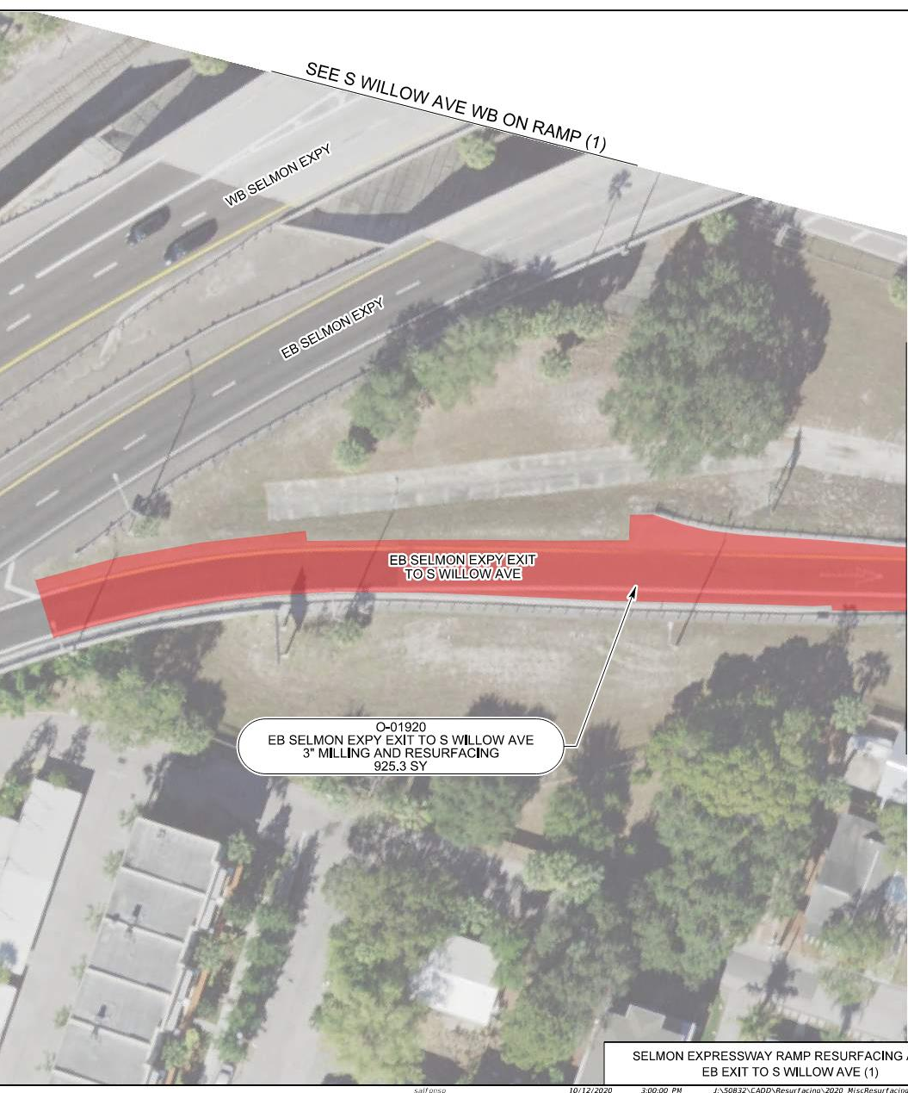
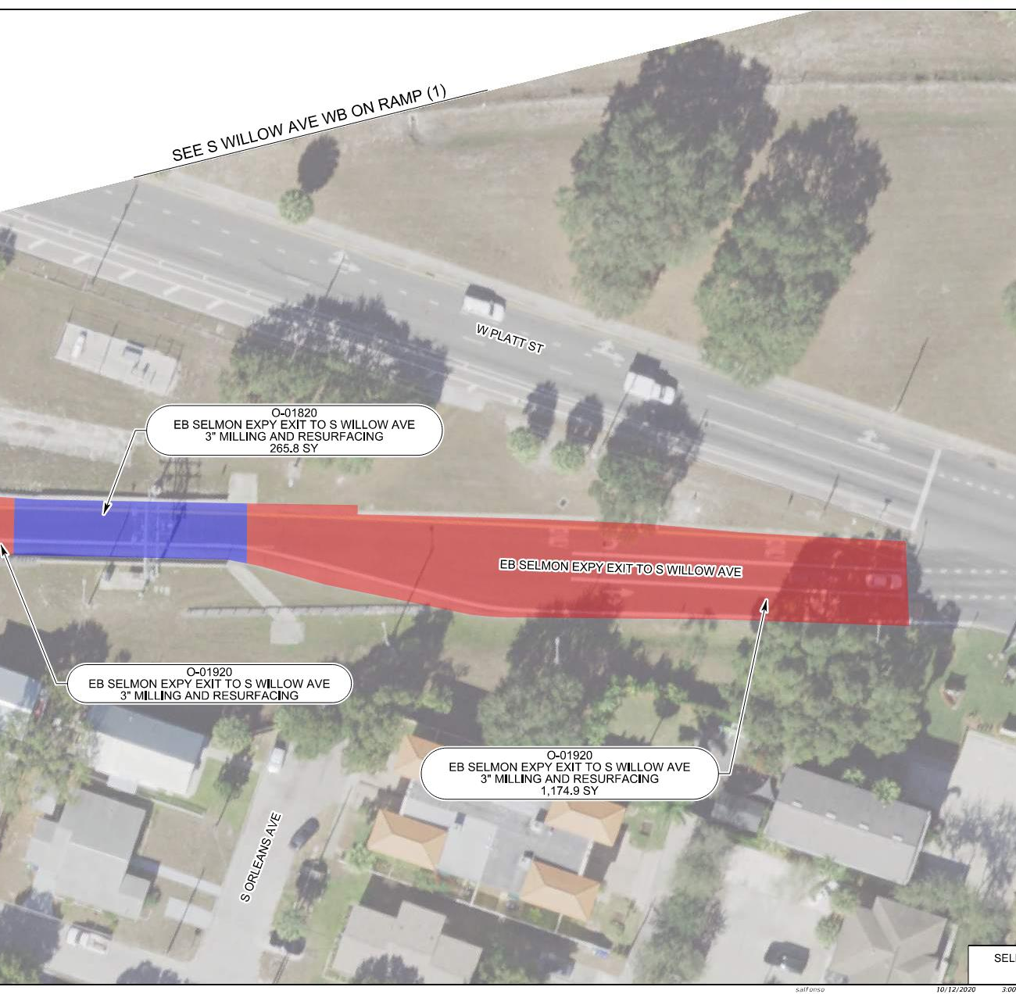
SELMON EXPRESSWAY MISC. RESURFACINGS
WILLOW AVENUE EB EXIT RAMP O-01820/O-01920

Slide 14
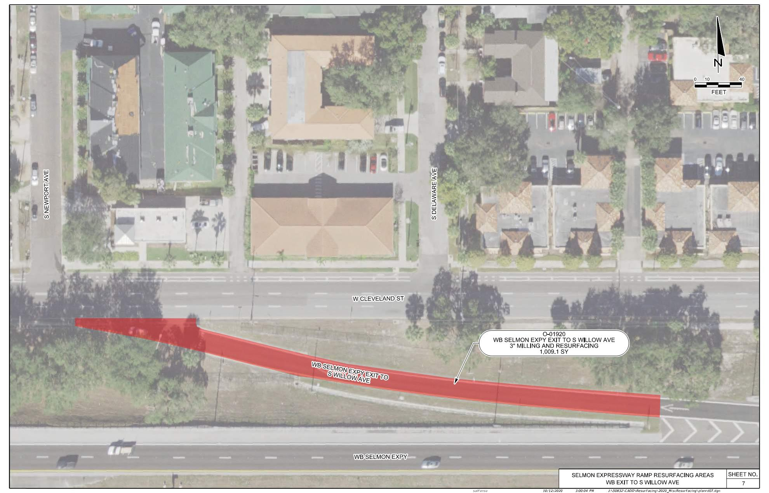
SELMON EXPRESSWAY MISC. RESURFACINGS
WILLOW AVE WB EXIT RAMP O-01920

Slide 15
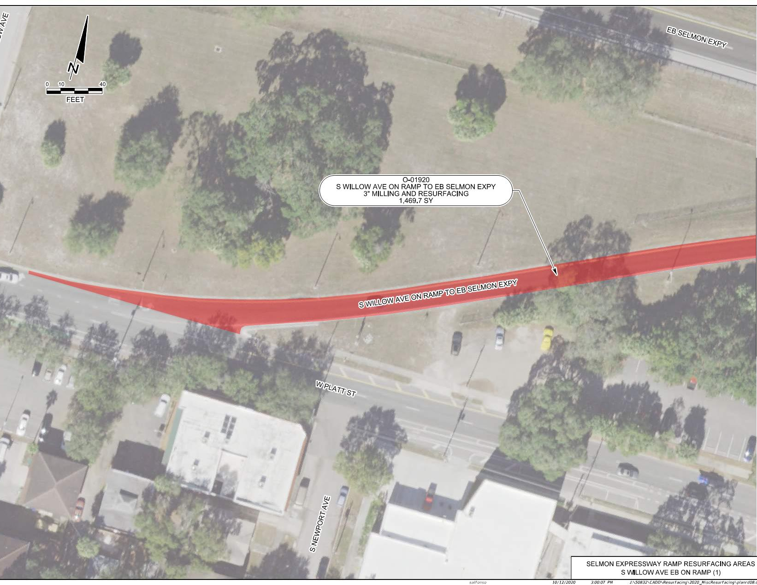
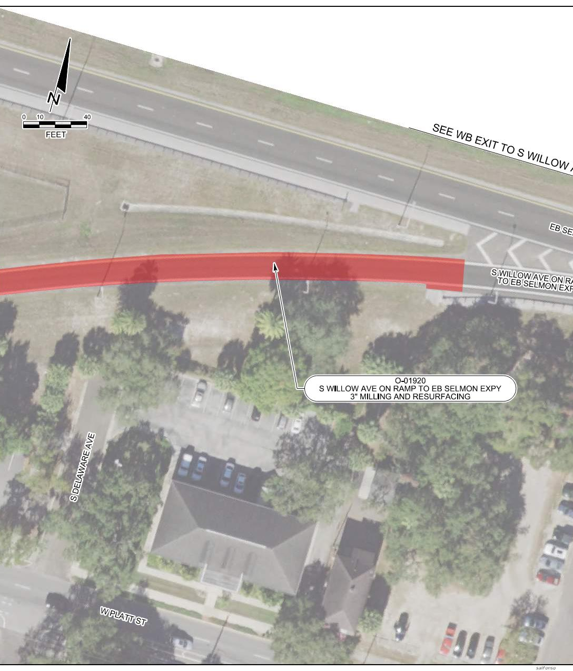
SELMON EXPRESSWAY MISC. RESURFACINGS
WILLOW AVE EB ENTRANCE RAMP O-01920

Slide 16
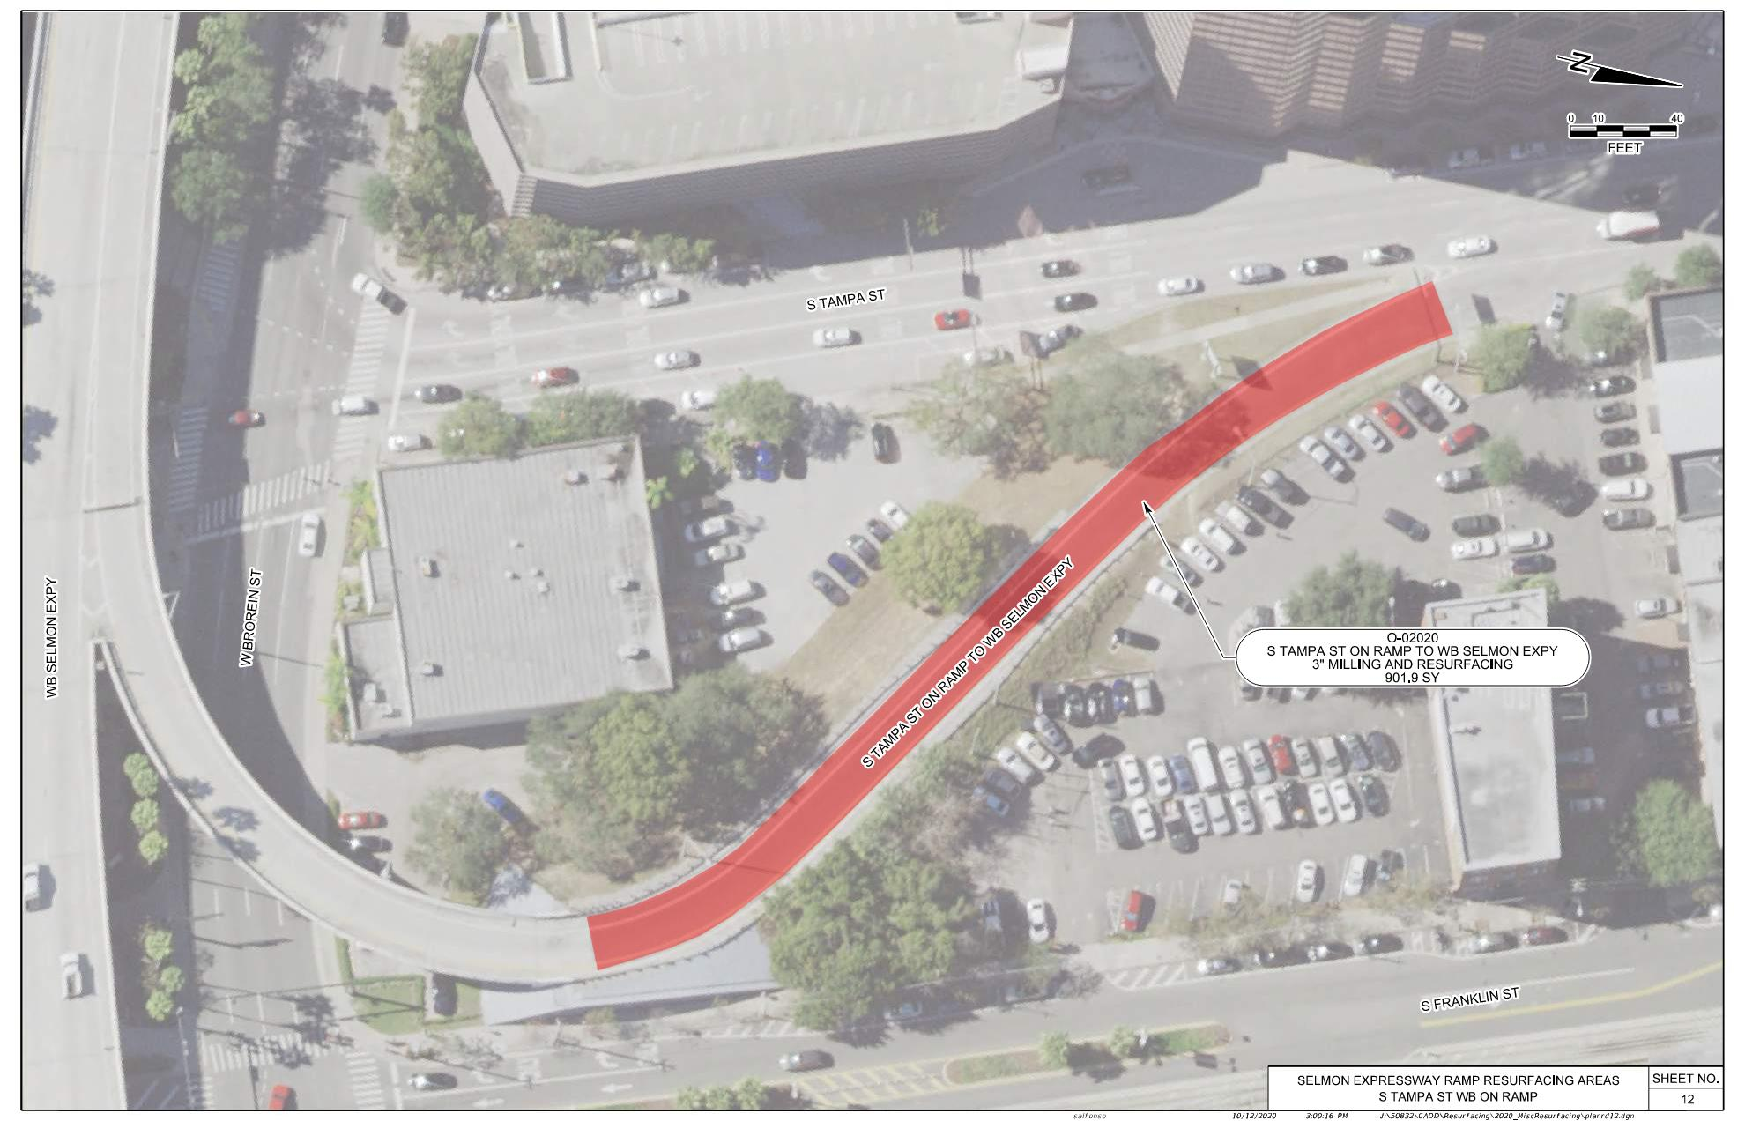
SELMON EXPRESSWAY MISC. RESURFACINGS
TAMPA ST WB ENTRANCE RAMP O-02020

Slide 17
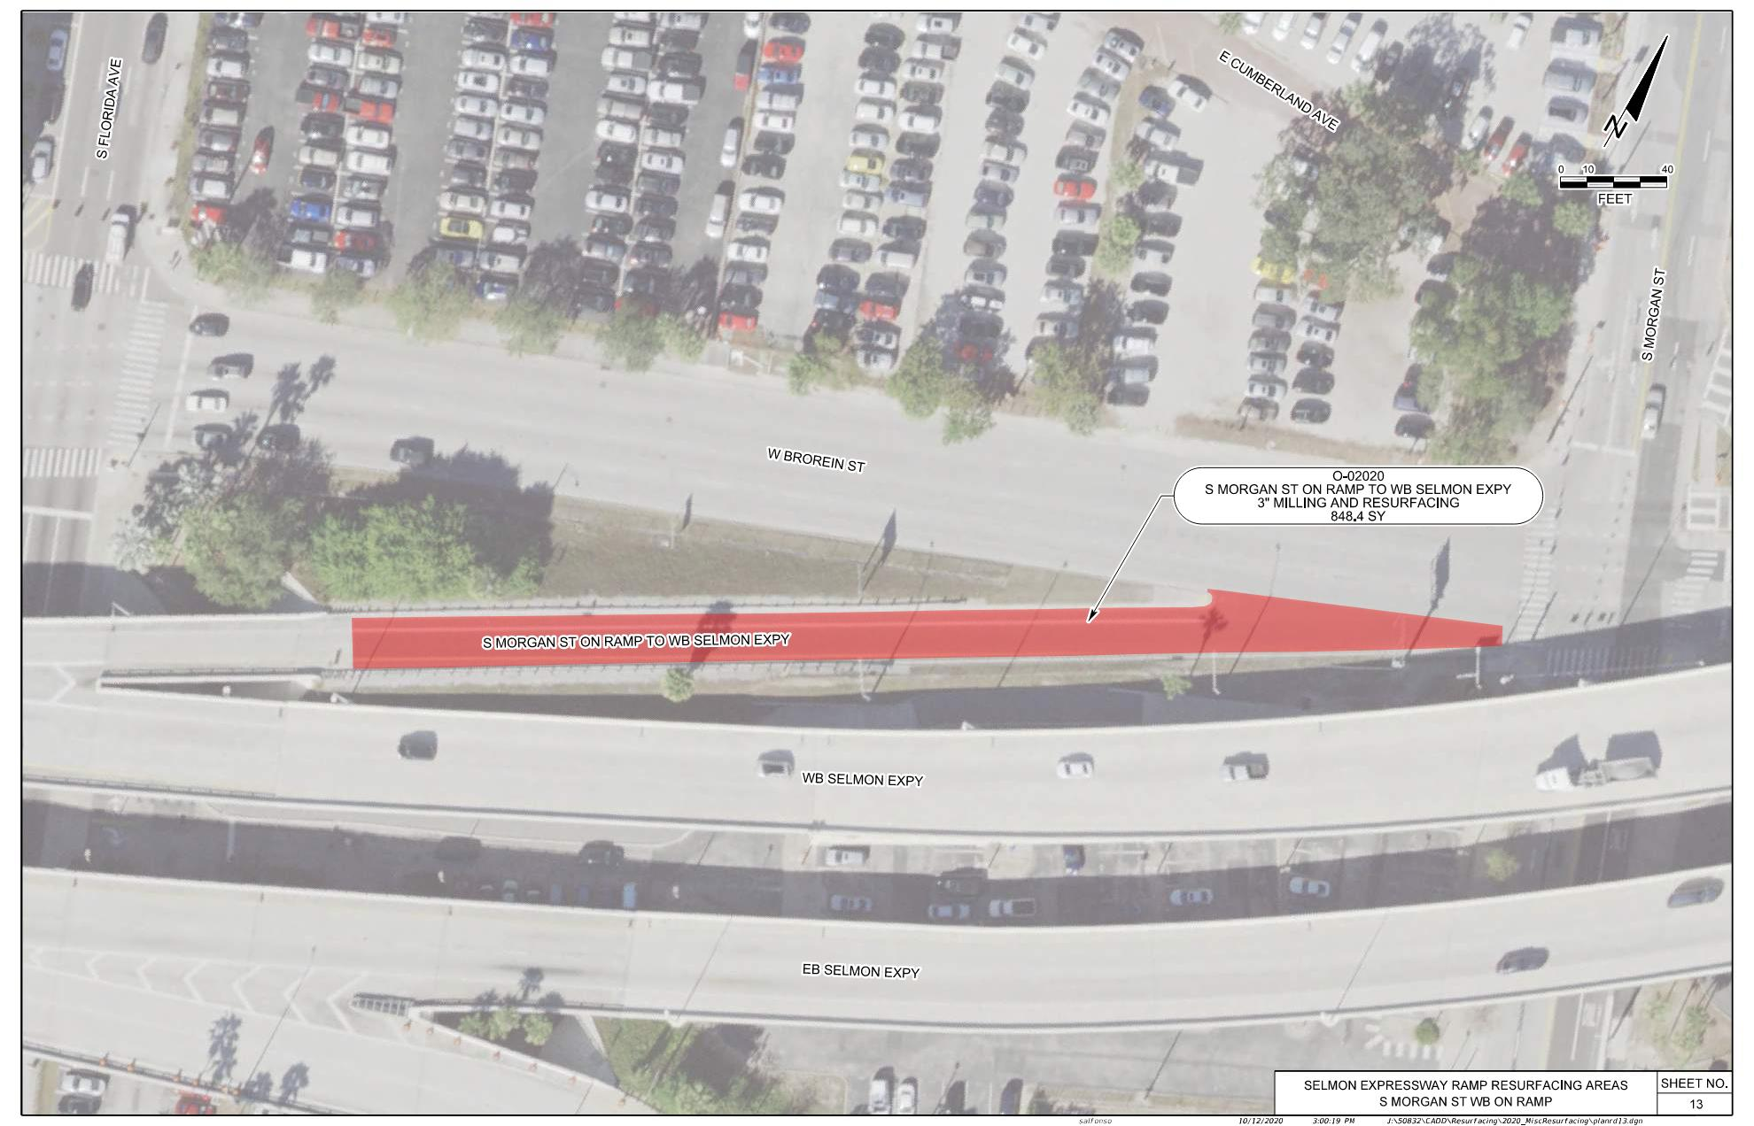
SELMON EXPRESSWAY MISC. RESURFACINGS
MORGAN ST WB ENTRANCE RAMP O-02020

Slide 18
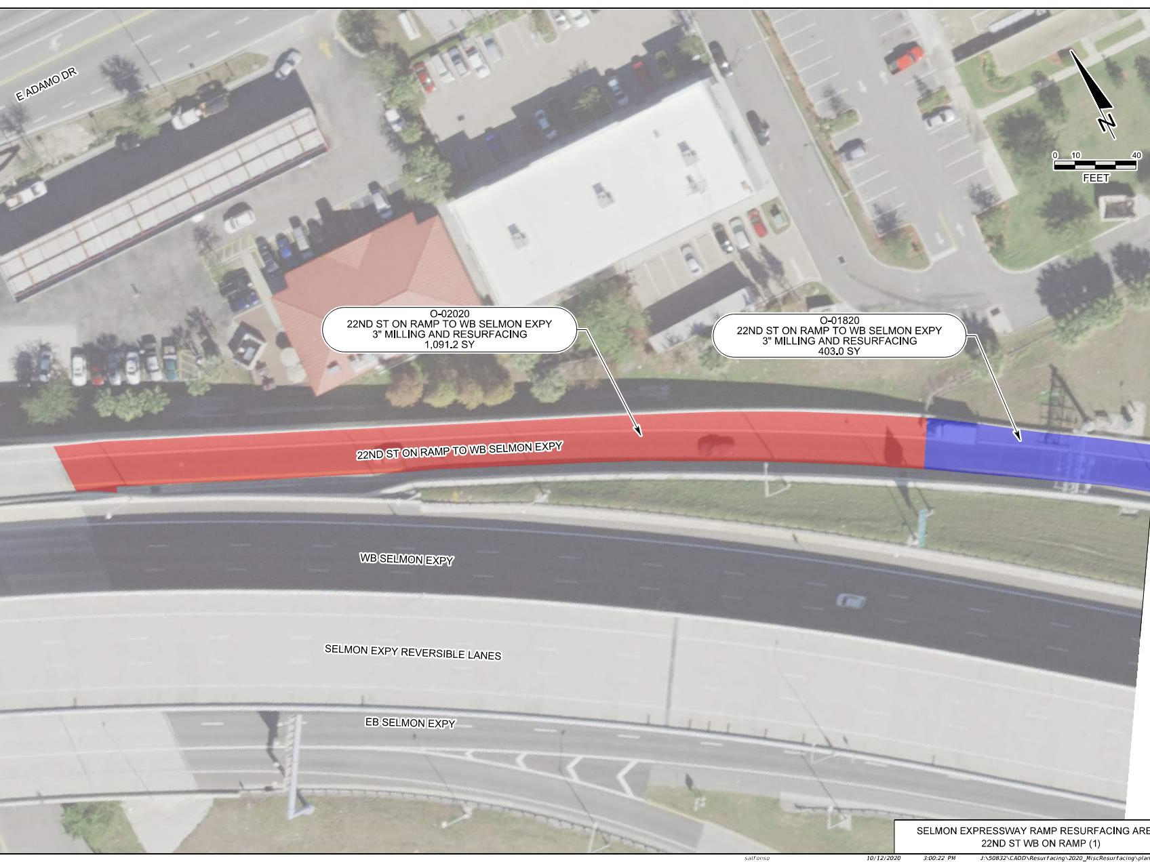
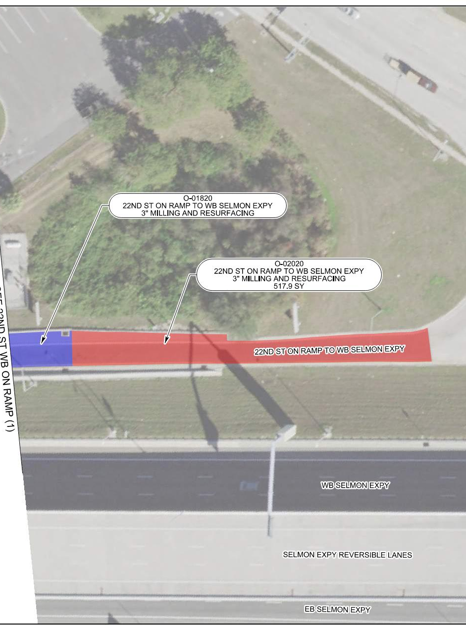
SELMON EXPRESSWAY MISC. RESURFACINGS
22ND ST WB ENTRANCE RAMP O-01820/O-02020

Slide 19
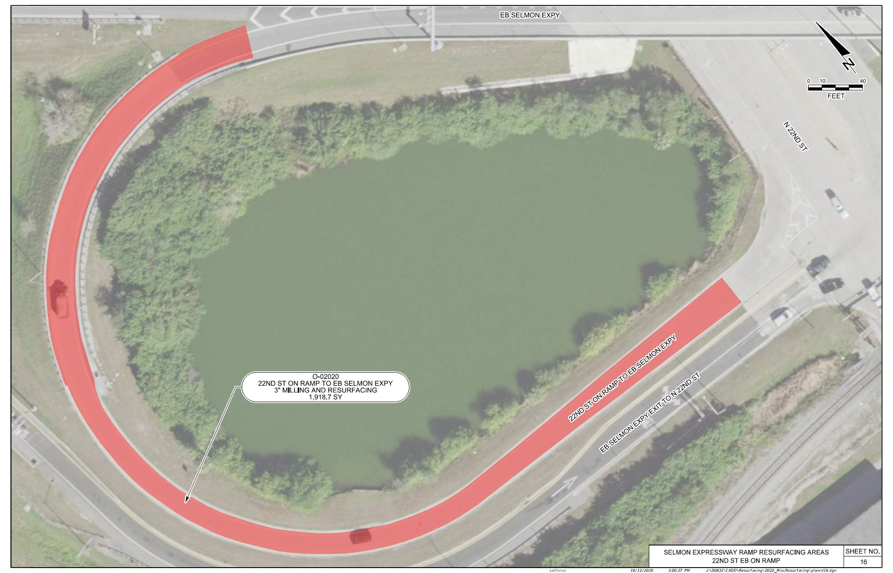
SELMON EXPRESSWAY MISC. RESURFACINGS
22ND ST EB ENTRANCE RAMP O-02020

Slide 20
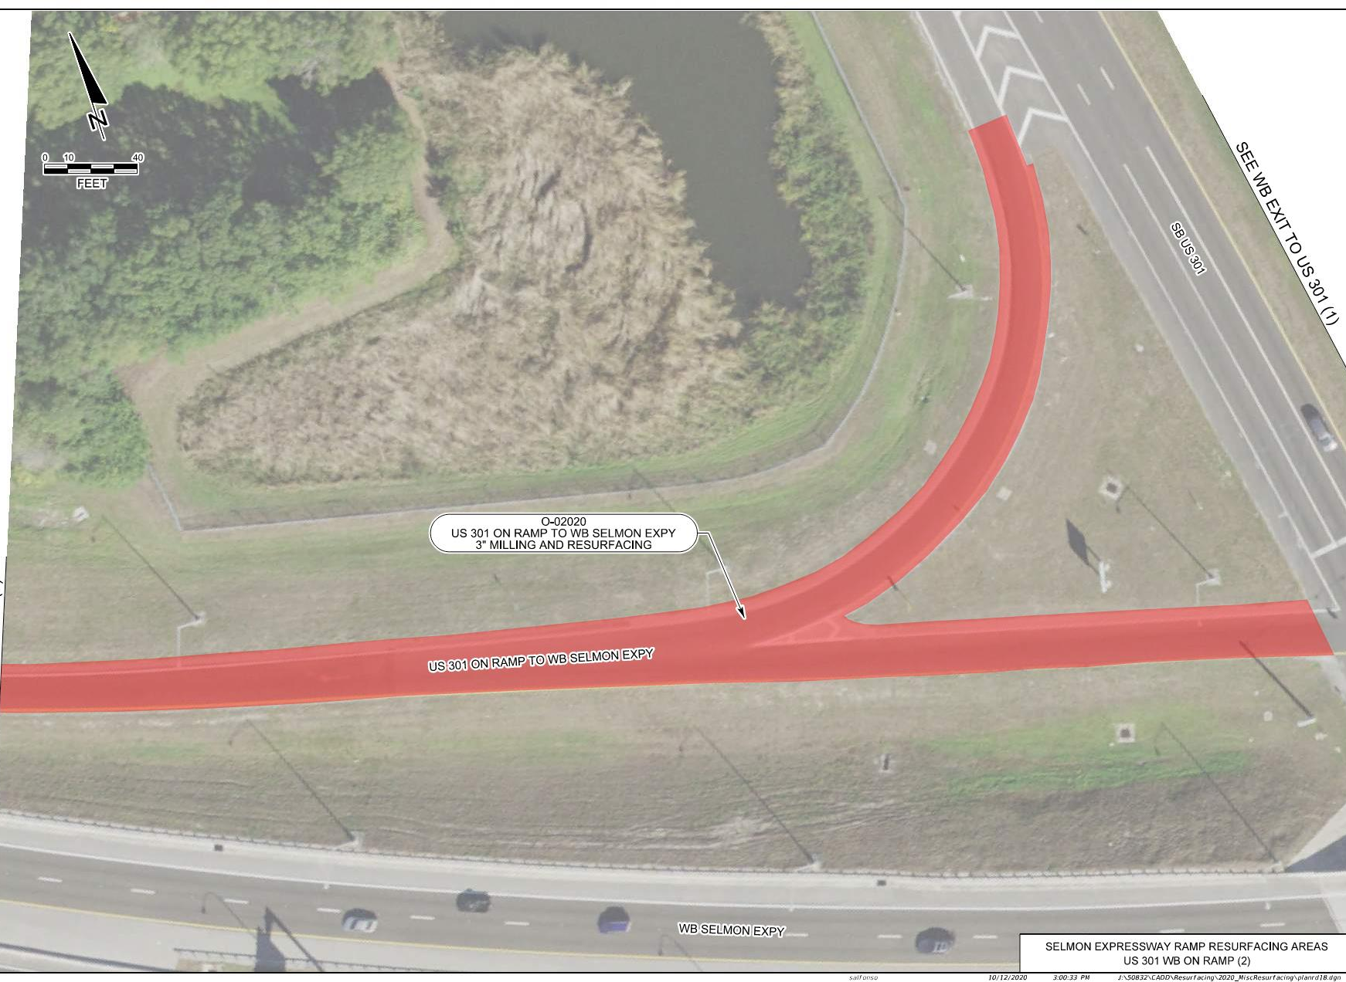
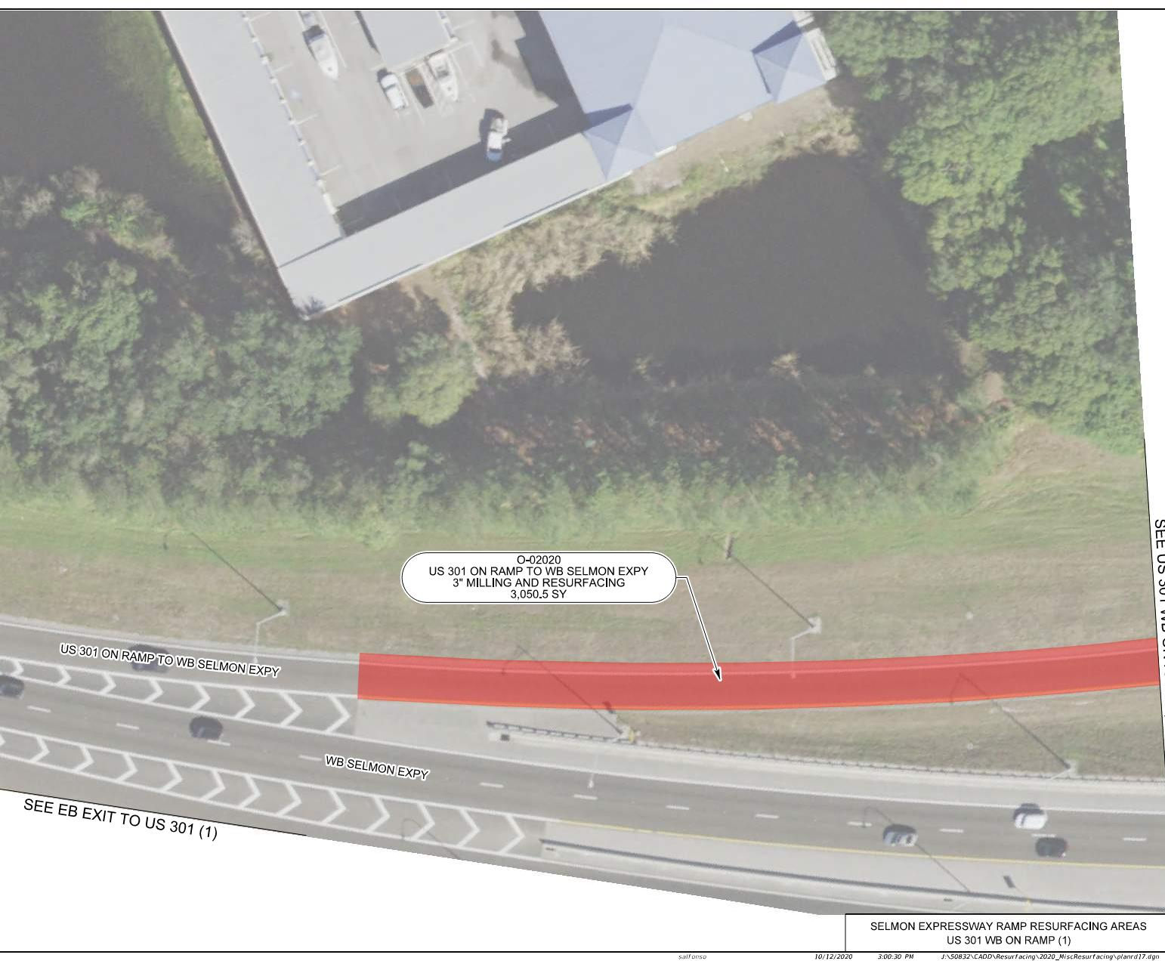
SELMON EXPRESSWAY MISC. RESURFACINGS
US HWY 301 WB ENTRANCE RAMP O-02020

Slide 21
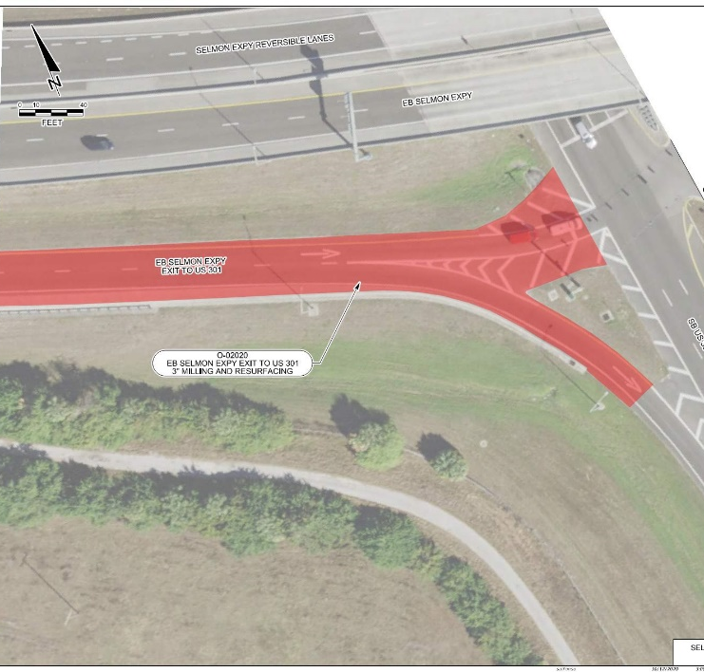
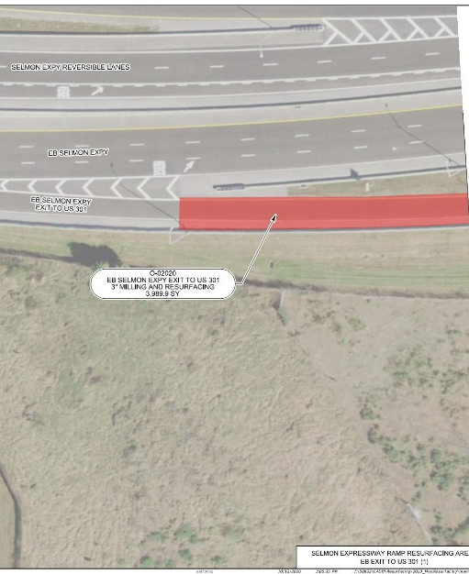
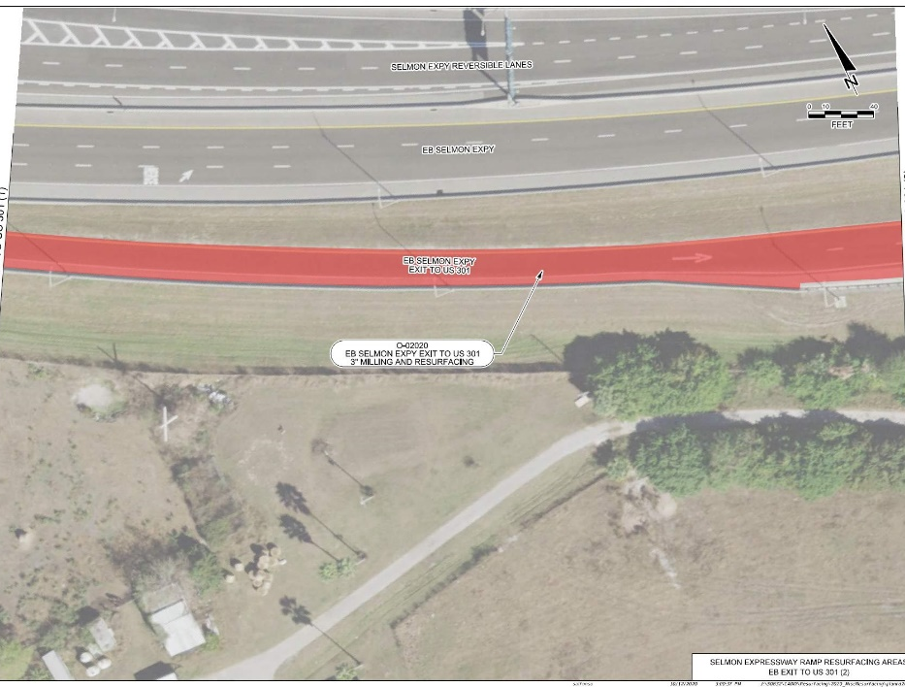
SELMON EXPRESSWAY MISC. RESURFACINGS
US HWY 301 EB EXIT RAMP O-02020

Slide 22
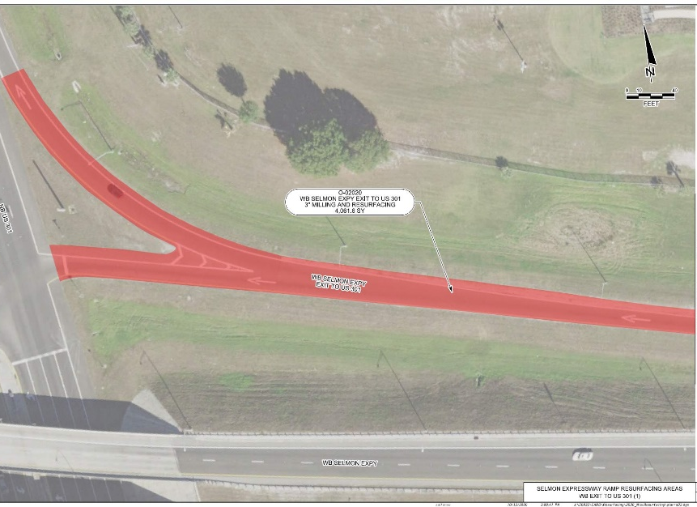
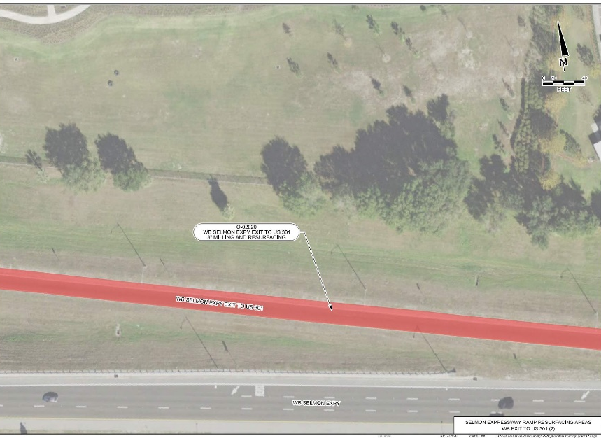
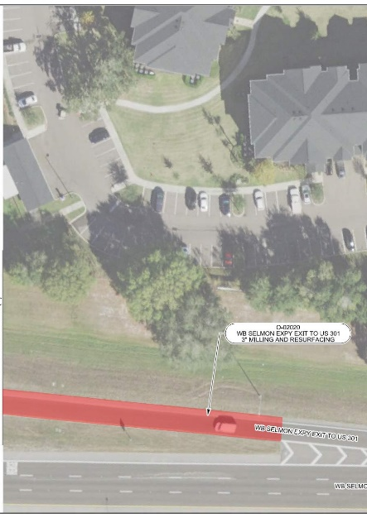
SELMON EXPRESSWAY MISC. RESURFACINGS
US HWY 301 WB EXIT RAMP O-02020

Slide 23
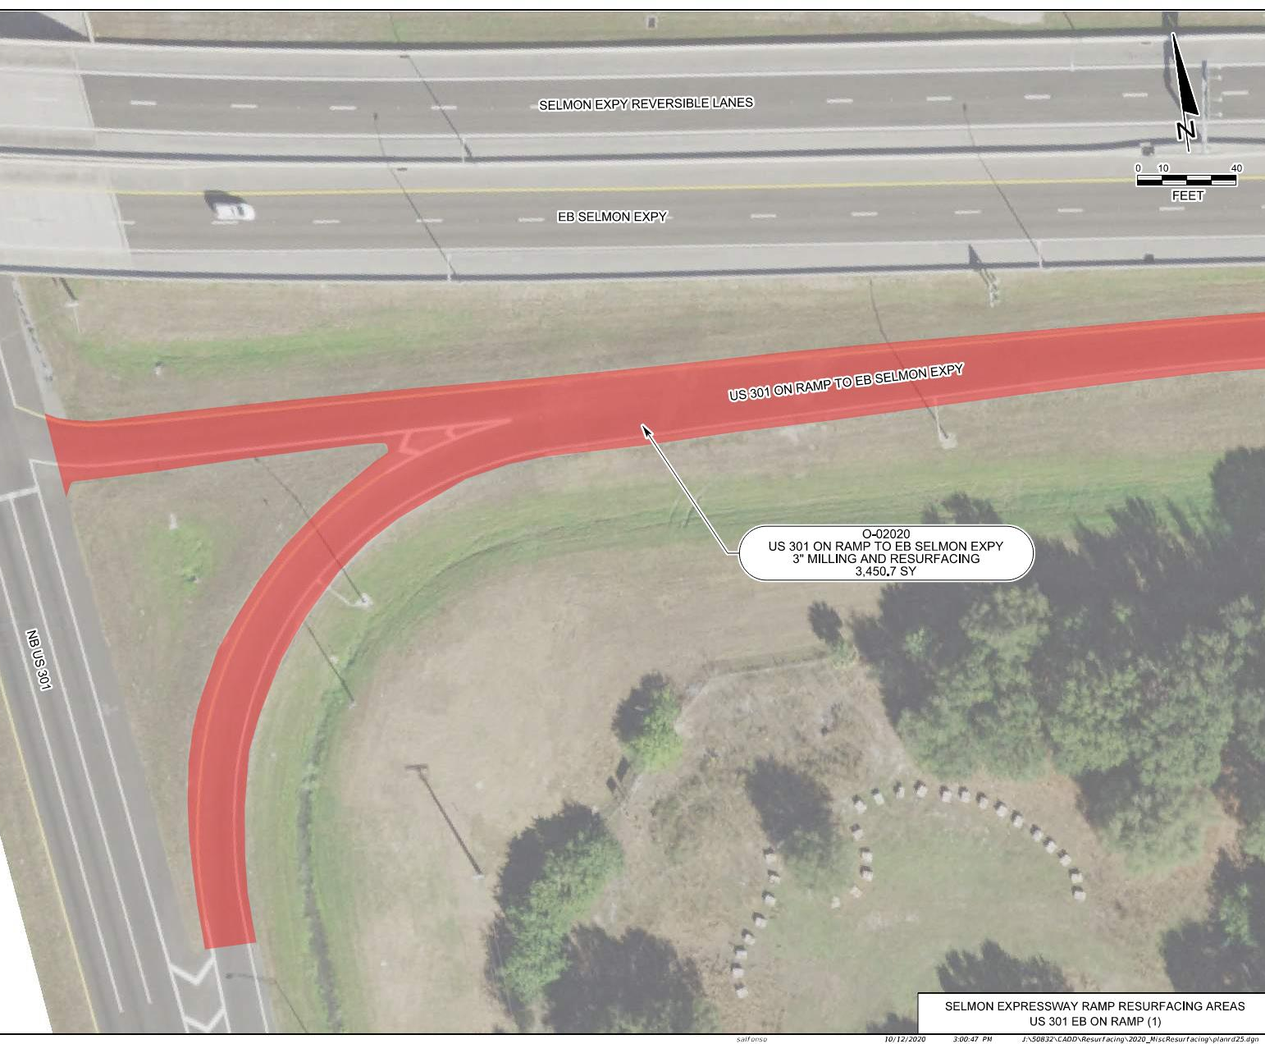
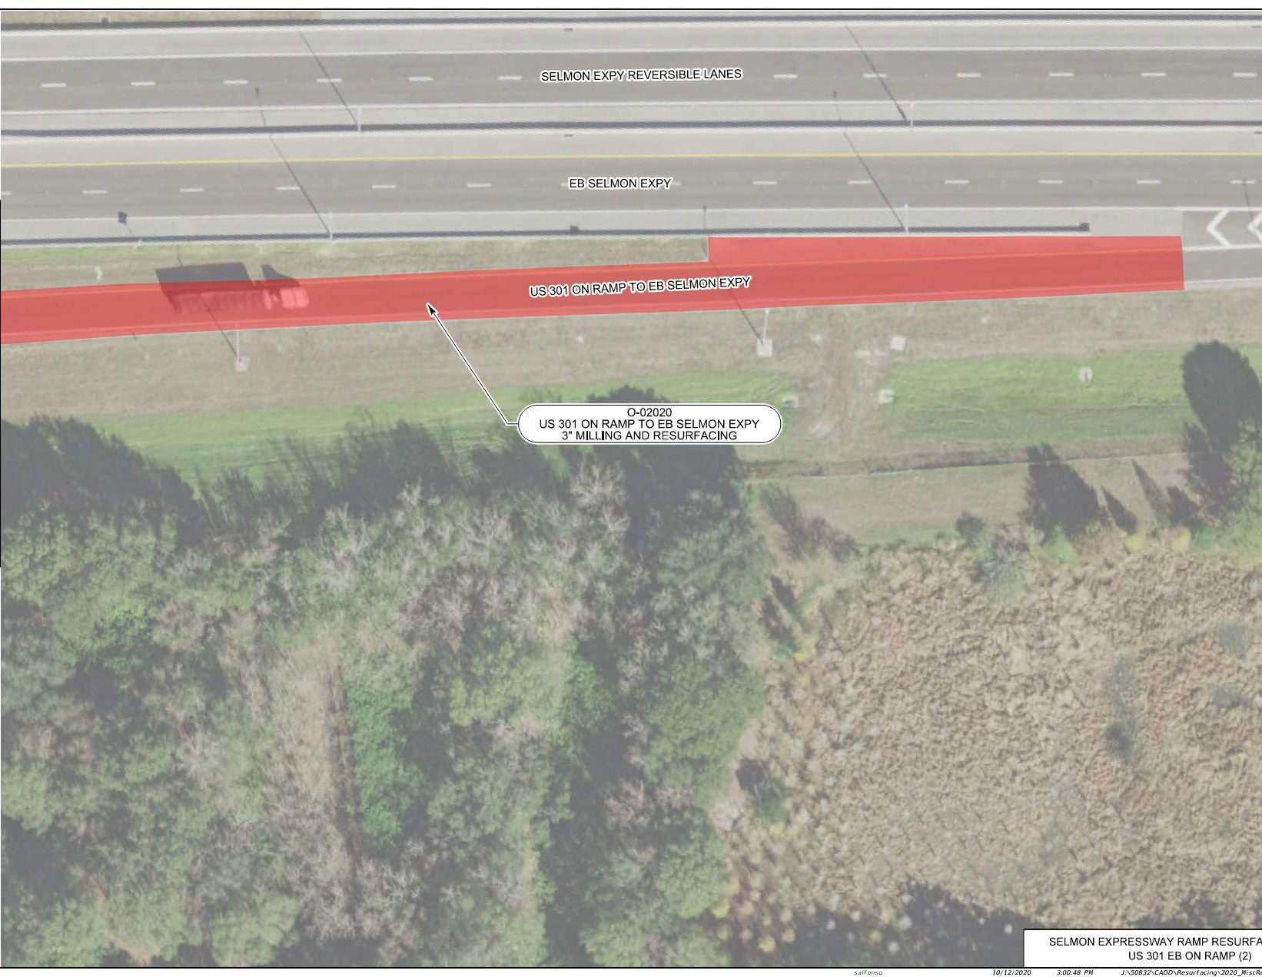
SELMON EXPRESSWAY MISC. RESURFACINGS
US HWY 301 EB ENTRANCE RAMP O-02020

Slide 24
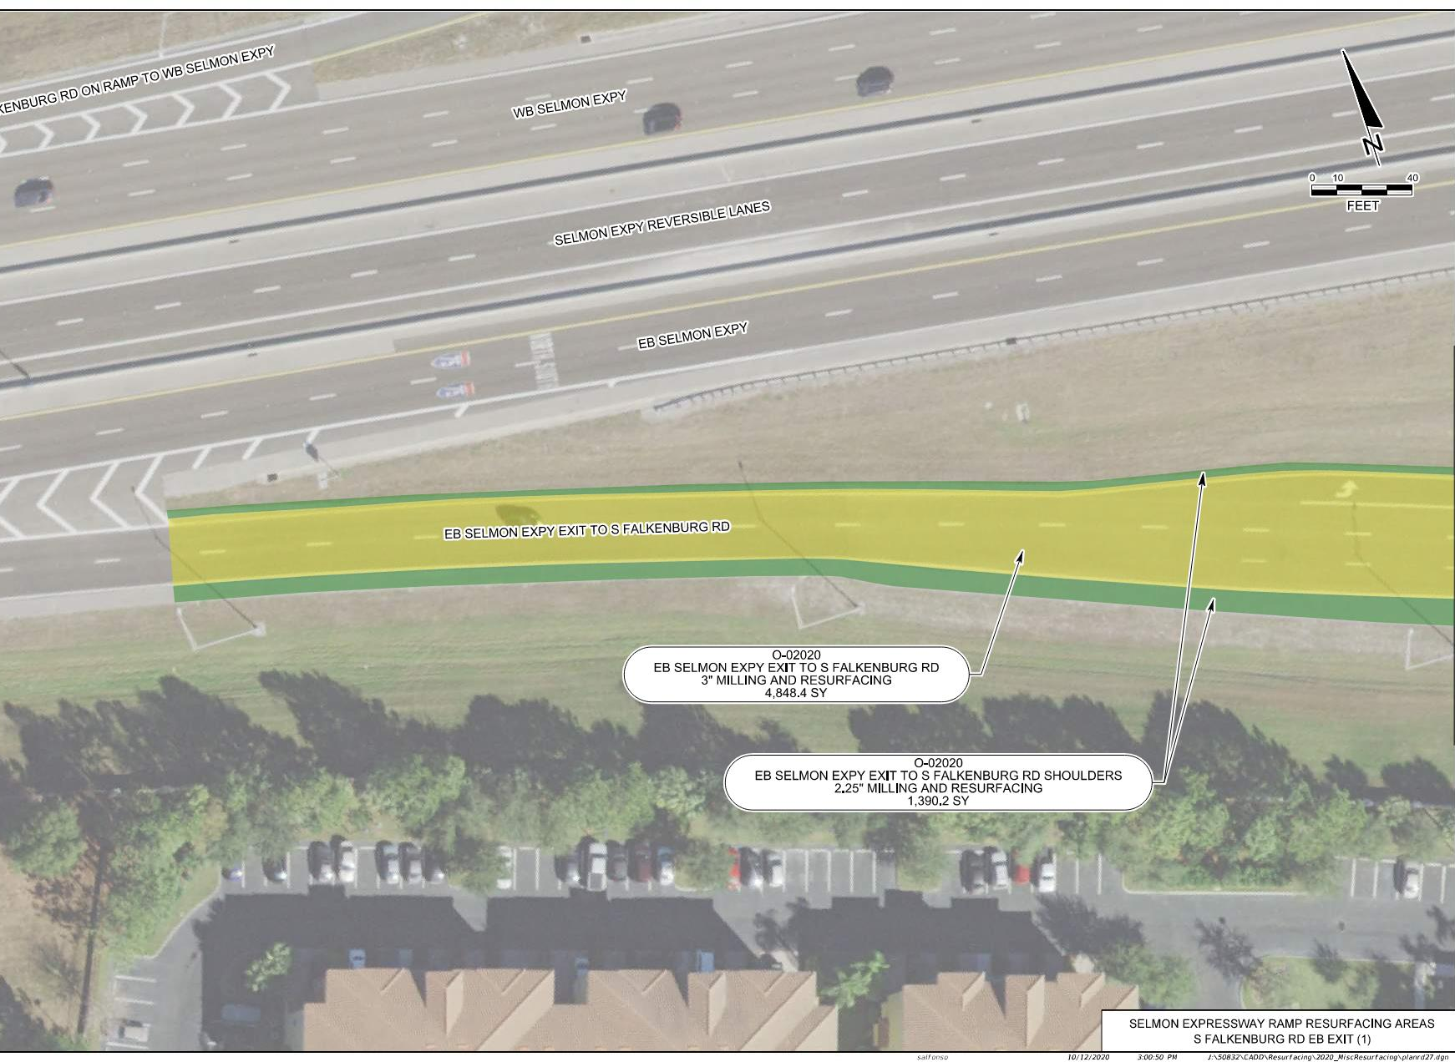
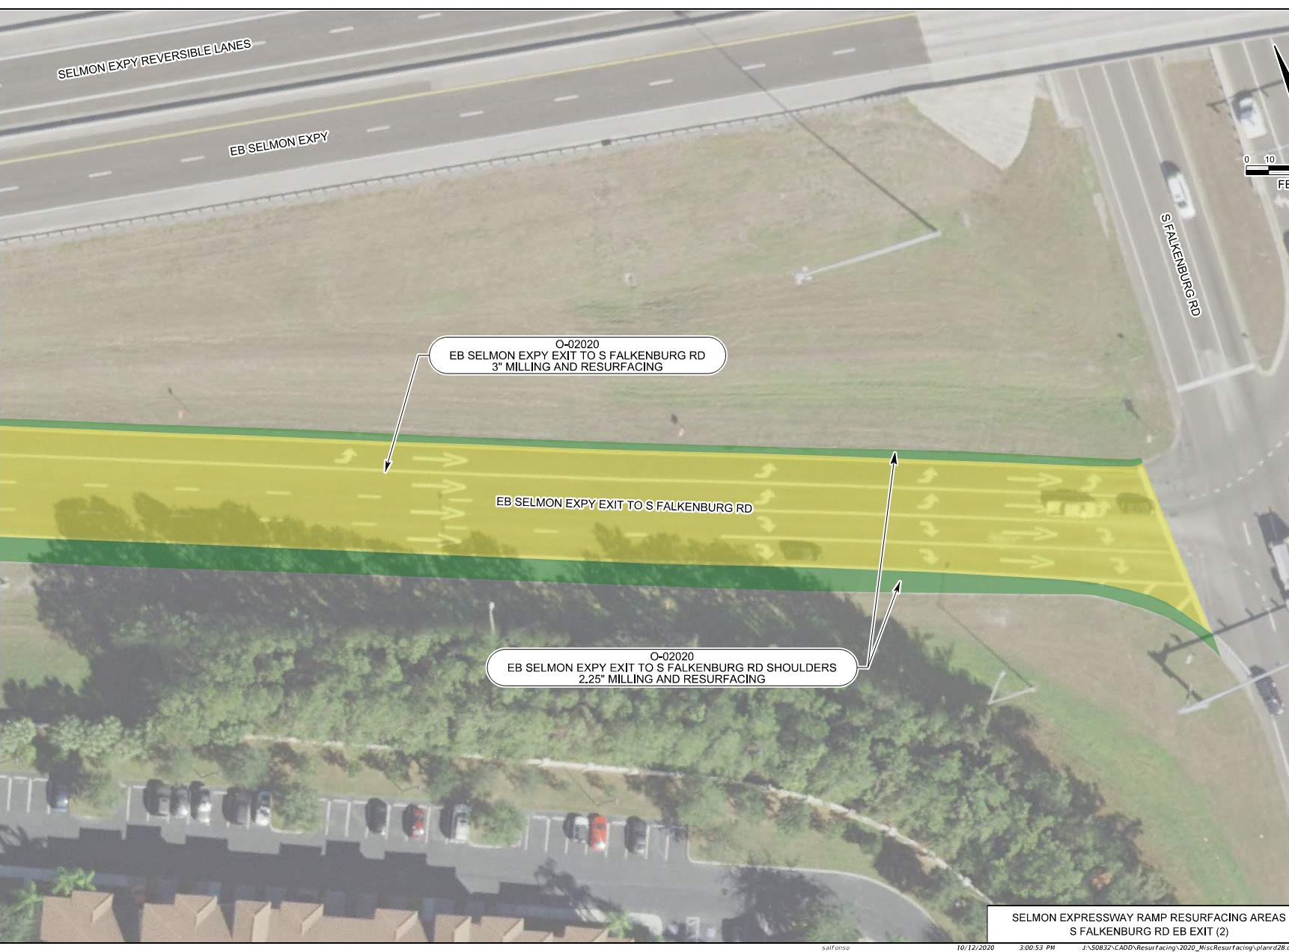
SELMON EXPRESSWAY MISC. RESURFACINGS
FALKENBURG RD EXIT RAMP O-02020
FC-5: LANES AND 8” SHLDR. OVERLAP

Slide 25
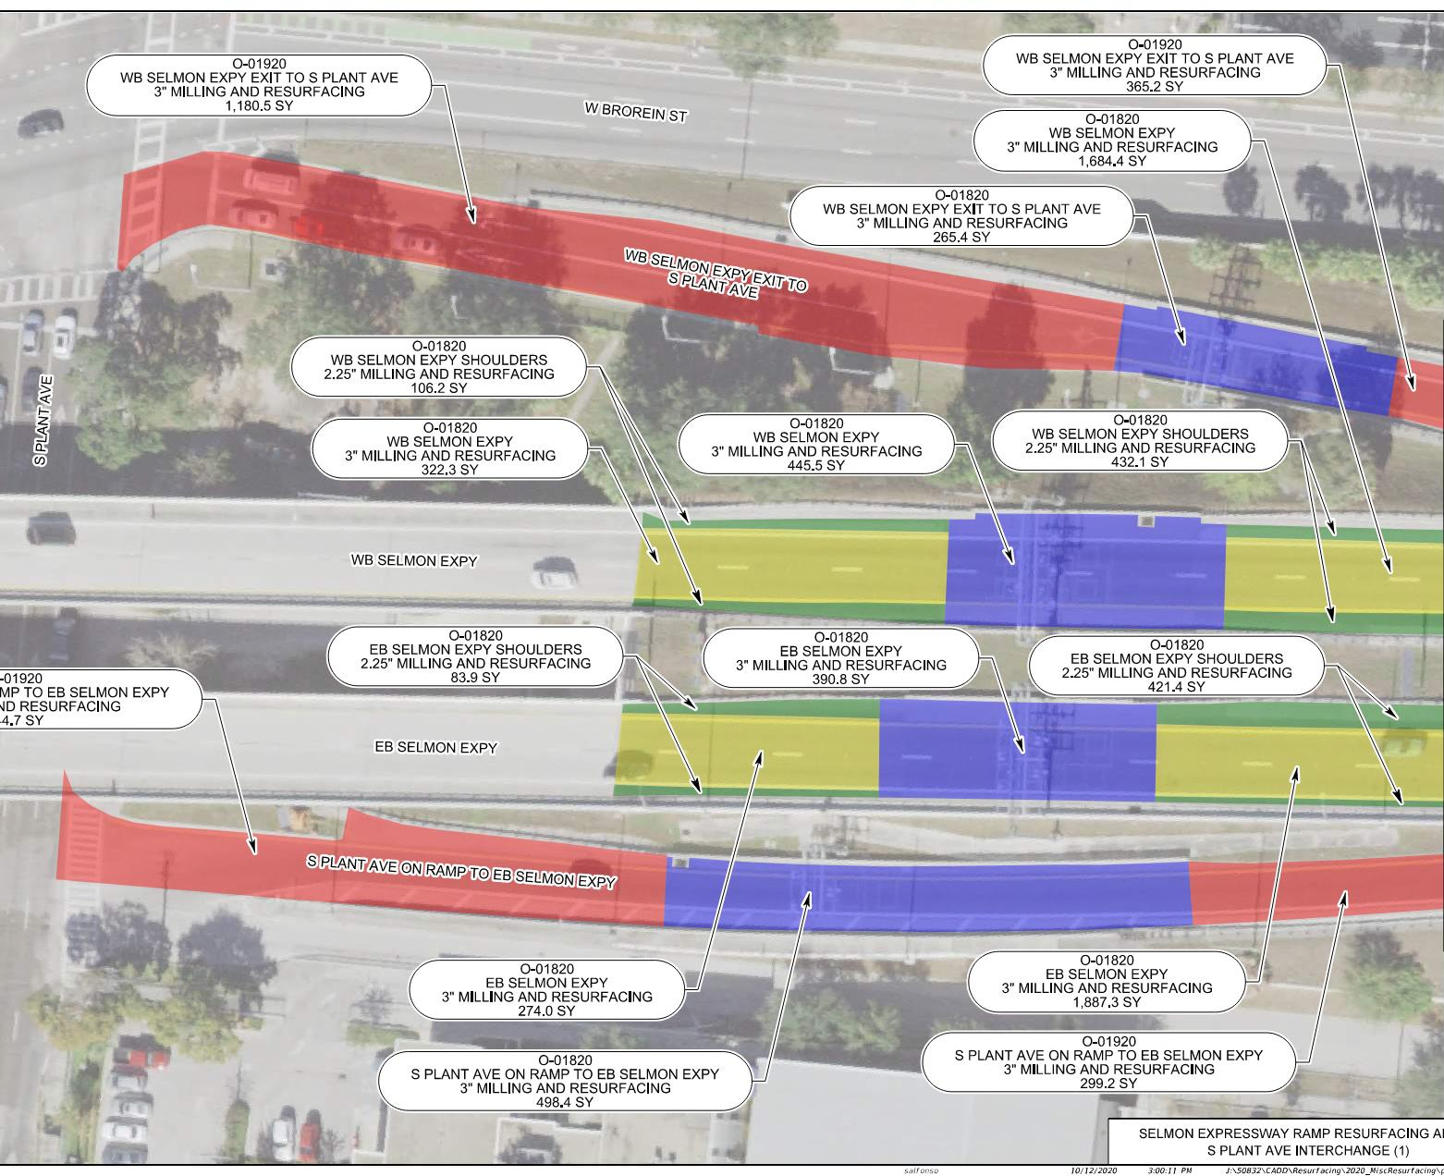
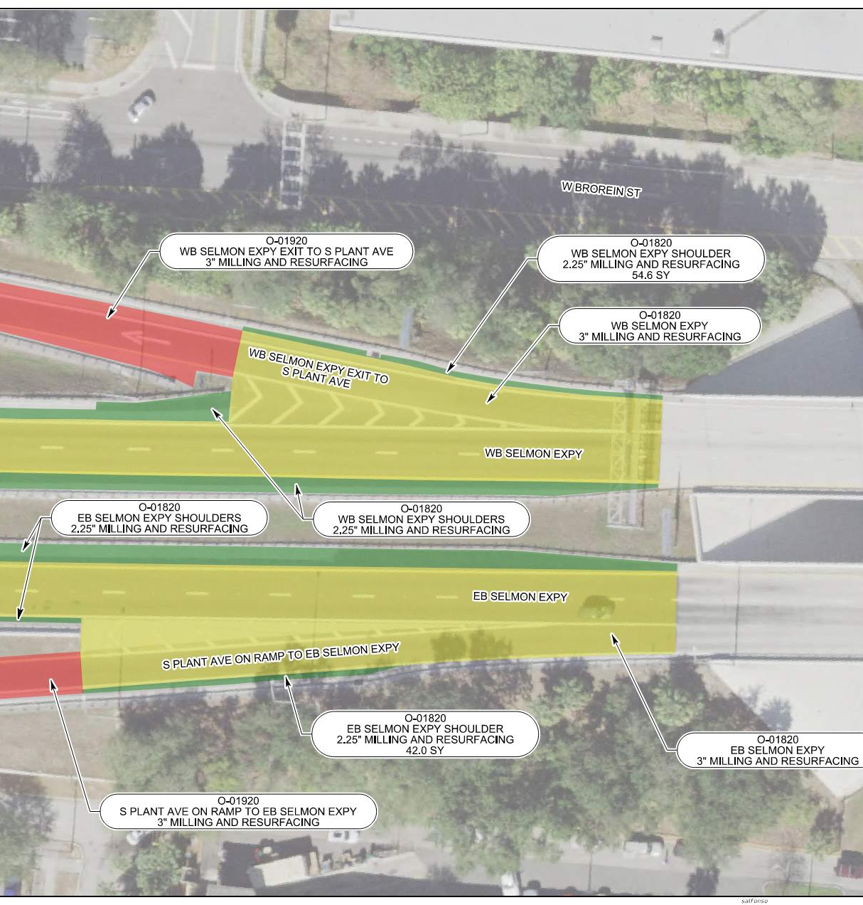
SELMON EXPRESSWAY MISC. RESURFACINGS
SOUTH SELMON GANTRY AREA O-01820/O-01920
TRANSITION TO FC-12.5 AT TOLL GANTRIES

Slide 26
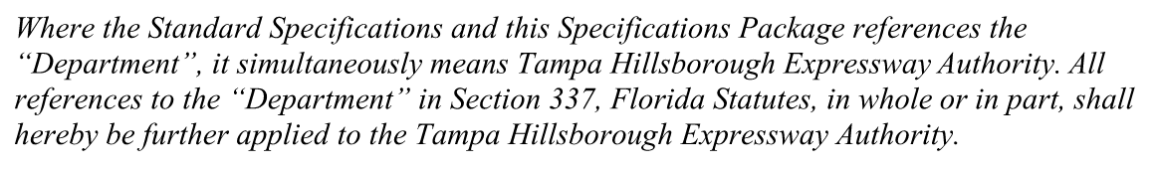
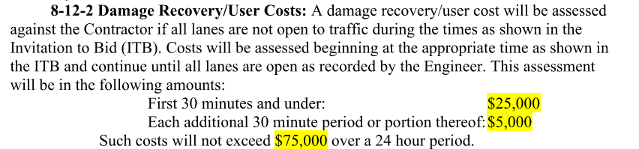
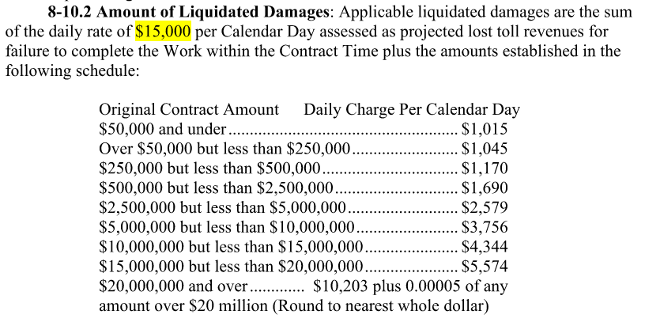
SELMON EXPRESSWAY MISC. RESURFACINGS
Use THEA-modified FDOT Specifications
Liquidated Damages/Damage Recovery

Slide 27
CEI/PUBLIC INVOLVEMENT
Consor/KCI - THEA CEI Consultant
Sue Chrzan & THEA staff/consultants to perform Public Involvement efforts

Slide 28
Schedule
Deadline for Questions:
October 26, 2020
Deadline for Responses to Questions:
October 30, 2020

Slide 29
Schedule
Bid Package Due:
2:00pm November 5, 2020
November 16, 2020:
THEA Board Approval
NTP & Construction:
January 4, 2021 - May, 2021

Slide 30
Project Documents
http://www.tampa-xway.com/procurement/#
Project is advertised, therefore, cone of silence is in effect for all THEA, FDOT, HNTB, and Consor/KCI staff until Board of Directors Selection.
All questions should be emailed to Man Le, THEA Contracts & Procurement Manager: man.le@tampa-xway.com
Answers will be posted on the THEA website

Slide 31

Questions?

