Slide 1
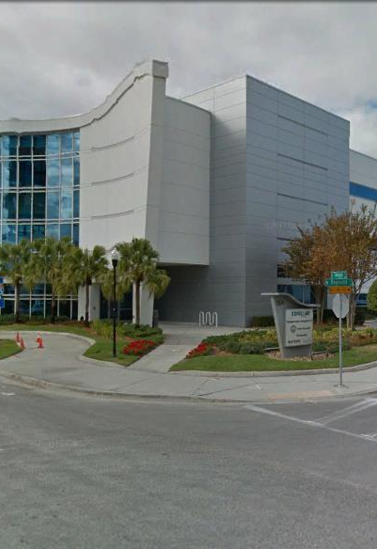
Tampa Hillsborough
Expressway
Authority
O-00820
Twiggs Street Improvements
Low Bid Design-Build Pre-Proposal Meeting
6/11/2020

Slide 2
Introductions
Man Le – THEA Contracts & Procurement Manager
Judith Villegas, EI– THEA Project Manager
Sue Chrzan– THEA Director of Public Affairs and Communications
Brian Ramirez – THEA Planning & Communications Assistant
Jim Drapp, PE – THEA GEC Program Manager
Al Stewart, PE– THEA GEC
Dave Hubbard, PE – THEA GEC

Slide 3
Project Roles
Tampa Hillsborough Expressway Authority (THEA)- Developer
City of Tampa- Owner
FDOT – Owner (Nebraska Ave/SR 45/US 41)
HNTB- General Engineering Consultant (GEC) to THEA
Tierra- Geotechnical Consultant to GEC & THEA
Element- Survey Consultant to GEC & THEA
Omni- Utilities Consultant to GEC & THEA
Judith Villegas, EI- THEA Project Manager
Brian Pickard, PE- THEA Director of Expressway Operations (Effective 6/15/20)
Jim Drapp, PE- GEC Project Manager

Slide 4

Agenda
Project Overview & Objectives
Innovative Aspects
Letters of Interest
Technical Proposal
Price Proposal
SBE
DB Stipend
TRC Members & Technical Advisors
Construction Engineering & Inspection (CEI)
Project Documents Questions

Slide 5
Project Overview & Objectives
Project Limits- West of Nebraska Ave. to Meridian Ave.
Other Projects
Project Goals
Plan Views
Sidewalk & Parking Lots reconfiguration
TTCP/Work Hours
Drainage
Signalization replacement @ Twiggs/Nebraska
  Joint Participation Agreement (JPA) – FDOT Funded
Sign Structures & Lighting
Utility Relocations
Project Information

Slide 6
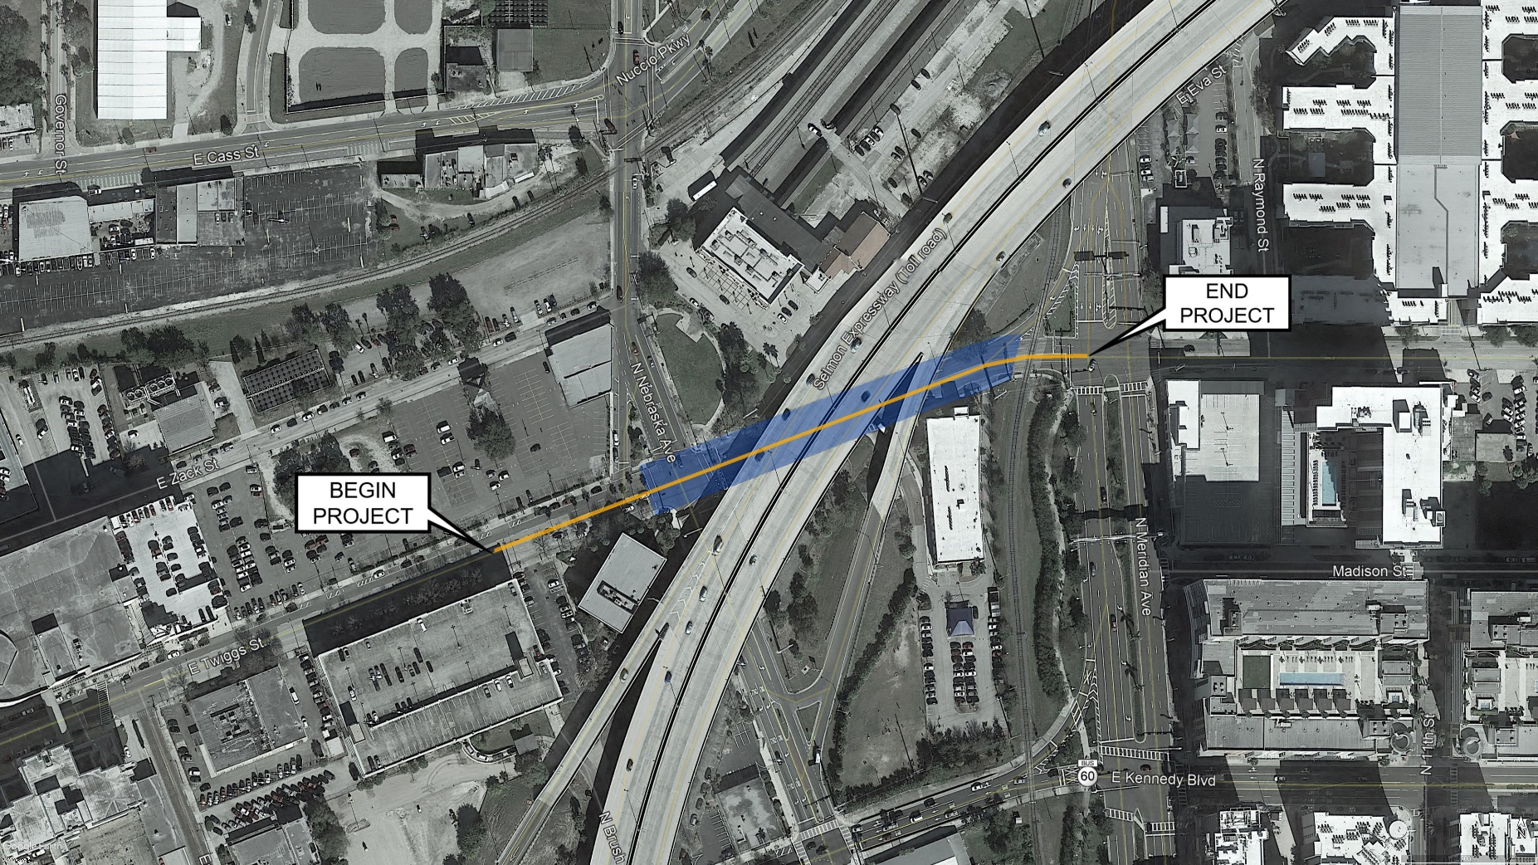
Project Limits

Slide 7
Project Goals
Improve safety and operational efficiency to the corridor within the limits described.
Minimize the inconvenience to the travelling public.
Improve, to the maximum extent possible, the quality of existing traffic operations, both in terms of flow rate and safety, throughout the duration of the Project.
Minimize the number of different Traffic Control Plan (TCP) phases, i.e., number of different diversions and detours for a given traffic movement.
Maintain direct access to adjacent properties at all times.
Coordinate with adjacent construction projects and maintaining agencies.
Minimize the inconvenience to adjacent railroad station and charter school.

Slide 8
FDOT JPA Requirements
FDOT providing funding for intersection signal upgrades through Joint Participation Agreement (JPA), included in RFP attachments.
All JPA work requires separate project tracking, reporting and invoicing.
DB Firm and CEI Firms are responsible for adhering to JPA requirements, not limited to:
  Design and construct the intersection in accordance with all FDOT procedures and specifications
  Testing and sampling per FDOT Materials Manual and entered into MAC
  FDOT design coordination and reviews
  FDOT Standard Clear Letters
  RFC process and as-built procedures to follow FDOT, and FDOT will approve signalization and ITS components as applicable
Additional terms of the FDOT Construction Agreement (under review)
RFC and As-built Process
  FDOT to review and approve RFC plans and as-builts
  Exhibit ‘C’ - Engineer’s Certification of Compliance

Slide 9
Twiggs Street DB Project
ROADWAY PLANS

Slide 10
Twiggs Street DB Project
ROADWAY PLANS

Slide 11
Twiggs Street DB Project
COT SIDEWALK
REVISIONS AND PARKING LOT RECONFIGURATIONS

Slide 12
Roadway
Typical Section Package submittal required
Combination of widening and milling and resurfacing w/ overbuild anticipated
  Pavement design provided in the RFP
  Reconstruction option by DB Firm
Resurface as needed to replace markings removed during MOT and to place high-emphasis crosswalk markings.
Lateral Offset to Bridge Piers
  Verify existing columns meet 600-kip Vehicle Collision Force requirement
  Retrofit may be necessary to meet requirement
Sidewalks and parking lot config. shall match Concept Plan
  Sidewalks may have vertical obstructions due to existing utilities but handholes should be flush with sidewalk to meet ADA.

Slide 13
TTCP/Work Hours
Lanes Closures not allowed Monday thru Friday between the hours of:
  6:00 AM to 9:00 AM
  2:00 PM to 7:00 PM
Work Hours
  Minimize noise impacts to adjacent facilities and residences
Coordination with School & Union Station as required
DB Team is responsible for obtaining FDOT Railroad Clearance Letter, all required railroad permits and scheduling and paying for railroad flagmen if required
FDOT Construction Agreement in process for work on Nebraska Avenue

Slide 14
Drainage
Construct drainage modifications to accommodate the proposed improvements
  Modifying/Converting curb inlets to manholes
  New/Modified/Relocated inlets
  Desilting, video inspection, and adding cured-in-place-pipe liners to existing storm drain pipes
  Looking for innovative approach to accommodating inlet in northeast return of Nebraska/Twiggs intersection

Slide 15
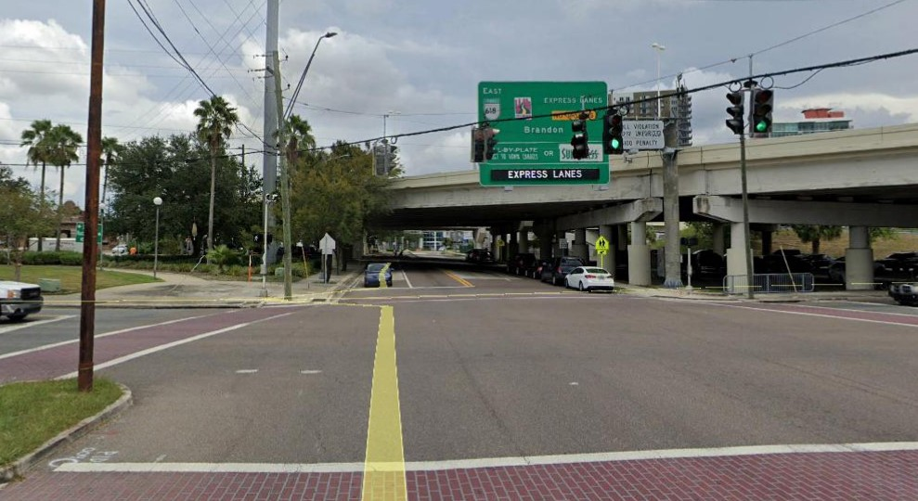
Twiggs Street DB Project
Signalization

Slide 16
Signalization
Replace the span-wire supported signals at Nebraska Avenue/Twiggs Street intersection (FDOT JPA 437535-1-A8/58/68-01)
Mast-arm support signals in the NE and SW corners
In accordance with approved Design Variation
Update the pedestrian signals and ITS communication connections
Lighting luminaire on Mast-arm in SW corner

Slide 17
Sign Structures & Lighting
Construct overhead sign restricting westbound Twiggs Street traffic from turning left at Nebraska Avenue between 7 am and 9 pm
Install electronic DMS signs informing motorists when the east access driveway for the Twiggs Street Garage is open for entering traffic
Coordinate with TECO on Twiggs St./Nebraska Ave. intersection lighting including luminaire on mast-arm

Slide 18
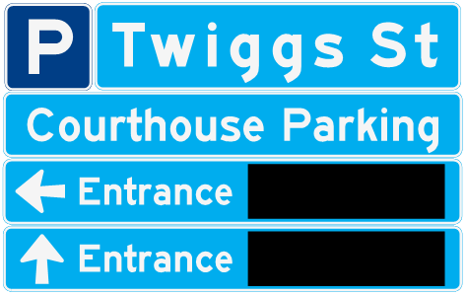
East DMS Sign
Twiggs Street Garage
East Driveway
Dynamic Message Sign

Slide 19
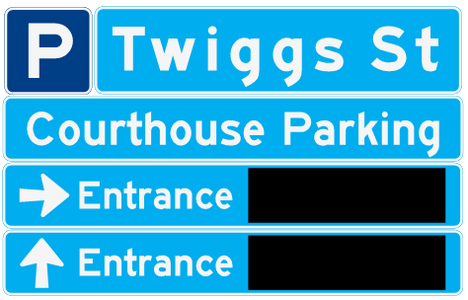
West DMS Sign
Twiggs Street Garage
West Driveway
Dynamic Message Sign

Slide 20
Utilities
Important City/County communication facilities impacted by project.
Utilities that are able are relocating/adjusting in advance of the Design-Build project to be complete by 9/1/20
Some utility relocation/adjusting/holding in place work will be necessary with the Design-Build project
  City of Tampa water, sewer, storm drain manhole/valve top adjustments

Slide 21
Twiggs Street DB Project
UTILITY RELOCATION PLANS

Slide 22
Twiggs Street DB Project
UTILITY RELOCATION PLANS

Slide 23
Twiggs Street DB Project
UTILITY RELOCATION PLANS

Slide 24
Innovative Aspects
Innovation should be limited to:
  Means and Methods
  Roadway Alignments
  Approach to Project
  Use of New Products
  New Uses of Established Products, etc.
Innovations which deviate from the Design & Construction Criteria, Commitments, etc. will not be considered.

Slide 25
Utilities

Slide 26
Letter of Interest (for Shortlisting Purposes Only)
THEA will judge the relative ability of each submitting firm to perform the required services based on qualification information and the LOI
New Times Roman type font, minimum font size ten (10)
LOI limited to five (5) 81/2” x 11” pages
  Contact Info for DB Contact Person
  Qualification status of the Contractor & Consultant
  Qualifications of Subs and Key Personnel
One (1) page 11” x 17” Organization Chart*
Three (3) pages of Performance History with the Authority or FDOT*
*Not Considered in the five (5) page count/limitation

Slide 27
Letter of Interest (for Shortlisting Purposes Only)
CRITERIA FOR EVALUATING PHASE I LOI SUBMITTALS
Design-Build Firm Name and Prequalifications including Contractor and Consultant (pass/fail)
Past Performance Evaluations, Design-Build Project Experience, Organization, and Staffing (10 Total Points)
  Contractor & Consultant Grades with the Department
  Performance History with THEA, FDOT, & Other Agencies
  DB History of Contractor and Consultant
  Similar Types of Work Experience
  Environmental Record with Department
  DB Firm Organization, Staffing Plan, Coordination Plan
  Availability
  SBE Participation

Slide 28
Letter of Interest (for Shortlisting Purposes Only)
CRITERIA FOR EVALUATING PHASE I LOI SUBMITTALS Continued
Design-Build Project Requirements and Critical Issues (10 Total Points)
  Understanding of Design-Build Project Requirements
  Identification of critical Issues
  Outline for addressing critical issues.

Slide 29
Technical Proposal
Submit FDOT Low Bid Design-Build Qualification Validation Form #700-011-36 a minimum of 24 hours prior to Bid/Price Proposal Opening
Submit FDOT Low Bid Design-Build Technical Proposal Form #700-010-21
  Use Pages 4 and 5 of form to provide:
    Proposed approach and understanding of project
    Proposed key personnel and their proposed roles (do not include resumes)
    Responsible Office
Technical Proposals will be reviewed for responsiveness only after opening of Bid/Price Proposal, starting with the low bidder

Slide 30
Price Proposal
Since JPA, Signal Replacement Work is required to be priced separately from remaining work on Twiggs.
Bid price shall be the total of the signal replacement work price plus the price of the remaining project work.
Price proposal shall include separate schedule of values for Signal Replacement Work
Contractor invoices shall include separate invoices for signal replacement work
Bid Price Proposal shall include # of Contract Calendar Days and % of SBE Proposed

Slide 31
Procurement Schedule
Fri., June 5, 2020 Advertisement
Thurs., June 11, 2020 Mandatory Virtual Pre-Proposal Meeting
Thurs., July 18, 2020 Deadline to submit Questions/Request for Clarification
Mon., June 22, 2020 Addendum Release (if required)
Fri., June 26, 2020 Letter of Interest Due
Tues., June 30, 2020 Evaluation Committee Meeting
Wed., July 1, 2020 Posting of Shortlist
Mon., July, 13, 2020 Board Approval @ Board Committee As a Whole Mtg.
Tues., July, 14, 2020 Posting of Board Approval of Shortlist
Wed., July 15, 2020 Deadline for Shortlisted Firms to Declare Intent to Continue
Mon., Aug., 17, 2020 Final deadline for requests for Design Exceptions
or Design Variations
Notes:
n

Slide 32
Procurement Schedule
Mon., Aug. 24, 2020 Deadline to submit Questions prior to submission of Price Proposal
Mon., Aug. 31 2020 Deadline for Authority to post Responses to Questions
Thurs., Sept. 3, 2020 Deadline for DB Firms to submit FDOT Low Bid
Design-Build Qualification Validation Form No.
700-011-36
Fri., Sept., 4, 2020 Technical & Price Proposals Due, announcing of Bid/Price Proposals, TRC Meeting to determine responsiveness of Technical Proposals
Mon., Sept. 14, 2020 Public Meeting of Selection Committee (Board Committee Meeting as a Whole) & posting of Award
Wed., Sept. 16, 2020 Anticipated Award Date
Mon., Sept. 21, 2020 Anticipated Execution Date
Notes:
n

Slide 33
SBE
THEA’s Small Business Enterprise (SBE) Policy requires nondiscrimination on the basis of race, color, national origin, and gender in its employment and contracting practices and encourages the solicitation and utilization of SBE’s. This means that the Authority’s goal is to spend a portion of the highway dollars with Certified SBE’s as prime Design-Build Firms or as subcontractors. Race-neutral means that the Authority believes that the overall goal can be achieved through the normal competitive procurement process. THEA has exceeded 15% SBE participation on its program for the last several years.

Slide 34
DB Stipend
$25,000 per non-selected shortlisted Design-Build Firm that meets the stipend eligibility requirements including submittals of written technical proposal and price proposal
Design-Build Firm must fully execute with original signatures and have delivered to the Authority within one (1) week after the Short-List protest period, four (4) originals of the Design-Build Stipend Agreement.

Slide 35

TRC Members and Technical Advisors
  TRC Members:
    Judith Villegas, EI – THEA
    Brian Pickard, PE– THEA
    Anna Quinones, EI – THEA
  Technical Advisors:
    Sue Chrzan – THEA
    Jim Drapp, PE – THEA GEC
    Al Stewart, PE – THEA GEC
    David Hubbard, PE – THEA GEC
    Julian Gutierrez, PE – THEA GEC
    Dan D’Antonio, PE, PTOE – THEA GEC

Slide 36
Project Documents
http://www.tampa-xway.com/procurement/#
The cone of silence remains in place for all THEA, FDOT, City of Tampa, HNTB, Tierra, Element and Omni staff.
All questions should be emailed to Man Le, THEA Contracts & Procurement Manager: man.le@tampa-xway.com
Answers will be posted on the THEA website

Slide 37
CEI
Selection from Expanded Letters of Response
  Understanding the Scope – 20 Points
  Qualifications & Experience of Key Personnel – 25 Points
  Quality Assurance – 20 Points
  Communication – 20 Points
  Workload – 10 Points
  SBE Utilization – 5 Points
Notes:
n

Slide 38
CEI
DATE | DESCRIPTION | LOCATION
Friday, June 12, 2020 | LOR Advertisement Published | DemandStar System THEA Vendor list & websites
Friday, June 26, 2020 @ 5 p.m. | Deadline for Respondent’s submission of questions to THEA | Man.Le@tampa-xway.com
Tuesday, June 23, 2020 | Deadline for THEA to respond to Respondent’s questions | THEA Website & Demandstar
Thursday, July 2, 2020 by 2 p.m. | Deadline for Submitting Proposal Package | TMC - 3rd floor
Friday, July 10, 2020 | Evaluation committee evaluate response package for ranking of firms | THEA Public Information Board, THEA Website & Demandstar
Friday, July 10, 2020 | Posting of Notice of Intended Final Ranking | THEA Public Information Board, THEA Website & Demandstar
Notes:
n

Slide 39
CEI
Monday, July 27, 2020 | Board Approval of Final Ranking and Authorization to Negotiate Contract | TMC - 1st floor
Tuesday, July 28, 2020 | Posting of Notice of Board Approval of Final Ranking | THEA Public Information Board THEA Website & DemandStar
Friday, August 28, 2020 | Anticipated Execution Date
Notes:
n

Slide 40

All questions should be emailed to Man Le, THEA Contracts & Procurement Manager: man.le@tampa-xway.com

