Slide 1
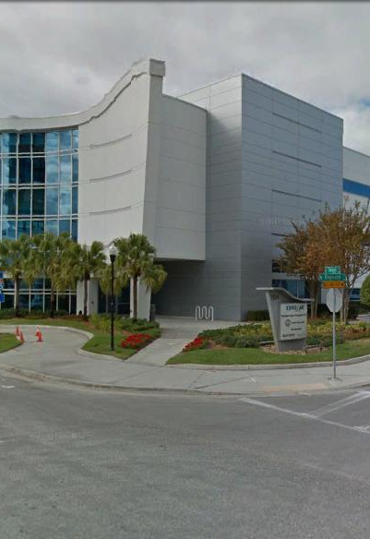
Tampa Hillsborough
Expressway
Authority
Industry Forum
1/9/2020
ITB O-XXXXX: REVERSIBLE EXPRESS LANE (REL) BRIDGE AESTHETIC LIGHTING

Slide 2
Introductions
Man Le – THEA Contracts & Procurement Manager
Dave May, PE – THEA Director of Expressway Operations
Judith Villegas, EI – THEA Project Manager
Sue Chrzan – THEA Director of Public Affairs & Communications
Jim Drapp, PE – THEA GEC
Terry Opdyke – THEA GEC
Jordan Leep, PE – THEA Design Consultant

Slide 3

Agenda
Project Overview
CEI/Public Involvement
Schedule
Project Documents
Questions

Slide 4
REVERSIBLE EXPRESS LANES (REL) BRIDGE
AESTHETIC LIGHTING
SCOPE OF WORK
The general Scope of Work consists of, but is not limited to: Provide all the labor, equipment, materials, tools, transportation, supplies, insurance, incidentals, mobilization, demobilization, and maintenance necessary for selective clearing and grubbing of the site, removal of the existing decorative pier lighting, removal, replacement, and upgrading as needed of existing electrical and fiber optic wiring and cabling, construction and installation of decorative pier and bridge lighting on the Reversible Express Lanes (REL) bridge structure, installation and commissioning of programmable digital control, which shall be remotely controllable from the THEA Traffic Management Center at THEA Headquarters, and maintenance of traffic for a signature lighting project on the REL.

Slide 5
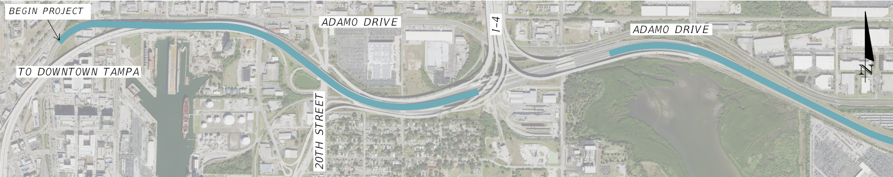
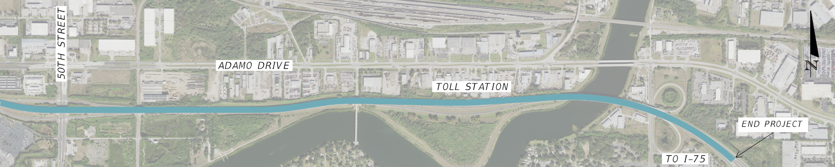
REVERSIBLE EXPRESS LANES (REL) BRIDGE
AESTHETIC LIGHTING

Slide 6
REVERSIBLE EXPRESS LANES (REL) BRIDGE
AESTHETIC LIGHTING
1. Base Bid Plans
All wiring, controllers, hardware, brackets and luminaires to light the Piers, Straddle Bents and Abutments
2. Bid Alternate Plans
Additional luminaires to light the bridge segments

Slide 7
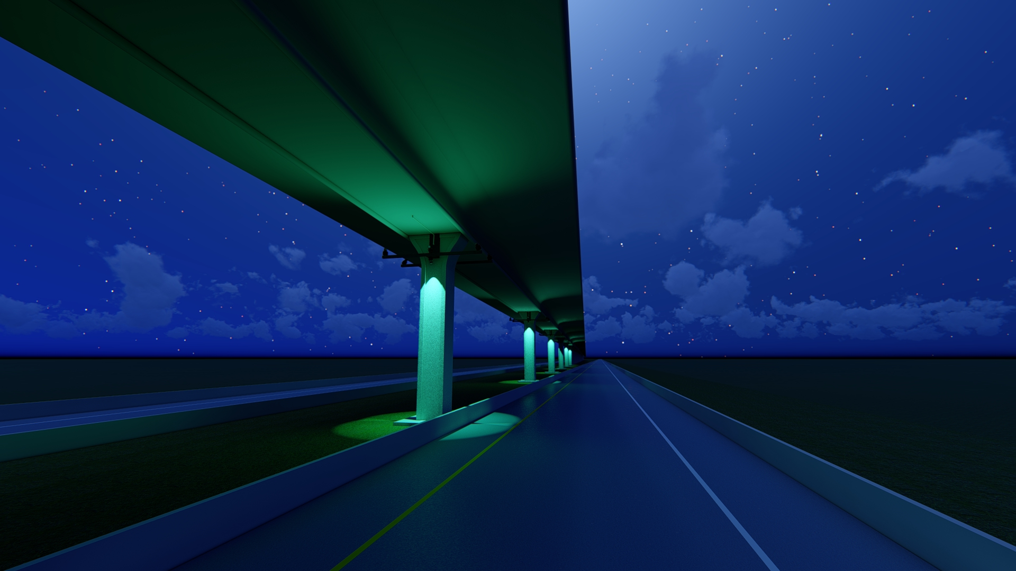
REVERSIBLE EXPRESS LANES (REL) BRIDGE
AESTHETIC LIGHTING- Base Bid Plans

Slide 8
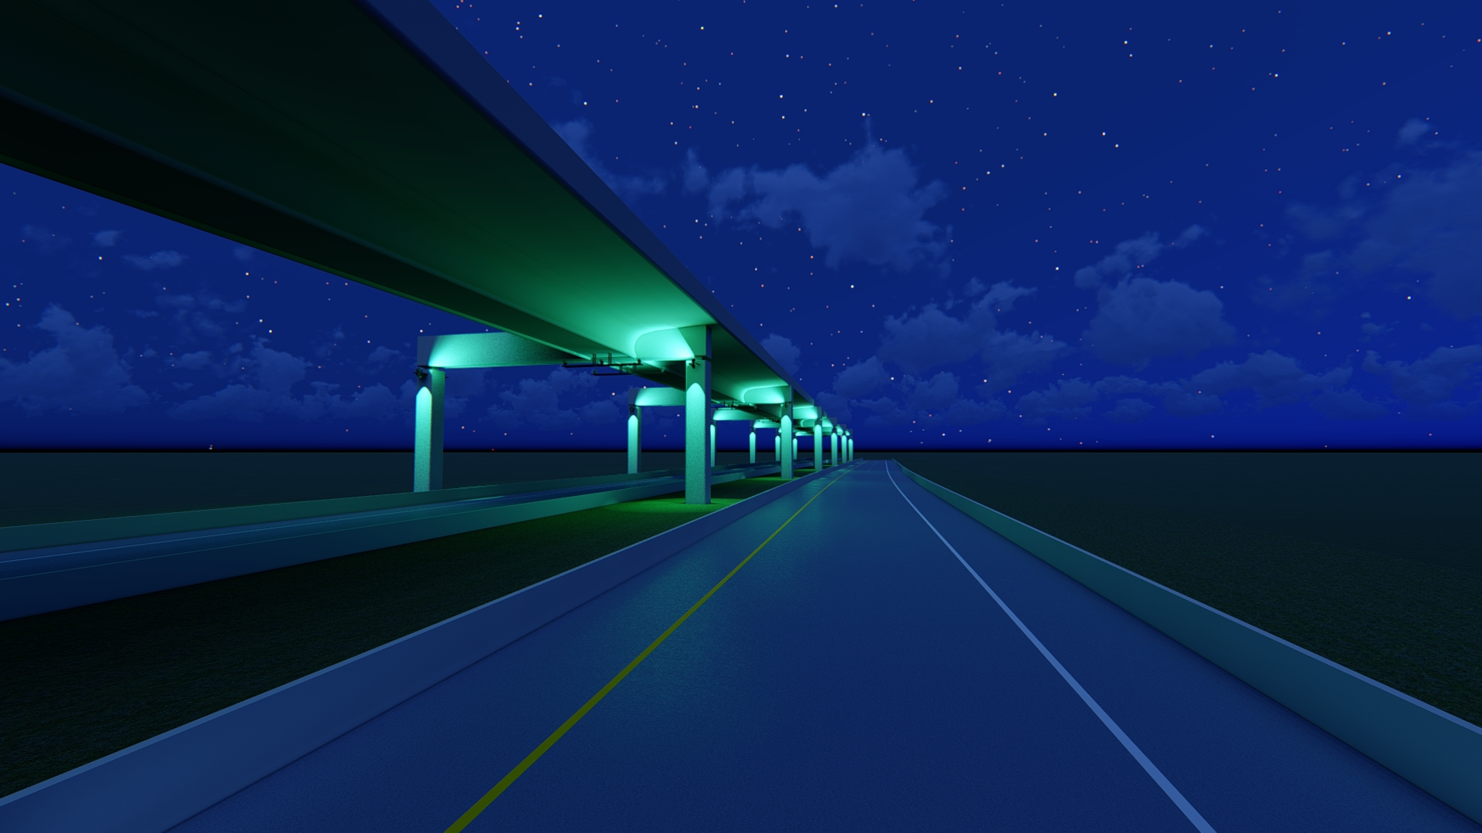
REVERSIBLE EXPRESS LANES (REL) BRIDGE
AESTHETIC LIGHTING- Base Bid Plans

Slide 9
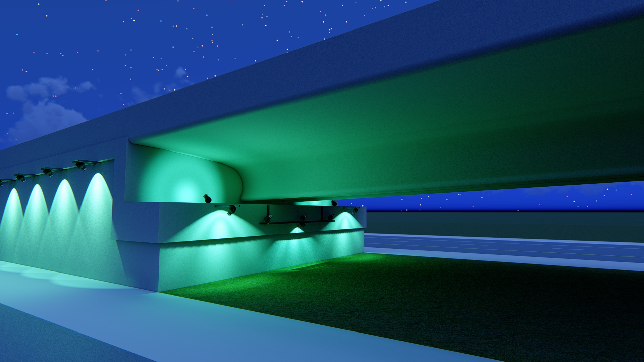
REVERSIBLE EXPRESS LANES (REL) BRIDGE
AESTHETIC LIGHTING- Base Bid Plans

Slide 10
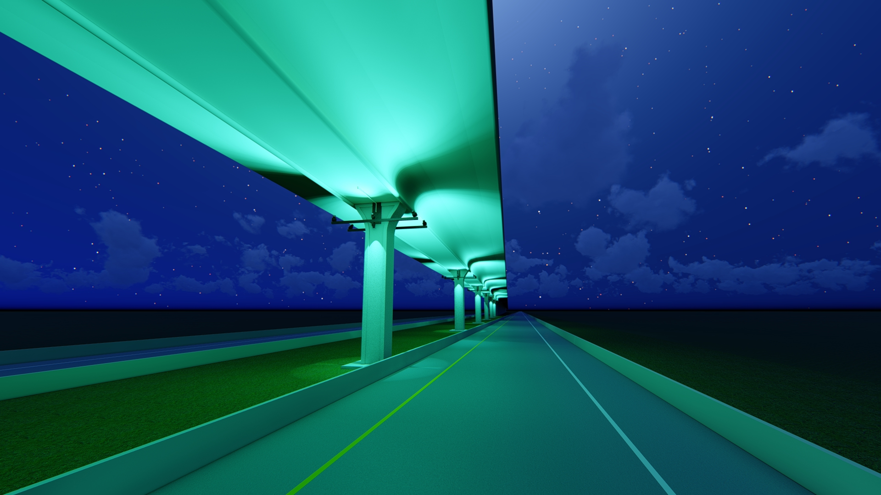
REVERSIBLE EXPRESS LANES (REL) BRIDGE
AESTHETIC LIGHTING-Bid Alternate Plans

Slide 11
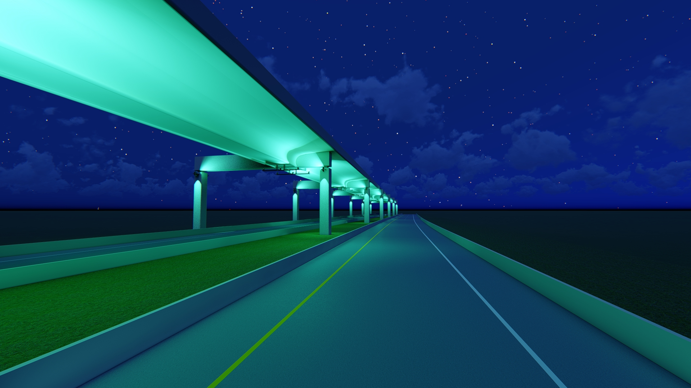
REVERSIBLE EXPRESS LANES (REL) BRIDGE
AESTHETIC LIGHTING- Bid Alternate Plans

Slide 12
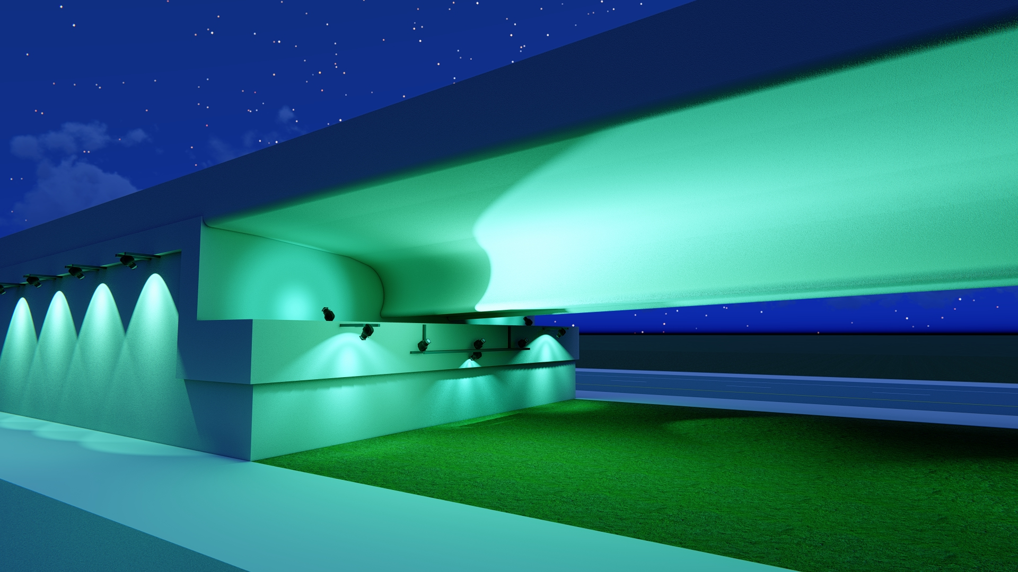
REVERSIBLE EXPRESS LANES (REL) BRIDGE
AESTHETIC LIGHTING- Bid Alternate Plans

Slide 13
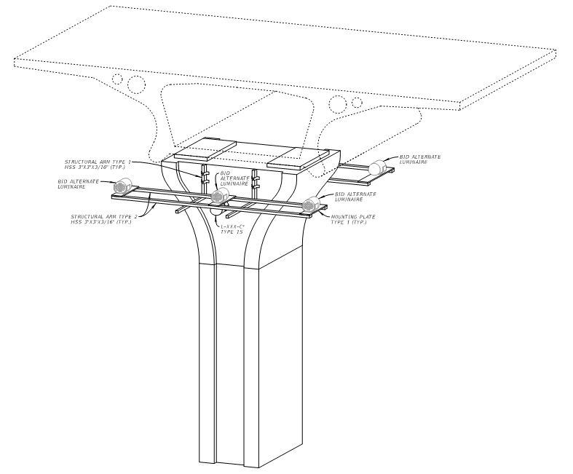
REVERSIBLE EXPRESS LANES (REL) BRIDGE
AESTHETIC LIGHTING- Pier Brackets

Slide 14
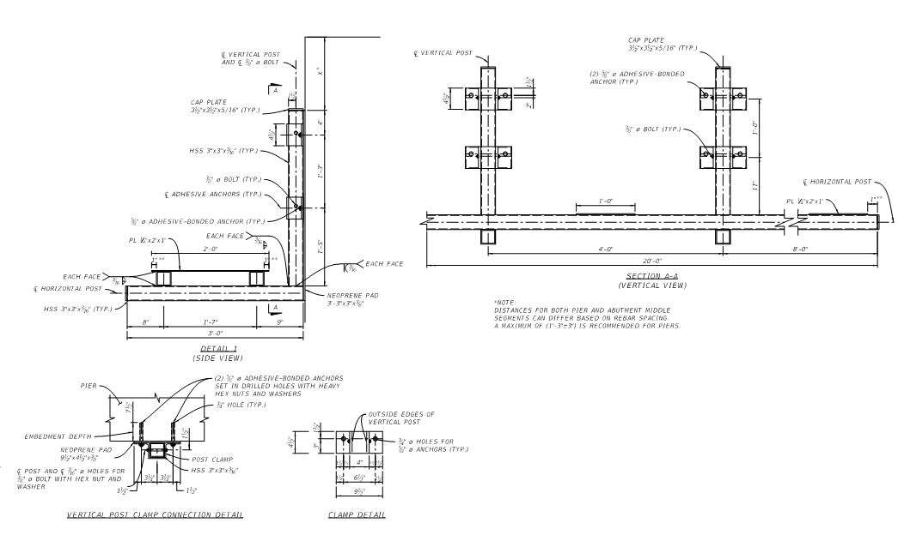
REVERSIBLE EXPRESS LANES (REL) BRIDGE
AESTHETIC LIGHTING- Pier Brackets

Slide 15
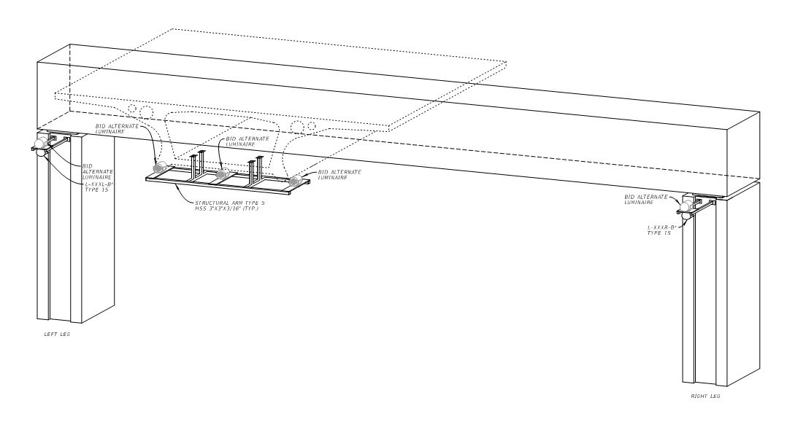
REVERSIBLE EXPRESS LANES (REL) BRIDGE
AESTHETIC LIGHTING-Straddle Bent Brackets

Slide 16
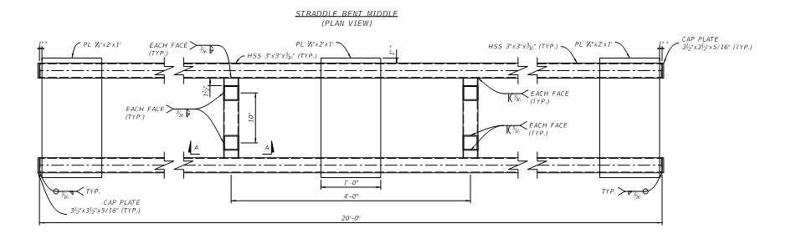
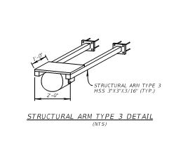
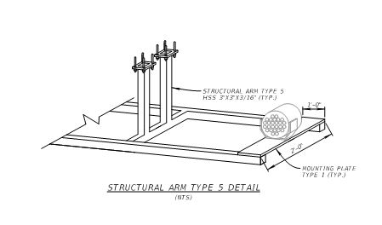
REVERSIBLE EXPRESS LANES (REL) BRIDGE
AESTHETIC LIGHTING- Straddle Bents Brackets

Slide 17
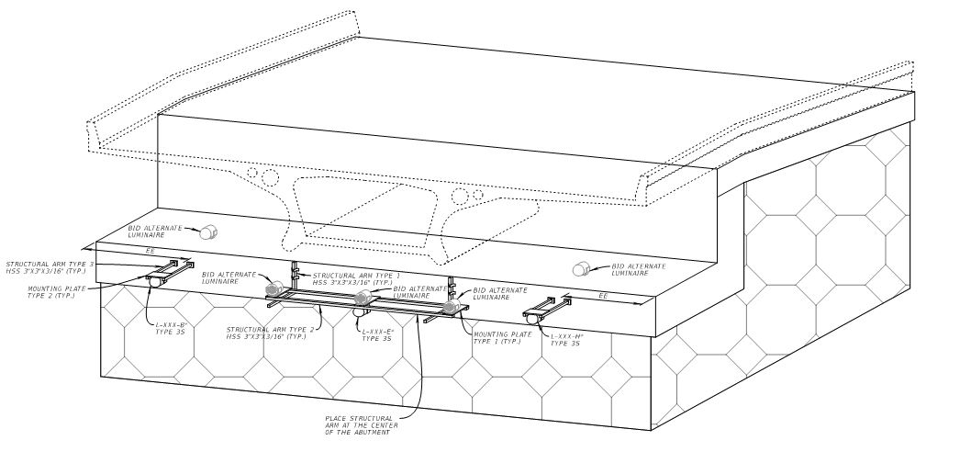
REVERSIBLE EXPRESS LANES (REL) BRIDGE
AESTHETIC LIGHTING- Abutment Brackets

Slide 18
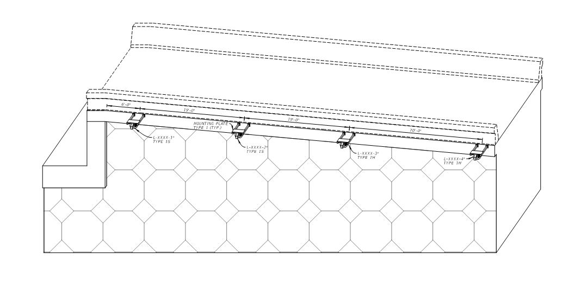
REVERSIBLE EXPRESS LANES (REL) BRIDGE
AESTHETIC LIGHTING- Abutment Brackets

Slide 19
REVERSIBLE EXPRESS LANES (REL) BRIDGE
AESTHETIC LIGHTING-Typical Plan Sheet

Slide 20
REVERSIBLE EXPRESS LANES (REL) BRIDGE
AESTHETIC LIGHTING- Luminaires

Slide 21
REVERSIBLE EXPRESS LANES (REL) BRIDGE
AESTHETIC LIGHTING
The Contractor is permitted to work at any time. However, lane closures will only be allowed at the following times: MONDAY-THURSDAY between the hours of 7 pm and 5 am, MONDAY – FRIDAY between the hours of 9 am and 3 pm, and between the hours of 7 am SATURDAY thru 5 am MONDAY. Coordination with THEA is required to ensure compliance with any special event or Holiday schedules that may be in effect during the period of performance.
Maintenance of Traffic, (MOT), to be provided by the Contractor during all set-up and take-down activities and work activities. Maintenance of Traffic to include at a minimum one (1) off-duty law enforcement officer per work operation. Maintenance of Traffic to be performed by “MOT certified” staff in accordance with the latest edition of the Florida Department of Transportation (FDOT), Standard Specifications for Road and Bridge Construction, Section 102, Maintenance of Traffic and the latest edition of the Florida Department of Transportation (FDOT) Standard Plans for Road Construction.

Slide 22
REVERSIBLE EXPRESS LANES (REL) BRIDGE
AESTHETIC LIGHTING
Work performance duration is 365 calendar days and includes active work and material acquisition and fabrication. However, it is THEA’s goal to have the entire aesthetic lighting system functional, and if not the entire system at least the system section from the downtown end to the Selmon/I-4 Connector Interchange functional before the Superbowl on February 7, 2021.

Slide 23
REVERSIBLE EXPRESS LANES (REL) BRIDGE
AESTHETIC LIGHTING

Slide 24
REVERSIBLE EXPRESS LANES (REL) BRIDGE
AESTHETIC LIGHTING
Plans and Quantities will be provided
Bid Bond will be required
Bid Tabulation Spreadsheets with Pay Items and Quantities will be provided for contractors to submit
Contractors will submit bids for the Base Bid Plans and the Bid Alternate Plans

Slide 25
CEI/PUBLIC INVOLVEMENT
The CEI contract has been advertised for selection of a consultant. The ELOI are due on Tuesday, January 14th and the Selection Meeting is Thursday, January 16th.
Sue Chrzan & THEA staff and consultant to perform Public Involvement efforts

Slide 26
Schedule
Anticipated Advertisement:
February XX, 2020
Anticipated Deadline for Responses to Questions:
February XX, 2020

Slide 27
Schedule
Bid Package Due: 2:00pm March XX, 2020
March 23, 2020 – THEA Board Approval
NTP & Construction: March, 2020 - March, 2021

Slide 28
Project Documents
http://www.tampa-xway.com/procurement/#
Once advertised, the cone of silence will be in place for all THEA, HNTB, KHA and selected CEI staff.
All questions should be emailed to Man Le, THEA Contracts & Procurement Manager: man.le@tampa-xway.com
Answers will be posted on the THEA website

Slide 29

Questions?

