Slide 1
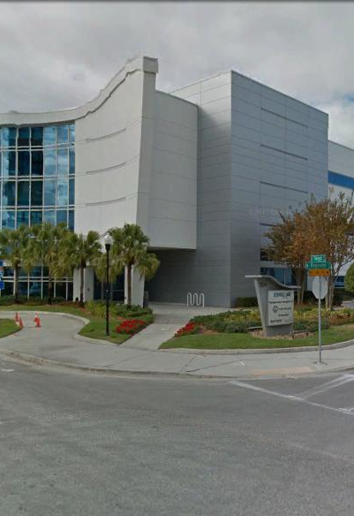
Tampa Hillsborough
Expressway
Authority
Pre-Bid Conference
12/5/2019
ITB O-02119: SELMON EXPRESSWAY 22nd STREET & 50th STREET RAMP CONCRETE RECONSTRUCTION AND RESURFACING
And
ITB O-02219: EAST TOLL GANTRY AREA & REVERSIBLE EXPRESS LANES (REL) RESURFACING

Slide 2
Introductions
Man Le – THEA Contracts & Procurement Manager
Dave May, PE – THEA Director of Expressway Operations
Judith Villegas – THEA Project Manager
Jim Drapp, PE – THEA GEC
Terry Opdyke – THEA GEC
David Hubbard, PE – THEA GEC
Tony Caruso, PE – THEA Consultant CEI

Slide 3

Agenda
Project Overview
CEI/Public Involvement
Schedule
Project Documents
Questions

Slide 4
SELMON EXPRESSWAY 22nd STREET & 50th STREET RAMP CONCRETE RECONSTRUCTION AND RESURFACING

Slide 5
SELMON EXPRESSWAY 22nd STREET & 50th STREET RAMP CONCRETE RECONSTRUCTION AND RESURFACING

Slide 6
SELMON EXPRESSWAY 22nd STREET & 50th STREET RAMP CONCRETE RECONSTRUCTION AND RESURFACING

Slide 7
SELMON EXPRESSWAY 22nd STREET & 50th STREET RAMP CONCRETE RECONSTRUCTION AND RESURFACING

Slide 8
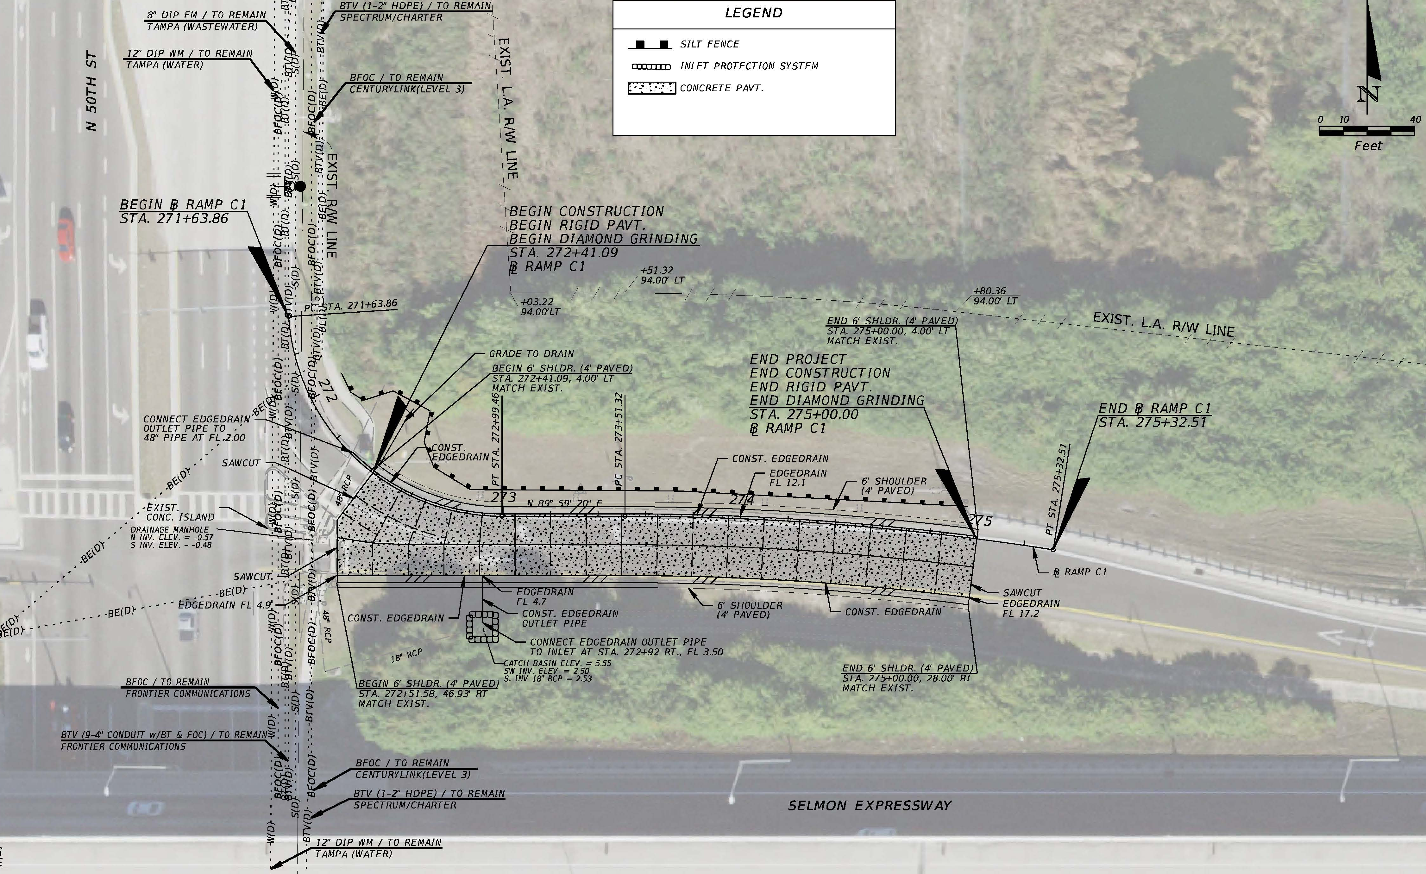
SELMON EXPRESSWAY 22nd STREET & 50th STREET RAMP CONCRETE RECONSTRUCTION AND RESURFACING

Slide 9
SELMON EXPRESSWAY 22nd STREET & 50th STREET RAMP CONCRETE RECONSTRUCTION AND RESURFACING

Slide 10
SELMON EXPRESSWAY 22nd STREET & 50th STREET RAMP CONCRETE RECONSTRUCTION AND RESURFACING

Slide 11
SELMON EXPRESSWAY 22nd STREET & 50th STREET RAMP CONCRETE RECONSTRUCTION AND RESURFACING

Slide 12
SELMON EXPRESSWAY 22nd STREET & 50th STREET RAMP CONCRETE RECONSTRUCTION AND RESURFACING

Slide 13
SELMON EXPRESSWAY 22nd STREET & 50th STREET RAMP CONCRETE RECONSTRUCTION AND RESURFACING

Slide 14
SELMON EXPRESSWAY 22nd STREET & 50th STREET RAMP CONCRETE RECONSTRUCTION AND RESURFACING

Slide 15
SELMON EXPRESSWAY 22nd STREET & 50th STREET RAMP CONCRETE RECONSTRUCTION AND RESURFACING

Slide 16
SELMON EXPRESSWAY 22nd STREET & 50th STREET RAMP CONCRETE RECONSTRUCTION AND RESURFACING

Slide 17
EAST TOLL GANTRY AREA & REVERSIBLE EXPRESS LANES (REL) RESURFACING

Slide 18
EAST TOLL GANTRY AREA & REVERSIBLE EXPRESS LANES (REL) RESURFACING

Slide 19
EAST TOLL GANTRY AREA & REVERSIBLE EXPRESS LANES (REL) RESURFACING

Slide 20
EAST TOLL GANTRY AREA & REVERSIBLE EXPRESS LANES (REL) RESURFACING

Slide 21
EAST TOLL GANTRY AREA & REVERSIBLE EXPRESS LANES (REL) RESURFACING

Slide 22
SELMON EXPRESSWAY 22nd STREET & 50th STREET RAMP CONCRETE RECONSTRUCTION AND RESURFACING

Slide 23
SELMON EXPRESSWAY 22nd STREET & 50th STREET RAMP CONCRETE RECONSTRUCTION AND RESURFACING

Slide 24
SELMON EXPRESSWAY 22nd STREET & 50th STREET RAMP CONCRETE RECONSTRUCTION AND RESURFACING

Slide 25
SELMON EXPRESSWAY 22nd STREET & 50th STREET RAMP CONCRETE RECONSTRUCTION AND RESURFACING

Slide 26
CEI/PUBLIC INVOLVEMENT
EXP- THEA CEI Consultant
Sue Chrzan & THEA staff and consultant to perform Public Involvement efforts

Slide 27
Schedule
Deadline for Questions:
December 12, 2019
Deadline for Responses to Questions:
December 13, 2019

Slide 28
Schedule
Bid Package Due: 2:00pm January 8, 2020
January 27, 2020 – THEA Board Approval
NTP & Construction: March, 2020 - July, 2020

Slide 29
Project Documents
http://www.tampa-xway.com/procurement/#
Once advertised, the cone of silence will be in place for all THEA, FDOT, HNTB, COT, Tierra, Omni, KCA and EXP staff.
All questions should be emailed to Man Le, THEA Contracts & Procurement Manager: man.le@tampa-xway.com
Answers will be posted on the THEA website

Slide 30

Questions?

