Slide 1
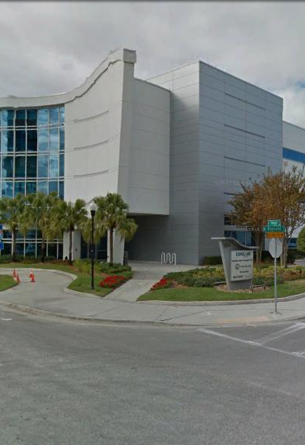
Tampa Hillsborough
Expressway
Authority
East Selmon Capacity Project PD&E Study Industry Forum
8/8/2019

Slide 2
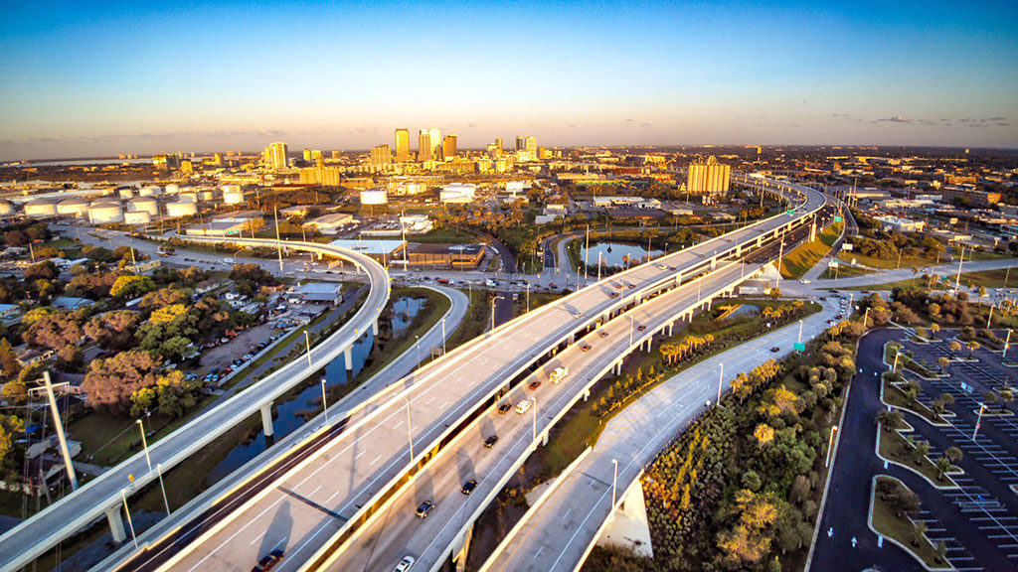
East Selmon Capacity Project PD&E Study

Slide 3
Introductions
Man Le – THEA Contracts & Procurement Manager
Joe Waggoner– THEA Executive Director
Dave May, PE – THEA Director of Expressway Operations
Bob Frey, AICP – THEA Planning Director – Project Manager
Anna Quiñones – THEA Deputy Project Manager
Jim Drapp, PE – THEA GEC
Al Stewart, PE – THEA GEC
Chris Piazza, PE – THEA GEC

Slide 4

Agenda
Project Overview
  East Selmon Expressway Capacity PEIR/SEIR
Project Objectives
Public Involvement
Environmental Analysis
Engineering Analysis
Schedule
Procurement
Questions

Slide 5
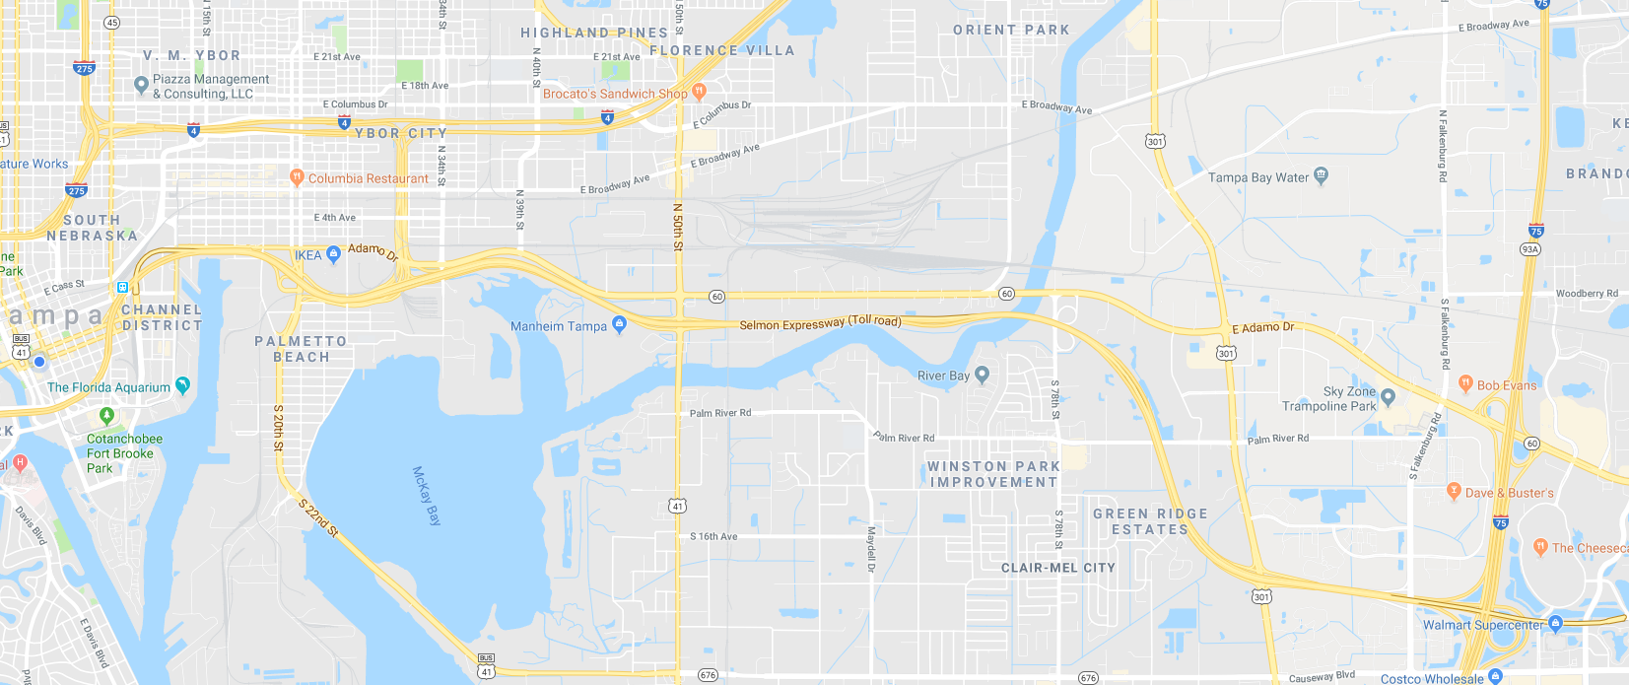
East Selmon Expressway Capacity Project
Project Overview

Slide 6
East Selmon Expressway Capacity Project
Project Overview
Selmon Expressway from Meridian Avenue to I-75
PEIR:
  PD&E study will evaluate three phases:
    Phase 1 – Westbound local lanes from the I-4 Connector to I-75
    Phase 2 – Eastbound local lanes from the I-4 Connector to I-75 and the REL from west of Palm River Road to I-75
    Phase 3 – Brorein Street to the I-4 Connector
  Phase 1 and 2 will be conducted as a SEIR
  Phase 3 will be conducted as a PEIR
  No state or federal funds
  Follow procedures and requirements set forth in FDOT PD&E manual

Slide 7

East Selmon Expressway Capacity Project
Roles:
Tampa Hillsborough Expressway Authority (THEA) – Owner/Developer/Operator
HNTB – General Engineering Consultant for THEA
Project Objective:
Evaluate capacity improvements based on traffic needs, costs, impacts
One additional local lane westbound and eastbound, one additional lane on the REL, dynamic toll pricing, other operational and safety concerns
Coordination:
THEA’s South Selmon Median Safety DB Project
THEA’s South Selmon PD&E
THEA’s Whiting Street PD&E
East Selmon Widening Feasibility Study

Slide 8
East Selmon Expressway Capacity Project
Public Involvement
Public Involvement Plan (PIP) in accordance w/PD&E Manual
Advance notification and transmittal letter
Public Meetings:
Minimum one public meeting
Minimum one public hearing
Develop list of stakeholders
Renderings and animation
Legal ads, notices, informational material, news releases, mail outs, court reporting, responses to stakeholders
Meeting coordination; identify/reserve venue, set up, tear down, meeting notes, agendas, presentations, seating, sound, audio/visual equipment, displays
Additional stakeholder/small group meetings as needed

Slide 9
East Selmon Expressway Capacity Project
Environmental Analysis
ETDM EST
Sociocultural Resources
Cultural Resources
Natural Resource Evaluation
Noise
Contamination
Prepare PEIR and SEIR

Slide 10
East Selmon Expressway Capacity Project
Engineering Analysis
Field review
Survey
Existing available data from THEA, FDOT or other agency
Current counts, truck counts, ramp and mainline counts at toll gantry
Turning movement counts at ramp intersections
Origin-destination data
Traffic methodology statement in accordance with FDOT’s Project Traffic Forecasting Procedure (#525-030-120)
Travel demand forecasting
TBRPM base year 2015
VISSIM
Future years 2026, 2036, 2046 –build + no build scenarios
Traffic:
Geotechnical data
Laser/Lidar
CADD Files Non-Existent for Majority of the Corridor

Slide 11
East Selmon Expressway Capacity Project
Engineering Analysis
Evaluate crash data
Identify safety improvements
Typical sections, design alternatives, access management
Structures
Drainage/Stormwater Management
Concept plans
Prepare typical section package
Multimodal accommodations
MOT/Phased Construction
Comparative analysis and evaluation matrix
Preferred alternative
ROW minimization and construction estimates
PER/ Concept Plans for Design Build

Slide 12
Recommended Build Phasing
Phase 1 (2026)
Add one westbound local lane from I-75 to I-4 Connector
Add northbound I-75 ramp to westbound REL ingress slip ramp
Add westbound REL to local lanes egress slip ramp at I-4 connector interchange
Add one lane to eastbound Off-Ramp to US 301
Relocate existing REL to local lane slip ramp to just east of US 301 overpass

Slide 13
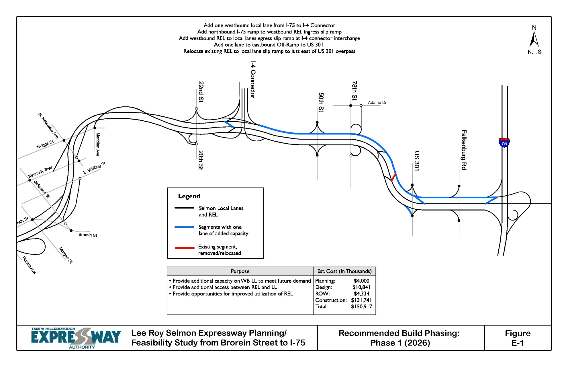

Slide 14
Recommended Build Phasing
Phase 2 (2026)
Add one eastbound local lane from I-4 connector interchange to I-75
Add one lane to REL from I-75 to current 3-lane section
Add eastbound REL to I-75 southbound off-ramp slip ramp

Slide 15
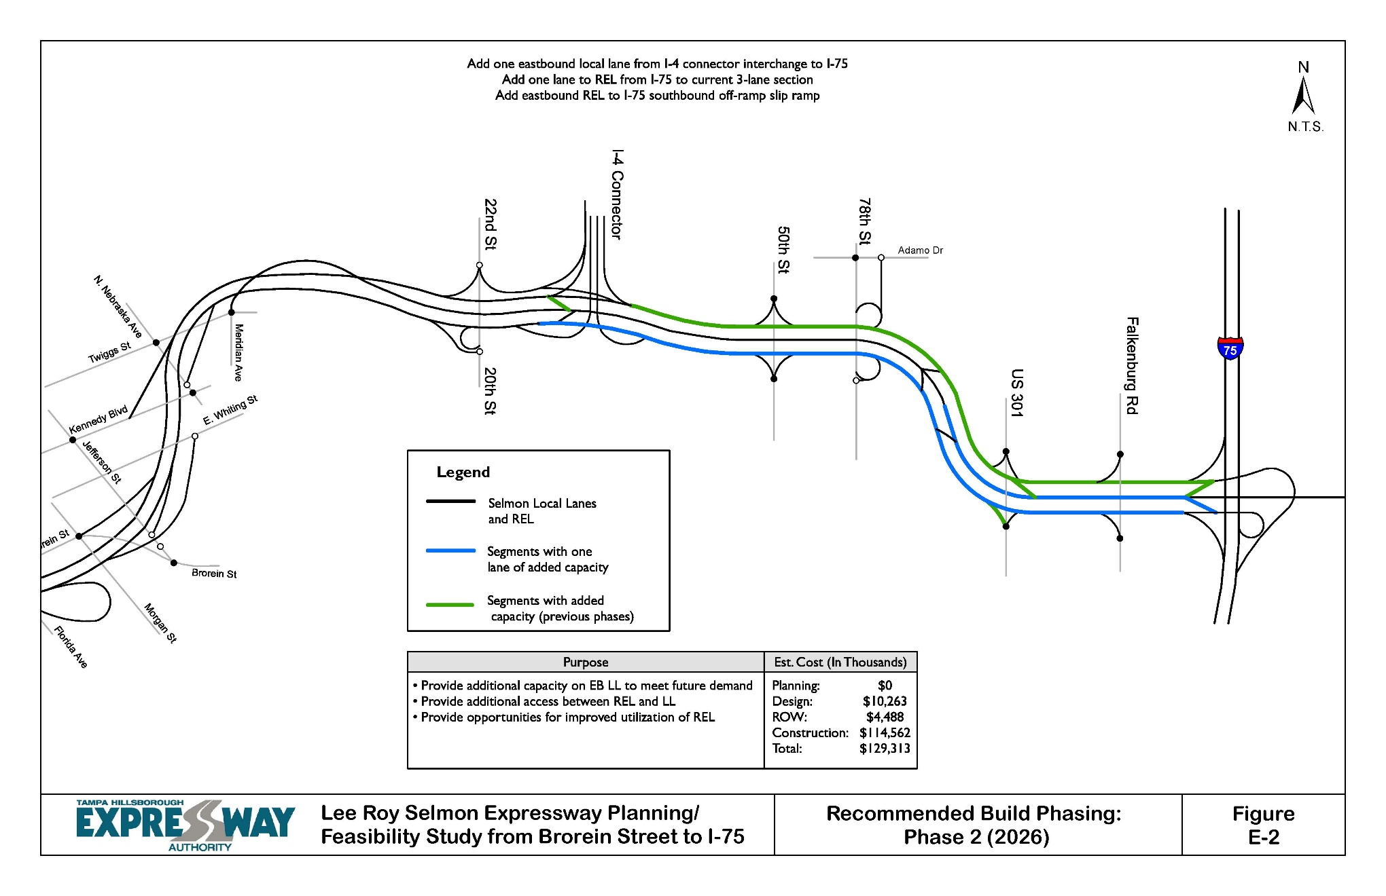

Slide 16
Recommended Build Phasing
Phase 3 (2040)
Add one westbound local lane from I-4 connector to Brorein Street off-ramp
Add one eastbound local lane from Jefferson Street on-ramp to I-4 connector
Widen westbound off-ramps to Kennedy Boulevard and Brorein Street (one additional lane)

Slide 17
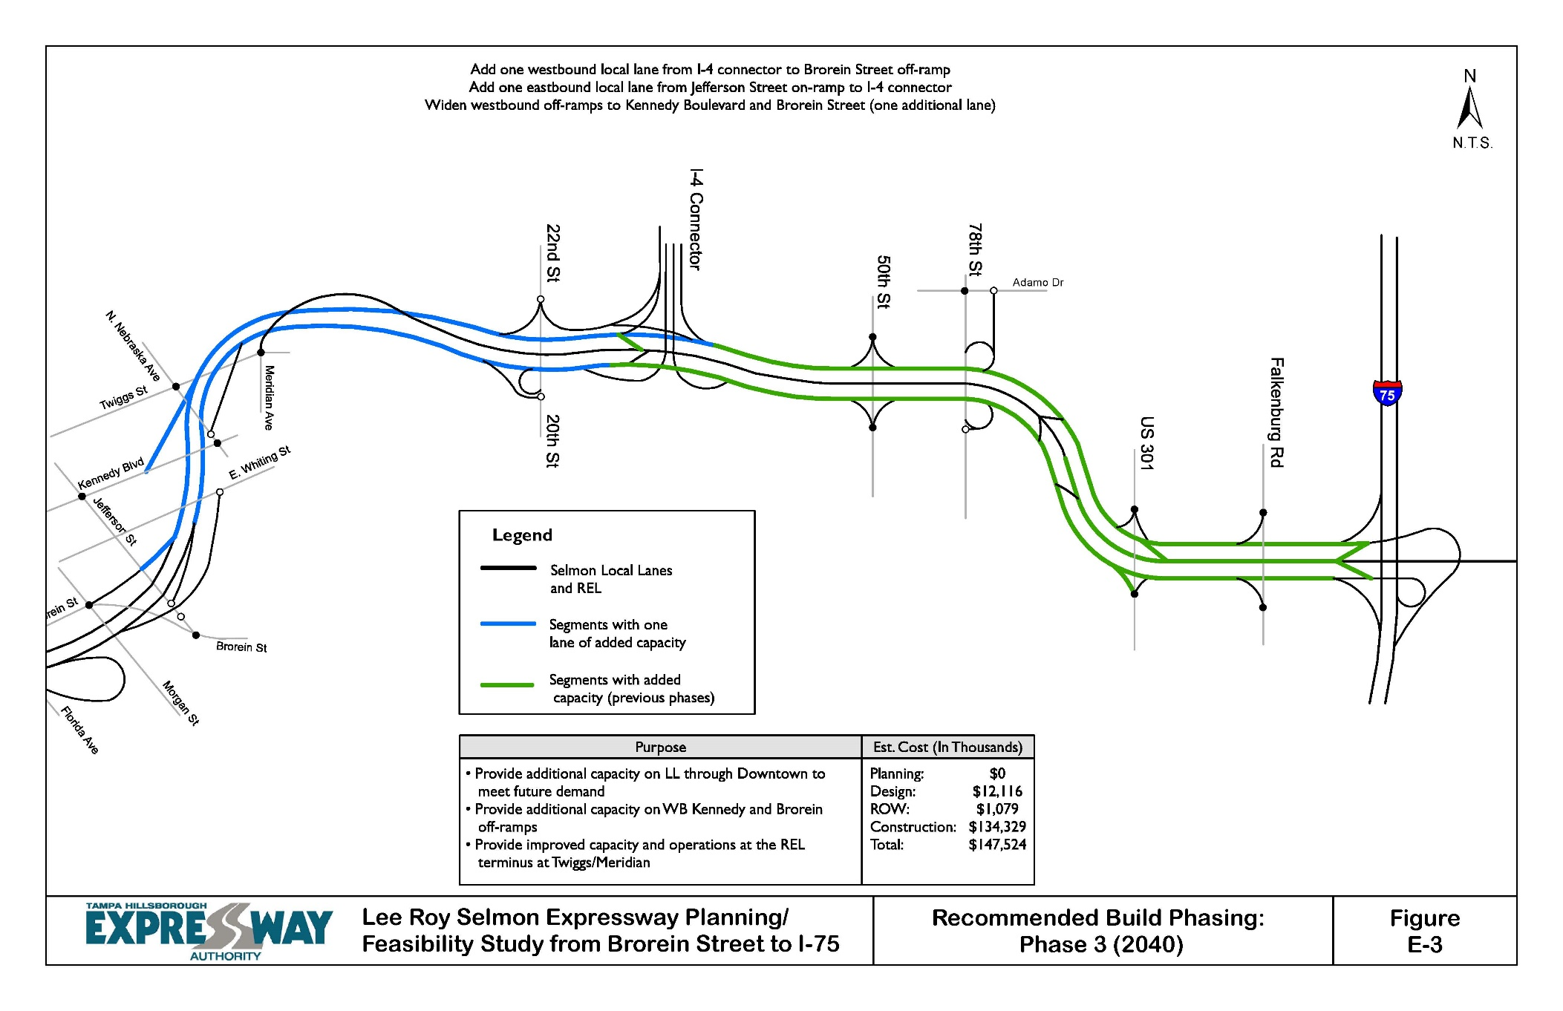

Slide 18
Schedule
Procurement: August, 2019 – September, 2019
SEIR/PEIR: October, 2019 – October, 2021
Public Meetings: August, 2020

Slide 19
Procurement
Letter of Interest
Short-list
Presentations/Q&A by Short-listed firms

Slide 20

TRC Members and Technical Advisors
East Selmon Expressway Capacity Project:
  TRC Members:
    Dave May, PE – THEA
    Bob Frey, AICP – THEA
    Anna Quiñones– THEA
  Technical Advisors:
    Sue Chrzan – THEA
    Jim Drapp, PE – THEA GEC
    Al Stewart, PE – THEA GEC
    Chris Piazza, PE – THEA GEC
    Julian Gutierrez – THEA GEC

Slide 21
Project Documents
http://www.tampa-xway.com/procurement/#
Once advertised, the cone of silence will be in place for all THEA, FDOT, HNTB, COT, Tierra, Element and OMNI staff.
All questions should be emailed to Man Le, THEA Contracts & Procurement Manager: man.le@tampa-xway.com
Answers will be posted on the THEA website

Slide 22
Closing Comments

Slide 23

Questions?

