Slide 1
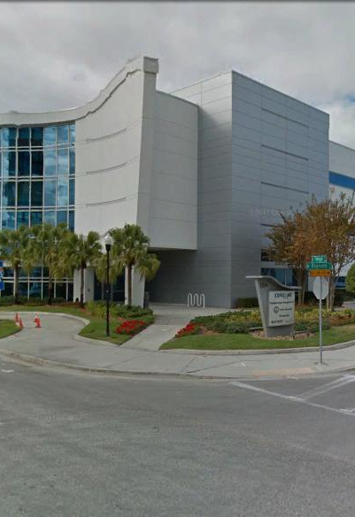
Tampa Hillsborough
Expressway
Authority
South Selmon Safety DB Mandatory Pre-proposal Meeting
7/11/2018

Slide 2
Introductions
Man Le – THEA Contracts & Procurement Manager
Joe Waggoner– THEA Executive Director
Dave May, PE – THEA Director of Expressway Operations
Bob Frey, AICP – THEA Planning Director
Christina Kopp, AICP – THEA Project Manager
Sue Chrzan – THEA Director of Public Affairs & Communication
Jim Drapp, PE – THEA GEC
Doug Burkhart, PE – THEA GEC
Dan D’Antonio, PE,PTOE – THEA GEC

Slide 3
Project Roles
Tampa Hillsborough Expressway Authority (THEA)- Owner/Developer/Operator
HNTB- General Engineering Consultant (GEC) to THEA
Tierra- Geotechnical Consultant to GEC & THEA
Omni- Utilities Consultant to GEC & THEA
Playbook- Public Involvement Consultant to THEA
Dave May, PE- THEA Project Manager
Doug Burkhart, PE- GEC Project Manager

Slide 4

Agenda
Project Overview & Objectives
Other Projects
Public Involvement
Innovative Aspects & ATC’s
Written Technical Proposal/Schedule
Page Turn Meeting
Q & A Session
Scoring
SBE
DB Stipend
TRC Members & Technical Advisors
Project Documents Questions

Slide 5
Project Overview & Objectives
Project Limits- Himes Ave. to Hyde Park Ave.
Project Goals
Full Depth Paved Median with Barrier Wall
Typical Sections
TTCP/Work Hours
Sign Structures
Lighting
Project Information

Slide 6
Project Limits

Slide 7
Project Goals
Improve safety to the corridor within the limits described.
Minimize the inconvenience to the travelling public.
Minimize environmental impacts, including impacts to established wetlands, to the maximum extent possible.
Maintain or improve, to the maximum extent possible, the quality of existing traffic operations, both in terms of flow rate and safety, throughout the duration of the Project.
Minimize the number of different Traffic Control Plan (TCP) phases, i.e., number of different diversions and detours for a given traffic movement.
Maintain direct access to adjacent properties at all times, with the exception in areas of limited access Right-of-Way where direct access is not permitted.
Coordinate with adjacent construction projects and maintaining agencies.
Minimize the inconvenience to adjacent residences including minimizing night work, noise and temporary construction lighting.

Slide 8
Project Overview & Objectives
Project Limits- Himes Ave. to Hyde Park Ave.
Project Goals
Full Depth Paved Median with Barrier Wall
Typical Sections
TTCP/Work Hours
Sign Structures
Lighting
Project Information

Slide 9
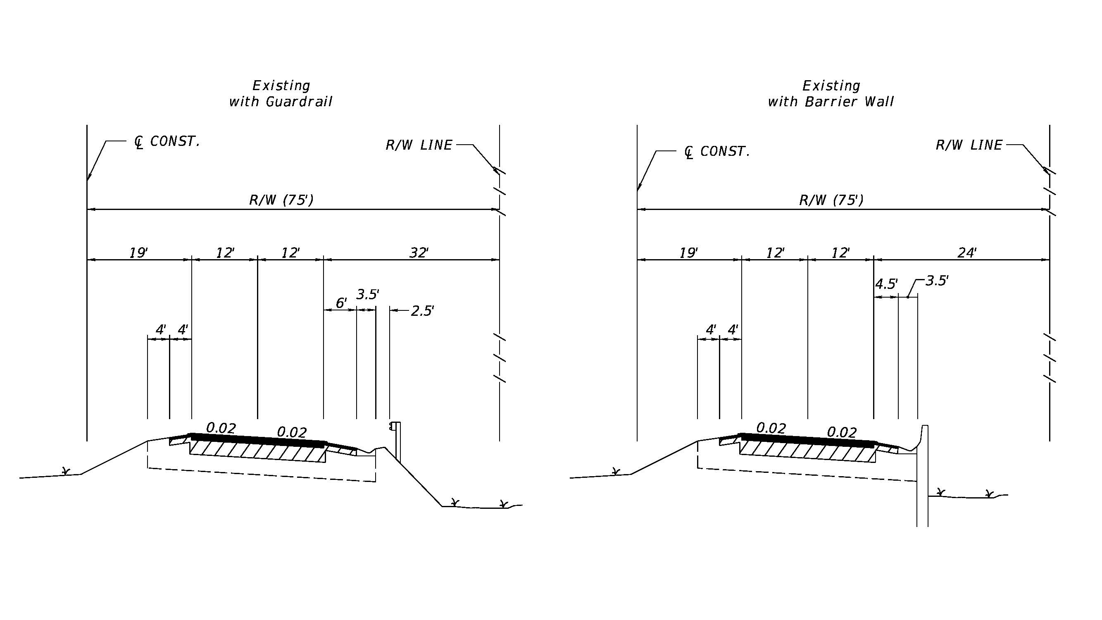
South Selmon Median Safety DB Project
Existing Typical
Sections

Slide 10
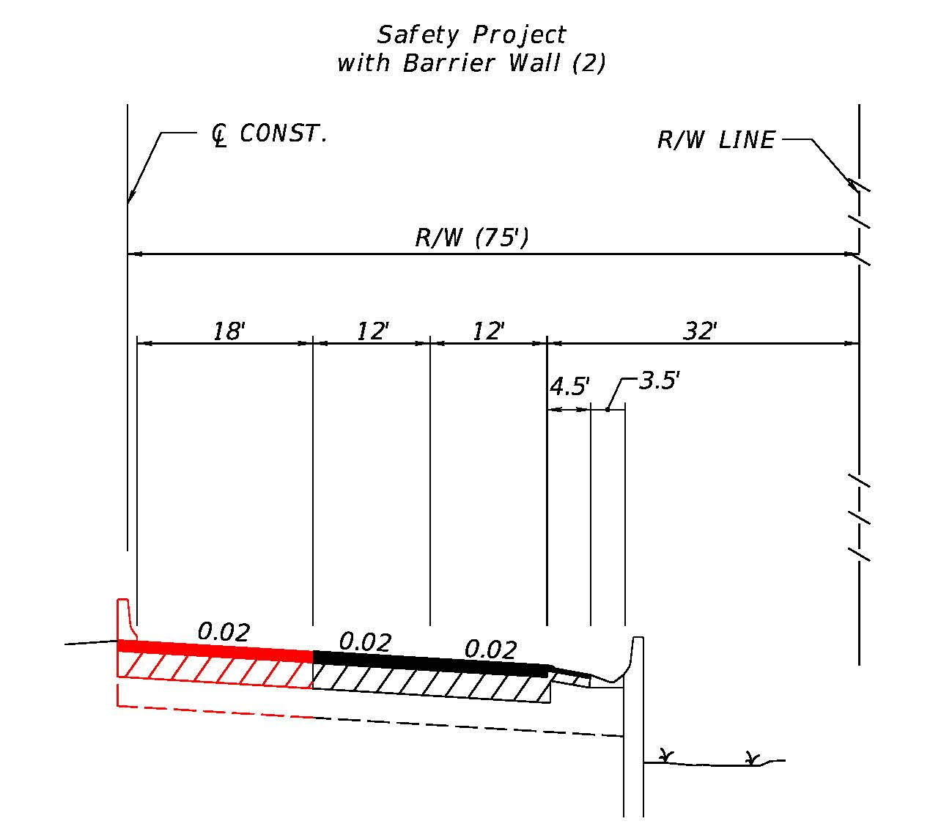
South Selmon Median Safety DB Project
Typical
Sections

Slide 11
TTCP/Work Hours
Project Limits- Himes Ave. to Hyde Park Ave.
Lanes Closures typically not allowed between the hours of:
  5:00 AM to 9:00 AM
  3:00 PM to 7:00 PM
Work Hours
  Minimize noise and light impacts to adjacent residences
Adjustments to Work Hours/Lane Closures may be considered through the ATC process through showing compelling benefits to THEA and adjacent residents
Minimize phases and lane shifts
Railroad Coordination as required
Public Involvement

Slide 12
Sign Structures
Remove and replace the following structures:
Overhead truss over the westbound lanes north of El Prado Boulevard
Overhead truss over the eastbound lanes south of Platt Street
Overhead truss over the eastbound lanes west of S. Boulevard
The following structures will be removed and not replaced:
Overhead truss over the eastbound lanes located east of Willow Avenue
Overhead truss over the westbound lanes west of Hyde Park Avenue

Slide 13
Sign Structures

Slide 14
Sign Structures

Slide 15
Sign Structures

Slide 16
Sign Structures

Slide 17
Project Overview & Objectives
Project Limits- Himes Ave. to Hyde Park Ave.
Project Goals
Full Depth Paved Median with Barrier Wall
Typical Sections
TTCP/Work Hours
Sign Structures
Lighting
Project Information

Slide 18
Agenda
Project Overview & Objectives
Other Projects
Public Involvement
Innovative Aspects & ATC’s
Written Technical Proposal/Schedule
Page Turn Meeting
Q & A Session
Scoring
SBE
DB Stipend
TRC Members & Technical Advisors
Project Documents Questions

Slide 19
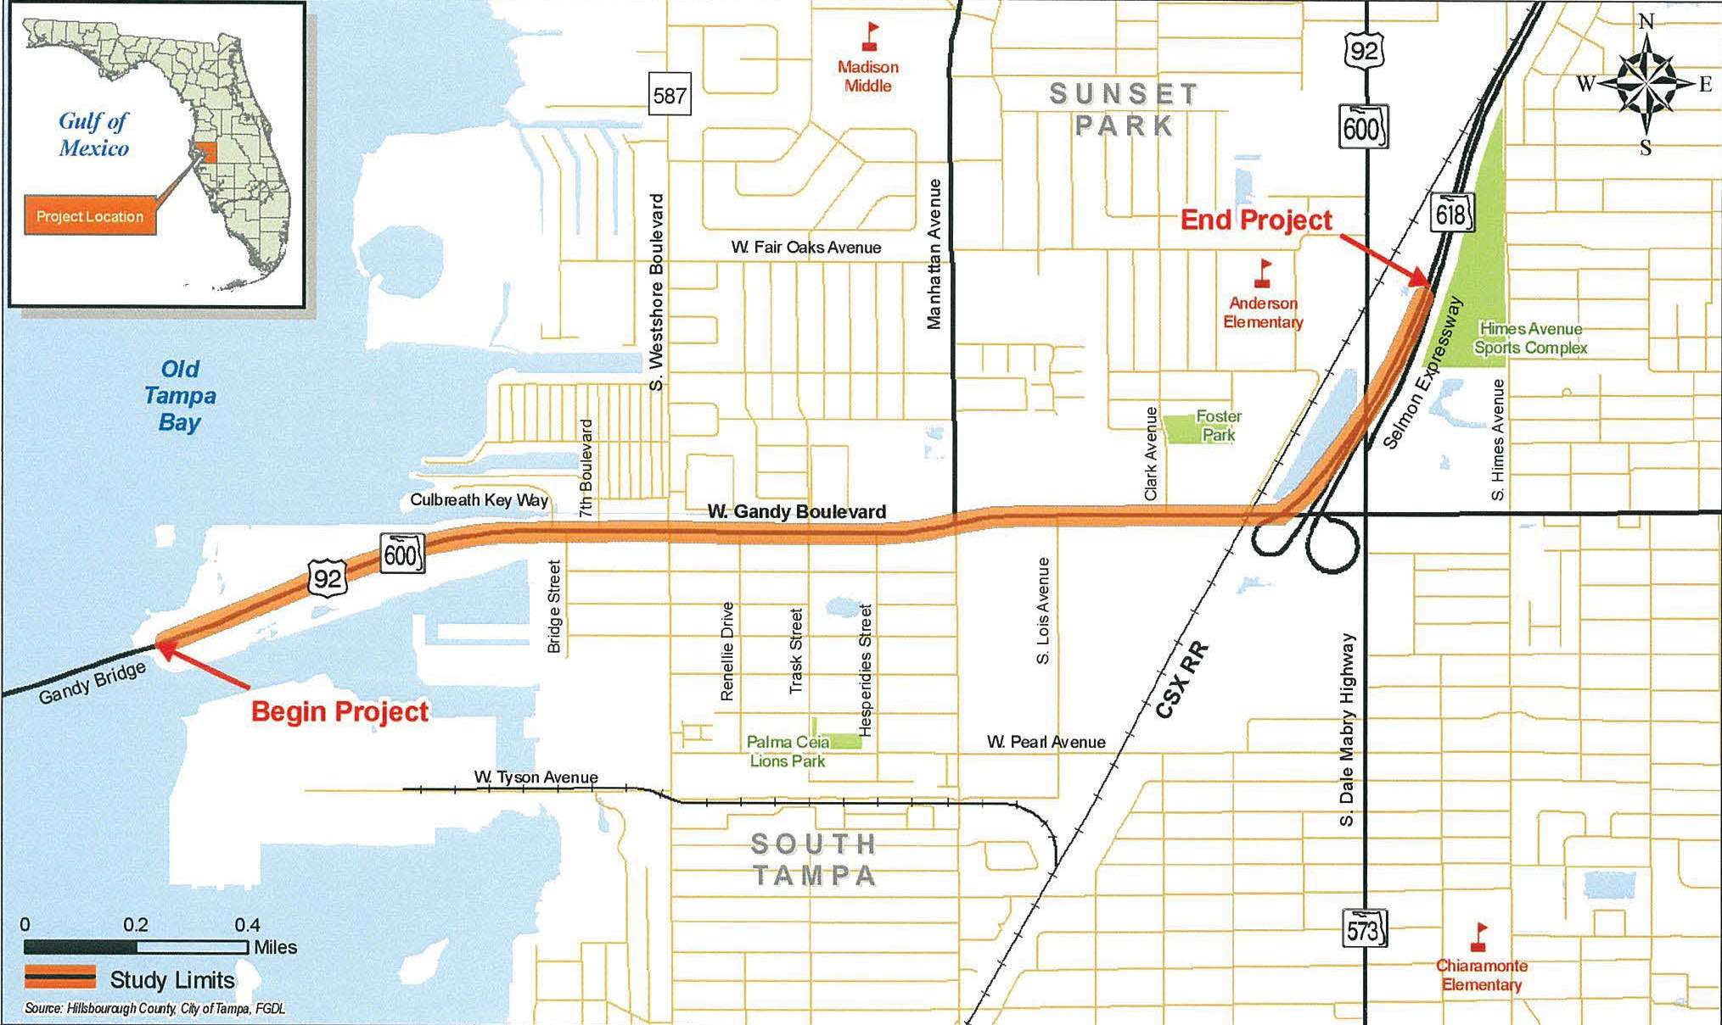
Selmon West Extension Project

Slide 20
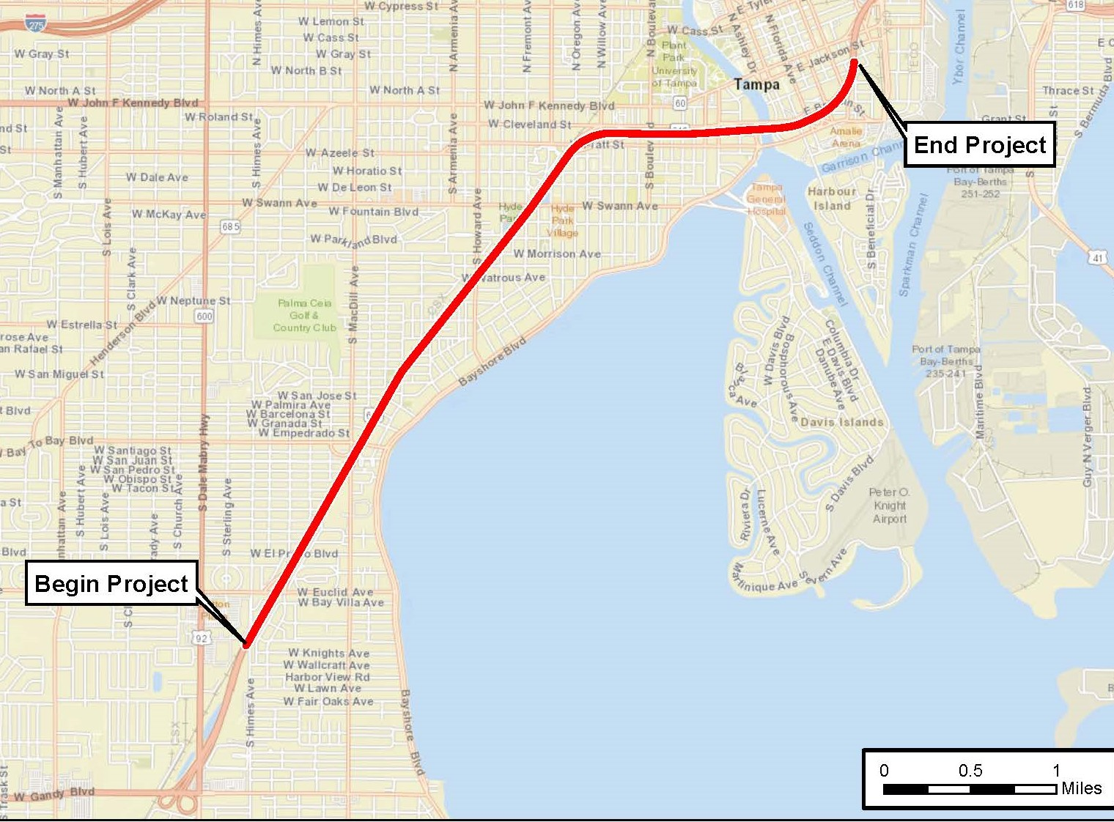
Selmon Expressway South Capacity Project
Project Overview
Selmon Expressway from Selmon West Extension to Whiting Street
PEIR:
PD&E study will be conducted as a PEIR
No state or federal funds
Follow procedures and requirements set forth in FDOT PD&E manual

Slide 21
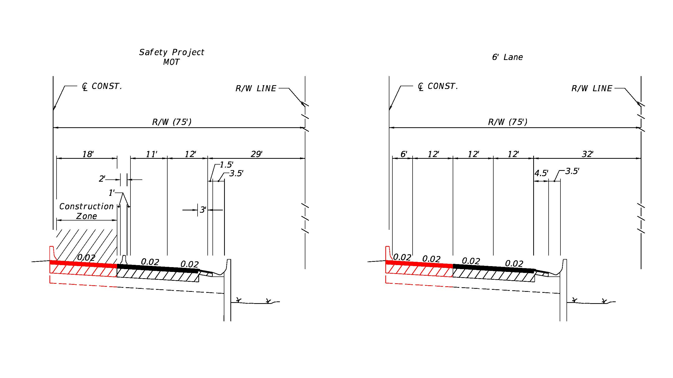
Selmon Expressway South Capacity Project
Typical
Sections

Slide 22
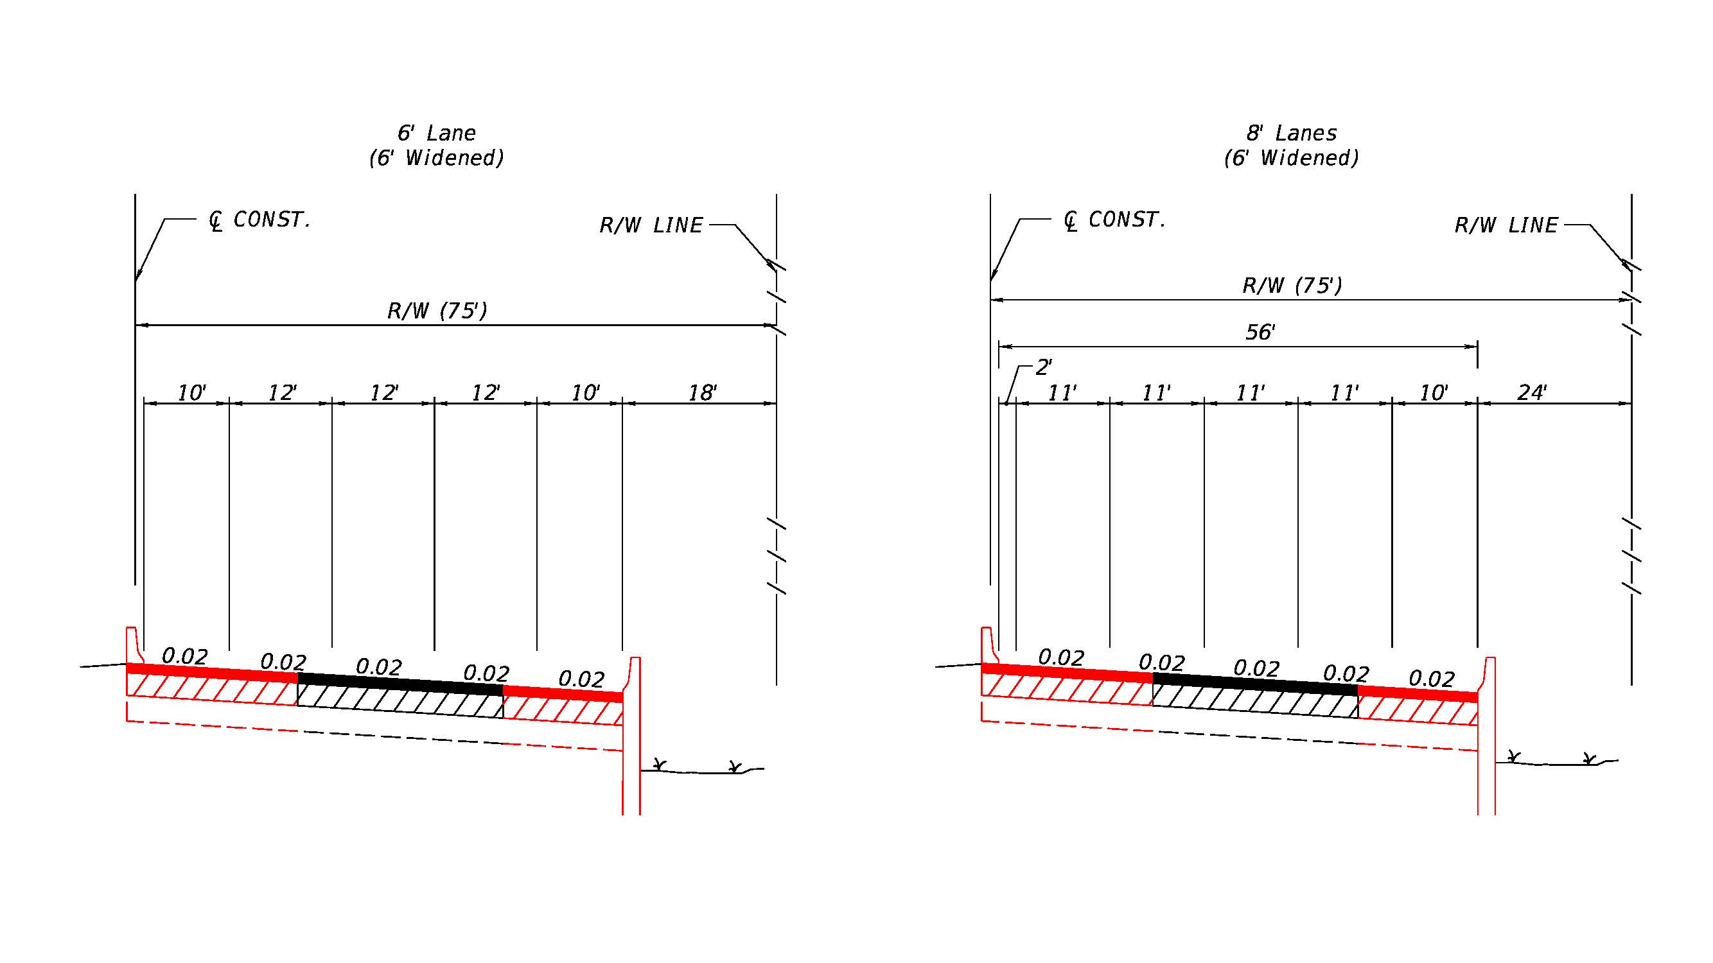
Selmon Expressway South Capacity Project
Typical
Sections

Slide 23
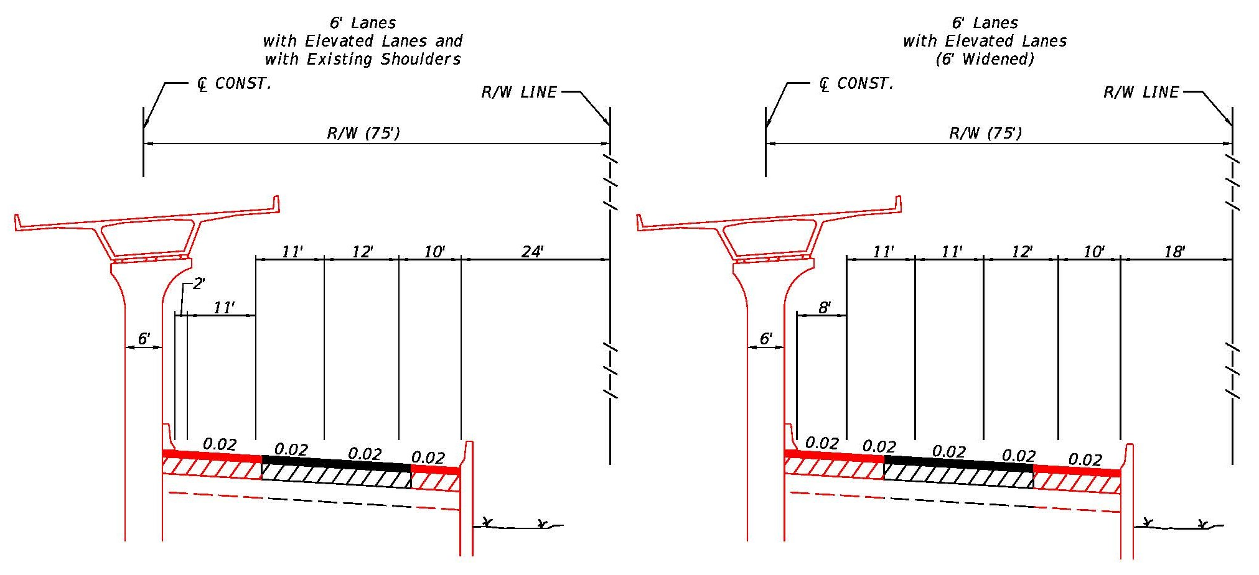
Selmon Expressway South Capacity Project
Typical
Sections

Slide 24
Schedule
Procurement: August, 2018 – January, 2019
PIER: February, 2019 – February, 2021
Public Meetings: December, 2020

Slide 25
Public Involvement
THEA Public Information Officer (PIO) will-
  Send Out Weekly Lane Closure Notifications
  Send Out Bi-weekly Project Status Emails
  Maintain and Update Project Website
  Post Updates on Social Media
Design Build Team will Coordinate Closely with PIO
Design Build Team will Attend Meetings with the Public to Provide Quick Response to the PIO that will Address Construction Issues
Design Build Team will Proactively Report any Interaction with the Public to the PIO
Design Build Team will Attend Meetings with Homeowners Associations or other groups as Requested by the PIO
Design Build Team will Provide Support as needed by PIO

Slide 26
Innovative Aspects & ATC’s
The following will not be considered:
Reduction in the begin and end Project limits
Reduction in the number of lanes and lane widths as depicted in the Typical Section Package and Concept Plans
Reduction in permanent Design Speeds on all State or local roads
Reduction in the Access Classification and Control, or changes to the access management or property access requirements
Reduction in the minimum storage lengths at intersections, as depicted in the Concept Plans
Elimination of tolling point locations
Elimination or relocation of proposed median openings shown in the Concept Plans
Elimination of tolling site and equipment
ATC’s (One Round only) will follow standard FDOT process

Slide 27
Written Technical Proposal
Submit 1 Original, seven (7) Flash Drives containing the Technical Proposal in PDF format and seven (7) collated, complete sets of hard copies, including roll plots
New Times Roman type font, minimum font size ten (10)
Project Approach- Maximum of 10 pages
  8 ½” x 11” sheets
  Schedule Narrative for Design & Construction with Bar Charts showing Critical Path. Duration w/no WAR
Plans
  Plan & Profile Sheets (Roll Plots or 11’ x17’ sheets)
    Roll Plots (Max. Width- 36”, Max. Length- 48”)
  All Others (11” x17” sheets)
TSP’s

Slide 28
Page Turn Meeting
60 minutes followed by 5 minutes of THEA questions
One unaltered Aerial Photo or Map allowed
No other handouts, electronic presentations, etc. other than copies of the submitted Written Technical Proposal
No questions allowed by the DB Team
Maximum of 8 attendees of the DB Team allowed

Slide 29
Q & A Session
60 minutes in length
No other handouts, electronic presentations, etc. other than copies of the submitted Written Technical Proposal
No questions allowed by the DB Team
Some questions, but not necessarily all will be provided to each DB Team approximately 24 hours prior to their Q& A Session

Slide 30
Scoring
Element: Points:
Letter of Interest 20
Design 10
Construction 10
MOT 15
Schedule 15
Price 30
Total Possible Points: 100
Price Proposal scoring:
X/Y multiplied by 30
Where:
X = the lowest Scored Price as proposed by any responsive Proposer
Y = the Scored Price proposed by Proposer
A = Proposer’s Price Proposal score, to three decimal places

Slide 31
Procurement Schedule
Thurs., Aug. 2, 2018 Deadline to request participation in ATC Mtg. No. 1
Thurs., Aug, 9, 2018 Deadline to submit Preliminary List of ATC’s prior to ATC Meeting No. 1
Wed., Aug. 15, 2018 One-on-One ATC Meetings
Tues., Aug. 28, 2018 Deadline to submit ATC Concept Proposals & Design Exceptions or Variations
Fri., Aug. 31, 2018 Deadline to submit Questions prior to Technical Proposal
Fri., Sept. 7, 2018 Deadline for Authority to post Responses to Questions
Fri., Sept. 28, 2018 Technical Proposals Due
Wed., Oct. 3, 2018 Deadline to “opt out” of Technical Proposal Page Turn Meeting
Thurs., Oct. 11, 2018 Technical Proposal Page Turn Meetings
Wed,. Oct, 24, 2018 Question & Answer Sessions
Thurs., Nov. 1, 2018 Deadline to submit Written Clarification Letter following Q & A Sessions and Questions prior to submission of Price Proposal
Tues., Nov. 6, 2018 Deadline for Authority to post Responses to Questions
Mon., Nov. 12, 2018 Price Proposals Due, announcing of Technical Scores, and posting of Final Scores and Bid Prices
Mon., Nov. 26, 2018 Public Meeting of Selection Committee & posting of Award
Fri., Nov. 30, 2018 Anticipated Award Date
Tues., Dec. 18, 2018 Anticipated Execution Date
Notes:
n

Slide 32
SBE
THEA’s Small Business Enterprise (SBE) Policy requires nondiscrimination on the basis of race, color, national origin, and gender in its employment and contracting practices and encourages the solicitation and utilization of SBE’s. This means that the Authority’s goal is to spend a portion of the highway dollars with Certified SBE’s as prime Design-Build Firms or as subcontractors. Race-neutral means that the Authority believes that the overall goal can be achieved through the normal competitive procurement process. THEA has exceeded 15% SBE participation on its program for the last several years.

Slide 33
DB Stipend
$46,166 per non-selected shortlisted Design-Build Firm that meets the stipend eligibility requirements
Design-Build Firm must fully execute with original signatures and have delivered to the Authority no later than July 18, 2018, four (4) originals of the Design-Build Stipend Agreement. TSP’s

Slide 34

TRC Members and Technical Advisors
South Selmon Median Safety DB Project:
  TRC Members:
    Dave May, PE – THEA
    Bob Frey, AICP – THEA
    Christina Kopp, AICP – THEA
  Technical Advisors:
    Sue Chrzan – THEA
    Jim Drapp, PE – THEA GEC
    Doug Burkhart, PE – THEA GEC
    Julian Gutierrez, PE – THEA GEC
    Dan D’Antonio, PE, PTOE – THEA GEC

Slide 35
Project Documents
http://www.tampa-xway.com/procurement/#
The cone of silence remains in place for all THEA, HNTB, Tierra and OMNI staff.
All questions should be emailed to Man Le, THEA Contracts & Procurement Manager: man.le@tampa-xway.com
Answers will be posted on the THEA website

Slide 36

Questions?

